Slide 1


Mobile Computing
Mobile Development
Introduction to Mobile development

Slide 2
Outline
Mobile computing
Mobile devices
Applications
Ubiquitous and Pervasive Computing
Wearable computing
Constraints of mobile computing
References
Build your first project

Slide 3
Mobile computing
Mobile computing systems are computing systems that may be easily moved physically and whose computing capabilities may be used while they are being moved.
Mobile computing systems are distributed systems over a network to communicate between different machines. Wireless connection is required to do the communication.

Slide 4
Mobile Devices
Examples of mobile devices are:
laptops,
personal digital assistants (PDAs),
mobile phones,
tablets and
wearable computing such as smart watches.

Slide 5
By distinguishing mobile computing systems from other computing systems we can identify the distinctions in the tasks that they are designed to perform, the way that they are designed, and the way in which they are operated.

Slide 6
Applications
The word “Apps” is a term for software that allows users to perform specific functions. Therefore, the word “app” isn’t limited to a single device. There are several types of apps:
Desktop applications run on a desktop, and don’t need web access to function. They could be represented by icons and often come standard with new computers.
Examples include Paint, Notepad and iPhoto. They could also refer a custom “application” used for a specific purpose within a corporate environment.

Slide 7
A desktop application is a standalone application that is installed on a desktop or laptop computer. It can be full-featured like Microsoft Excel or perform one or two functions like the calendar app.
Usually, desktops apps are limited by the hardware they run on. Combined with the legacy of mainframe terminal applications, they have a less complex user interface.
They can also be a hassle to update, especially if hardware upgrades are necessary for the apps to work.

Slide 8
Web apps are those which download some parts of the program from the web onto devices every time they run.
These apps are becoming more popular these days as they don’t require installation, manual updates, or hardware upgrades.

Slide 9
Now there are two types of web apps:
Browser Based Web Apps – Written in a combination of HTML and JavaScript, browser-based applications run within web browsers.
They aren’t platform dependent, which means that you can run these in a Windows PC, Mac or Linux machine.
There may be a few differences in the way these apps may appear on different browsers, but they’re negligible.
Client Based Web Apps – While they require an internet connection, client based applications don’t need a browser to run. Instead, you can install them onto your device (computer or mobile device).
This is similar to the client/server architecture which companies used before the internet. The only difference is that the server is online rather than the local network. As for data storage, you can choose to store locally or remotely.

Slide 10
Mobile applications are made for mobile devices, are downloaded on “application stores” such as App Store and Google Play and are accessed through an icon on your phone’s desktop.
Creating these can be challenging for a developer as different mobile apps need to be created for Apple, Android and Blackberry and for the most part the code can’t be shared between device platforms.
Instagram, Facebook, many and social media sites all have mobile applications.
This course will focus on Android applications.

Slide 11
Mobile apps, by definition, are software applications that run on portable devices such as smartphones and tablets. These apps are available for download through device-specific portals like Google Play Store and are installed onto users’ devices.
There are three types of mobile applications you can pick from:
Native (this type will be considered in this course)
Web
Hybrid

Slide 12
Native Apps – Native mobile apps are programmed in the recommended language for a specific operating system. For example, Android native applications are programmed using Java.
These applications are compatible with the device’s hardware and features. They’re also faster and more efficient because they work in tandem with the device they’re developed for.
In some cases, this speed can be the result of their limited need for internet connectivity. However, native apps will need user permission to download updates.
Web Apps – Mobile web applications are websites that look and feel like native applications. However, they have limited access to the device’s features and require permission before interacting with them.
Written in HTML 5 most of the time, they require your device’s native browser to run.
A good example of this is Google Maps. Whether you use the app or the website, you won’t see much of a difference.

Slide 13
There is a third type that experts tend to add to this list:
Hybrid apps- These applications are available through the app store and allow users to interact with the device’s features. However, they rely on HTML being rendered in a browser that’s embedded within the app. A good example of hybrid applications is the Netflix app, which uses the same code to run on both desktop and mobile devices.

Slide 14
Ubiquitous and Pervasive Computing
Ubiquitous computing, or Ubicom, and also known as pervasive computing is the term given to the third era of modern computing.
The first era was defined by the mainframe computer, a single large time-shared computer owned by an organization and used by many people at the same time.
Second, came the era of the PC, a personal computer primarily owned and used by one person, and dedicated to them.
The third era, ubiquitous computing, representative of the present time, is characterized by the explosion of small networked portable computer products in the form of Smart phones, personal digital assistants (PDAs), and embedded computers built into many of the devices we own—resulting in a world in which each person owns and uses many computers.

Slide 15
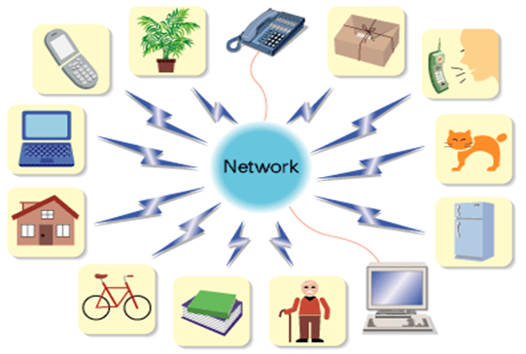
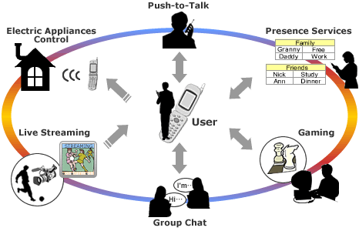
- Computers available anytime everywhere
- Embedding microprocessors in every day object
- GOAL: Smart, intelligent environment
- Vision: Small and expensive
Ubiquitous computing will enable divers wireless applications including monitoring of pets and houseplant, operation of appliances, keeping track of books and bicycles and much more.

Slide 16
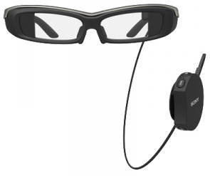
Wearable Computing
Wearable computers, also known as wearables or body-worn computers, are small computing devices (nowadays usually electronic) that are worn under, with, or on top of clothing.
The definition of “wearable computer” may be narrow or broad, extending to smartphones or even ordinary wristwatches.
Good examples of wearable devices are Google glasses and iWatch.

Slide 17
Constraints of Mobile Computing
Mobile computers are expected to be resource-poor than the desktops
Mobile computers is less secure and reliable. Since mobile devices are accompanied their user everywhere, is much more likely to be lost or stolen.
Mobile computers connectivity can be highly variable in terms of its performance (bandwidth and latency).

Slide 18
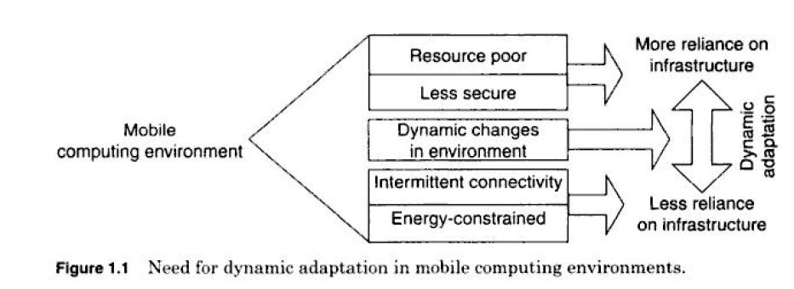

Slide 19
References
B’FAR, R. (2005). Mobile computing principles. CAMBRIDGE UNIVERSITY PRESS.
Adelstein, F., Gupta, S., Richard, G. and Schweibert, L. (2005). Fundamentals of mobile and pervasive computing. McGraw-Hill.
Krumm, J. (2010).Ubiquitous computing fundamentals. Taylor and Francis Group.
Poslad, S. (2009). Ubiquitous computing. Wiley.
Dourish, P. and Bell, G. (2011). Divining a digital future. Massachusetts Institute of Technology.

Slide 20
Start your first Project
To create your new Android project, follow these steps:
Install the latest version of Eclipse.
In the Welcome to ECLIPSE window, click Start a new Android project.
If you have a project already opened, select File > New > New Project.
In the Choose your project window, select Empty Activity and click Next.
In the Configure your project window, complete the following:
  Enter "My First App" in the Name field.
  Enter "com.example.myfirstapp" in the Package name field.
  Leave the other options as they are.
Click Finish

Slide 21
Assignment
Prepare a report to talk about:
“Ubiquitous and wearable computing”
Use resources from the internet (Reliable resources, such as PDFs).
Use the academic website “Google scholar” when you search about this topic.
Also, you can use text books from the library.

Slide 22
Thank you ?

