Slide 1
Enterprise Information Management
Fourth Lecture
Dr. Wurood Albayati

Slide 2
layout
BPA
Benefit of BPA
Implementing BPA
Case study#1 to be done in class
Case study #2
Enterprise risk management -ERM

Slide 3
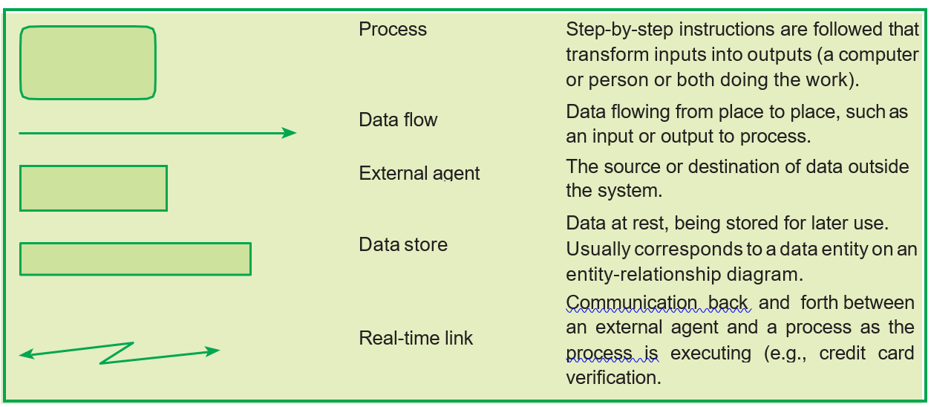
Diagrammatic Representation of business process
1- Flow chart
2-Data flow diagram

Slide 4
Automated Business process
With the advent of technology, most business process today have been automated to make enterprises more efficient and to handle the large volumes of transactions in today's world.
Business Process Automation (BPA) is the technology-enabled automation of activities or services and can be implemented for many different functions of company activities, including sales, management, operations, supply chain, human resources, information technology, etc.
Objectives ( or goals) of BPA
BPA should ensures the following:
Confidentiality: To ensure that data is only available to persons who have right to see the same;
Integrity: To ensure that no un-authorized changes can be made in the data;
Availability: To ensure that data is available when asked for; and
Timeliness: To ensure that data is made available in at the right time.

Slide 5
Benefit of BPA
Quality & Consistency
Time saving
Visibility
Improved operation efficiency
Governance & reliability
Reduce turnaround times
Reduced costs

Slide 6
Implementation of BPA
The steps to go about implementing Business Process Automation are:
Step 1: Define why we plan to implement a BPA?
The primary purpose for which an enterprise implements automation may vary from enterprise to enterprise. A list of generic reasons for going for BPA may include any or combination of the following:
Step 2: Understand the rules / regulation under which enterprise needs to comply with?
One of the most important steps in automating any business process is to understand the rules of engagement, which include following the rules, adhering to regulations and following document retention requirements.

Slide 7
Step 3: Document the process, we wish to automate
At this step, all the documents that are currently being used need to be documented.
Step 4: Define the objectives/goals to be achieved by implementing BPA
Once the above steps have been completed, entity needs to determine the key objectives of the process improvement activities. When determining goals, remember that goals need to be SMART:
Specific: Clearly defined,
Measurable: Easily quantifiable in financial terms,
Attainable: Achievable through best efforts,
Relevant: Entity must be in need of these, and
Timely: Achieved within a given time frame.
Step 5: Engage the business process consultant
Step 6: Calculate the RoI for project
Step 7: Developing the BPA
Once the requirements have been document, ROI has been computed and top management approval to go ahead has been received, the consultant develops the requisite BPA. The developed BPA needs to meet the objectives for which the same is being developed.
Step 8: Testing the BPA

Slide 8
Case Studies on Automation of Business Processes - Case 1- Automation of employee attendance
X enterprise have a manual attendance for (BP) the company want to upgrade and automate this process, they hire you to do so. Employee attendance process( or system ) for this company work as follow:
There are an attendance register and a register at the security gate. Employees are expected to put their signatures in attendance registers. The register at the gate is maintained by security staff, to mark when an employee has entered. There is always a dispute regarding the time when an employee has entered and what has been marked in the security register. The company policy specifies that an employee coming late by 30 minutes for two days in a month shall have a ½ day salary deduction. There are over-writing in attendance register, leading to heated arguments between human resource department staff (HR) and employees. As the time taken to arrive at the correct attendance is large, there is a delay in preparation of salary. The same has already lead to penal action against company by labor department of the state. A number of regulations are applicable to employee attendance including Factories Act 1948, Payment of Wages Act 1936,.

Slide 9
Automation of employee attendance Various steps of automation are given as follows:
Step 1: Define why we plan to go for a BPA?
The system of recording of attendance being followed is not generating confidence in employees about the accuracy. There have been complaints that salary payouts are not as per actual attendance. It has also created friction and differences between employees, as some feels that other employees have been paid more or their salary has not been deducted for being absent.
Step 2: Understand the rules/regulation under which needs to comply with?
A number of regulations are applicable to employee attendance including Factories Act 1948, Payment of Wages Act 1936, State laws, etc. This is a compliance requirement and hence, any BPA needs to cater to these requirements.

Slide 10
Step 3: Document the process, we wish to automate.
The present system includes
an attendance register – Employees have to register their arrival
a register at the security gate. The register at the gate is maintained by security staff, to mark when an employee has entered.
The company policy specifies that an employee coming late by 30 minutes for two days in a month shall have a ½ day salary deduction.
Salary preparation depend on these two registered attended list , the calculation of salary depends on how many days employee worked ( minus any deduction)
There is a delay in preparation of salary. Because of the time taken to arrive at the correct attendance registry.
This issues lead to penal action against company by labor department of the state.

Slide 11
Step 4: Define the objectives/goals to be achieved implementing BPA
The objective for implementing BPA, being:
Correct recording of attendance.
Timely compilation of monthly attendance so that salary can be calculated and distributed on a timely basis.
To ensure compliance with states.
Step 5: Engage the business process consultant
XYZ Limited a consultant of repute has been engaged for the same. The consultant has prior experience and also knowledge about entity's business.
Step 6: Calculate the RoI for project
The BPA may provide Tangible benefits in the form of reduced penalties and intangible benefits which may include:
Better employee motivation and morale,
Reduced difference between employees,
More focus on work rather than salary, and
Improved productivity.

Slide 12
Step 7: Developing the BPA
Implementing BPA includes would result in the following:
All employees would be given electronic identity cards.
The cards would contain details about employees.
The attendance system would work in the following manner:
Software with card reading machine would be installed at the entry gate.
Whenever an employee enters or leaves the company, he/she needs to put the card in front of machine.
The card reading machine would be linked to the software which would record the attendance of the employee.
At the end of month, the software would print attendance reports. These reports would also point out how many days an employee has reported late in the month.
Based on this report monthly attendance is put in the system to generate the monthly salary.

Slide 13
Step 8: Testing the BPA
Before making the process live, it should be thoroughly tested.
The above illustrations are of entities, which have gone for business process automation. There are thousands of processes across the world for which entity have gone for BPA and gained numerous benefits.

Slide 14
Case study #2 Financial system

Slide 15
Case study #2 Automation of Financial & accounting system
Every accounting systems stores data in two ways: Master Data and Non-Master Data (or Transaction Data) as shown in the Fig.
Master Data: Relatively permanent data not expected to change frequently.
Non-Master Data: Non-permanent data and expected to change frequently.

Slide 16
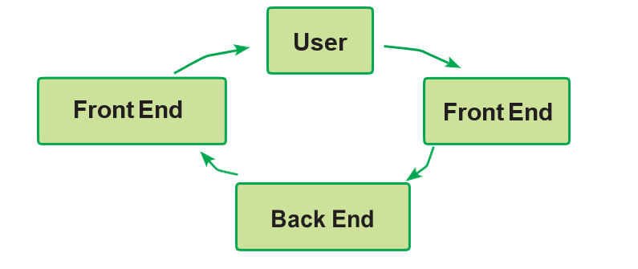
Front End & Back End
These two words are used by software people again and again. Let us understand these two words in a simple language.
Front End – It is part of the overall software which actually interacts with the user who is using the software.
Back End – It is a part of the overall software which does not directly interact with the user, but interact with Front End only.

Slide 17
Enterprise Risk Management (ERM)
Enterprise Risk Management (ERM) may be defined as a process of identifying potential events that may affect the ةobjectives of enterprise (or b usiness).
BPA gives substantial benefits to enterprises. However, it should be noted that it does have some inherent risks which should be understood. The risks are classified below:

Slide 18
Input & Access: All input transaction data may not be accurate, complete and authorized.
File & Data Transmission: All files and data transmitted may not be processed accurately and completely, due to network error.
Data: Master data and transaction data may be changed by unauthorized personnel due to weak access control.
Processing: Valid input data may not have been processed accurately and completely due to program error or bugs.
Output: Is not complete and accurate due to program error or bugs and is distributed to unauthorized personnel due to weak access control.
Infrastructure: All data & programs could be lost if there is no proper backup in the event of a disaster and the business could come to a standstill.

