Slide 1
Enterprise Information Management
Second Lecture
Dr. Wurood albayati

Slide 2
Layout
Level of information
Pyramid of organization level
Value chain
Types of system in organization
IOPF examples

Slide 3
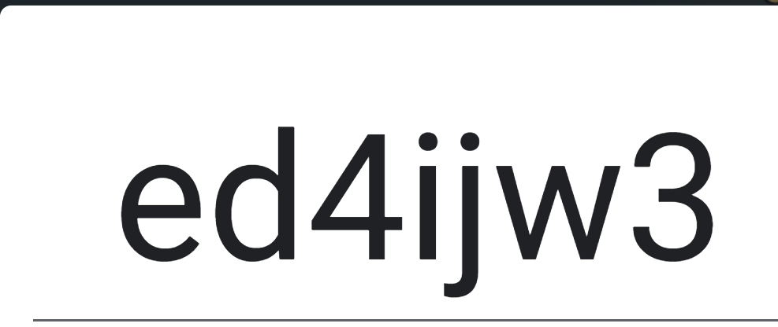

Slide 5
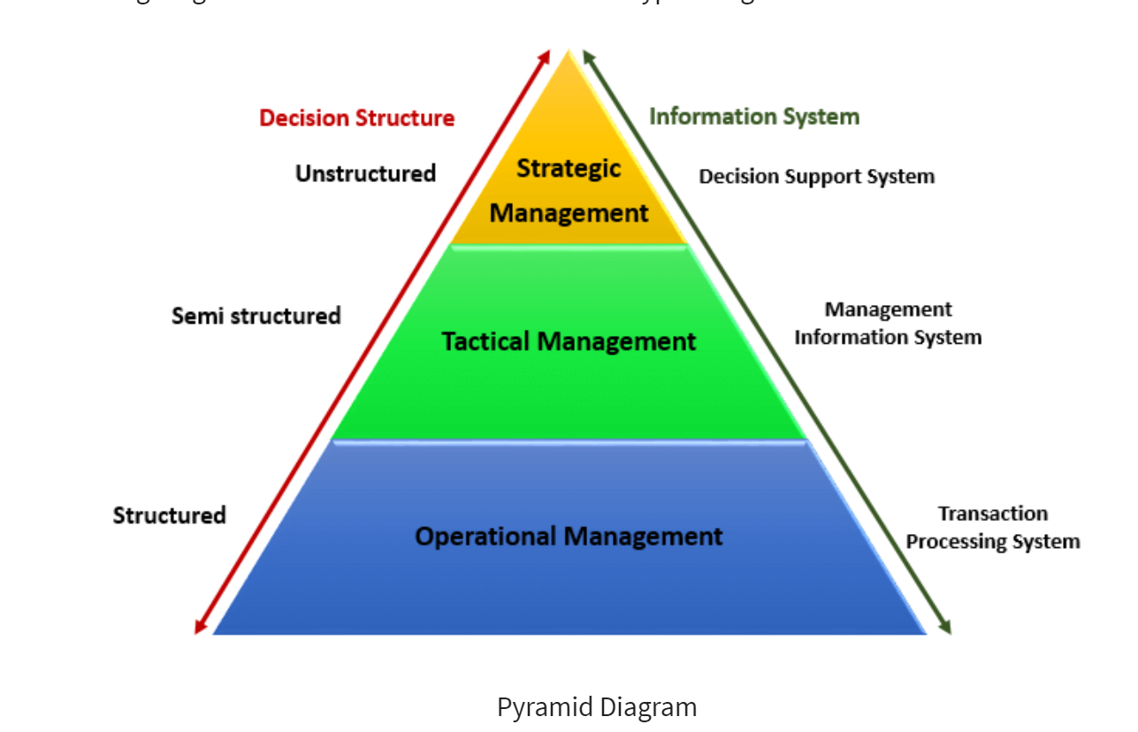
Pyramid Diagram of organizational level and information requirement

Slide 7
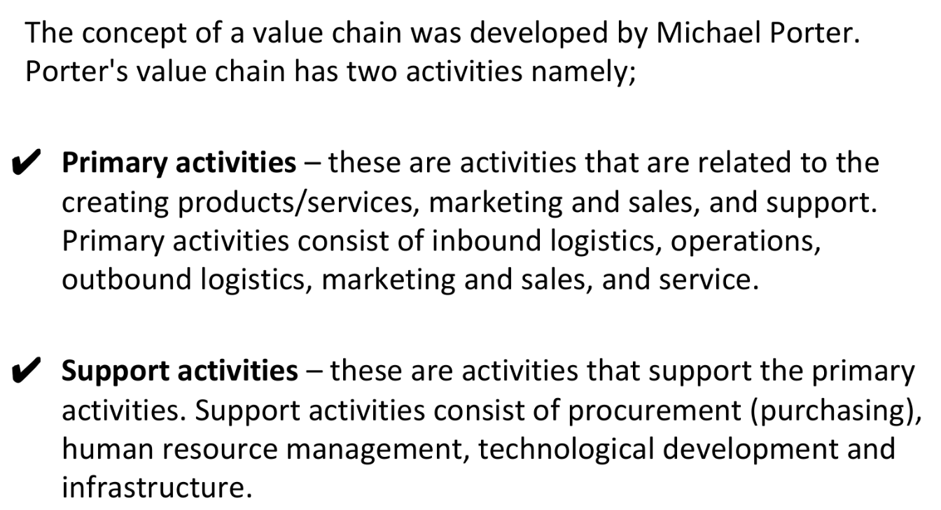

Slide 9
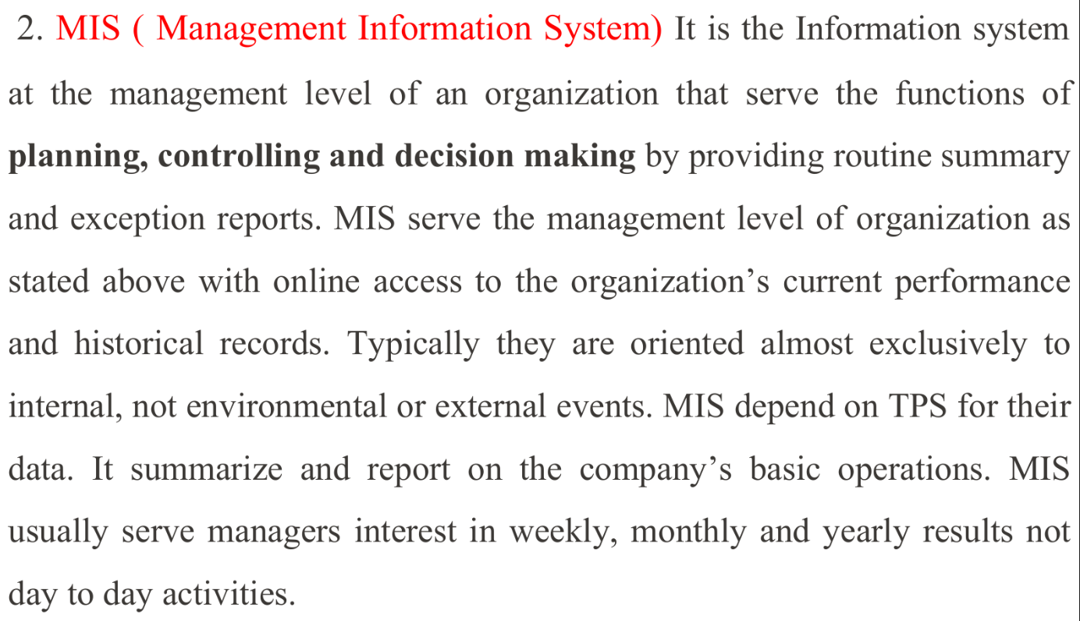

Slide 10
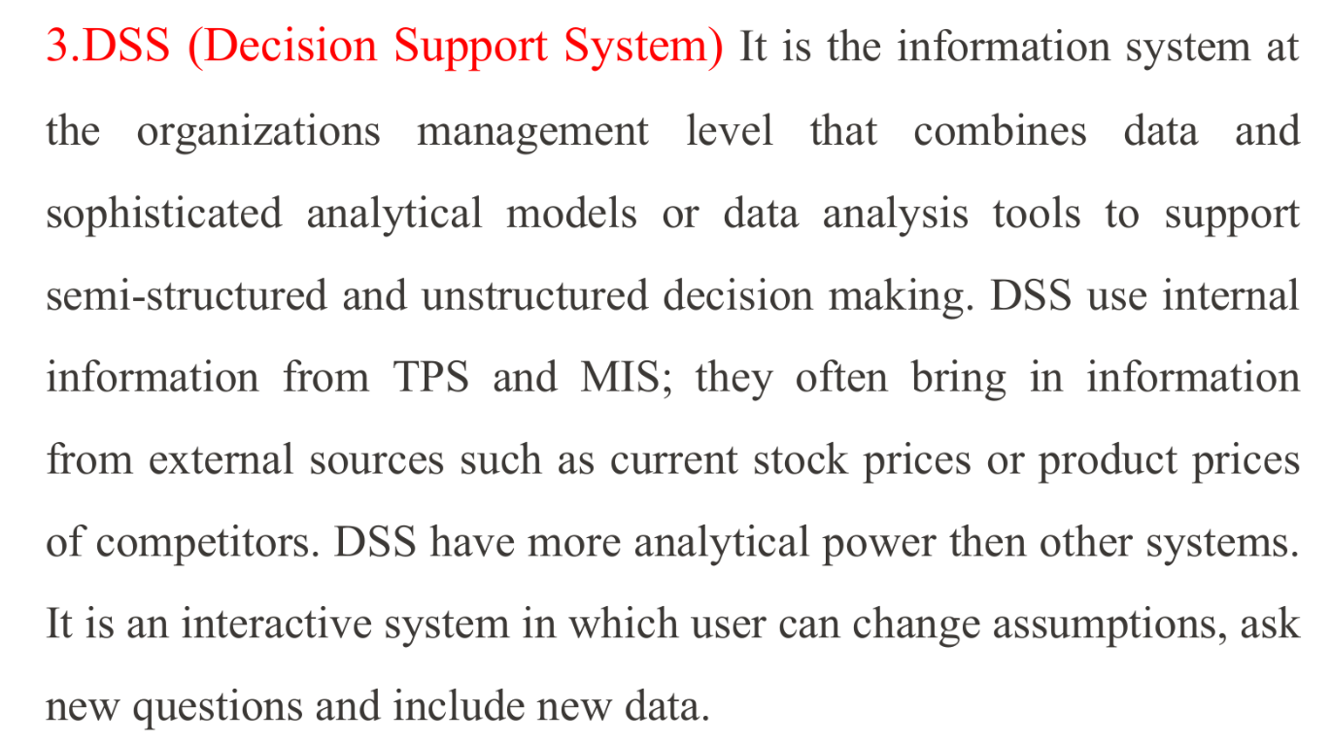

Slide 11
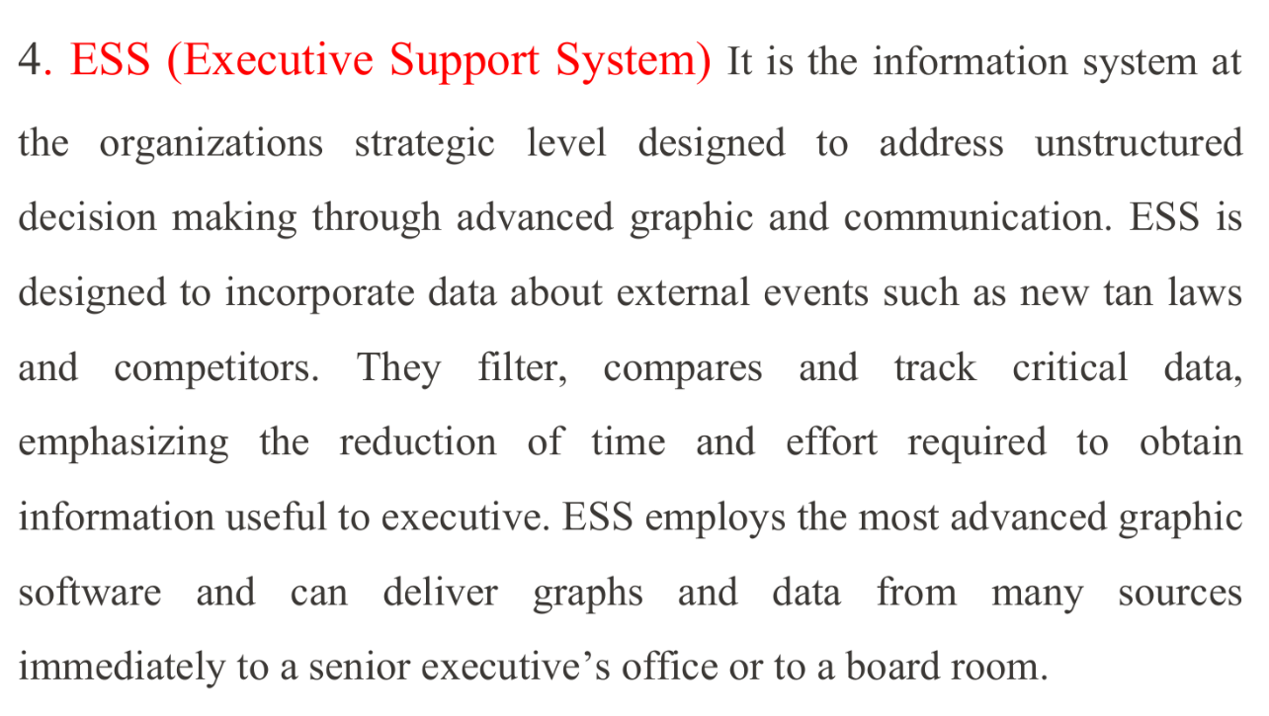

Slide 12
