Slide 1
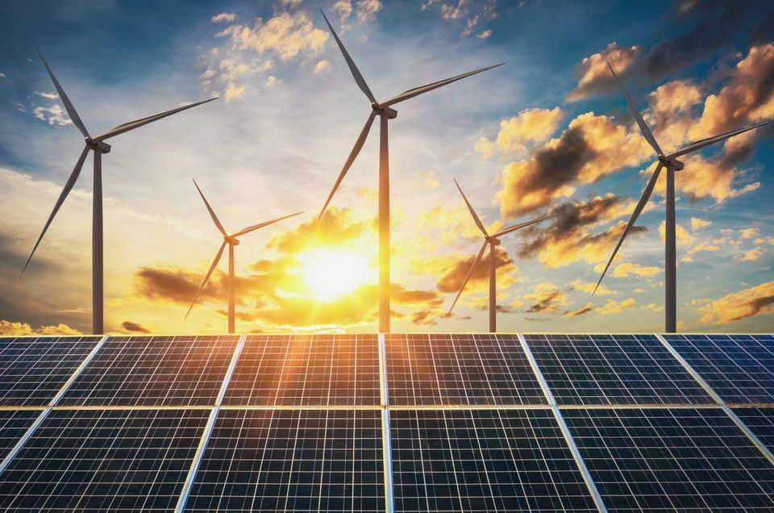
The Course of
Renewable energy
MUSTANSIRIYAH UNIVERSITY
COLLEGE OF SCIENCES
ATMOSPHERIC SCIENCES DEPARTMENT
2019-2020
Dr. Ali Alhafiz
fourth STAGE

Slide 2
Welcome Students! ☺
To LECTURE Two

Slide 3
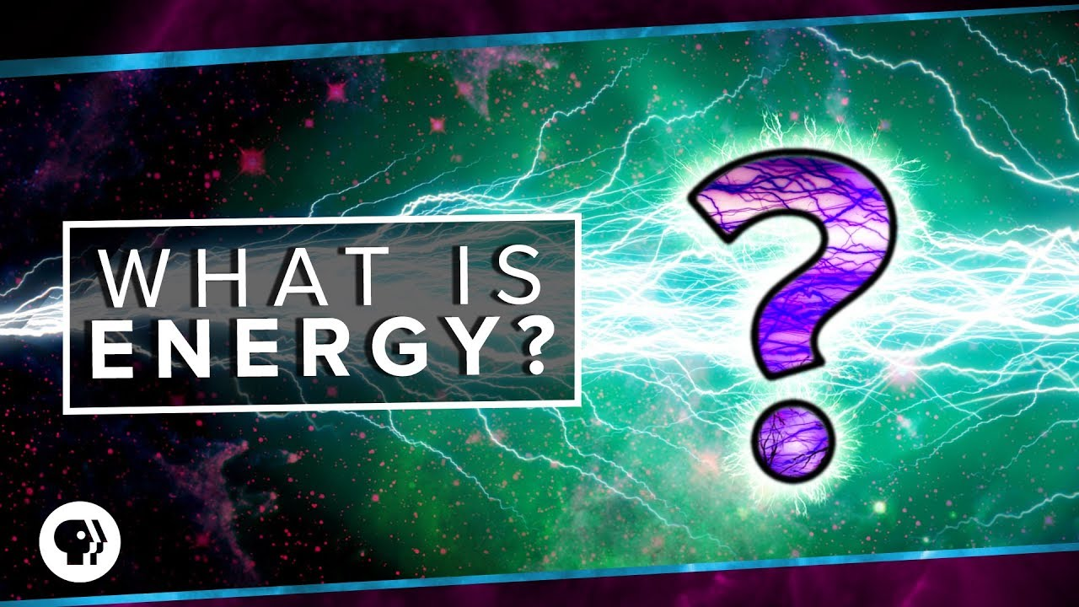
What is Energy?
energy is defined as the ability of a system to cause external action
Forms of energy: mechanical energy (i.e. potential or kinetic energy), thermal, electric and chemical energy, nuclear energy and solar energy
• The ability to perform work becomes visible by force, heat and light
• The ability to perform work from chemical energy, nuclear and solar energy is only given if these forms of energy are transformed into mechanical and/or thermal energy

Slide 4
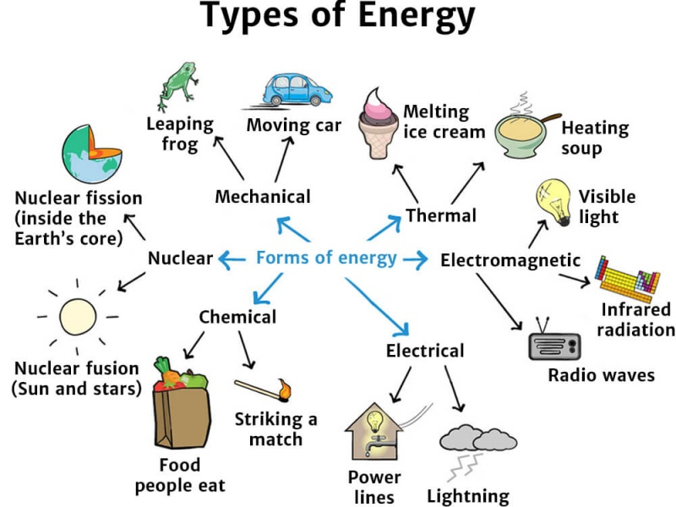

Slide 5
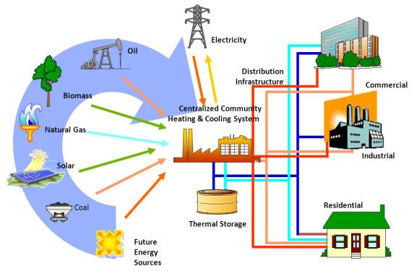
Energy resources are generally distinguished:
• Fossil energy(الطاقة الاحفورية) resources are stocks of energy that have formed during ancient geologic ages by biologic and/or geologic processes.
-fossil biogenous energy resources (i.e. stocks of energy carrier of biological origin) E.g: hard coal, natural gas, crude oil deposits-fossil mineral energy resources (i.e. stocks of energy carrier of mineral origin or non-biological origin) E.g: energy contents of uranium deposits and resources to be used for nuclear fusion processes.
• Recent resources are energy resources that are currently generated, for instance, by biological processes; E.g: the energy contents of biomass and the potential energy of a natural reservoir.

Slide 6
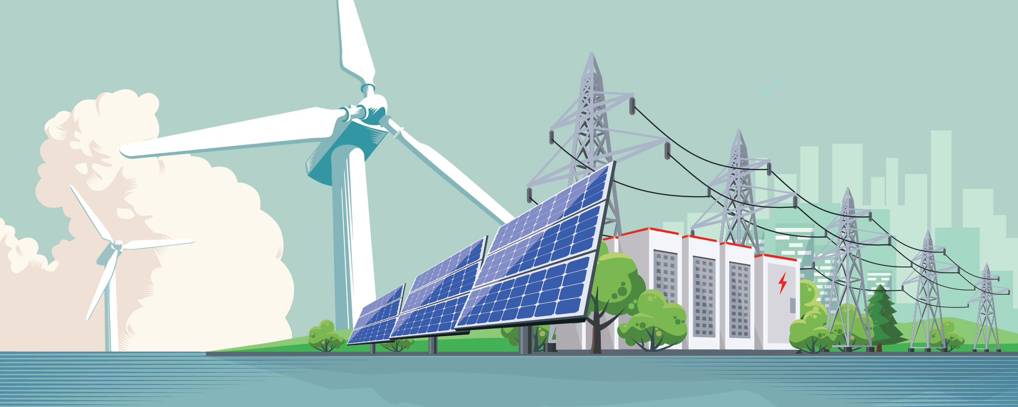
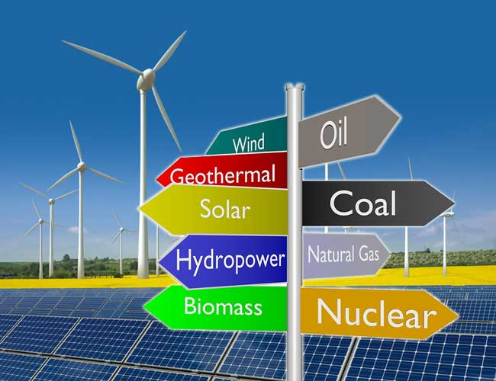
The term of Renewable energy refers to primary energies that are regarded as inexhaustible in terms of human (time) dimensions.

Slide 7
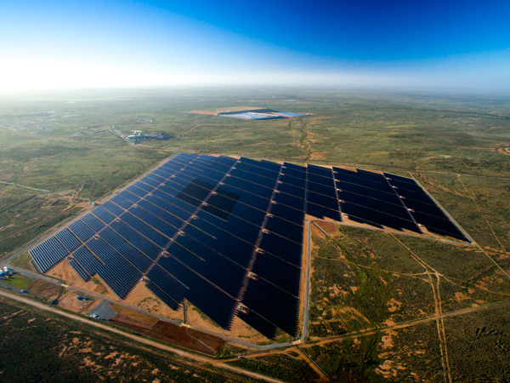
Characteristics:
• They are continuously generated by the energy sources solar energy,
geothermal energy and tidal energy.
• The energy produced within the sun is responsible for a multitude of other renewable energies (such as wind and hydropower) as well as renewable energy carriers (such as solid or liquid biofuels).
• The energy content of the waste can only be referred to as renewable if it is of non-fossil origin (e.g. organic domestic waste, waste from the food
processing industry).
Properly speaking, only naturally available primary energies or primary energy carriers are renewable but not the resulting secondary or final energies or the related energy carriers.
However, in everyday speech secondary and final energy carriers derived from renewable energy are often also referred to as renewable.

Slide 8
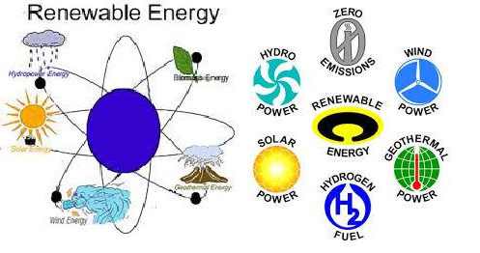
Applications of renewable energies…
The energy flows available on earth that directly or indirectly result from these renewable energy sources vary tremendously, for instance, in terms of energy density or with regard to spatial and time variations.

Slide 10
Total Energy Usage
Our total energy use can be divided into three principal areas each of which consume approximately equal amounts of energy on an annual basis:
• Electricity Generation
• Space Heating
• Transportation

Slide 11
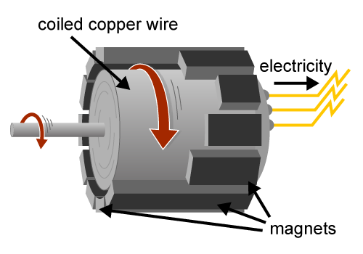
Most traditional Energy production comes about using steam driven turbines so the heating of water is what is essential.
• Coal Fired Steam
• Nuclear Fired Steam
• Oil/Natural Gas Fired Steam
The next table shows the Percentage changes in the number of quads delivered by various energy forms from 1973 to 1994
The primary energy input to generate electricity was 30.9 quads. About 2/3 of the energy was lost in conversion processes, leaving about 10 quads as electricity. 2/3of the delivered energy was delivered to the residential/commercial sector and 1/3 to industry.
Electricity as a percentage of total energy use has been increasing ever since electricity was introduced. In 1973 about 25% of primary energy used to make electricity. In 1994 the percentage of energy used to make electricity had increased to 34% of total energy.

Slide 12
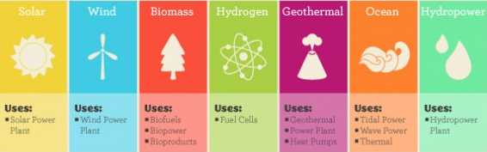
The Need for Alternative Energy
• Basic concept of alternative energy sources relates to issues of sustainability,renewability and pollution reduction.
• In reality, Alternative Energy means anything other than deriving energy via Fossil Fuel combustion
• Basic Barrier to all forms of alternative energy lies in initial costs
Forms of Alternative Energy:
• Solar: Advantages: Always there; no pollution
Disadvantages: Low efficiency (5-15%); Very high initial costs; lack of adequate storage materials (batteries); High cost to the consumer

Slide 13
Hydro: Advantages: No pollution; Very high efficiency (80%); little waste heat; low cost per KWH.
Disadvantages: Fish are endangered species; Sediment buildup and dam failure; changes hydrological cycle
• Wind: Advantages: supplemental power in windy areas; best alternative for individual homeowner
Disadvantages: Highly variable source; relatively low efficiency (30%); more power than is needed is produced when the wind blows; efficient energy storage is thus required
Geothermal: Advantages: very high efficiency; low initial costs since you already got steam
Disadvantages: non-renewable (more is taken out than can be put in by nature)
• Ocean Thermal Energy Conversion: Advantages: can be used on large scale; exploits natural temperature gradients in the ocean
Disadvantages: extremely high cost; Damage to coastal environments
• Tidal Energy :Advantages: Steady source; energy extracted from the potential and kinetic energy of the earth-sun-moon system; can exploit bore tides for maximum efficiency
Disadvantages: low duty cycle due to intermittent tidal flow; huge modification of coastal environment; very high costs for low duty cycle source

Slide 14
Hydrogen Burning: Advantages: very high energy density; good for space heating
Disadvantages: No naturally occurring sources of Hydrogen; needs to be separated from water via electrolysis which takes a lot of energy; Hydrogen needs to be liquefied for transport - takes more energy.
• Biomass Burning: Advantages: Biomass waste (wood products, sewage, paper, etc) are natural by products of our society
Disadvantages: Particulate pollution from biomass burners

