Slide 1
Lecture-2:
Ask question and create hypothesis
Steps of the scientific method
The scientific method uses a series of steps to establish facts or create knowledge.
The overall process is well established, but the specifics of each step may change depending on what is being examined and who is performing it.
The scientific method can only answer questions
that can be proven or disproven through testing.
The video outlines these steps and they are explained in more detail below.

Slide 2
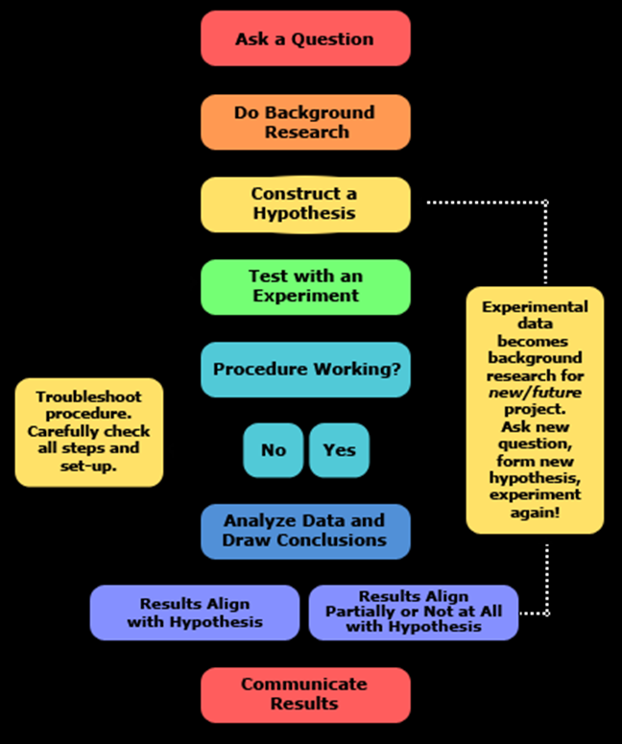

Slide 3
Make an observation or ask a question.
The first step is to observe something that you would like to learn about or ask a question that you would like answered. These can be specific or general.
Some examples would be "I read that hydroxychloroquine was banned from COVID-19 patients because it causes an increase in heart rate".
For this observation the question could be “does the hydroxychloroquine have an impact on heart? How or why? Taking the time to establish a well-defined question will help you in later steps.

Slide 4
Practice section:
See the video and ask a question about any phenomena you noticed.

Slide 5
Gather background information
This involves doing research into what is already known about the topic. This can also involve finding if anyone has already asked the same question.
Create a hypothesis
A hypothesis is an explanation for the observation or question. If proven later, it can become a fact.
Compared to our last example, it would be "the hydroxychloroquine effect on CK-MB or acetylcholine levels in plasma and heart tissue of the normal mice".

Slide 6
Practice section
See the video and create a hypothesis depend on your question.

