Slide 1
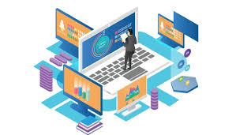
EIM
Enterprise information management

Slide 2
Layout
Introduction to information, management and system
MIS
Benefit of MIS
Information value
Characterstics of data in MIS system

Slide 3
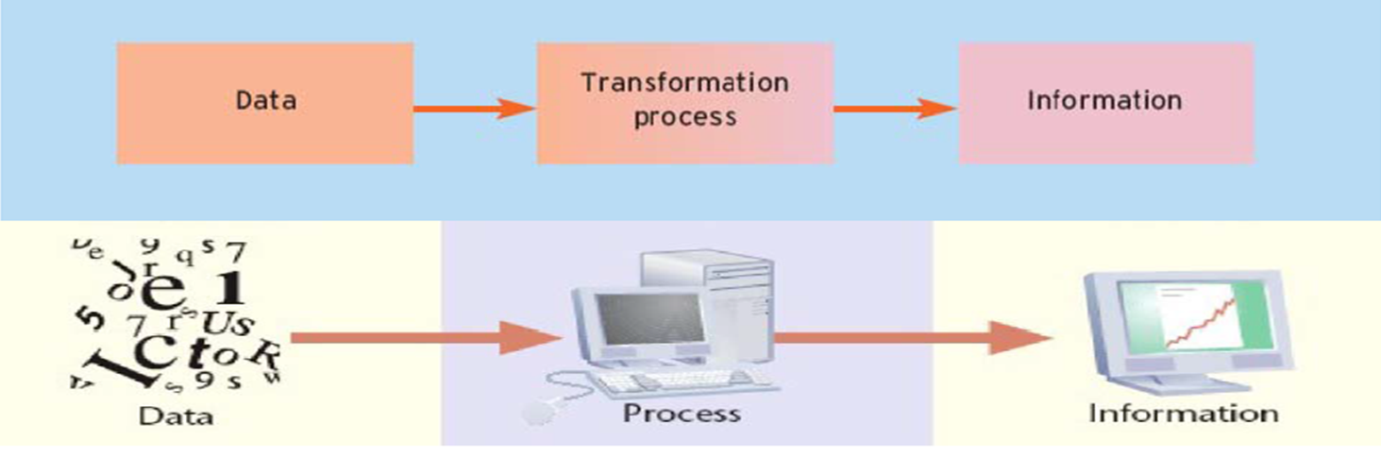
Understanding the keywords Management, Information, and System
Management?
Planning, control, and administration of an organization.
Management is generally hierarchical:
Top managers handle planning;
Mid – career managers control;
And, junior managers administer.
Information?
Processed data to support management functions

Slide 4
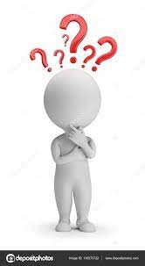
What is a System? (in the context of MIS)
An inputs – processing - output and feedback matrix.
Supports the processing of data into information.
A system is a group of interrelated components working together toward a common goal by accepting inputs and producing outputs in an organized transformation process.
Information system (IS) is an organized combination of People, Hardware, Software, and data Resource that collects, transforms and distributes information in an organization.

Slide 5
Management information system
Core goal is to make raw data into useful information that help managerial decision making
An organization with a well-defined information system will generally have a competitive advantage over organization with poor MIS and no MIS

Slide 6
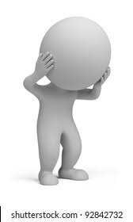
Management information systems (MIS)
Use the transaction data to produce information needed by managers to run the business
What is transaction Data
Transactional data are the elements that support the on-going operations of an organization .

Slide 7
What are the reasons for MIS?
MIS provides the necessary information to the managers and supervisors at various levels

Slide 8
Level of information
Strategic level of information
Management level of information
Operational level of information

Slide 9
Evolution of MIS
At first, MIS treated data and reported at regular intervals.
Later, data was distinguished from information;
MIS had to present information in formats that:
The concept of exception reporting makes MIS more impactful
Data is summarized accessible to authorized parties.
But processed further to suit the needs of different users.
Data is one, but viewed in different ways.
Recent EIM

Slide 10
Functions of MIS
MIS performs following functions to achieve organizational goal:
Data Capturing ( collect data) captures data from various internal and external sources of an organization. Data capturing may be manual or through computer terminals..
Information storage & Information retrieval MIS stores data as an organizational record and processed for future use. The data organizes as a fields, records, files and databases for future use. Information retrieval comprises to access the stored data as per the requirements of the management users.
Processing of Data: The captured data is processed to convert it into the required management information. Processing of data is done by such activities as calculating, comparing, sorting, classifying and summarizing.
Organize data
Analysis on data
Apply statistical, mathematical, operations to create predictive modeling research and forecasting
Distributing management information (Dissemination of Information) information of finished product is categorizes and distributed to the users in an organization as per the needs. This information could be periodic, through reports or online through computer terminals.
Planning & Control

Slide 11
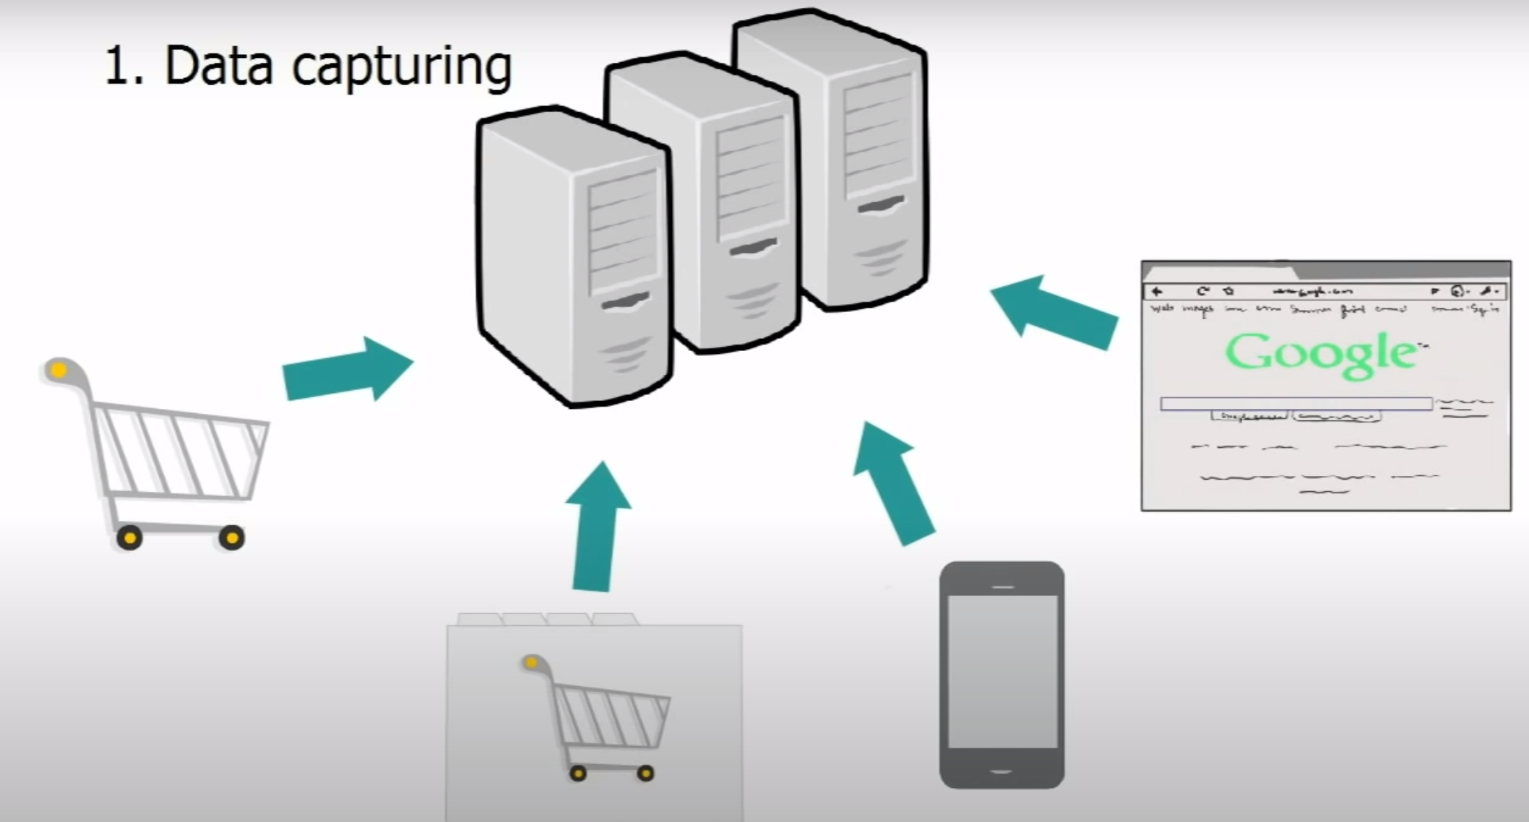
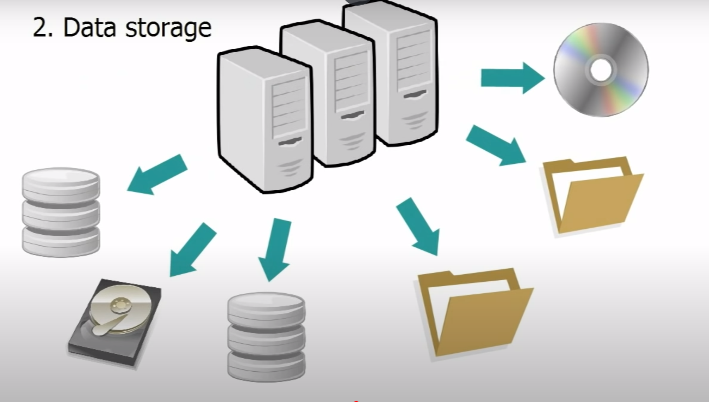
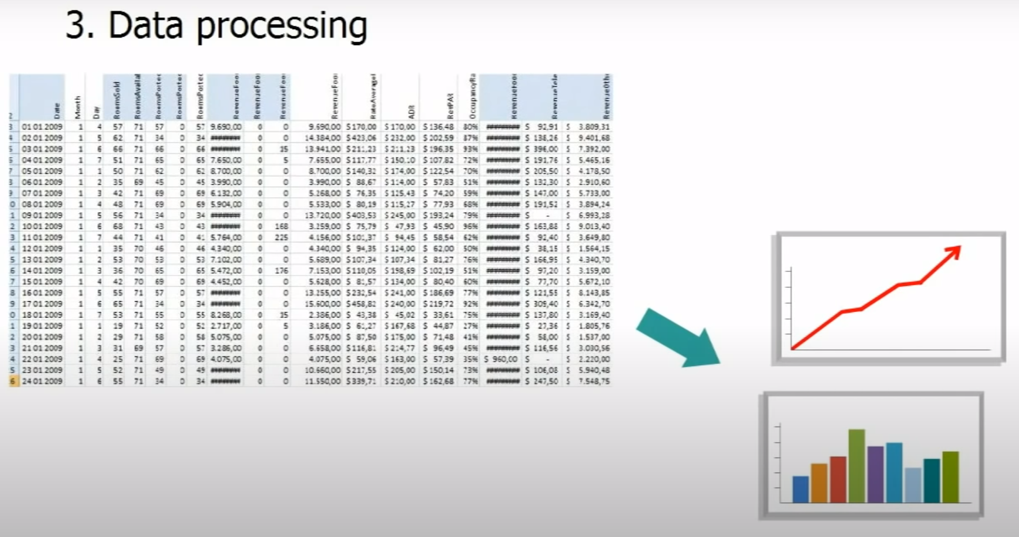
Raw Data🡪 Information

Slide 12
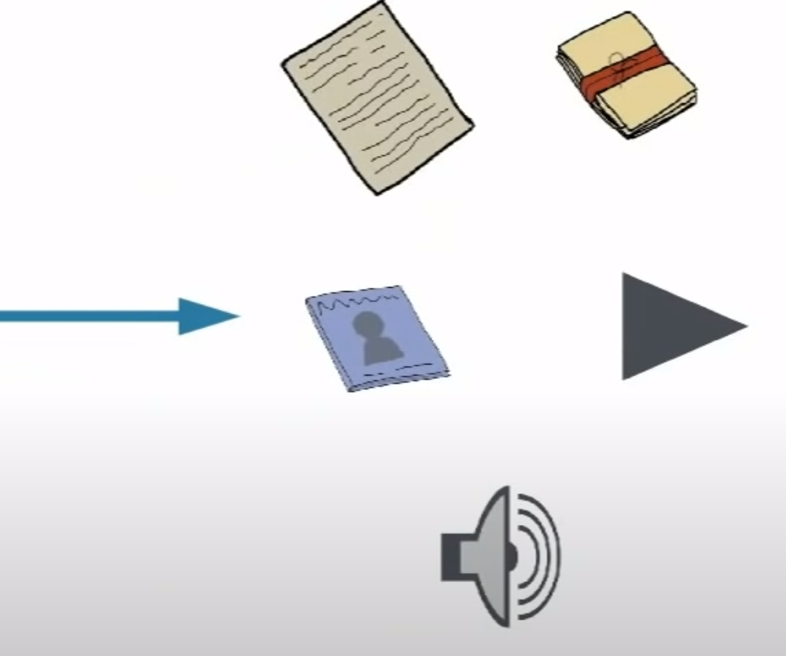
At the right time to the right person in a right form, the outpout could be any format and usually charts and statistics used in decision making

Slide 13
With the help of statistics Mis could used historical data to predict the future of the business and trends

Slide 14
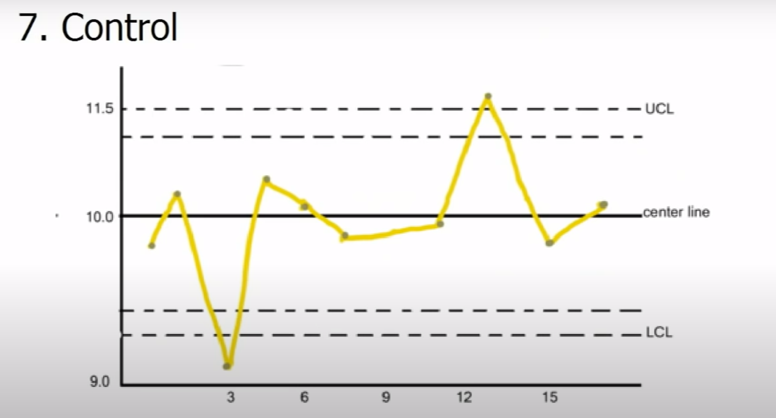
Notes:
Using the distributed report to plan for all institiution department control help montor and track obsticals against organisation plan this is the control

Slide 15
IT and MIS
Information Technology (IT) is sometimes referred to as a technological side of an information system, which includes hardware, software, networks and other devices. In other words, IT is a sub-system of an information system or management information system.

Slide 16
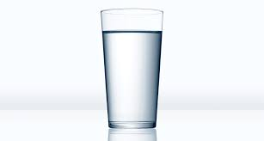
Value of Information
Information value is closely tied to the decisions that result from its use.
Information does not have an absolute universal value(can not be true or false)
Information Value =who use it+ when it is used+ in what situation it is used.
Value of water

Slide 17
Characteristics of information
Comprehension

Slide 18
Characteristics of information
Source trustworthiness , Communication with the right person
Detail : Information should contain the minimum number of details for effective decision making
Comprehensions : If the information is not understood it cannot be used and therefore it cannot add value. Many factors intervene in understanding information

Slide 19
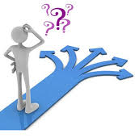
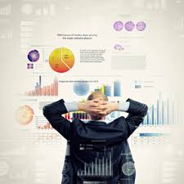
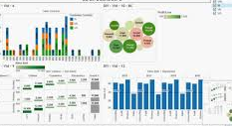
Information as an Aid to Decision Making
The process of decision making can be described as comprising four phases
Review
Choice
Generate alternatives
Put problem in context
Identify and structure the problem

