Slide 1
References
1- Essentials of biology 3rd edition Mader, S.S.and Windelspencht,M. (2012).McGraw-Hill.
3- Essential Cell Biology ,Davey, J.; and Lord, M.( 2002). Volume 2: Cell Function A Practical Approach. Oxford university Prees. P: 251.

Slide 2

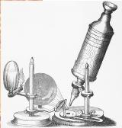
Introduction of cell biology
Cell biology
The branch of biology dealing with the study of structure, function, molecular organization, growth, reproduction and genetics of the cells, is called cytology or cell biology.
The discovery of the cells
• 1665 - Robert Hooke looks at cork
under a microscope. Calls the chambers
he saw "cells"
• 1665 -1675 Antonie van Leeuwenhoek, the invention of the microscope ,studies organisms living in pond water (like you did in lab). He called them "Animalcules."
• 1838-1839 German scientists Schleiden and Schawann ,all living organisms are made of cells. This forms the basis of the Cell Theory of Biology.

Slide 3
The Cell Theory of Biology
1- All living organisms (animals, plants and microbes) are made up of one or more cells and cell products.
2-All metabolic reactions in unicellular and multicellular organisms take place in cells.
3- Cells arise by division of preexisting cells.
4- The smallest clearly defined unit of life is the cell.
5-Cells can be cultured to produce more cells
in vitro = outside organism or cell
in vivo = inside organism or cell

Slide 4
Properties of Cells
1- Cells are complex and highly organized
• They contain numerous internal structures
• Some are membrane bound (organelles) while others do not
2-Cells contain a genetic blueprint and machinery to use it
• Genes are instructions for cells to create specific proteins
• All cells use the same types of information
o The genetic code is universal
o The machinery used for synthesis is interchangeable
• Information transfer must be error free
o Errors are called mutations

Slide 5
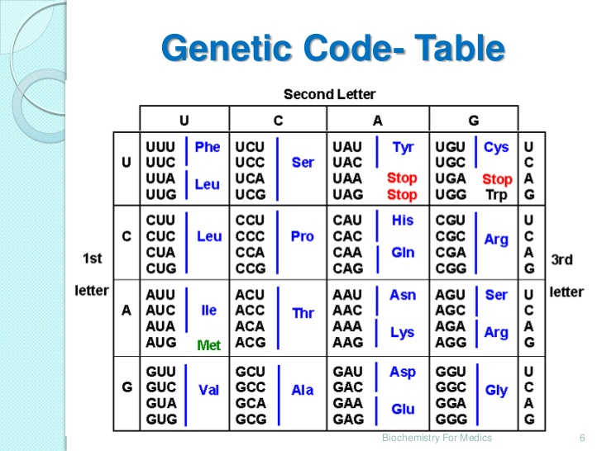

Slide 6
3-Cells arise from the division of other cells
•Daughter cells inherit the genes from the mother cells
•Daughter cells inherit cytoplasm and organelles from the mother cells
•Binary fission - cell division in bacteria
•Mitosis - the genetic complement of each daughter cell is identical to the other and to the mother cell. This is asexual reproduction
•Meiosis - the genetic complement of each daughter cell is reduced by half. This is sexual reproduction
The difference between sexual and asexual reproduction as in the following scheme:

Slide 7
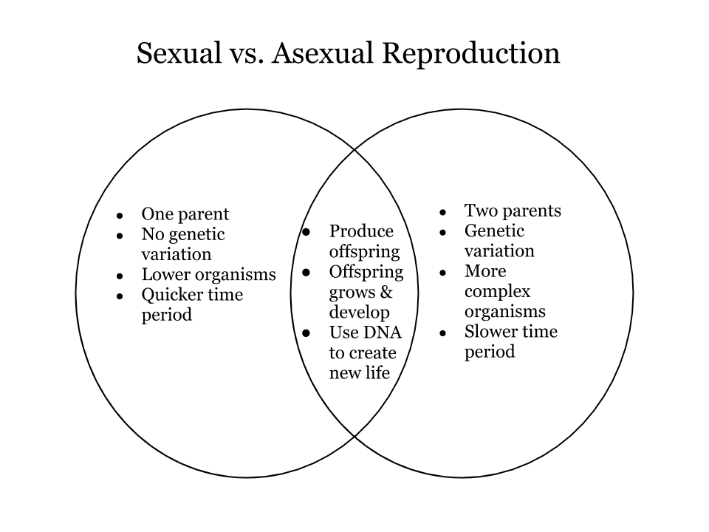

Slide 8
4-Cells acquire and utilize energy
• Plant cells undergo photosynthesis
o convert light energy and CO2 to chemical energy (ATP and glucose)
• Most cells respire
o release energy found in organic compounds
o convert organic compounds to CO2 and O2
o make ATP
5-Cells can perform a variety of chemical reactions
• convert simple organic molecules into complex molecules (anabolism)
• Breakdown complex molecules to release energy (catabolism)
• Metabolism = all reactions by cells

Slide 9
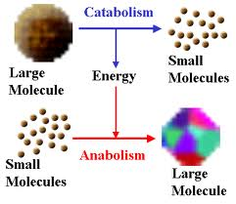

Slide 10
6-Cells can engage in mechanical activities
• Cells can move
• Organelles can move
• Cells can respond to stimuli
o chemotaxis - movement towards chemicals
o phototaxis - movement towards light
o hormone responses
o touch responses
7-Cells can regulate activities
• Cells control DNA synthesis and cell division
• Gene regulation - cells make specific proteins only when needed
• Turn on and off metabolic pathways
8-Cells all contain the following structures:
• Plasma membrane - separates the cell from the external environment
• Cytoplasm - fluid-filled cell interior
• Nuclear material - genetic information stored as DNA

Slide 11
Major Cell Structures and Primary Functions
Cell Membrane
Protects the cell; provides for communication via receptor proteins; surface proteins serve as positive identification tags; allows some substances to pass into and out of the cell while denying passage to other substances; this selectivity allows cells to receive nutrition and dispose of waste.
Cytoplasm
Provides storage and work areas for the cell; the work and storage elements of the cell, called organelles, are the ribosomes, endoplasmic reticulum, Golgi apparatus, mitochondria, lysosomes, and centrioles.
Ribosomes
Make enzymes and other proteins; nicknamed "protein factories".
Endoplasmic reticulum (ER)
Carries proteins and other substances through the cytoplasm.

Slide 12
Endoplasmic reticulum (ER)
Carries proteins and other substances through the cytoplasm.
Golgi apparatus
Chemically processes the molecules from the endoplasmic reticulum and the packages them into vesicles; nicknamed "chemical processing and packaging center".
Mitochondria
Involved in cellular metabolism and respiration; provides the principle source of cellular energy and is the place where complex, energy-releasing chemical reactions occur continuously; nicknamed "power plants".
Lysosomes
Contain enzymes that can digest food compounds; nicknamed "digestive bags".
Centrioles
Play an important role in cell reproduction

Slide 13
Cilia
Hair-like processes that project from epithelial cells; help propel mucus, dust particles, and other foreign substances from the respiratory tract.
Flagellum
"Tail" of the sperm that enables for the sperm to "swim" or move toward the ovum.
Nucleus
Controls every organelle (little organ) in the cytoplasm; contains the generic matter necessary for cell reproduction as well as control over activity within in the cell's cytoplasm; responsible for the cell's metabolism, growth, and reproduction.

Slide 14
Types of Cells
1-Prokaryotes
• Pro = before; karyon = nucleus
• relatively small 5 - 10 um
• lack membrane-bound organelles
• earliest cell type
2-Archaea
• Originally thought to be prokaryotes
• relatively small 5 - 10 um
• lack membrane-bound organelles
• Usually live in extreme environments (thermophiles, halophiles) etc)
3-Eukaryotes
• Eu = true; karyon = nucleus
• contain membrane-bound organelles
• Evolved from prokaryotes by endosymbiosis association
• Include Protozoans , Fungi, Animals, and Plants

Slide 15
A comparison of a few traits of bacteria, archaea, and eukarya.
Property | Bacteria | Archaea | Eukaryotes
Cell type | Prokaryotic | Prokaryotic | Eukaryotic
Cell wall | Madeof peptidoglycan | Does not contain peptidoglycan | In plants and fungi, composed of polysaccharides
Sensitivityto antibiotics | Yes | No | No
Firstaminoacid duringprotein synthesis | Formylmethionine | Methionine | Methionine
DNA | Mostlycircular chromosomeand plasmids | Circular chromosomeand plasmids | Linear chromosome, rarely plasmids
Histones | No | Yes | Yes
Organelles | No | No | Yes
Ribosomes | 70S | 70S | 80S

Slide 16
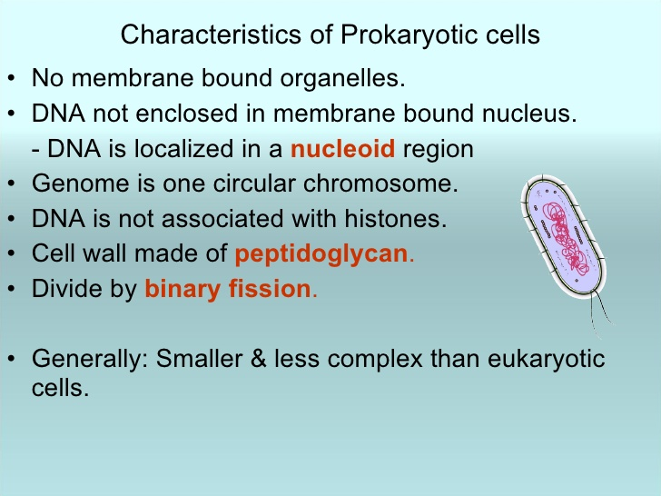

Slide 17
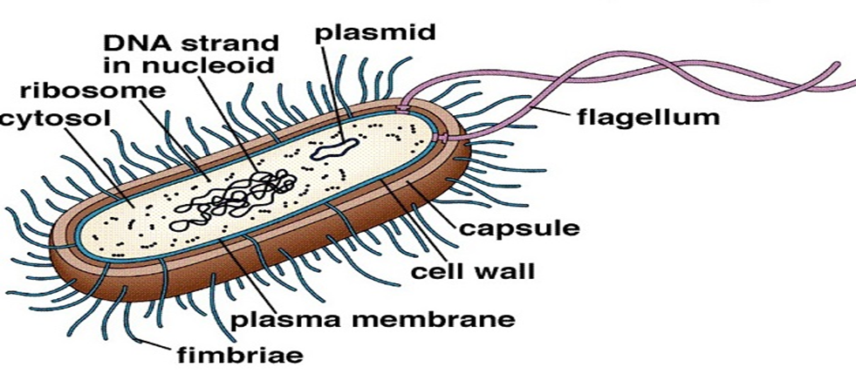
structure of typical prokaryotic cells:

Slide 18
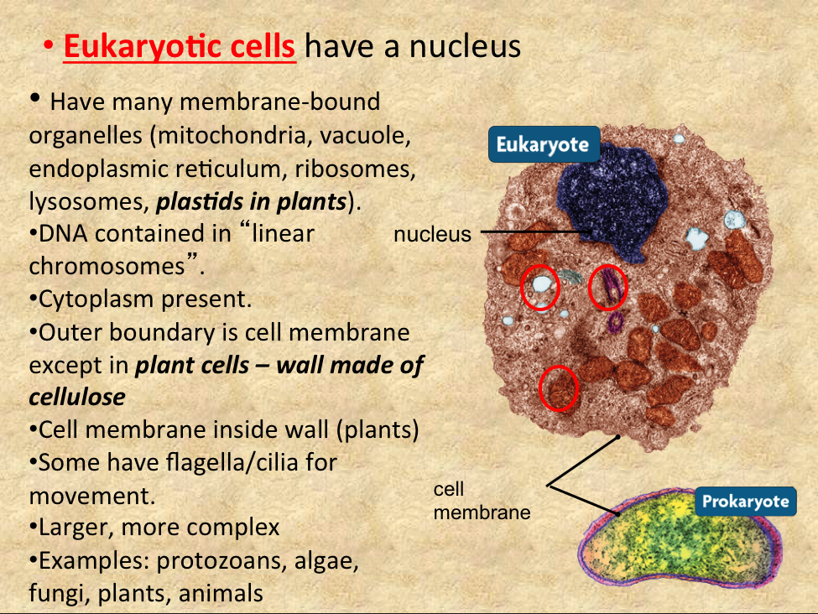
characteristic of eukaryotic cells:

Slide 19
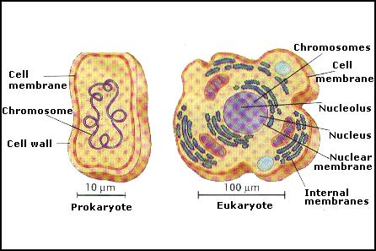

Slide 20
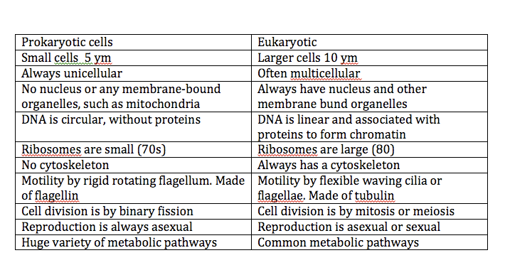
What is the difference between prokaryotic and eukaryotic:

Slide 21
What is the difference between an animal cell and a plant cell?
Animal cell Animal cells are generally small in size 2.Cell wall is absent. 3. absent plastids. 4. Vacuoles are many and small. 5. Single highly complex Golgi apparatus. 6. present centrosome and centrioles. | Plant cell 1. Plant cells are larger than animal cells. 2. Rigid cell wall of cellulose 3. present plastids. 4. Vacuoles are few and large 5. many simpler units of Golgi apparatus, called dictyosomes. 6. Absent centrosome and centrioles.

Slide 22
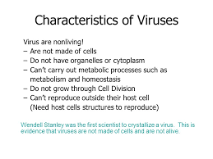

Slide 23
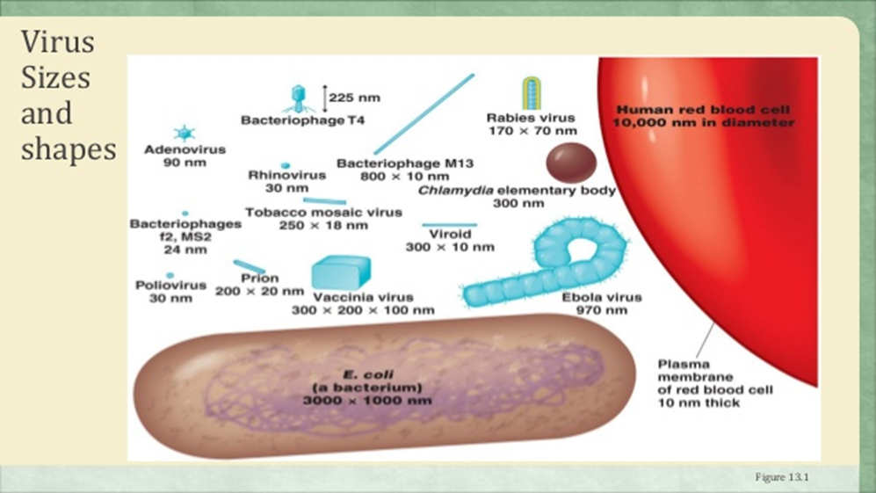

Slide 24
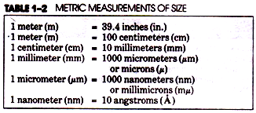

Slide 25


