Slide 1
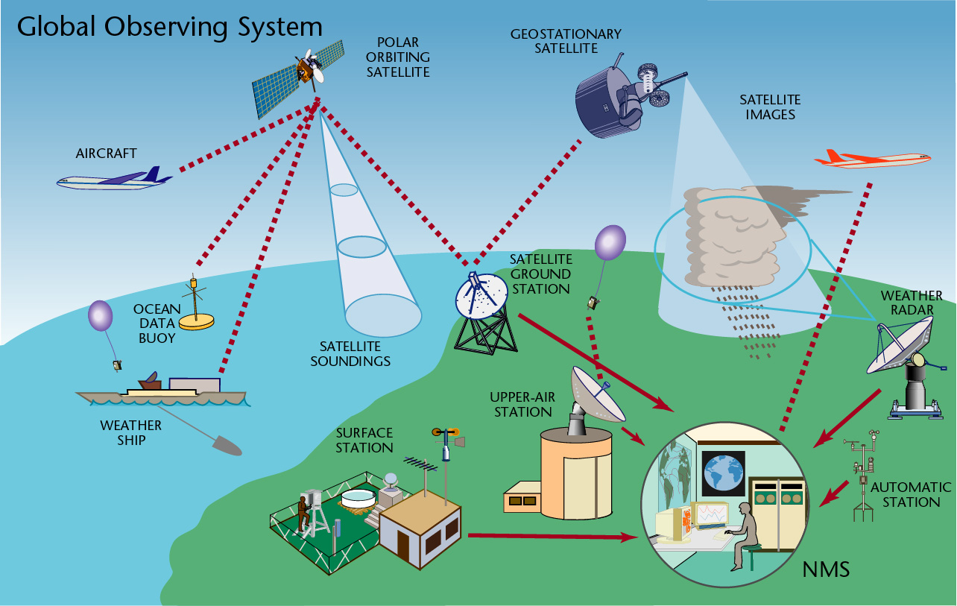
The Course of
Meteorological Instrumentation and Observations
MUSTANSIRIYAH UNIVERSITY
COLLEGE OF SCIENCES
ATMOSPHERIC SCIENCES DEPARTMENT
2022-2023
Dr. Husain A. Nema
SECOND STAGE

Slide 2
Welcome Students! ☺
To LECTURE ONE
Principles of Measurement
and Instrumentation

Slide 3
What are covered in this course?
1. Introduction to Met Instruments
6. Wind measurement
Mechanical method
Electrical method
2. Observing System
3. Temperature and Moisture measurement
  Basic principles
  Sensor types
  Response time
8. Clouds measurement
9. Upper atmosphere measurement
7. Radiation
Basic principles
Sensors
4. Precipitation measurement
Rain gauges
Radars for precipitation
10. Weather radar
5. Pressure measurement
Basic principles
Sensors
11. Satellite observations
12. Weather Maps and how to represent Weather Phenomena

Slide 4
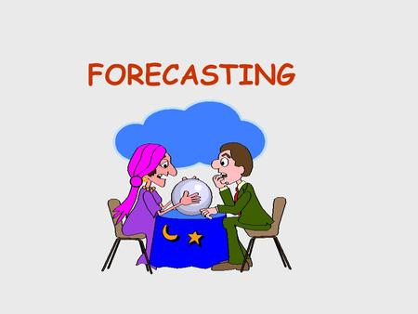
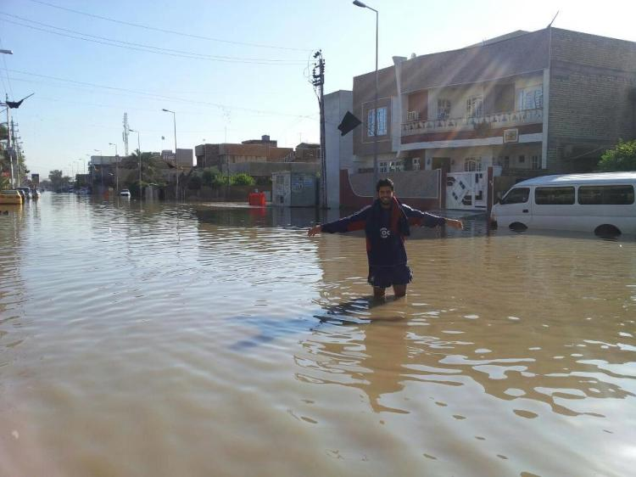
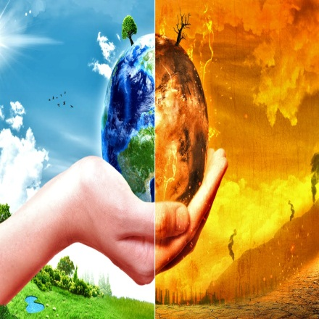


Meteorological observations are made for a variety of reasons:
for the real-time preparation of weather analyses, forecasts and severe weather warnings,
for the study of climate,
for local weather dependent operations (for example, local aerodrome flying operations,
construction work on land and at sea),
for hydrology and agricultural meteorology,
for research in meteorology and climatology.

Slide 5
OBSERVING PARAMETERS
PARAMETER | SENSOR | UNIT | MEASURING RANGE
Wind speed | Anemometer | m/sec, knot | 0..75 m/sec
Wind direction | Wind vane | Degree | 0..360 o
Air temperature | Thermometer | o C | -60 o C..+60 o C
Wet bulb temp. | Thermometer | o C | 0...+40 o C
Dew point | Thermometer | o C | -60 o C...+50 o C
Rel. Humidity | Hygrometer | % | 0%...100%
Soil Terre. Temp. | Thermometer | o C | -60 o C...+70 o C
Soil temp. | Thermometer | o C | -50 o C...+70 o C
Soil moisture | Moisture sensor | % H2O | Undefined

Slide 6
OBSERVING PARAMETERS
PARAMETER | SENSOR | UNIT | MEASURING RANGE
Pressure | Barometer | hPa | 600....1100 hPa
Precipitation | Pluviometer | mm | Unlimited
Snow depth | Depth sensor | cm | 0..1000 cm
Evaporation | Evap. Pool | mm | 0...100 mm/day
Global radiation | Pyranometer | Watt/m2 | 0...1500 W/m2
Direct radiation | Pyrheliometer | Watt/m2 | 0...1500 W/m2
Diffuse radiation | Pyranometer | Watt/m2 | 0...1500 W/m2
Net radiation | Pyranometer | Watt/m2 | Undefined
Sunshine duration | Heliometer | Hour | 120 W/m2 (threshold)

Slide 7
OBSERVING PARAMETERS
PARAMETER | SENSOR | UNIT | MEASURING RANGE
Leaf wetness | Wetness sensor | Kg/m2, capacity% | Undefined
Soil heat flux | Flux sensor | Watt/m2 | Undefined
Lightning | Lightning Detector | Count | 0....9999
Cloud height | Ceilometer | M, feet | 30...25.000 m
Visibility | Transmissometer Forward scatt. | M, km | 25....50.000 m
Present weather | Pre. Weat. Sen. | Phenomena code | ----

Slide 8
    A measurement is a quantity that has both a number and a unit.
2.34 g
36.1 mL
996 hPa
      Measurements are fundamental to the experimental sciences. For that reason, it is important to be able to MAKE measurements and to decide whether a measurement is CORRECT.

Slide 9
We can make these observations in two ways:
In situ measurement
Remote sensing measurement
acquisition of information of an object or phenomenon, by the use of either recording or real-time sensing devices that are wireless, not in physical or intimate contact with the object.
measurements obtained through direct contact with the respective object (basically you take measurements of the parameters right were you are)
they measure the parameters from where they are located at that moment, Surface (stations, ships, or, buoys), or upper-air(rockets; balloons, and aircrafts)
It has two types: active and passive remote sensing
Notes:
The in-situ observations can be surface based measurements, such as, those collected by surface meteorological stations, ships, or, buoys, but may also include those collected by rockets; balloons, and even aircrafts because they measure the parameters from where they are located at that moment.

Slide 10
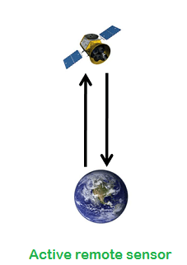
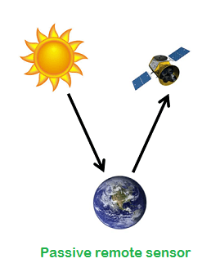
Active remote Sensing: Makes
use of sensors that detect reflected responses from objects that are irradiated from
artificially-generated energy sources, such as radar(send out radiation, hoping to get it back to analyze it ).
Passive Remote Sensing:
Makes use of sensors that detect the reflected or emitted electro-magnetic radiation from natural sources (wait for radiation to come to them so that they can analyze the data)

Slide 11

Steps needed to make measurements for a specific application:
1. Define and research the problem (literature review is advised).
What parameters are required and what must be measured.
What is the frequency of the observations that will be required?
How long will the observations be made?
What level of error is acceptable?
2. Know and understand the instruments that will be used
(consider cost, durability, and availability).
3. Apply instruments and data processing
(consider deployment, and data collection).
4. Analyze the data (apply computational tools, statistics, etc..).

Slide 12
Instruments and measurement systems
determining the magnitude of a physical environmental parameter (ex. Temp.)
sensing technology is able to respond the quantity to be measured
a recording technique for the quantified response
a method of quantifying the response
Closely related is the need to evaluate how well the quantity has been measured, to provide an assessment of the associated uncertainty.

Slide 13
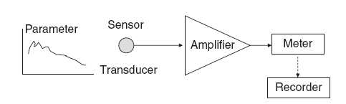
The sensor responds to the specific parameter measured.
(In some cases, energy exchange by a transducer may also be required, to convert the sensor’s response into something which can be more conveniently measured.)
An amplifier is used to increase the magnitude of the changes produced by the sensor. Amplifiers operate on a variety of principles, for example mechanical, chemical, optical or electronic. As well as increasing the signal, an amplifier usually increases other random variations (noise) present as well.
The meter provides the final readout in terms of a magnitude, and can be digital or analogue.
A recording device of some form may be attached to the meter, such as a chart recorder, a computerized logging system or, more simply, an observer with a notebook.

Slide 14
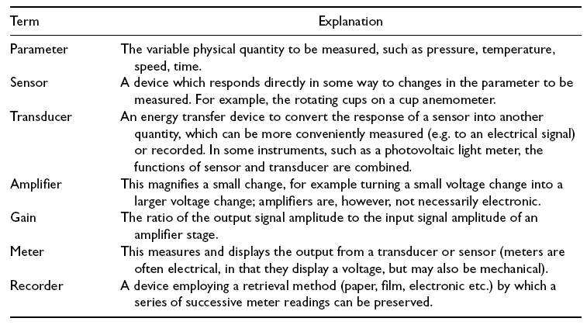
Descriptions of parts of an instrument

