Slide 1
the Circulation
By
Professor Dr.Noori Mohammed Luaibi

Slide 2
Overview of the Circulation; Biophysics of Pressure, Flow, and Resistance
The function of the circulation is to serve the needs of the body tissues—to transport nutrients to the body tissues, to transport waste products away, to transport hormones from one part of the body to another and, in general, to maintain an appropriate environment in all the tissue fluids of the body for survival and optimal function of the cells. The rate of blood flow through many tissues is controlled mainly in response to their need for nutrients. In some organs, such as the kidneys, the circulation serves additional functions. Blood flow to the kidney, for example, is far in excess of its metabolic requirements and is related to its excretory function, which requires that a large volume of blood be filtered each minute. The heart and blood vessels, in turn, are controlled to provide the necessary cardiac output and arterial pressure to cause the needed tissue blood flow. What are the mechanisms for controlling blood volume and blood flow, and how does this process relate to the other functions of the circulation? These are some of the topics and questions that we discuss in this section on the circulation.
PHYSICAL CHARACTERISTICS OF THE CIRCULATION
The circulation, shown in Figure 14-1, is divided into the systemic circulation and the pulmonary circulation. Because the systemic circulation supplies blood flow to all the tissues of the body except the lungs, it is also called the greater circulation or peripheral circulation.

Slide 3
Functional Parts of the Circulation
Before discussing the details of circulatory function, it is important to understand the role of each part of the circulation. The function of the arteries is to transport blood under high pressure to the tissues. For this reason, the arteries have strong vascular walls, and blood flows at a high velocity in the arteries. The arterioles are the last small branches of the arterial system; they act as control conduits through which blood is released into the capillaries. Arterioles have strong muscular walls that can close the arterioles completely or can, by relaxing, dilate the vessels severalfold, thus having the capability of vastly altering blood flow in each tissue in response to its needs. The function of the capillaries is to exchange fluid, nutrients, electrolytes, hormones, and other substances between the blood and the interstitial fluid. To serve this role, the capillary walls are thin and have numerous minute capillary pores permeable to water and other small molecular substances. The venules collect blood from the capillaries and gradually coalesce into progressively larger veins. The veins function as conduits for transport of blood from the venules back to the heart; equally important, they serve as a major reservoir of extra blood. Because the pressure in the venous system is very low, the venous walls are thin. Even so, they are muscular enough to contract or expand and thereby serve as a controllable reservoir for the extra blood, either a small or a large amount, depending on the needs of the circulation.
Volumes of Blood in the Different Parts of the Circulation
Figure 14-1 gives an overview of the circulation and lists the percentage of the total blood volume in major segments of the circulation. For instance, about 84 percent of the entire blood volume of the body is in the systemic circulation and 16 percent is in the heart and lungs. Of the 84 percent in the systemic circulation, approximately 64 percent is in the veins, 13 percent is in the arteries, and 7 percent is in the systemic arterioles and capillaries. The heart contains 7 percent of the blood, and the pulmonary vessels, 9 percent. Most surprising is the low blood volume in the capillaries. It is here, however, that the most important function of the circulation occurs—diffusion of substances back and forth between the blood and the tissues.

Slide 4
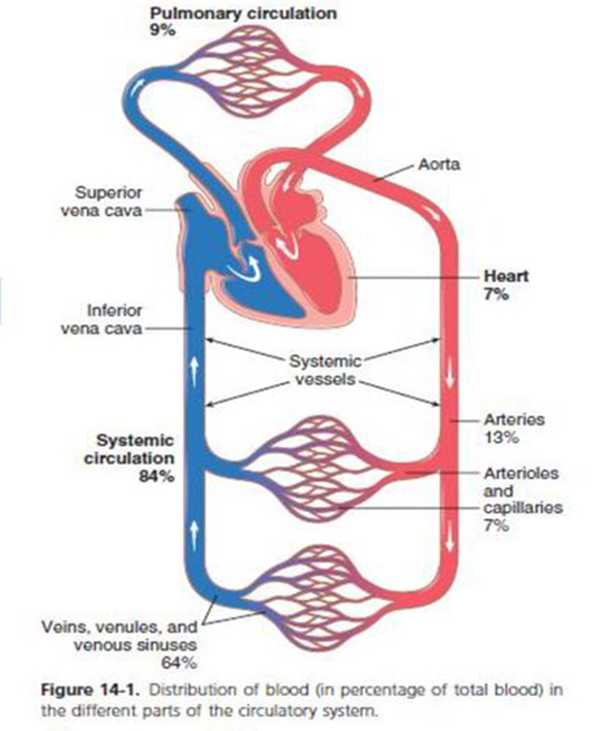
Cross-Sectional Areas and Velocities of Blood Flow.
If all the systemic vessels of each type were put side by side, their approximate total cross-sectional areas for the average human being would be as follows:
Note particularly that the cross-sectional areas of the veins are much larger than
those of the arteries, averaging about four times those of the corresponding
arteries. This difference explains the large blood storage capacity of the
venous system in comparison with the arterial system. Because the same volume
of blood flow (F) must pass through each segment of the circulation each minute,
the velocity of blood flow (v) is inversely proportional to vascular
cross-sectional area. (A): v F/A = Thus, under resting conditions,
the velocity averages about 33 cm/sec in the aorta but is only 1/1000
as rapid in the capillaries—about 0.3 mm/sec. However, because the
capillaries have a typical length of only 0.3 to 1millimeter, the blood
remains in the capillaries for only 1 to 3 seconds, which is surprising
because all diffusion of nutrient food substances and electrolytes that occurs
through the capillary walls must be performed in this short time.
Vessel Cross-Sectional Area (cm2 )
Aorta 2.5
Small arteries 20
Arterioles 40
Capillaries 2500
Venules 250
Small veins 80
Venae cavae 8

Slide 5
Pressures in the Various Portions of the Circulation.
Because the heart pumps blood continually into the aorta, the mean pressure in the aorta is high, averaging about 100 mm Hg.
Also, because heart pumping is pulsatile, the arterial pressure alternates between a systolic pressure level of 120 mm Hg and
a diastolic pressure level of 80 mm Hg, as shown on the left side of Figure 14-2. As the blood flows through the systemic
circulation, its mean pressure falls progressively to about 0 mm Hg by the time it reaches the termination of the superior and
inferior venae cavae where they empty into the right atrium of the heart. The pressure in the systemic capillaries varies from
as high as 35 mm Hg near the arteriolar ends to as low as 10 mm Hg near the venous ends, but their average “functional”
pressure in most vascular beds is about 17 mm Hg, a pressure low enough that little of the plasma leaks through the minute
pores of the capillary walls, even though nutrients can diffuse easily through these same pores to the outlying tissue cells.
Note at the far right side of Figure 14-2 the respective pressures in the different parts of the pulmonary circulation.
In the pulmonary arteries, the pressure is pulsatile, just as in the aorta, but the pressure is far less: pulmonary artery systolic
pressure averages about 25 mm Hg and diastolic pressure averages about 8 mm Hg, with a mean pulmonary arterial pressure
of only 16 mm Hg. The mean pulmonary capillary pressure averages only 7 mm Hg. Yet, the total blood flow through the lungs
each minute is the same as through the systemic circulation. The low pressures of the pulmonary system are in accord with the
needs of the lungs because all that is required is to expose the blood in the pulmonary capillaries to oxygen and other gases
in the pulmonary alveoli

Slide 6
BASIC PRINCIPLES OF CIRCULATORY FUNCTION
Although the details of circulatory function are complex, three basic principles underlie all functions of the system.
1. Blood flow to most tissues is controlled according to the tissue need. When tissues are active, they need a greatly
increased supply of nutrients and therefore much more blood flow than when at rest— occasionally as much as 20 to
30 times the resting level. Yet, the heart normally cannot increase its cardiac output more than four to seven times
greater than resting levels. Therefore, it is not possible simply to increase blood flow everywhere in the body when
a particular tissue demands increased flow. Instead, the microvessels of each tissue continuously monitor tissue needs, such as the availability of oxygen and other nutrients and the accumulation of carbon dioxide and other tissue waste products, and these microvessels in turn act directly on the local blood vessels, dilating or constricting them, to control local blood flow precisely to that level required for the tissue activity. Also, nervous control of the circulation from the central nervous system and hormones provide additional help in controlling tissue blood flow.
2. Cardiac output is the sum of all the local tissue flows. When blood flows through a tissue, it immediately returns by way of the veins to the heart. The heart responds automatically to this increased inflow of blood by pumping it immediately back into the arteries. Thus, the heart acts as an automaton, responding to the demands of the tissues. The heart, however, often needs help in the form of special nerve signals to make it pump the required amounts of blood flow.
3. Arterial pressure regulation is generally independent of either local blood flow control or cardiac output control. The circulatory system is provided with an extensive system for controlling the arterial blood pressure. For instance, if at any time the pressure falls significantly below the normal level of about 100 mm Hg, within seconds a barrage of nervous reflexes elicits a series of circulatory changes to raise the pressure back toward normal. The nervous signals especially (a) increase the force of heart pumping, (b) cause contraction of the large venous reservoirs to provide more blood to the heart, and (c) cause generalized constriction of the rterioles in many tissues so that more blood accumulates in the large arteries to increase the arterial pressure. Then, over more prolonged periods— hours and days—the kidneys play an additional major role in pressure control both by secreting pressure-controlling hormones and by regulating the blood volume.

Slide 7
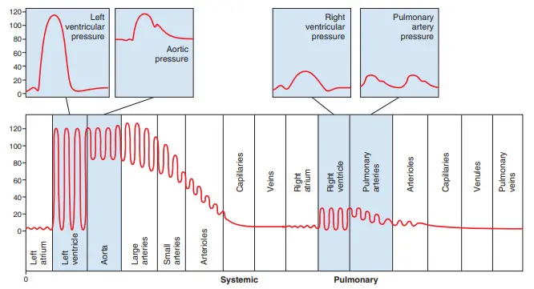
Thus, the needs of the individual tissues are served specifically by the circulation. In the remainder of this chapter, we begin to discuss the basic details of the management of tissue blood flow and control of cardiac output and arterial pressure.
INTERRELATIONSHIPS OF PRESSURE, FLOW, AND RESISTANCE
Blood flow through a blood vessel is determined by two factors: (1) pressure difference of the blood between the two ends of the vessel, also sometimes called “pressure gradient” along the vessel, which pushes the blood through the vessel, and (2) the impediment to blood flow through the vessel, which is called vascular resistance. Figure 14-3 demonstrates these relationships, showing a blood vessel segment located anywhere in the circulatory system. P1 represents the pressure at the origin of the vessel; at the other end, the pressure is P2. Resistance occurs as a result of friction between the flowing blood and the intravascular endothelium all along the inside of the vessel. The flow through the vessel can be calculated by the following formula, which is called Ohm’s law: F= Δ P ⁄ R.
R= ΔP ⁄ F.
Figure 14-2. Normal blood pressures in the different portions of the circulatory system when a person is lying in the horizontal position

Slide 8
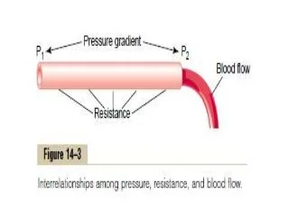
BLOOD FLOW
Blood flow means the quantity of blood that passes a given point in the circulation in a given period of time. Ordinarily, blood flow is expressed in milliliters per minute or liters per minute, but it can be expressed in milliliters per second or in any other units of flow and time. The overall blood flow in the total circulation of an adult person at rest is about 5000 ml/min. This is called the cardiac output because it is the amount of blood pumped into the aorta by the heart each minute.
Laminar Flow of Blood in Vessels.
When blood flows at a steady rate through a long, smooth blood vessel, it flows in streamlines, with each layer of blood remaining the same distance from the vessel wall. Also, the centralmost portion of the blood stays in the center of the vessel. This type of flow is called laminar flow or streamline flow, and it is the opposite of turbulent flow, which is blood flowing in all directions in the vessel and continually mixing within the vessel, as discussed subsequently.

Slide 9
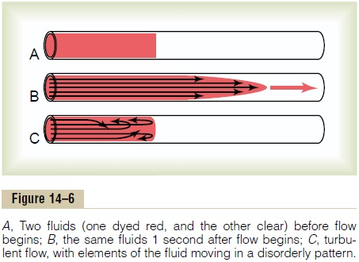
Parabolic Velocity Profile During Laminar Flow.
When laminar flow occurs, the velocity of flow in the center of the vessel is far greater than that toward the outer edges. This phenomenon is demonstrated in Figure 14-6. In Figure 14-6A, a vessel contains two fluids, the one at the left colored by a dye and the one at the right a clear fluid, but there is no flow in the vessel. When the fluids are made to flow, a parabolic interface develops between them, as shown 1 second later in Figure 14-6B; the portion of fluid adjacent to the vessel wall has hardly moved, the portion slightly away from the wall has moved a small distance, and the portion in the center of the vessel has moved a long distance. This effect is called the “parabolic profile for velocity of blood flow.” The cause of the parabolic profile is the following: The fluid molecules touching the wall move slowly because of adherence to the vessel wall. The next layer of molecules slips over these, the third layer over the second, the fourth layer over the third, and so forth. Therefore, the fluid in the middle of the vessel can move rapidly because many layers of slipping molecules exist between the middle of the vessel and the vessel wall; thus, each layer toward the center flows progressively more rapidly than the outer layers.

Slide 10
Turbulent Flow of Blood Under Some Conditions.
when it passes by an obstruction in a vessel, when it makes a sharp turn, or when it passes over a rough surface,
the flow may then become turbulent, or disorderly, rather than streamlined (see Figure 14-6C). Turbulent flow
means that the blood flows crosswise in the vessel and along the vessel, usually forming whorls in the blood,
called eddy currents. These eddy currents are similar to the whirlpools that one frequently sees in a rapidly flowing
river at a point of obstruction. When eddy currents are present, the blood flows with
much greater resistance than when the flow is streamlined, because eddies add tremendously to the overall
friction of flow in the vessel. The tendency for turbulent flow increases in direct proportion to the velocity of blood flow,
the diameter of the blood vessel, and the density of the blood and is inversely proportional to the viscosity of the blood, in
accordance with the following equation: Re = ν ⋅ d ⋅ ρ ⁄ η where Re is Reynolds’ number and is the measure of the tendency for
turbulence to occur, ν is the mean velocity of blood flow (in centimeters/second), d is the vessel diameter (in centimeters), ρ is
density, and η is the viscosity (in poise). The viscosity of blood is normally about 1/30 poise, and the density is only slightly
greater than 1. When Reynolds’ number rises above 200 to 400, turbulent flow will occur at some branches of vessels but will
die out along the smooth portions of the vessels. However, when Reynolds’ number rises above approximately 2000, turbulence
will usually occur even in a straight, smooth vessel. Reynolds’ number for flow in the vascular system normally rises to 200 to
400 even in large arteries; as a result there is almost always some turbulence of flow at the branches of these vessels.
In the proximal portions of the aorta and pulmonary artery, Reynolds’ number can rise to several thousand during the rapid
phase of ejection by the ventricles, which causes considerable turbulence in the proximal aorta and pulmonary artery where
many conditions are appropriate for turbulence: (1) high velocity of blood flow, (2) pulsatile nature of the flow,
(3) sudden change in vessel diameter, and (4) large vessel diameter.
However, in small vessels, Reynolds’ number is almost never high enough to cause turbulence

Slide 11
BLOOD PRESSURE
Standard Units of Pressure.
Blood pressure almost always is measured in millimeters of mercury (mm Hg) because the mercury manometer has been used as the standard reference for measuring pressure since its invention in 1846 by Poiseuille. Actually, blood pressure means the force exerted by the blood against any unit area of the vessel wall. When one says that the pressure in a vessel is 50 mm Hg, this means that the force exerted is sufficient to push a column of mercury against gravity up to a level 50 millimeters high. If the pressure is 100 mm Hg, it will push the column of mercury up to 100 millimeters. Occasionally, pressure is measured in centimeters of water (cm H2O). A pressure of 10 cm H2O means a pressure sufficient to raise a column of water against gravity to a height of 10 centimeters. One millimeter of mercury pressure equals 1.36 centimeters of water pressure because the specific gravity of mercury is 13.6 times that of water, and 1 centimeter is 10 times as great as 1 millimeter.
RESISTANCE TO BLOOD FLOW
Units of Resistance.
Resistance is the impediment to blood flow in a vessel, but it cannot be measured by any direct means. Instead, resistance must be calculated from measurements of blood flow and pressure difference between two points in the vessel. If the pressure difference between two points is 1 mm Hg and the flow is 1 ml/ sec, the resistance is said to be 1 peripheral resistance unit, usually abbreviated PRU.
Expression of Resistance in CGS Units.
Occasionally, a basic physical unit called the CGS (centimeters, grams, seconds) unit is used to express resistance. This unit is dyne sec/cm5 . Resistance in these units can be calculated by the following formula:
R (in dyne sec/ cm5)= 1333 × mm Hg /ml /sec.

Slide 12
Total Peripheral Vascular Resistance and Total Pulmonary Vascular Resistance.
The rate of blood flow through the entire circulatory system is equal to the rate of blood pumping by the heart—that is, it is equal to the cardiac output. In the adult human being, this is approximately 100 ml/sec. The pressure difference from the systemic arteries to the systemic veins is about 100 mm Hg. Therefore, the resistance of the entire systemic circulation, called the total peripheral resistance, is about 100/100, or 1 PRU. In conditions in which all the blood vessels throughout the body become strongly constricted, the total peripheral resistance occasionally rises to as high as 4 PRU. Conversely, when the vessels become greatly dilated, the resistance can fall to as little as 0.2 PRU. In the pulmonary system, the mean pulmonary arterial pressure averages 16 mm Hg and the mean left atrial pressure averages 2 mm Hg, giving a net pressure difference of 14 mm. Therefore, when the cardiac output is normal at about 100 ml/sec, the total pulmonary vascular resistance calculates to be about 0.14 PRU (about one seventh that in the systemic circulation).
“Conductance” of Blood in a Vessel Is the Reciprocal of Resistance.
Conductance is a measure of the blood flow through a vessel for a given pressure difference. This measurement is generally expressed in terms of milliliters per second per millimeter of mercury pressure, but it can also be expressed in terms of liters per second per millimeter of mercury or in any other units of blood flow and pressure. It is evident that conductance is the exact reciprocal of resistance in accord with the following equation: Conductance = 1/ Resistance

Slide 13
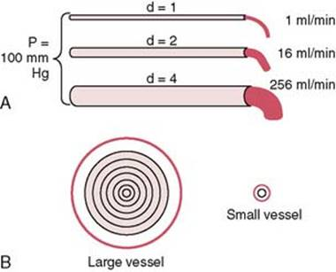
Small Changes in Vessel Diameter Markedly Change Its Conductance.
Slight changes in the diameter of a vessel cause tremendous changes in the vessel’s ability to conduct blood when the blood flow is streamlined. This phenomenon is demonstrated by the experiment illustrated in Figure 14-8A, which shows three vessels with relative diameters of 1, 2, and 4 but with the same pressure difference of 100 mm Hg between the two ends of the vessels. Although the diameters of these vessels increase only fourfold, the respective flows are 1, 16, and 256 ml/min, which is a 256-fold increase in flow. Thus, the conductance of the vessel increases in proportion to the fourth power of the diameter, in accordance with the following formula:
Conductance ∝ Diameter 4
Figure 14-8 A, Demonstration of the effect of vessel diameter on blood flow. B, Concentric rings of blood flowing at different velocities; the farther away from the vessel wall, the faster the flow.

Slide 14
Poiseuille’s Law.
The cause of this great increase in conductance when the diameter increases can be explained by referring to Figure 14-8B, which shows cross sections of a large and a small vessel. The concentric rings inside the vessels indicate that the velocity of flow in each ring is different from that in the adjacent rings because of laminar flow, which was discussed earlier in the chapter. That is, the blood in the ring touching the wall of the vessel is barely flowing because of its adherence to the vascular endothelium. The next ring of blood toward the center of the vessel slips past the first ring and, therefore, flows more rapidly. The third, fourth, fifth, and sixth rings likewise flow at progressively increasing velocities. Thus, the blood that is near the wall of the vessel flows slowly, whereas that in the middle of the vessel flows much more rapidly. In the small vessel, essentially all the blood is near the wall, so the extremely rapidly flowing central stream of blood simply does not exist. By integrating the velocities of all the concentric rings of flowing blood and multiplying them by the areas of the rings, one can derive the following formula, known as Poiseuille’s law:
F → π ∆Pr4 /8 η l
in which F is the rate of blood flow, ΔP is the pressure difference between the ends of the vessel, r is the radius of the vessel, l is length of the vessel, and η is viscosity of the blood. Note particularly in this equation that the rate of blood flow is directly proportional to the fourth power of the radius of the vessel, which demonstrates once again that the diameter of a blood vessel (which is equal to twice the radius) plays by far the greatest role of all factors in determining the rate of blood flow through a vessel.

Slide 15
Importance of the Vessel Diameter “Fourth Power Law” in Determining Arteriolar Resistance.
In the systemic circulation, about two thirds of the total systemic resistance to blood flow is arteriolar resistance in the small arterioles. The internal diameters of the arterioles range from as little as 4 micrometers to as great as 25 micrometers. However, their strong vascular walls allow the internal diameters to change tremendously, often as much as fourfold. From the fourth power law discussed earlier that relates blood flow to diameter of the vessel, one can see that a fourfold increase in vessel diameter can increase the flow as much as 256-fold. Thus, this fourth power law makes it possible for the arterioles, responding with only small changes in diameter to nervous signals or local tissue chemical signals, either to turn off almost completely the blood flow to the tissue or at the other extreme to cause a vast increase in flow. Indeed, ranges of blood flow of more than 100-fold in separate tissue areas have been recorded between the limits of maximum arteriolar constriction and maximum arteriolar dilation.

Slide 16
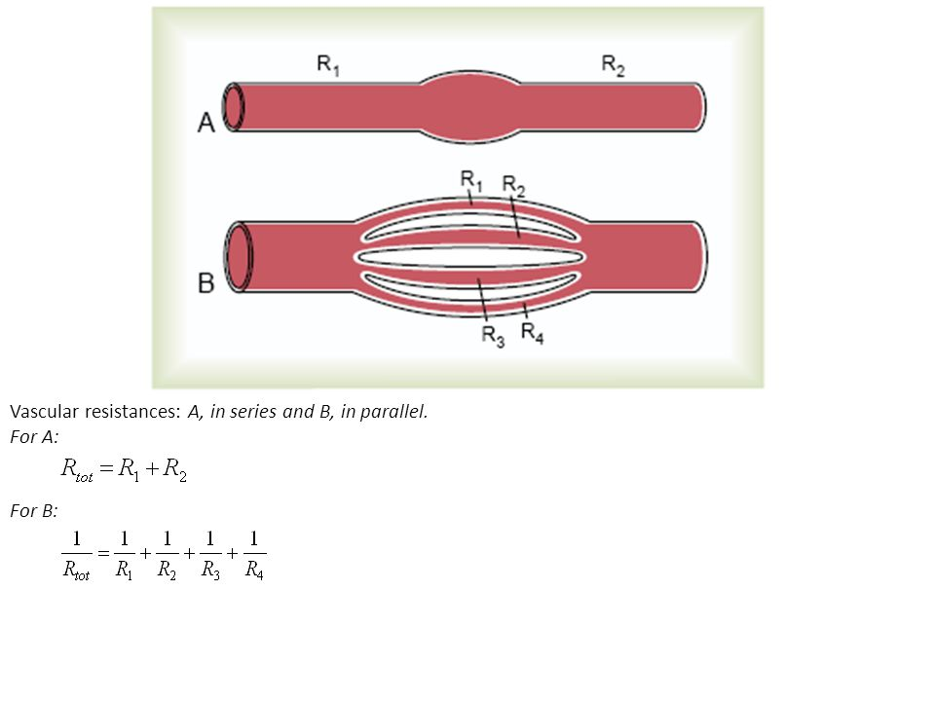
Resistance to Blood Flow in Series and Parallel Vascular Circuits.
Blood pumped by the heart flows from the high-pressure part of the systemic circulation (i.e., aorta) to the low-pressure side (i.e., vena cava) through many miles of blood vessels arranged in series and in parallel. The arteries, arterioles, capillaries, venules, and veins are collectively arranged in series. When blood vessels are arranged in series, flow through each blood vessel is the same and the total resistance to blood flow (Rtotal) is equal to the sum of the resistances of each vessel: R R R R R total = + + + 1 2 3 4 … The total peripheral vascular resistance is therefore equal to the sum of resistances of the arteries, arterioles, capillaries, venules, and veins. In the example shown in Figure 14-9A, the total vascular resistance is equal to the sum of R1 and R2. Blood vessels branch extensively to form parallel circuits that supply blood to the many organs and tissues of the body. This parallel arrangement permits each tissue to regulate its own blood flow, to a great extent, independently of flow to other tissues. For blood vessels arranged in parallel (Figure 14-9B), the total resistance to blood flow is expressed. It is obvious that for a given pressure gradient, far greater amounts of blood will flow through this parallel system than through any of the individual blood vessels. Therefore, the total resistance is far less than the resistance of any single blood vessel. Flow through each of the parallel vessels in Figure 14-9B is determined by the pressure gradient and its own resistance, not the resistance of the other parallel blood vessels. However, increasing the resistance of any of the blood vessels increases the total vascular resistance. It may seem paradoxical that adding more blood vessels to a circuit reduces the total vascular resistance.
Many parallel blood vessels, however, make it easier for blood to
flow through the circuit because each parallel vessel provides
another pathway, or conductance, for blood flow.
The total conductance (Ctotal) for blood flow is the
sum of the conductance of each parallel pathway:
C total = C 1 + C2 + C3 + C4 …

Slide 17
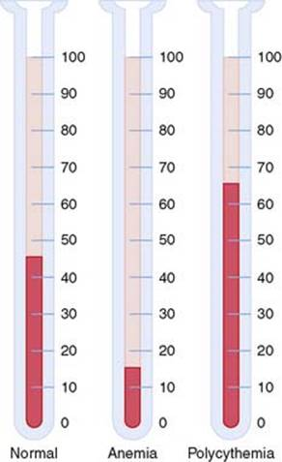
For example, brain, kidney, muscle, gastrointestinal, skin, and coronary circulations are arranged in parallel, and each tissue contributes to the overall conductance of the systemic circulation. Blood flow through each tissue is a fraction of the total blood flow (cardiac output) and is determined by the resistance (the reciprocal of conductance) for blood flow in the tissue, as well as the pressure gradient. Therefore, amputation of a limb or surgical removal of a kidney also removes a parallel circuit and reduces the total vascular conductance and total blood flow (i.e., cardiac output) while increasing total peripheral vascular resistance.
Effect of Blood Hematocrit and Blood Viscosity on Vascular Resistance and Blood Flow Note that another important factor in Poiseuille’s equation is the viscosity of the blood. The greater the viscosity, the lower the flow in a vessel if all other factors are constant. Furthermore, the viscosity of normal blood is about three times as great as the viscosity of water. What makes the blood so viscous? It is mainly the large numbers of suspended red cells in the blood, each of which exerts frictional drag against adjacent cells and against the wall of the blood vessel.
Hematocrit—the Proportion of Blood That Is Red Blood Cells.
If a person has a hematocrit of 40, this means that 40 percent of the blood volume is
cells and the remainder is plasma. The hematocrit of adult men averages about 42,
whereas that of women averages about 38. These values vary tremendously,
depending on whether the person has anemia, the degree of bodily activity,
and the altitude at which the person resides. Hematocrit is determined by
centrifuging blood in a calibrated tube, as shown in Figure 14-10.
The calibration allows direct reading of the percentage of cells
Figure 14-10. Hematocrits in a healthy (normal) person and in patients with anemia and polycythemia. The numbers refer to percentage of the blood composed of red blood cells

Slide 18
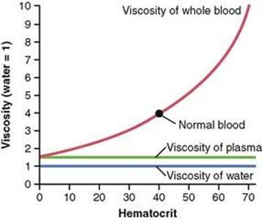
Increasing Hematocrit Markedly Increases Blood Viscosity.
The viscosity of blood increases drastically as the hematocrit increases, as shown in Figure 14-11. The viscosity of whole blood at normal hematocrit is about 3 to 4, which means that three to four times as much pressure is required to force whole blood as to force water through the same blood vessel. When the hematocrit rises to 60 or 70, which it often does in persons with polycythemia, the blood viscosity can become as great as 10 times that of water, and its flow through blood vessels is greatly retarded. Other factors that affect blood viscosity are the plasma protein concentration and types of proteins in the plasma, but these effects are so much less than the effect of hematocrit that they are not significant considerations in most hemodynamic studies. The viscosity of blood plasma is about 1.5 times that of water.
Increasing Hematocrit Markedly Increases Blood Viscosity.
The viscosity of blood increases drastically as the hematocrit increases, as shown in Figure 14-11. The viscosity of whole blood at normal hematocrit is about 3 to 4, which means that three to four times as much pressure is required to force whole blood as to force water through the same blood vessel. When the hematocrit rises to 60 or 70, which it often does in persons with polycythemia, the blood viscosity can become as great as 10 times that of water, and its flow through blood vessels is greatly retarded. Other factors that affect blood viscosity are the plasma protein concentration and types of proteins in the plasma, but these effects are so much less than the effect of hematocrit that they are not significant considerations in most hemodynamic studies. The viscosity of blood plasma is about 1.5 times that of water
Figure 14-11. Effect of hematocrit on blood viscosity (water viscosity = 1).

Slide 19
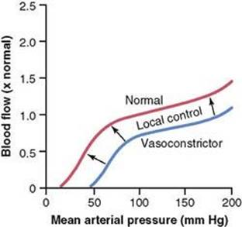
EFFECTS OF PRESSURE ON VASCULAR RESISTANCE AND TISSUE BLOOD FLOW “Autoregulation” Attenuates the Effect of Arterial Pressure on Tissue Blood Flow.
From the discussion thus far, one might expect an increase in arterial pressure to cause a proportionate increase in blood flow through the various tissues of the body. However, the effect of arterial pressure on blood flow in many tissues is usually far less than one might expect, as shown in Figure 14-12. The reason for this is that an increase in arterial pressure not only increases the force that pushes blood through the vessels but also initiates compensatory increases in vascular resistance within a few seconds through activation of the local control mechanisms. Conversely, with reductions in arterial pressure, vascular resistance is promptly reduced in most tissues and blood flow is maintained at a relatively constant rate. The ability of each tissue to adjust its vascular resistance and to maintain normal blood flow during changes in arterial pressure between approximately 70 and 175 mm Hg is called blood flow autoregulation. Note in Figure 14-12 that changes in blood flow can be caused by strong sympathetic stimulation, which constricts the blood vessels. Likewise, hormonal vasoconstrictors, such as norepinephrine, angiotensin II, vasopressin, or endothelin, can also reduce blood flow, at least transiently. Blood flow changes rarely last for more than a few hours in most tissues even when increases in arterial pressure or increased levels of vasoconstrictors are sustained. The reason for the relative
constancy of blood flow is that each tissue’s local autoregulatory mechanisms eventually
override most of the effects of vasoconstrictors to provide a blood flow that is appropriate
for the needs of the tissue.
Figure 14-12. Effect of changes in arterial pressure over a period of several minutes on blood flow in a tissue such as skeletal muscle. Note that between pressure of 70 and 175 mm Hg, blood flow is “autoregulated.” The blue line shows the effect of sympathetic nerve stimulation or vasoconstriction by hormones such as norepinephrine, angiotensin II, vasopressin, or endothelin on this relationship. Reduced tissue blood flow is rarely maintained for more than a few hours because of the activation of local autoregulatory mechanisms that eventually return blood flow toward normal.

Slide 20
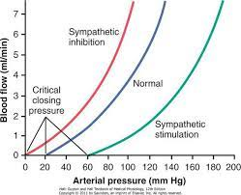
Pressure-Flow Relationship in Passive Vascular Beds.
In isolated blood vessels or in tissues that do not exhibit autoregulation, changes in arterial pressure may have important effects on blood flow. In fact, the effect of pressure on blood flow may be greater than predicted by Poiseuille’s equation, as shown by the upward curving lines in Figure 14-13. The reason for this is that increased arterial pressure not only increases the force that pushes blood through the vessels but also distends the elastic vessels, actually decreasing vascular resistance. Conversely, decreased arterial pressure in passive blood vessels increases resistance as the elastic vessels gradually collapse due to reduced distending pressure. When pressure falls below a critical level, called the critical closing pressure, flow ceases as the blood vessels are completely collapsed. Sympathetic stimulation and other vasoconstrictors can alter the passive pressure-flow relationship shown in Figure 14-13. Thus, inhibition of sympathetic activity greatly dilates the vessels and can increase the blood flow twofold or more. Conversely, very strong sympathetic stimulation can constrict the vessels so much that blood flow occasionally decreases to as low as zero for a few seconds despite high arterial pressure. In reality, there are few physiological conditions in which tissues display the passive pressure-flow relationship
shown in Figure 14-13. Even in tissues that do not effectively autoregulate
blood flow during acute changes in arterial pressure, blood flow is
regulated according to the needs of the tissue when the pressure changes are sustained.
Figure 14-13. Effect of arterial pressure on blood flow through a passive blood vessel at different degrees of vascular tone caused by increased or decreased sympathetic stimulation of the vessel.

