Slide 1
Q1) If an orchard is planted with (100) trees per square kilometer where each tree is (4m )tall and has a vertical cross-section area of (5 $m^{2}$) , what is the aerodynamic roughness length?
Letta (1969) suggested a method for estimating the aerodynamic roughness length based on the average vertical extent of the roughness elements (𝒉∗), the average vertical cross –section area obtainable to the wind by one element (S𝒔), and [ S_{L} = (total ground surface area / number of elements)].
𝑧₀ = 0.5 ℎ∗ (S𝑠/ 𝑆_{𝐿}) ………………………………… (1.1)

Slide 2
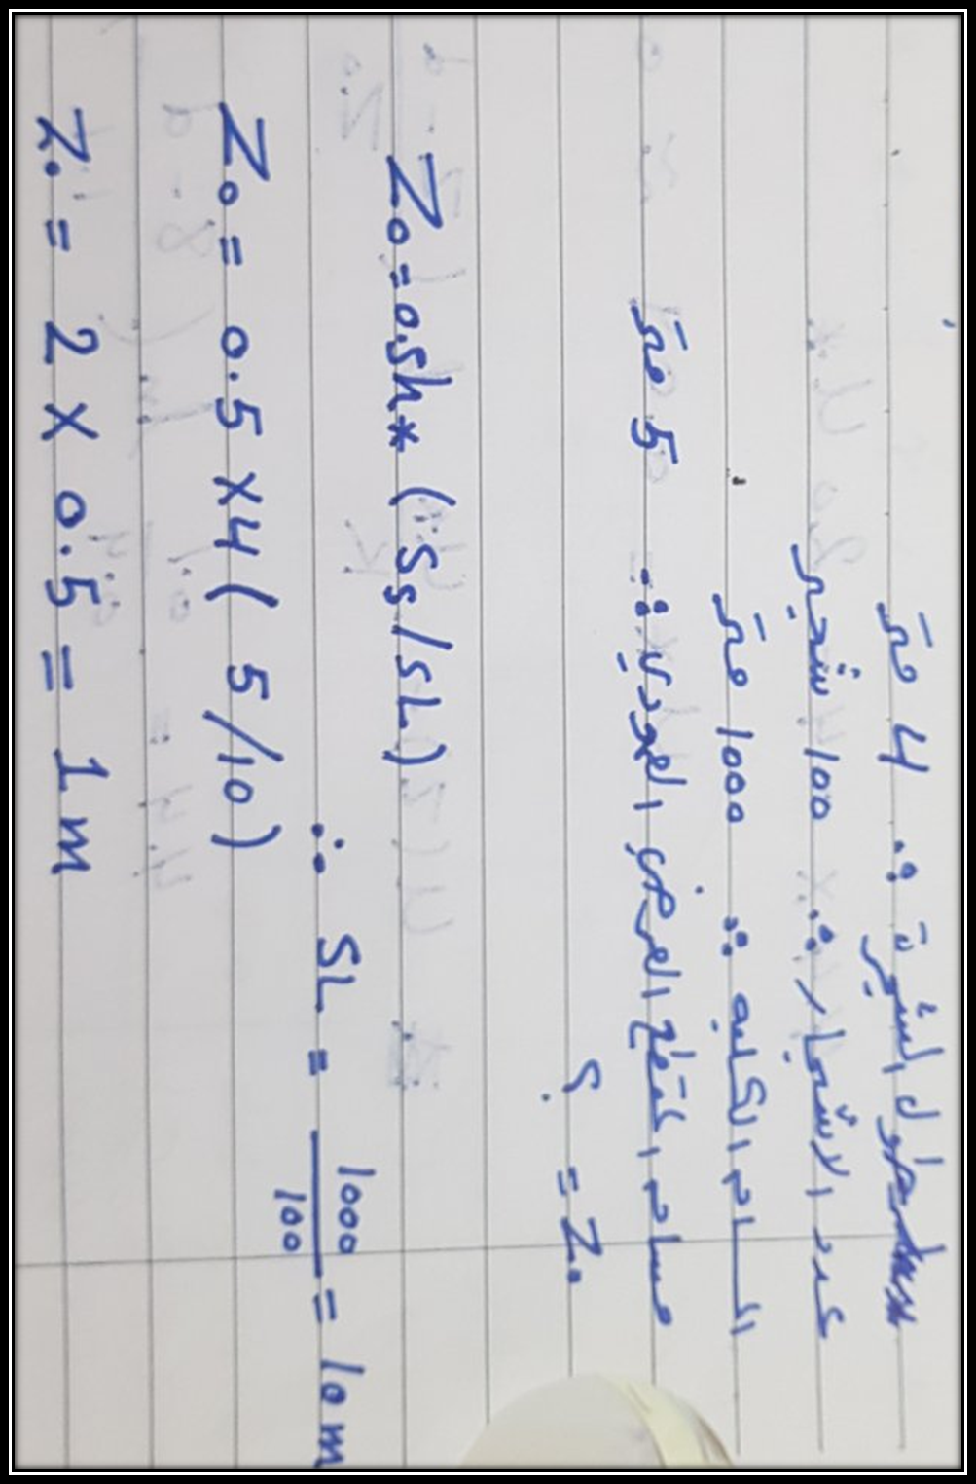

Slide 3
Q2) Given the following wind speed data for a neutral surface layer , find the roughness length ( z₀ ), displacement distance,(d) friction velocity ( u* ), and the shear stress at the ground ( 𝜏) ,air density ρ=1.2 𝑘𝑔 $m^{−3}$, k= 0.4.
$u\left(z\right)=\frac{u^{∗}}{k}ln({\frac{z−d}{z_{o}}})$ ……………………………(1.3)
𝑢∗ =$\sqrt{\frac{τ}{ρ}}$ …………………………. (1.4)

Slide 6
Q4) when we putting anemometers to measured wind speed over surface coated with grass and at two level ( 4m and 12m) , the mean record wind speed is u(4m) =5.5m/s, u(12m) =6.5m/s. Find Drag coefficient and Shear stress at the level 4m. (used k= 0.4, z₀=0.065m, 𝜌 = 1.2 𝑘𝑔 𝑚3, assumed neutral condition).
C$D=\frac{u^{∗2}}{{u(z)}^{2}}$
$u\left(z\right)=(\frac{u_{∗}}{ĸ})\ln{(\frac{z}{z_{o}}}) −−−−−−− 1.5$
𝑢∗ =$\sqrt{\frac{τ}{ρ}}$ …………………………. (1.4)

Slide 7
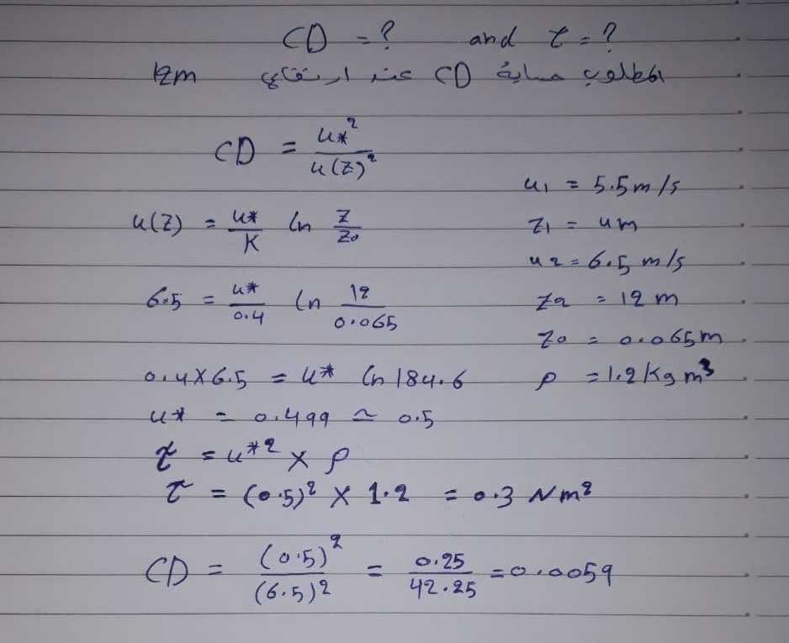

Slide 8
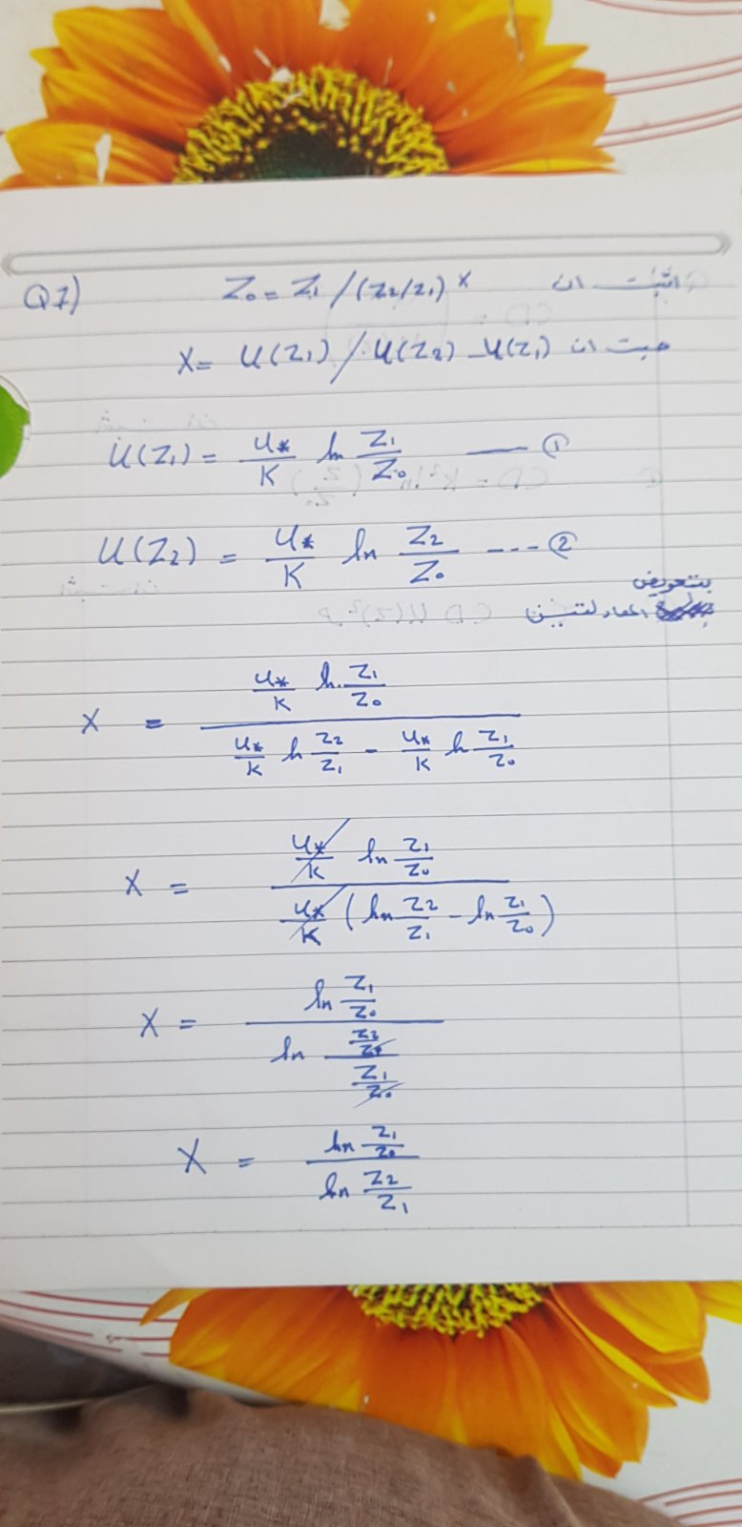
Q7)
Through the use of logarithms wind speed at two level 𝑧₁, 𝑧₂, state that roughness length is equal to:
𝑧₀ = 𝑧₁ / (𝑧₂ / 𝑧₁) 𝑥
𝑤ℎ𝑒𝑟𝑒 𝑥 = 𝑢(𝑧₁) / 𝑢(𝑧₂) − 𝑢(𝑧₁)

Slide 10
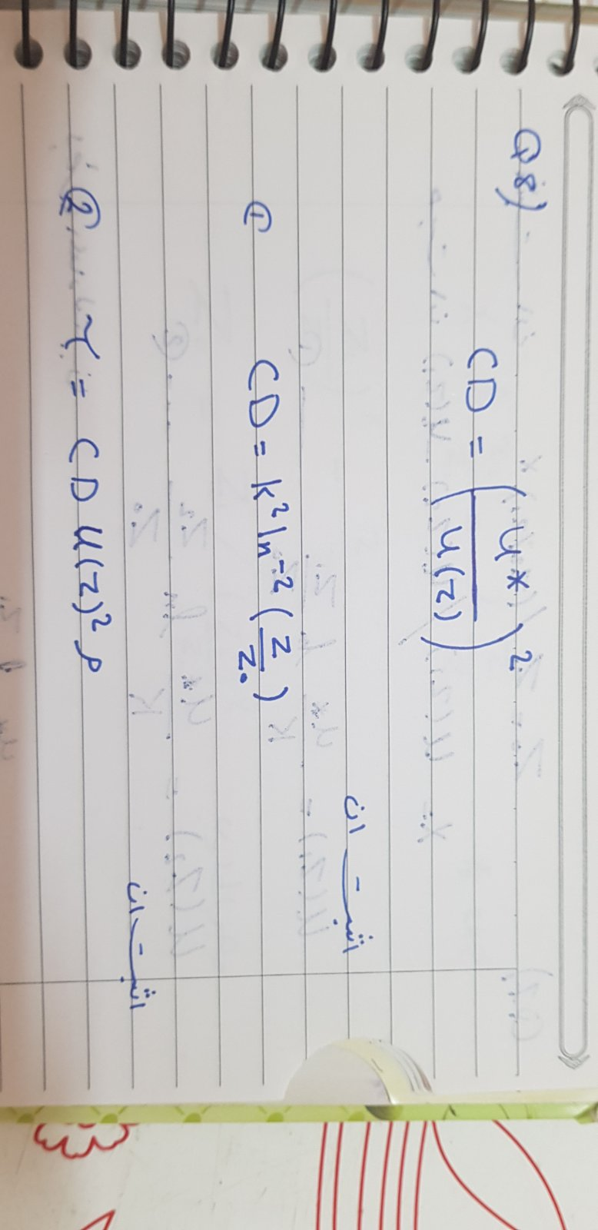

Slide 11
Q6)
State that when the friction velocity is constant at two levels, the friction velocity can be putting in:
𝑢∗ = 𝑘 (𝑢(𝑧₂) − 𝑢(𝑧₁)) / ln (𝑧₂ /𝑧₁)

