Slide 1

The Course of Atmospheric Thermodynamics
MUSTANSIRIYAH UNIVERSITY
COLLEGE OF SCIENCES
ATMOSPHERIC SCIENCES DEPARTMENT
2021-2022
Dr. Sama Khalid Mohammed
SECOND STAGE
Lecture 9

Slide 2

THIS LECTURE INCLUDING THE FOLLOWING ITEMS
The Carnot cycle
The Entropy Maximum Principle
The Energy Minimum Principle
The Enthalpy Minimum Principle
Helmholtz Free Energy Minimum Principle
Gibbs Free Energy Minimum Principle
Maxwell Relations

Slide 3
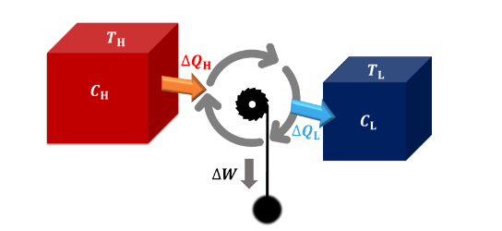
Recall from the previous lecture
The Heat Engine
A heat engine is an engine that takes heat from a hot reservoir, converts part of this heat into work, and deposits the remainder into a cold reservoir.

Slide 4
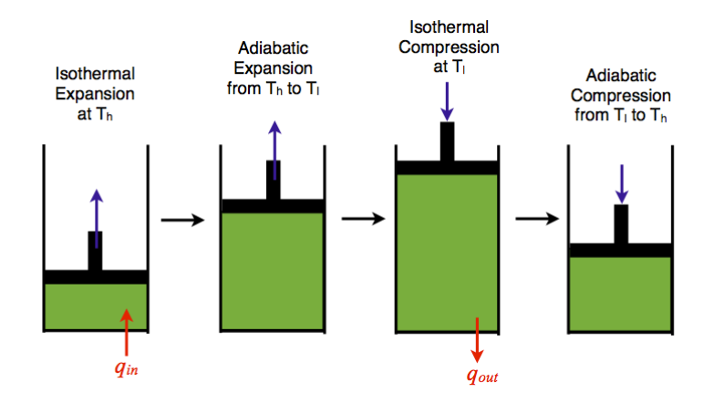
THE CARNOT CYCLE
The Carnot cycle consists of the following four processes:
A reversible isothermal gas expansion process. In this process, the ideal gas in the system absorbs q_{in} amount heat from a heat source at a high temperature T_{high}, expands and does work on surroundings.
A reversible adiabatic gas expansion process. In this process, the system is thermally insulated. The gas continues to expand and do work on surroundings, which causes the system to cool to a lower temperature, T_{low} .
A reversible isothermal gas compression process. In this process, surroundings do work to the gas at T_{low}, and causes a loss of heat, q_{out}.
A reversible adiabatic gas compression process. In this process, the system is thermally insulated. Surroundings continue to do work to the gas, which causes the temperature to rise back to T_{high}.
https://www.youtube.com/watch?v=ELR1Hx4qymo

Slide 5
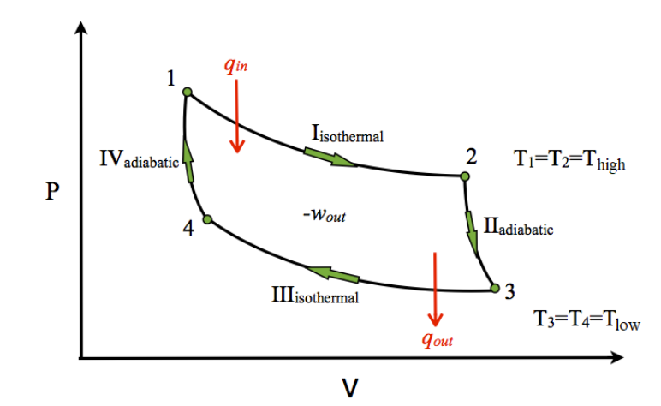
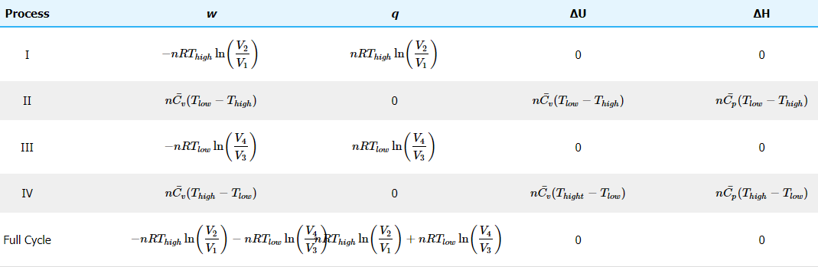
THE CARNOT CYCLE
The P-V diagram of the Carnot cycle is shown in Figure.
In isothermal processes I and III, ∆U=0 because ∆T=0.
In adiabatic processes II and IV, q=0.
Work, heat, ∆U, and ∆H of each process in the Carnot cycle are summarized in Table.

Slide 6
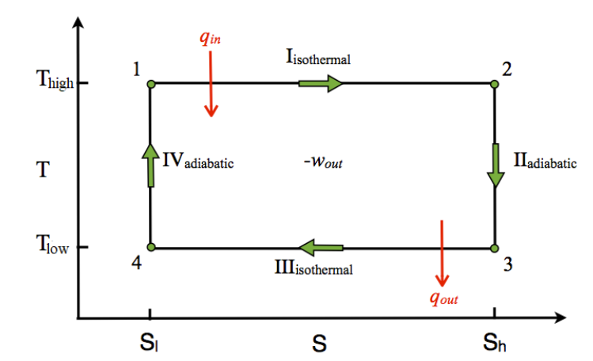
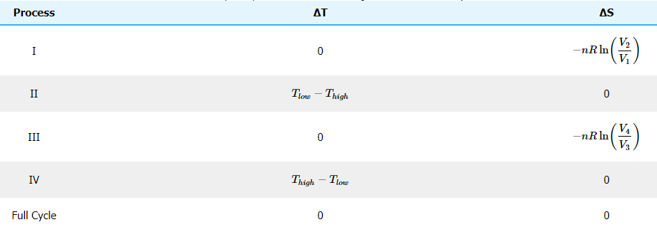
THE CARNOT CYCLE
The T-S diagram of the Carnot cycle is shown in the Figure.
  In isothermal processes I and III, ∆T=0.
  In adiabatic processes II and IV, ∆S=0 because dq=0.
∆T and ∆S of each process in the Carnot cycle are shown in the table.
The Carnot cycle has the greatest efficiency possible of an engine (although other cycles have the same efficiency) based on the assumption of the absence of incidental wasteful processes such as friction, and the assumption of no conduction of heat between different parts of the engine at different temperatures.

Slide 7
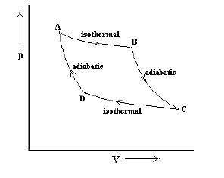
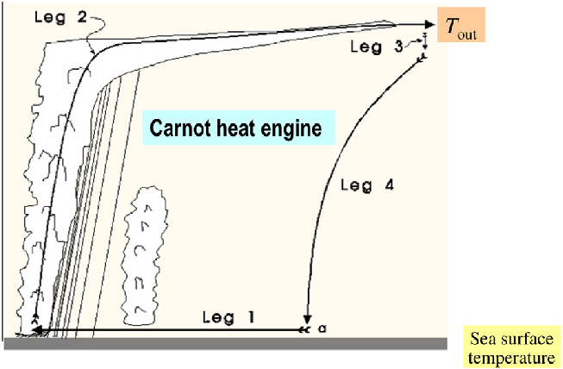
FYI: THE CARNOT HEAT ENGINE
Schematic of the hurricane viewed as a Carnot engine of the classical Carnot cycle in thermodynamics.
Leg 1 represents the isothermal expansion, namely gas is been heated and pressure is reduced, θ_{e} increases
Leg 2 represents an adiabatic expansion where there is no heat exchange and thus pressure is reduced but temperature is decreasing, keeping θ_{e} constant.
Leg 3 represents an isothermal compression where gas is cooled, with pressure increased and thus θ_{e} decreases.
Leg 4 represents an adiabatic compression where there is no heat exchange and pressure is increased while θ_{e} keeps constant.
https://www.researchgate.net/publication/308608010_Hurricane_Dynamics/figures?lo=1

Slide 8
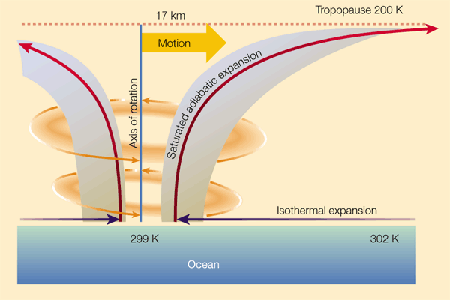
Heat-engine efficiency is very relevant to atmospheric processes
Tropical cyclones, the Hadley circulation, monsoons, etc. can all be thought of as heat engines that operate between a high temperature reservoir (the Tropical oceans) and a low temperature reservoir (the upper troposphere), and convert the heat into kinetic energy.
A knowledge of the ‘efficiency’ of these heat engines can allow us to place upper limits on the amount of kinetic energy that can be produced.
https://www.nature.com/articles/44287

Slide 9
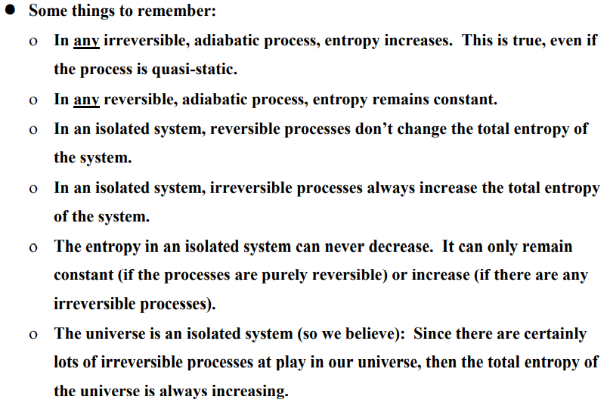
Recall from the previous lecture
FURTHER COMMENTS ON THE SECOND LAW

Slide 10
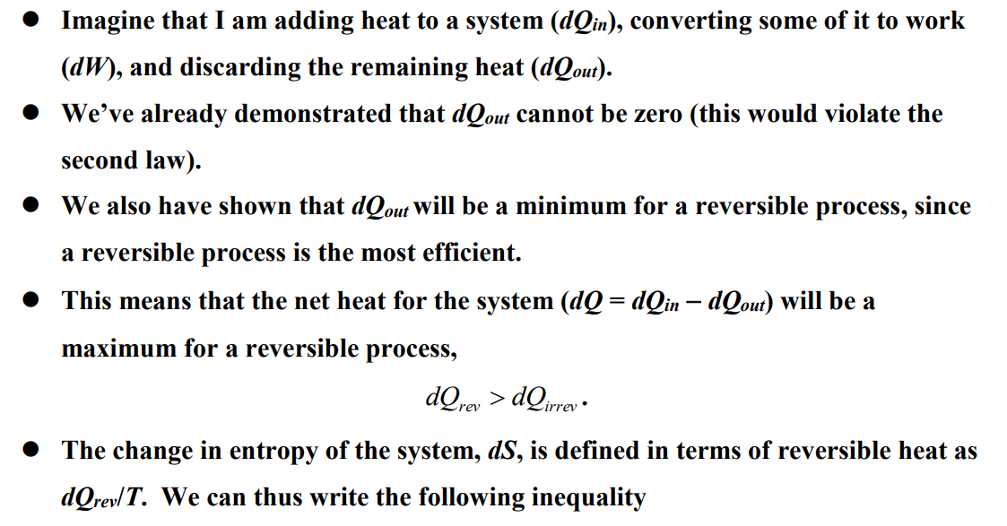
THE ENTROPY MAXIMUM PRINCIPLE
you cannot convert a given amount of heat into an equal amount of work (there is no such thing as a 100% efficient engine

Slide 11
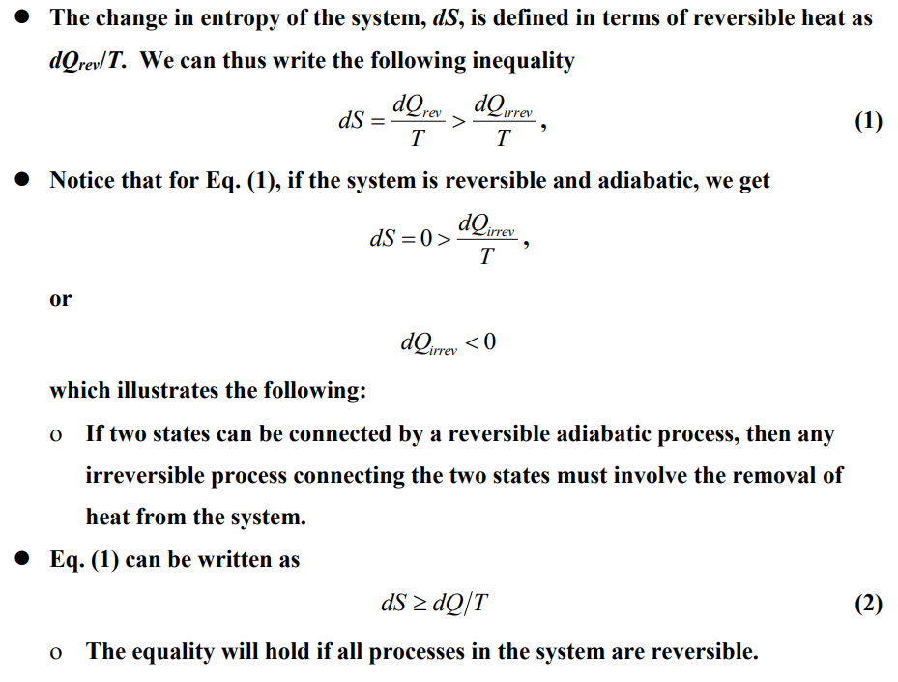
THE ENTROPY MAXIMUM PRINCIPLE
The equality sign holds only when the system is in material equilibrium. For a reversible process, dS equals dq/T. For an irreversible chemical reaction or phase change, dS is greater than dq/T because of the extra disorder created in the system by the irreversible material change

Slide 12
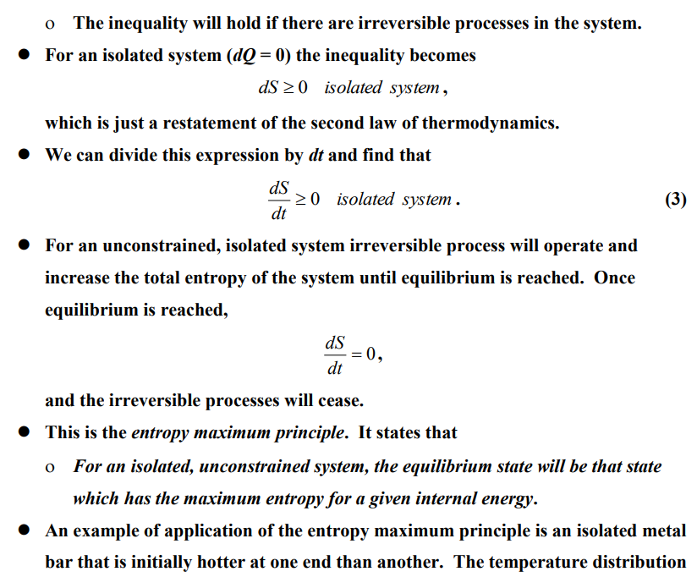
THE ENTROPY MAXIMUM PRINCIPLE

Slide 13
THE ENTROPY MAXIMUM PRINCIPLE
This is the entropy maximum principle. It states that:
For an isolated, unconstrained system, the equilibrium state will be that state which has the maximum entropy for a given internal energy.
An example of application of the entropy maximum principle is an isolated metal bar that is initially hotter at one end than another. The temperature distribution that maximizes the entropy is one that is uniform (isothermal). Therefore, if left alone, the temperature will spontaneously adjust to an isothermal distribution.

Slide 14
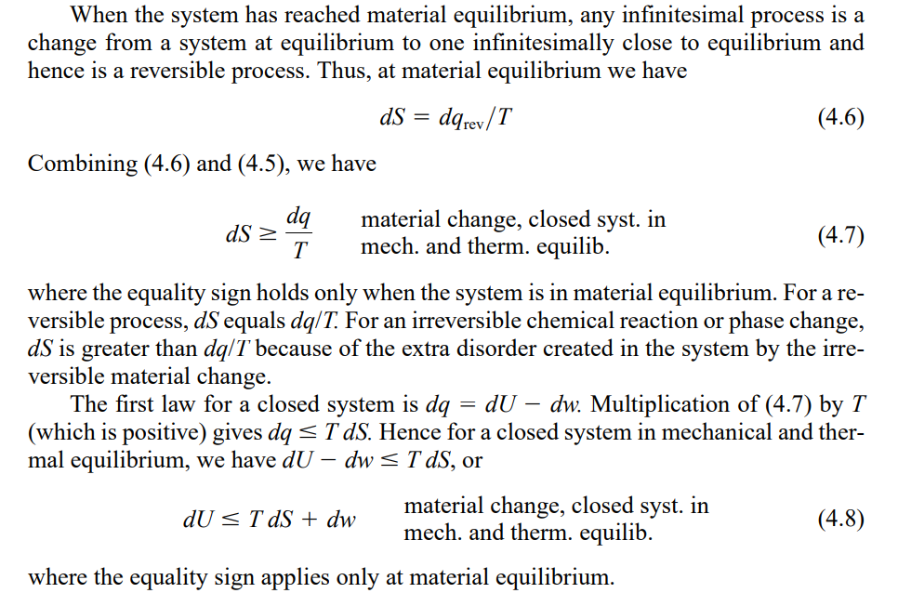
FYI: THE ENTROPY MAXIMUM PRINCIPLE

Slide 15
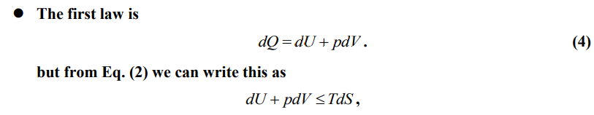

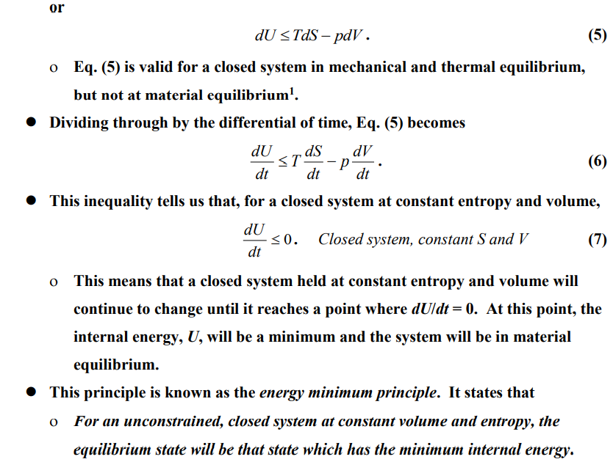
THE ENERGY MINIMUM PRINCIPLE
or

Slide 16
THE ENERGY MINIMUM PRINCIPLE
This principle is known as the energy minimum principle. It states that
For an unconstrained, closed system at constant volume and entropy, the equilibrium state will be that state which has the minimum internal energy.

Slide 17
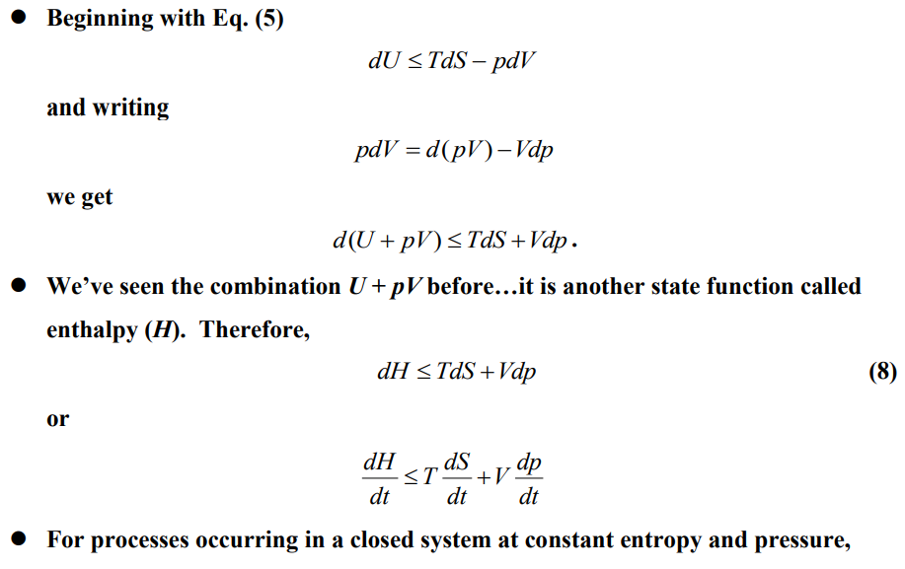

ENTHALPY MINIMUM PRINCIPLE

Slide 18
ENTHALPY MINIMUM PRINCIPLE
An unconstrained system at constant entropy and pressure will spontaneously evolve into a state that minimizes enthalpy.
This principle is known as the enthalpy minimum principle. It states that
For an unconstrained, closed system at constant pressure and entropy, the equilibrium state will be that state which has the minimum enthalpy.

Slide 19
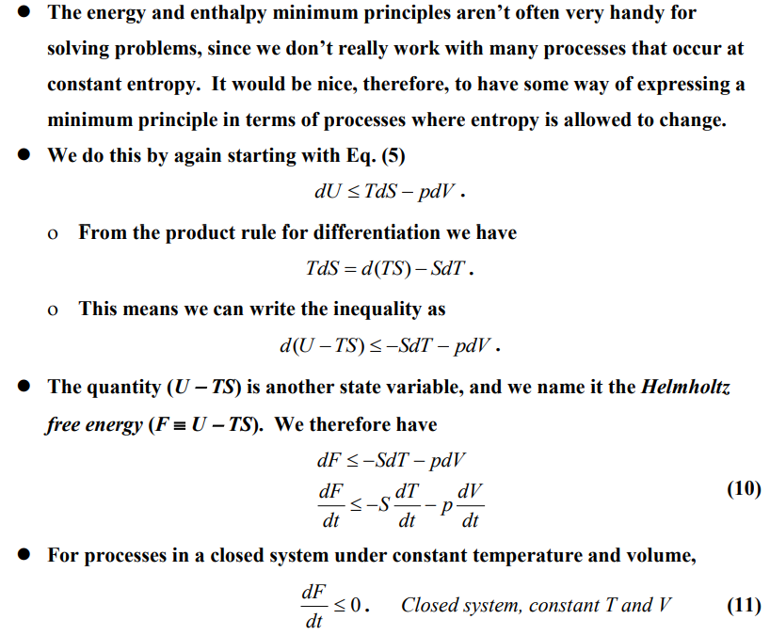
HELMHOLTZ FREE ENERGY MINIMUM PRINCIPLE

Slide 20
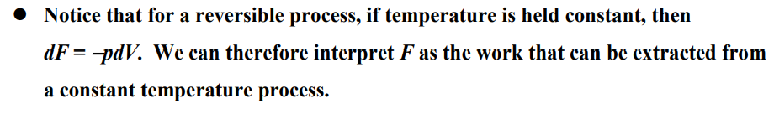
HELMHOLTZ FREE ENERGY MINIMUM PRINCIPLE
This principle is known as the Helmholtz free energy minimum principle. It states that
For an unconstrained, closed system at constant temperature and volume, the equilibrium state will be that state which has the minimum Helmholtz free energy.

Slide 21
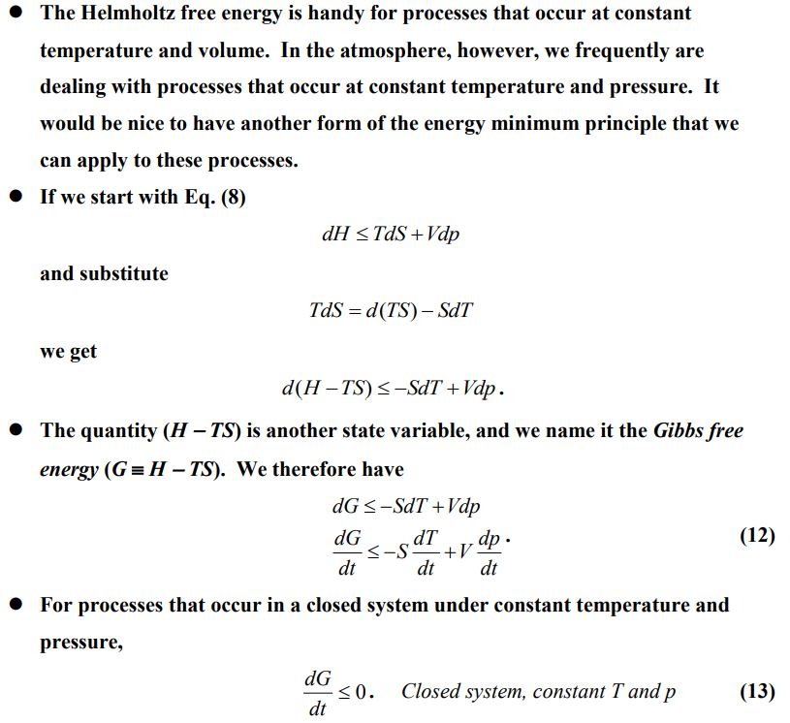
GIBBS FREE ENERGY MINIMUM PRINCIPLE

Slide 22
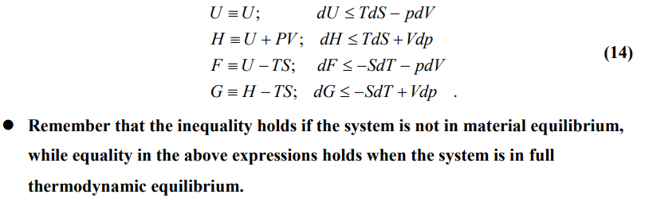
GIBBS FREE ENERGY MINIMUM PRINCIPLE
This principle is known as the Gibbs free energy minimum principle. It states that
For an unconstrained, closed system at constant temperature and pressure, the equilibrium state will be that state which has the minimum Gibbs free energy.
U, H, F, and G are referred to as thermodynamic potentials. The inequalities associate with each potential are summarized below
Remember that the inequality holds if the system is not in material equilibrium, while equality in the above expressions holds when the system is in full thermodynamic equilibrium.

Slide 23
Summery
Entropy maximum principle: For an isolated, unconstrained system, the equilibrium state will be that state which has the maximum entropy for a given internal energy.
Energy minimum principle: For an unconstrained, closed system at constant volume and entropy, the equilibrium state will be that state which has the minimum internal energy.
Enthalpy minimum principle: For an unconstrained, closed system at constant pressure and entropy, the equilibrium state will be that state which has the minimum enthalpy.
Helmholtz free energy minimum principle: For an unconstrained, closed system at constant temperature and volume, the equilibrium state will be that state which has the minimum Helmholtz free energy.
Gibbs free energy minimum principle: For an unconstrained, closed system at constant temperature and pressure, the equilibrium state will be that state which has the minimum Gibbs free energy.

Slide 24
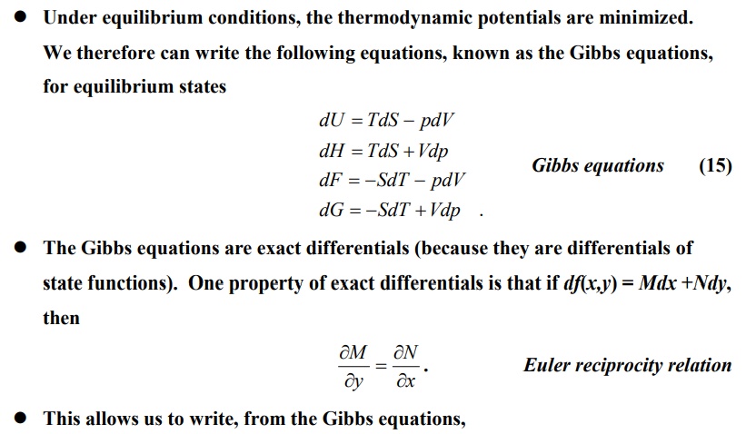
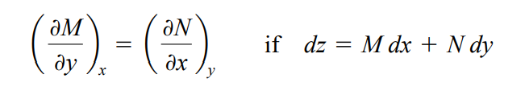
Maxwell Relations

Slide 25
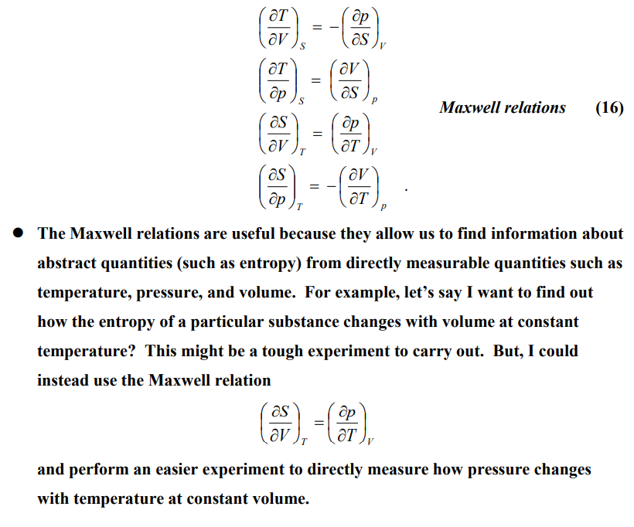
Maxwell Relations

