Slide 1
The Course of Atmospheric Thermodynamics
MUSTANSIRIYAH UNIVERSITY
COLLEGE OF SCIENCES
ATMOSPHERIC SCIENCES DEPARTMENT
2021-2022
Dr. Sama Khalid Mohammed
SECOND STAGE
Lecture 8

Slide 2
THIS LECTURE INCLUDING THE FOLLOWING ITEMS
The potential temperature
The second law of thermodynamics
The maximum work theorem
The maximum efficiency of a heat engine
The Carnot cycle

Slide 3
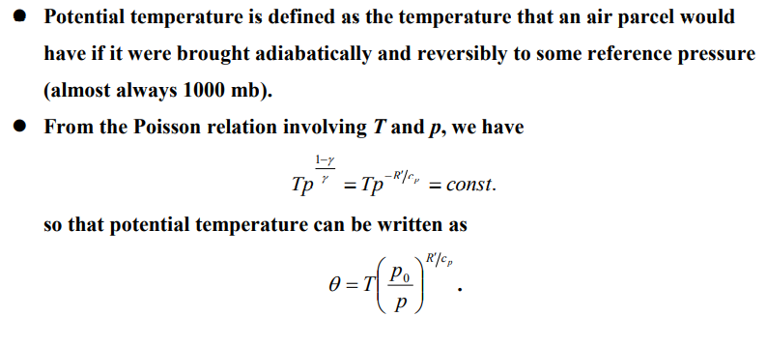
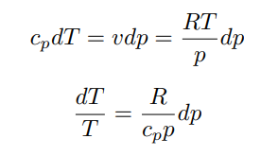
POTENTIAL TEMPERATURE
And for adiabatic process

Slide 4
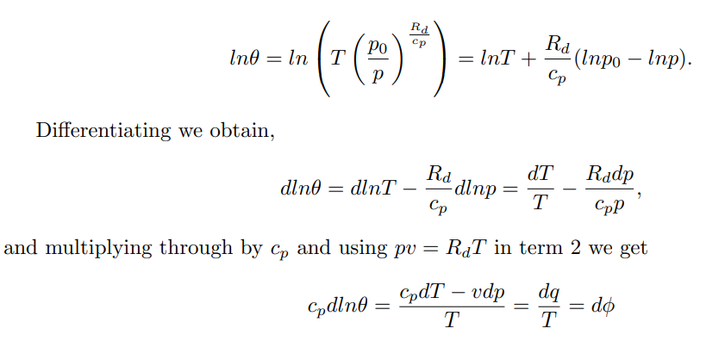
POTENTIAL TEMPERATURE
ds

Slide 5
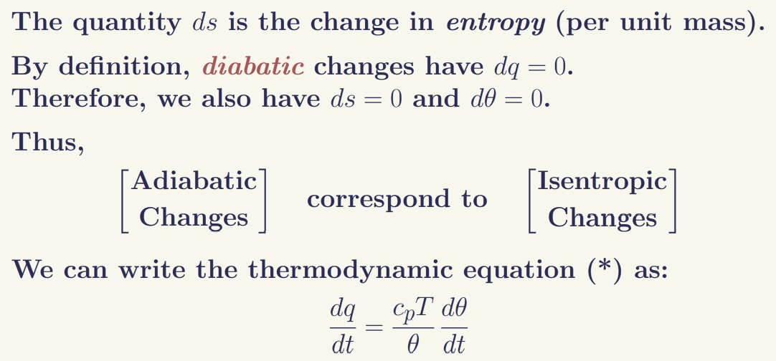
POTENTIAL TEMPERATURE
The potential temperature is constant for adiabatic flow. The entropy is constant for adiabatic flow.
Parameters that remain constant during certain transformations are said to be conserved. Potential temperature is a conserved quantity for an air parcel that moves around in the atmosphere under adiabatic conditions. Potential temperature is an extremely useful parameter in atmospheric thermodynamics, since atmospheric processes are often close to adiabatic, in which case θ remains essentially constant.

Slide 6
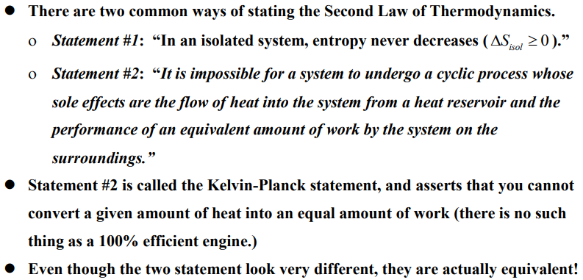
THE SECOND LAW OF THERMODYNAMICS

Slide 7
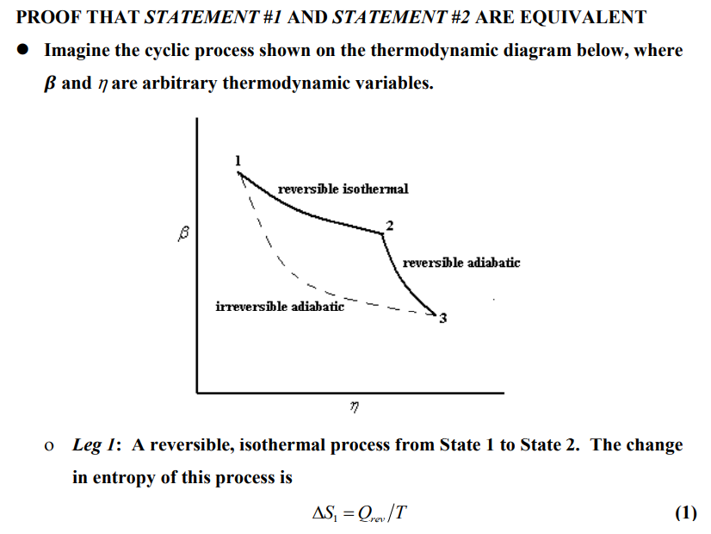
PROOF THAT STATEMENT #1 AND STATEMENT #2 ARE EQUIVALENT

Slide 8
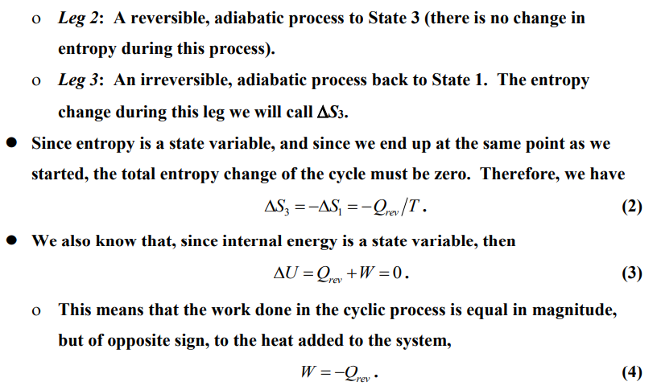
PROOF THAT STATEMENT #1 AND STATEMENT #2 ARE EQUIVALENT

Slide 9
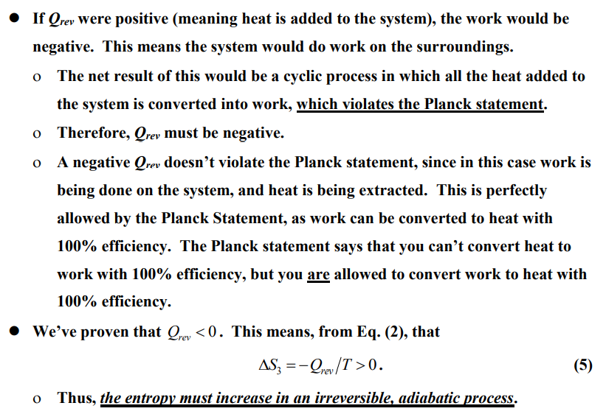
PROOF THAT STATEMENT #1 AND STATEMENT #2 ARE EQUIVALENT

Slide 10
PROOF THAT STATEMENT #1 AND STATEMENT #2 ARE EQUIVALENT

Slide 11
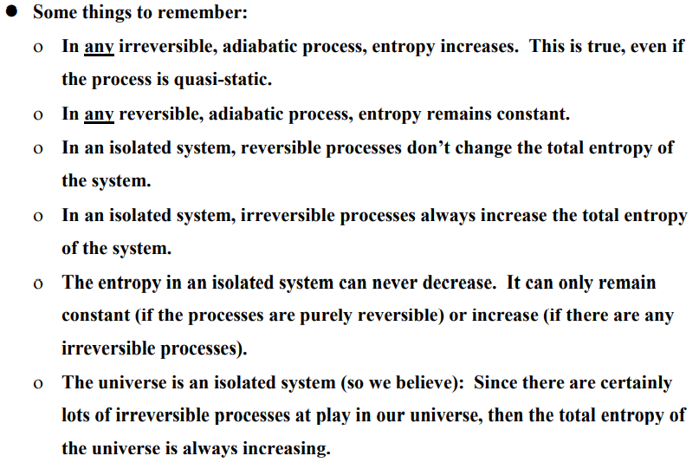
FURTHER COMMENTS ON THE SECOND LAW

Slide 12
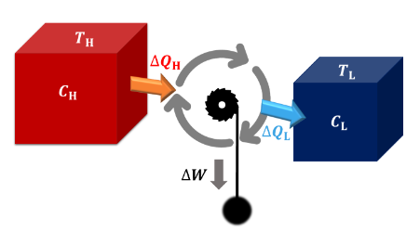
THE MAXIMUM WORK THEOREM
The second law of thermodynamics tells us that “there is no such thing as a 100% efficient heat engine” (one that can consume a given amount of thermal energy and convert it completely into work).
We can use the second law of thermodynamics to investigate the maximum theoretical efficiency of a heat engine " Many meteorological phenomenon, such as tropical cyclones, behave like heat engines, converting thermal energy into work (kinetic energy)".
We can therefore speak of the maximum theoretical efficiencies of tropical cyclones, the Hadley circulation, etc.
A heat engine is an engine that takes heat from a hot reservoir, converts part of this heat into work, and deposits the remainder into a cold reservoir.

Slide 13
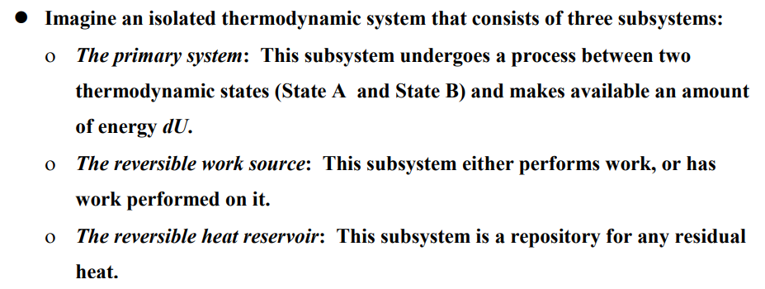
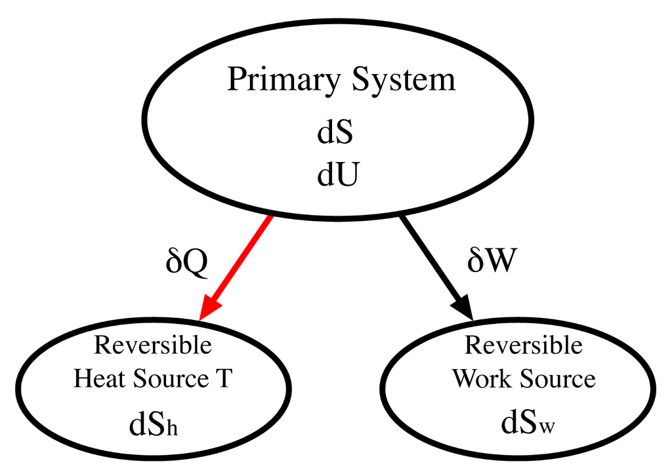
THE MAXIMUM WORK THEOREM
Equal to dq/T_{r}
Equal to zero because the entropy does not change
Notes:
A reversible work source is a system which, when it does work, or has work done to it, does not change its entropy. It is therefore not a heat engine and does not suffer dissipation due to friction or heat exchanges. A simple example would be a frictionless spring, or a weight on a pulley in a gravitational field.
A cyclic process is a series of operations by which the state of a substance (called the working substance) changes but the substance is finally returned to its original state in all respects. If the volume of the working substance changes, the working substance may do external work, or work may be done on the working substance, during a cyclic process. Since the initial and final states of the working substance are the same in a cyclic process, and internal energy is a function of state, the internal energy of the working substance is unchanged in a cyclic process. Therefore, the net heat absorbed by the working substance is equal to the external work that it does in the cycle. A working substance is said to undergo a reversible transformation if each state of the system is in equilibrium so that a reversal in the direction of an infinitesimal change returns the working substance and the environment to their original states. A heat engine (or engine for short) is a device that does work through the agency of heat

Slide 14
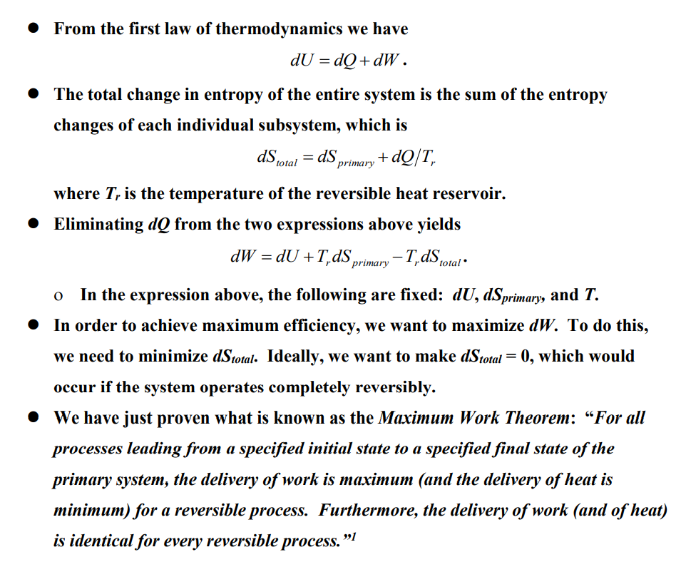
THE MAXIMUM WORK THEOREM
We have just proven what is known as the Maximum Work Theorem:
“For all processes leading from a specified initial state to a specified final state of the primary system, the delivery of work is maximum (and the delivery of heat is minimum) for a reversible process. Furthermore, the delivery of work (and of heat) is identical for every reversible process.

Slide 15
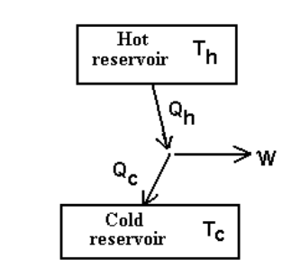
MAXIMUM EFFICIENCY OF A HEAT ENGINE
We can use the maximum work theorem to determine the maximum theoretical efficiency of a heat engine.
We will use a heat engine and imagine that the hot and cold reservoirs are so large that their temperatures remain practically constant.

Slide 16
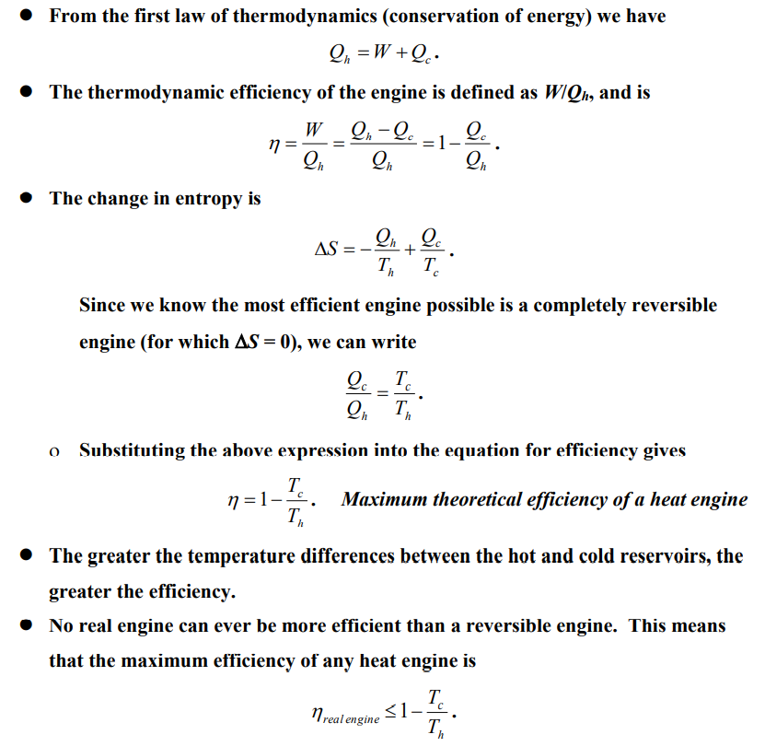
MAXIMUM EFFICIENCY OF A HEAT ENGINE

