Slide 1

Stability Concepts
Basim ALknani

Slide 2
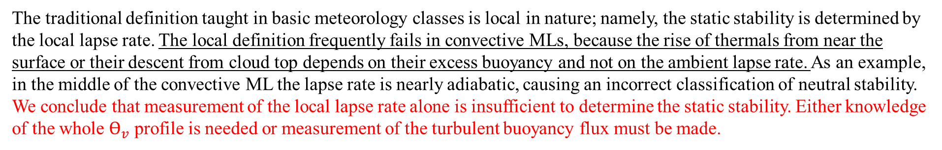
Stability Concepts
Unstable flows become or remain turbulent. Stable flows become or remain laminar.
There are many factors that can cause laminar flow to become turbulent, and other factors that tend to stabilize flows.
If the net effect of all the destabilizing factors exceeds the net effect of the stabilizing factors, then turbulence will occur.
one destabilizing factor with one stabilizing factor, and expressed these factors as a dimensionless ratio. Examples of these ratios are the Reynolds number, Richardson number, Rossby number, Froude number, and Rayleigh number.
Static Stability and Convection
Static stability is a measure of the capability for buoyant convection. The word "static" means "having no motion"; hence this type of stability does not depend on wind. Air is statically unstable when less-dense air (warmer ) underlies more dense air.
The flow responds to this instability by supporting convective circulations such as thermals that allow buoyant air to rise to the top of the unstable layer. Thermals also need some trigger mechanism to get them started. In the real boundary layer, there are so many triggers (hills, buildings, trees, dark fields, or other perturbations to the mean flow) that convection is usually insured, given the static instability.
The traditional definition taught in basic meteorology classes is local in nature; namely, the static stability is determined by the local lapse rate. The local definition frequently fails in convective MLs, because the rise of thermals from near the surface or their descent from cloud top depends on their excess buoyancy and not on the ambient lapse rate. As an example, in the middle of the convective ML the lapse rate is nearly adiabatic, causing an incorrect classification of neutral stability. We conclude that measurement of the local lapse rate alone is insufficient to determine the static stability. Either knowledge of the whole $ϴ_{v}$ profile is needed or measurement of the turbulent buoyancy flux must be made.

Slide 3

It is better to examine the stability of the whole layer, and make a layer determination of stability ,For example,
If at the earth's surface is positive, or if displaced air parcels will rise from the ground or sink from cloud top as thermals traveling across a BL, then the whole BL is said to be unStable or Convective.
If is negative at the surface, or if displaced air parcels return to their starting point, then the BL is said to be Stable if the buoyancy term is near zero, then the boundary layer is said to be Neutral.
Neutral conditions are frequently found in the RL aloft. In overcast conditions with strong winds but little temperature difference between the air and the surface, the BL is often close to neutral stability.
dynamic Stability The word "dynamic" refers to motion; hence, dynamic stability depends in part on the winds. Even if the air is statically stable, Wind shears may be able to generate turbulence dynamically.

Slide 4
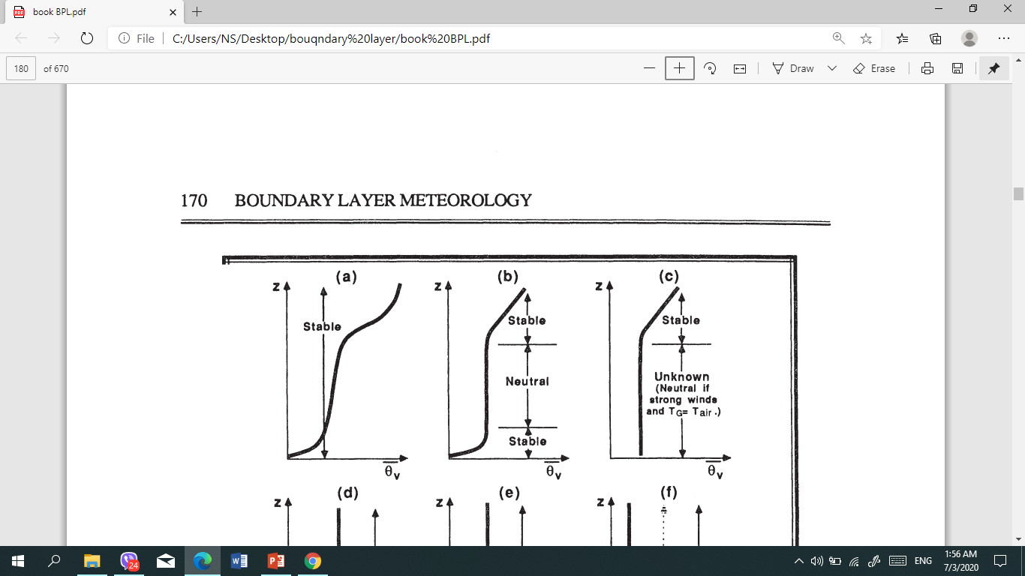
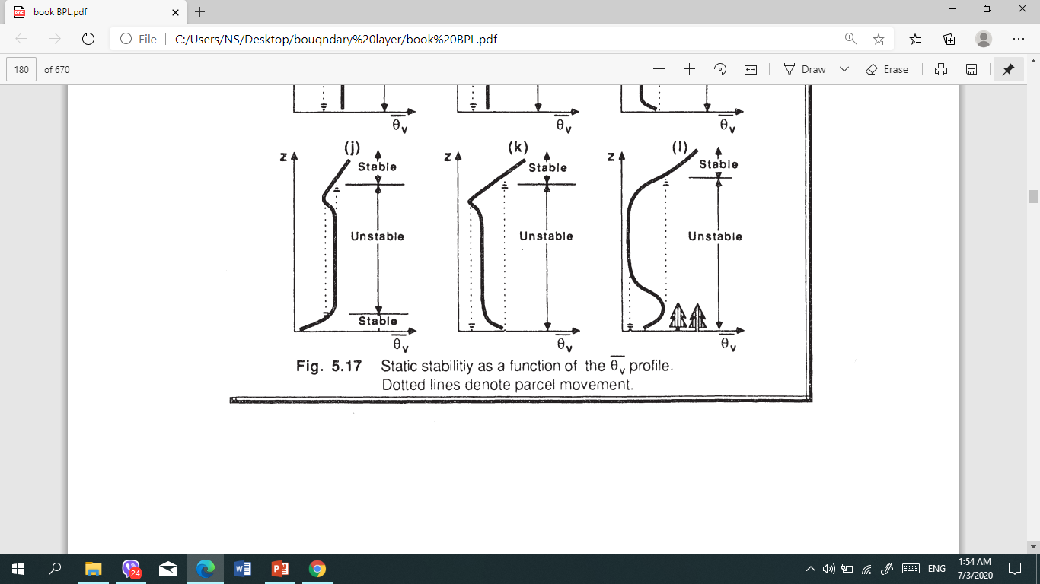
As an example, in the middle 50% of the convective ML the lapse rate is nearly adiabatic, causing an incorrect classification of neutral stability

Slide 5
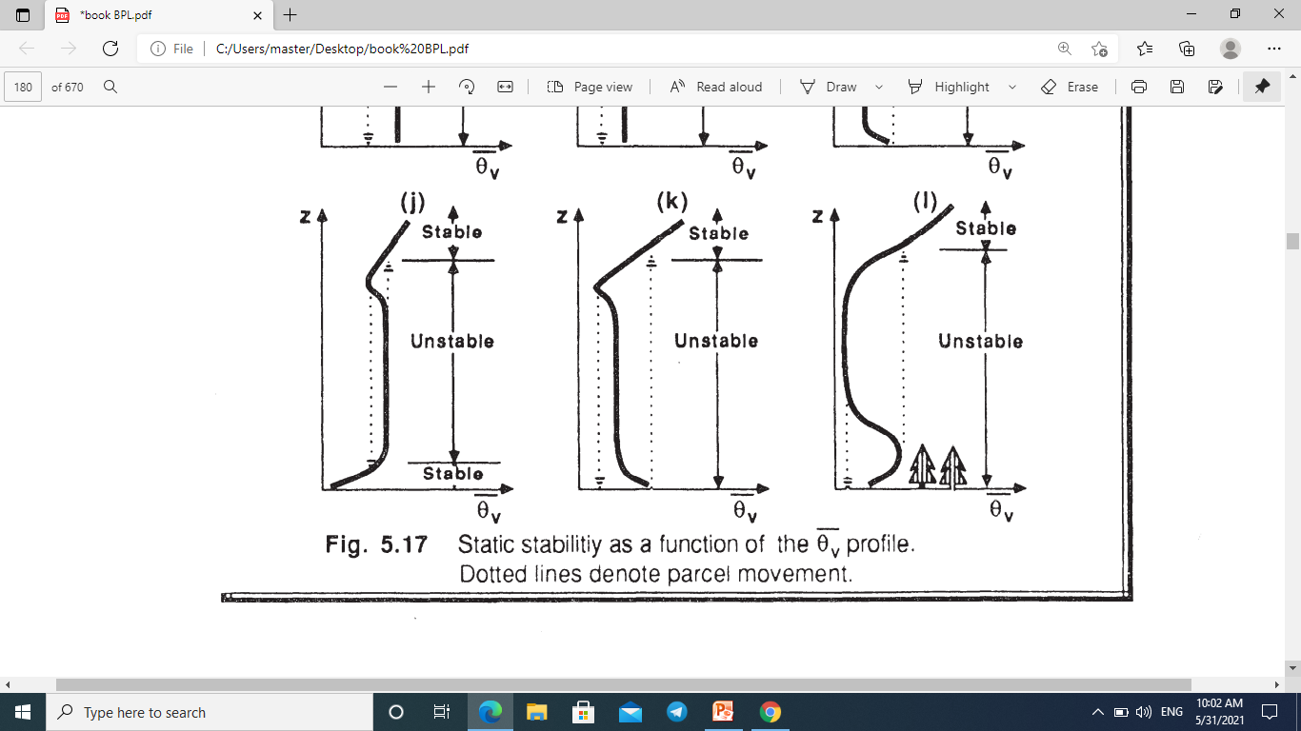
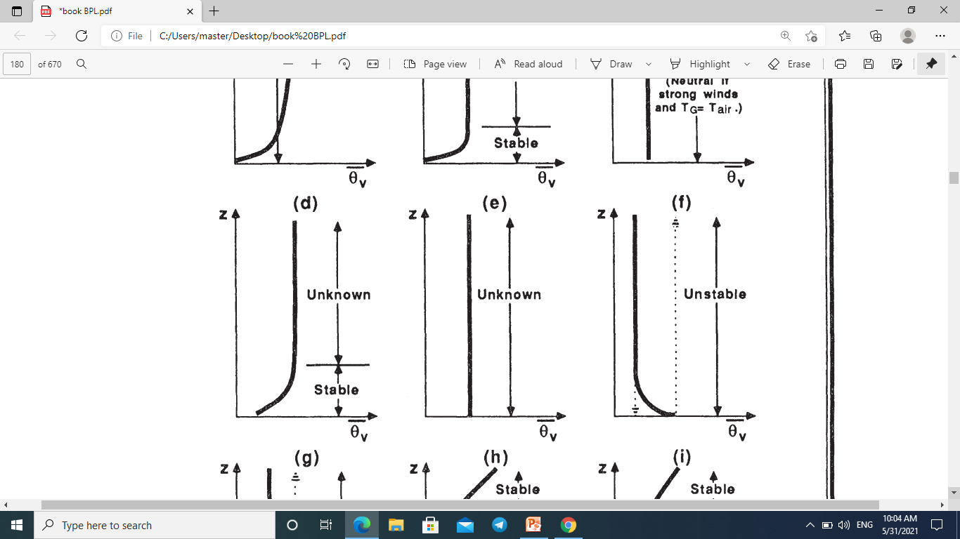

Slide 6
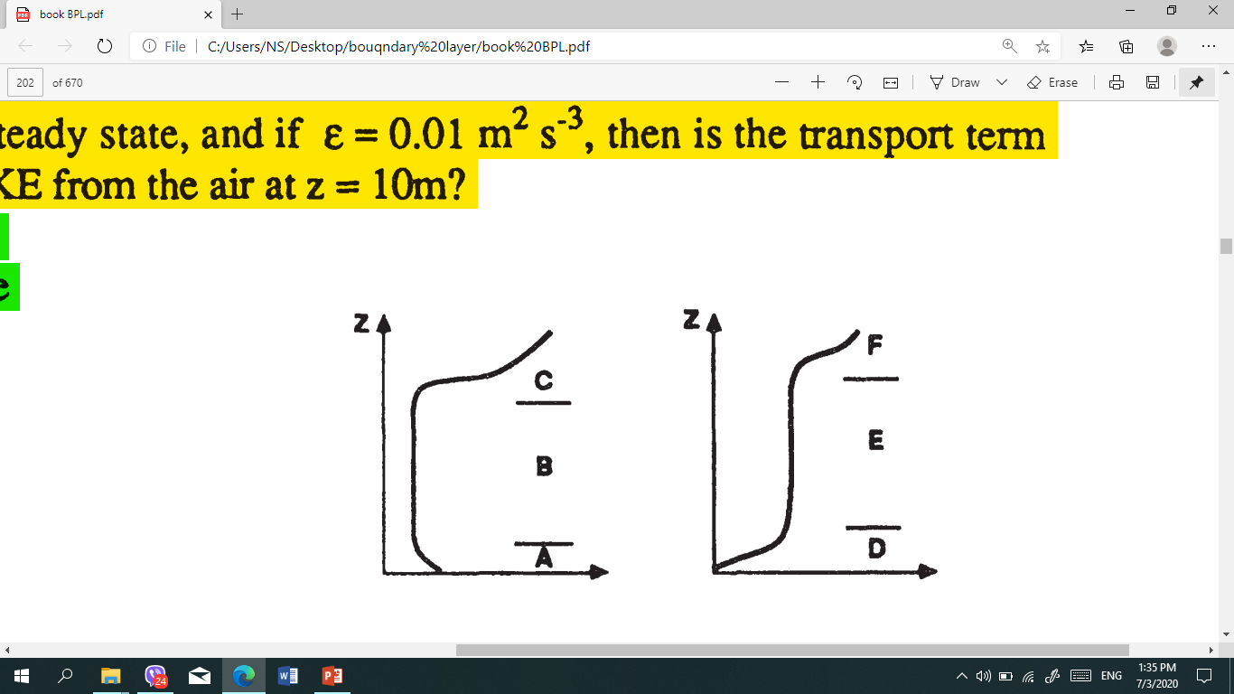
Q2) What is the static stability of each of the layers in the diagram at right?

Slide 7
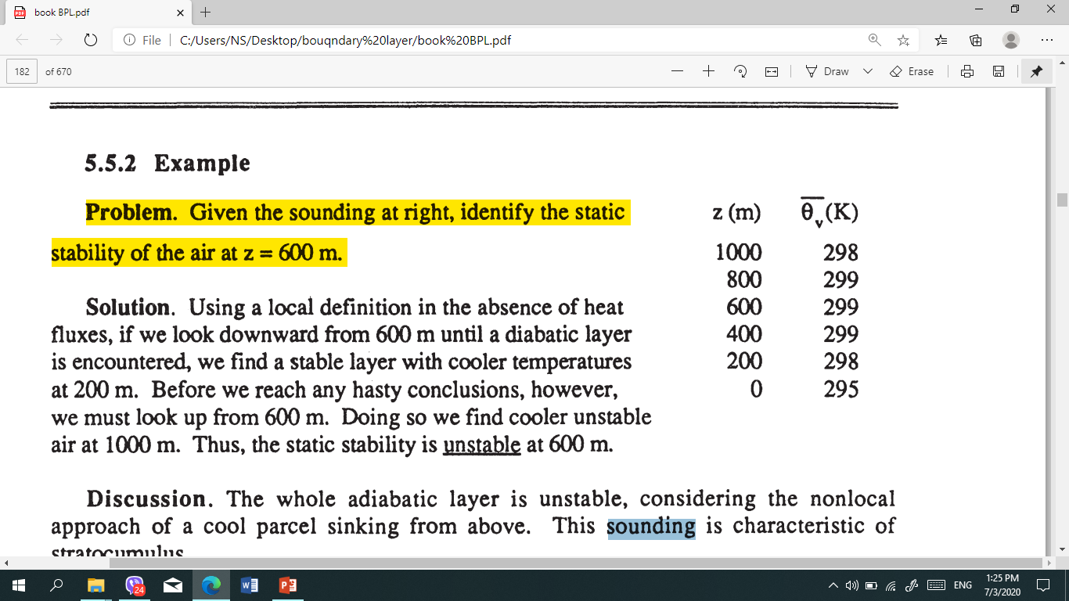
Kelvin-Helmholtz (KH) wave is wave begins to "roll up" or "break". This "breaking" wave is called a Kelvin- Helmholtz (KH) wave , These waves are frequent occurrence within statically stable shear layers
Clear - Air Turbulence (CAT) These often occur above and below strong wind jets, such as the nocturnal jet and the planetary-scale jet stream. In these situations, continued dynamic forcing's can allow turbulence to continue for hours to days. These regions of CAT have large horizontal extent (hundreds of kilometers in some cases), but usually limited vertical extent (tens to hundred of meters).
Home work
Q1) From data radio sound, identify the static stability of the air at z = 200 m ,
400 m and 1000 m ?

