Slide 1
The Course of Atmospheric Thermodynamics
MUSTANSIRIYAH UNIVERSITY
COLLEGE OF SCIENCES
ATMOSPHERIC SCIENCES DEPARTMENT
2021-2022
Dr. Sama Khalid Mohammed
SECOND STAGE
Lecture 7

Slide 2
THIS LECTURE INCLUDING THE FOLLOWING ITEMS
Entropy of an Ideal Gas
Entropy Change in an Adiabatically Expanding Ideal Gas
Gibbs’ theorem
Entropy of mixing

Slide 3
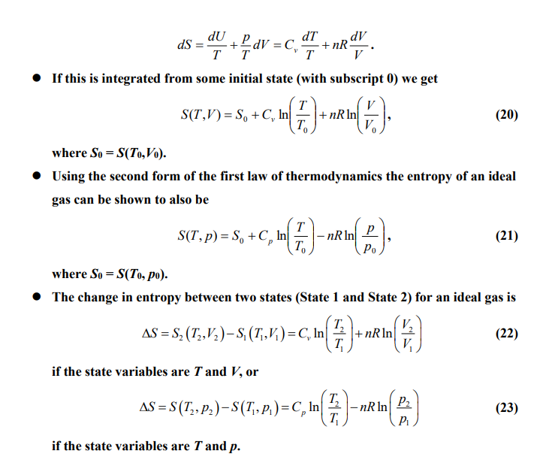
Entropy of an Ideal Gas
The Eqn. set can be rewritten (for an ideal gas) as:

Slide 4
Entropy of an Ideal Gas
For one mole of ideal gas, there is a special cases:
For isothermal transformation( at constant temperature (T₂=T₁))
$∆S_{T}\text{= }\text{−}\text{R} \text{ln}\frac{P_{2}}{P_{1}}$ , $∆S_{T}\text{= }\text{R} \text{ln}\frac{V_{2}}{V_{1}}$
In which T denotes to the change of Entropy is done for constant temperature.
From the equations above, we can conclude that:
If V₂>V₁ ( which is the case of expansion), $∆S_{T}$ will be positive, therefore the expansion of the ideal gas at constant temperature will corresponds with increasing Entropy; and similarly, the ideal gas compression will corresponds with decreasing Entropy).

Slide 5
Entropy of an Ideal Gas
For one mole of ideal gas, there is a special cases:
2. For isobaric transformation (at constant pressure (P₂=P₁))
$∆S_{P}\text{= }C_{p} \text{ln}\frac{T_{2}}{T_{1}}$
In which P denotes to the change of Entropy is done for constant pressure.
From the equations above, we can conclude that:
If T₂>T₁ ( which is the case of increasing temperature at constant pressure), $∆S_{P}$ will be positive, therefore the increasing of the temperature of the ideal gas at constant Pressure will corresponds with increasing Entropy and vice versa(i.e. the case of the decreasing of the temperature ideal gas at constant pressure).

Slide 6
Entropy of an Ideal Gas
For one mole of ideal gas, there is a special cases:
3. For isochoric transformation (at constant volume (V₂=V₁))
$∆S_{V}\text{= }C_{V} \text{ln}\frac{T_{2}}{T_{1}}$
In which V denotes to the change of Entropy is done for constant volume.
From the equations above, we can conclude that:
If T₂>T₁ ( which is the case of increasing temperature at constant volume), $∆S_{V}$ will be positive, therefore the increasing of the temperature of the ideal gas at constant volume will corresponds with increasing Entropy and vice versa(i.e. the case of the decreasing of the temperature ideal gas at constant volume ).

Slide 7
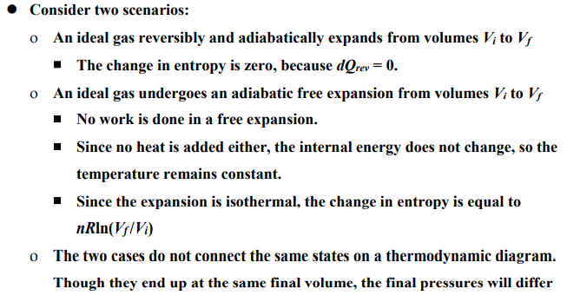
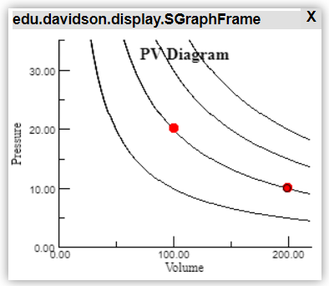
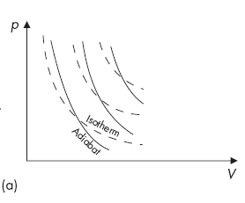
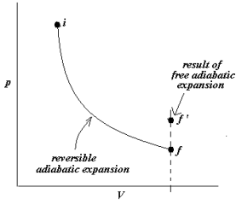
Entropy Change in an Adiabatically Expanding Ideal Gas
Free Expansion
P $V$= const.
P ${\text{α} }^{\text{γ}}$ = const.
Notes:
http://physics.bu.edu/~duffy/semester1/c27_process_expansion_sim.html

Slide 8
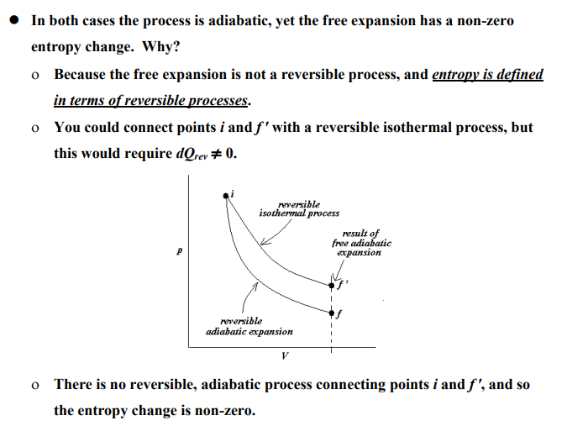
Entropy Change in an Adiabatically Expanding Ideal Gas

Slide 9
GIBBS’ THEOREM

Slide 10
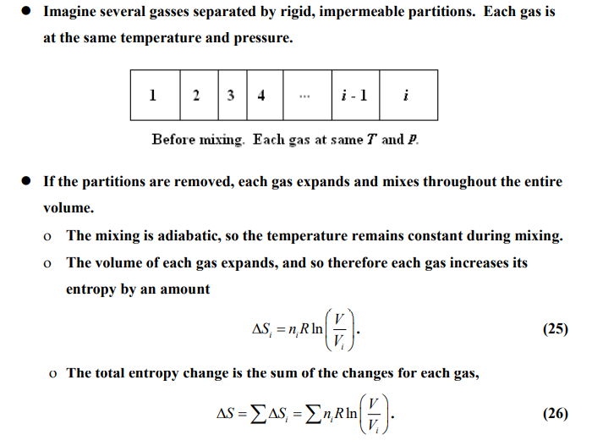
ENTROPY OF MIXING

Slide 11
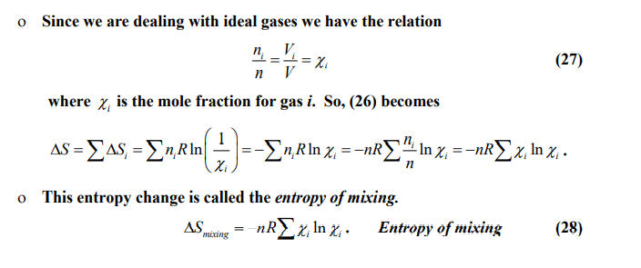
ENTROPY OF MIXING
Remember: Avogadro's Law: It gives the relationship between volume and amount (moles) when pressure and temperature are held constant
Equation (28) implies that the entropy of mixing is always a positive value, so mixing of gasses always increased the entropy!!! Why???
Notes:
Notice that when the two gases will be mixed, their mole fraction will be less than one, making the term inside the parentheses negative, and thus the entropy of mixing will always be positive. This observation makes sense, because as you add a component to another for a two-component solution, the mole fraction of the other component will decrease, and the log of a number less than 1 is negative. Multiplied by the negative in the front of the equation gives a positive quantity. Equation 88 applies to both ideal solutions and ideal gases.

