Slide 1
8- Icon Operations
To change the arrangement of icons on the desktop do the following:
1 - Right Click the desktop
2- Click Sort by
3- Select one of the 4 options to arrange
icons from sub-menu

Slide 2
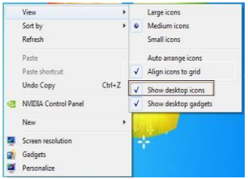
View/Hide Icons
Right Click the desktop
Click View
Check to see if Auto Arrange
has a check mark
If it does uncheck it.

Slide 3
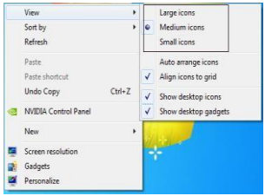
Change Icon size
Right Click the desktop
Click View
Show the required size

Slide 4
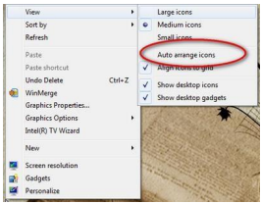
Auto Arrange Icon
Right Click the desktop
Click View
Check to see if Auto Arrange
has a check mark
If it does uncheck it

Slide 5
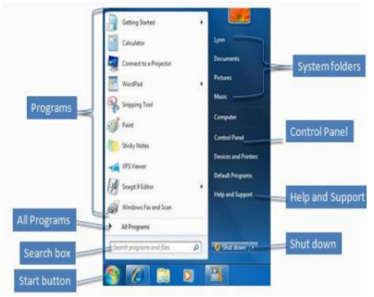
Start Menu Parts
The Start menu for Windows 7 consists of many Parts,
to show Use the Start menu to do these common activities
Start programs
Open commonly used folders
Search for files, folders, and programs
Adjust computer settings
Get help with the Windows operating system
Turn off the computer
Log off from Windows or switch to a different user account

Slide 6
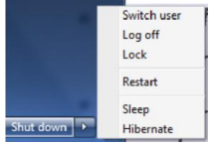
At the bottom of the right pane is the Shutdown button.
Click the Shutdown button to turn off your computer.
Clicking the arrow next to the Shutdown button displays a menu with additional options for switching users, logging off, restarting,
or shutting down.

Slide 7
Switch user: If you have more than one user account on your computer, Fast User Switching is an easy way for another person to log on to the computer without logging you off or closing your programs and files.
Log off: When you log off from Windows, all of the programs you were using are closed, but the computer is not turned off.
Lock: Locking your PC is a good option if you’ll be back soon. You'll have to enter your password when you come back, which helps keep your work more secure.

Slide 8
Restart: The Restart button "reboots" your computer (it is sometimes called a "warm boot" or "soft boot.") That means it saves your information to the hard drive, turns off the computer for a moment, and then turns it back on again.
Sleep: Clicking on Sleep puts your computer in a low-power state, but doesn't turn it off. The main advantage is that it allows you to get back to work quickly, without having to wait for the computer to do a full reboot.

Slide 9
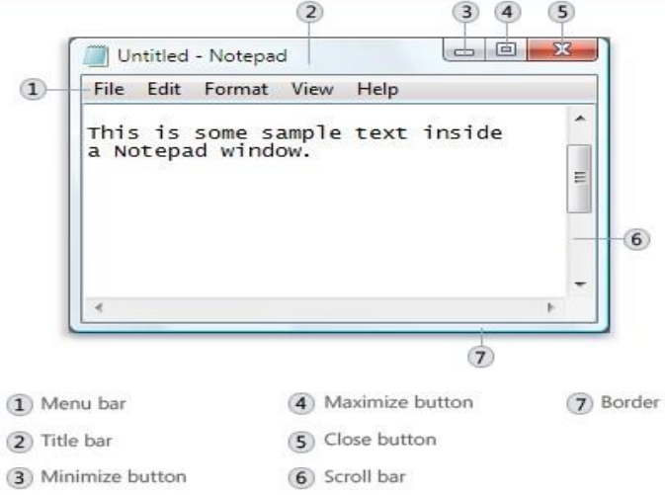
Parts of a window
1- Title bar.
Displays the name of the document and program (or the folder name if you're working in a folder).
2- Minimize, Maximize, and Close buttons.
These buttons hide the window, enlarge
it to fill the whole screen, and close it,
respectively

Slide 10
3- Menu bar.
Contains items that you can click to make choices in a program.
4- Scroll bar.
Let’s you scroll the contents of the window
to see information that is currently out of view.
5- Borders and corners.
You can drag these with your mouse pointer
to change the size of the window.

