Slide 1
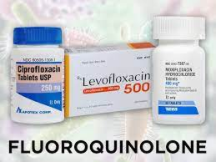
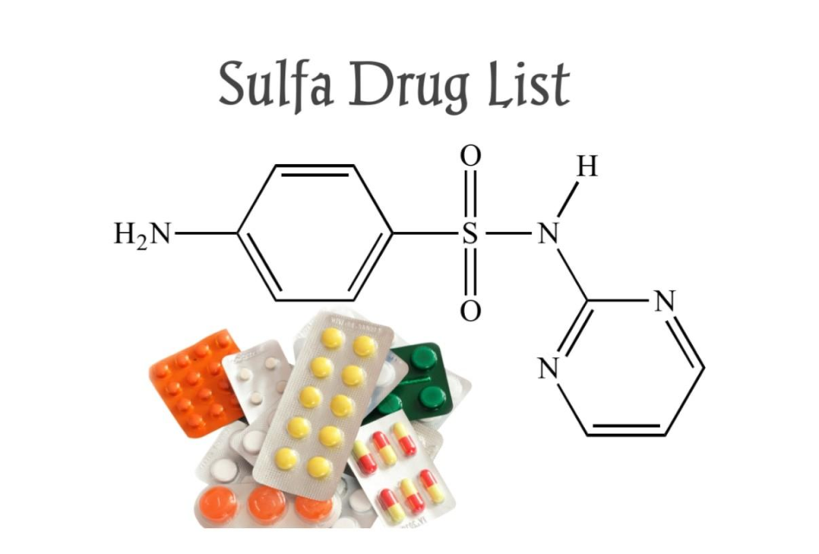
Sulpha drug & Quinolones …the Antimicrobial agents
Fourth Lecture
2022
Assist. Prof. Mohammed AboKsour

Slide 2
Sulfonamide, Sulphanoamide, Sulfa or Sulpha drugs
Sulfonamides are synthetic antimicrobial agents that contain the active antibacterial sulfonamide group which is the first synthetic antibacterial agent against awide range of infections.
The early used drug related to this group was Prontosil, red dye in 1933 was used against staphylococcal septicemia and in 1935 Gerhard Domagk used it to cure streptococcal infections in mice and rabbits
By the discovery of Penicillin G in 1929 by Alexander Fleming
and shown to be successful as antibacterial agent in humans in 1941 which lead to a decline in use of sulfa drug
However, sulfa drugs are still used for malaria, tuberculosis, leprosy, meningitis, pneumonia, scarlet fever, plague, respiratory infections, and intestinal/urinary tract infections

Slide 3
Sulfa mode of action
Antibacterial sulfonamides affect bacteria by interfering with their metabolism targeting their metabolic pathway as competitive inhibitors of dihydropteroate synthetase (DHPS). Dihydropteroate synthetase is essential in the synthesis of folate, and folate is required for cells to make nucleic acids, such as DNA or RNA.
The effect is bacteriostatic unless one of sulfa derivatives is mixed with trimethoprim and will be bactericidal.
Because sulfa drugs concentrate in the urine before being excreted, treating urinary tract infections is one of their most common uses.
Sulfa drugs do not cause the same disruption in animal cells, because our cells do not synthesize folate. Since we can’t make folate, we need to consume it, and folate is requirement.

Slide 4
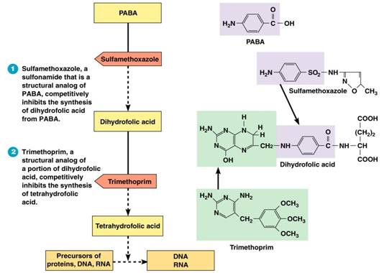

Slide 5
co –trimoxazole
It is example of sulfonamides, it is a combination between Trimethoprim (one part)/ sulfamethoxazole (five parts) (TMP/SMX), also known as co-trimoxazole. It is anantimicrolbial agent used to treat a variety of bacterial infections.
It is used for UTI, MRSA, skin infections, travelers’ diarrhea, respiratory tract infections, and cholera.
It may be used both to treat and prevent pneumocystis pneumonia (it is a form of pneumonia, caused by the yeast-like fungus Pneumocystis jirovecii) in people with HIV/AIDS.
Common side effects: include nausea, vomiting, rash, and diarrhea. Severe allergic reactions and Clostridium difficile diarrhea may occasionally occur. Because sulfonamides displace bilirubin from albumin, kernicterus (brain damage due to excess bilirubin) is an important potential side effect of sulfonamide.

Slide 6
Examples of Sulfonamides
Sulfadoxine
Belongs to a new generation of sulfonamides
Long lasting antibacterial agent
Once weekly dosing regime
Used for the treatment of malaria
Succinyl sulfathiazol
Acts as a prodrug of sulfathiazole
Ionized in the alkaline conditions of the intestine
Too polar to cross the gut wall
Concentrated in the gut and slowly hydrolysed by enzymes in the gut
Used for gut infections
Sulfonamides with reduced toxicity
Thiazole ring is replaced with a pyrimidine ring
Its metabolite is more water soluble
Reduced toxicity
Silver sulfadiazine is used topically to prevent infection of burns

Slide 7
Quinolones
Quinolones were first developed in the 1960s and can be classified into generations based on antimicrobial activity.
The first quinolone used was nalidixic acid (1962), it was marketed in many countries as Negram followed by many derivatives, such as flumequine, which are not marketed now.
They had an antibacterial effect on Escherichia coli, Proteus, Enterobacter and because of their urinary elimination in high concentrations they were used for treatment of urinary tract infections.
it cant reach the blood stream thus it doesn't used to treat systemic infection.

Slide 8
Fluoroquinolones
Quinolones with a fluorine atom are called fluoroquinolones; Because of their very good diffusion, they act on infections with different locations. Fluoroquinolones are used in the treatment of the urinary tract infections are eliminated in the urine in high concentration, and they are used in urogenital infections.
The microorganisms sensitive to fluoroquinolones are very numerous: Gram-negative bacilli, Salmonellas, Escherichia coli, shigella, gonococci, Proteus, Enterobacter, Helicobacter, Gram-positive bacilli, like staphylococci, streptococci…
The fluoroquinolones indicated in general infections (septicemia) or localized infections (meningeal, respiratory, osteoarticular, urogenital).
The majority of fluoroquinolones is active against Mycobacterium tuberculosis and can be useful for the treatment of resistant tuberculosis.

Slide 9
Generational Classification
1. First Generation Quinolones (1stgeneration)
-- Active against Gram-negative, but Pseudomonas spp.
Highly protein bound
Mostly used in UTIs
2. Second Generation
Gram-negative, some gram-positive and mycobacteria.
3. Third and Fourth Generation
Have increased activity against gram-positive pathogens including S. pneumoniae. They are also active against many agents causing zoonotic infection and against Mycobacteria.
Fluoroquinolones (2nd, 3rd and 4th generation)
Modified 1st generation quinolones
Not highly protein bound
Used in urine and other tissues; limited CSF penetration.

Slide 10
Generational Classification
Generation | Drug Names | Spectrum
1st | nalidixic acid cinoxacin | Gram ve- but not Pseudomonas species
2nd | norfloxacin ciprofloxacin enoxacin ofloxacin | Gram ve- (including Pseudomonas species), some Gram ve+ (S. aureus) and some atypicals
3rd | levofloxacin sparfloxacin moxifloxacin gemifloxacin | Same as 2nd generation with extended Gram+ and atypical coverage
4th | *trovafloxacin | Same as 3rd generation with broad anaerobic coverage
First Generation
Cinoxacin
Nalidixic Acid
Oxolinic acid
Second Generation
Ciprofloxacin
Enoxacin
Fleroxacin
Lomefloxacin
Levofloxacin
Norfloxacin
Ofloxacin
rulfloxacin
Third Generation
Gatifloxacin
Grepafloxacin
Pazufloxacin
Sparfloxacin
Tosufloxacin
Fourth Generation
Clinafloxacin
Gemifloxacin
Moxifloxacin
Trovafloxacin

Slide 11
Mechanism of Action( Bactericidal)
The quinolones act by inhibiting type 2 bacterial DNA topoisomerases, DNA gyrase and topoisomerase IV. They bind to and trap the enzyme-DNA complex. This blocks DNA synthesis and cell growth and ultimately has a lethal effect on the cell.
Inhibition of bacterial DNA Gyrase (Topoisomerase II)
- Formation of quinolone-DNA-Gyrase complex
- Induced cleavage of DNA
Inhibition of bacterial Topoisomerase IV

Slide 12
Spectrum of activity
The fluoroquinolones are bactericidal against:
E. coli and various species of Salmonella, Shigella, Enterobacter, Campylobacter, and Neisseria
Ciprofloxacin is more active than norfioxacin against
. P. aeruginosa
Fluoroquinolones also have good activity against staphylococci, including methicillin­resistant strains.
Several intracellular bacteria are inhibited by fluoroquinolones like Chlamydia, Mycoplasma, Legionella, Brucella, and Mycobacterium (including Mycobacterium tuberculosis).

Slide 13
Ciprofloxacin (Ciprodar)
Administration (Usual Dosage):
IV, tablet each 8-12h.
Spectrum:
Gram- aerobic rods, and Legionella pneumophila, and other atypical bacteria. Poor activity against Streptococcus pneumoniae.
Indications:
Nosocomial pneumonia, Intra-abdominal infections (typhoid fever and dysentery) Uncomplicated / complicated UTI , Anthrax exposure.
Side effects (ADRs):
Arrhythmias, Nausea, GI upset Interstitial nephritis.

Slide 14
Levofloxacin (Ciprodar)
Administration [Usual Dosage]:
IV, and ophthalmic Tablet [500-750 mg each 24h]
Spectrum:
Gram-, Gram+ (S. aureus including MRSA & S. pneumoniae) and Legionella pneumophila, atypical respiratory pathogens, and Mycobacterium tuberculosis
Indications:
Chronic bronchitis and Nosocomial pneumonia and Intra-abdominal infections
Side effects (ADRs):
Blood glucose disturbances in DM patients, arrhythmias Nausea, GI upset, Interstitial nephritis.

Slide 15
Mechanism of resistance
Resistance to quinolones may develop during therapy via mutations in the bacterial chromosomal genes encoding DNA gyrase or topoisomerase IV, or by active transport of the drug out of the bacteria.
Mechanism of resistance:
1. Chromosomal:
- Alter target enzymes: DNA gyrase and topoisomerase IV
- Decreased drug penetration (Efflux pump): Pseudomonas, E. coli.
2. Plasmid:
seen in some K. pneumoniae and E. coli
- Mutations in both target enzymes are needed to produce / significant resistance

Slide 16
Clinical uses of fluoroquinolones
Disease |  | Recommendations
RESPIRATORY TRACT INFECTIONS
Pharyngitis, otitis media | Not appropriate
Necrotizing otitis | Ciprofloxacin for P. aeruginosa
Sinusitis | Third-generation fluoroquinolone
Community-acquired pneumonia | Third-generation fluoroquinolone
Hospital-acquired pneumonia | Ciprofloxacin, for pathogens
URINARY TRACT INFECTIONS
Cystitis, uncomplicated | All effective (2nd generation are appropriate)
Pyelonephritis | All effective (2nd generation are appropriate)
Prostatitis | All effective
SKIN STRUCTURE INFECTIONS
Primary cellulitis | Not appropriate as first line therapy
Anaerobic soft-tissue infections | Not appropriate

Slide 17
Disease | Recommendations
OSTEOMYELITIS
Gram-negative bacterial infections | Ciprofloxacin
BACTERIAL DIARRHEAL DISEASES | Ciprofloxacin used most commonly; all considered likely to be effective
SEXUALLY TRANSMITTED DISEASES
Gonorrhea | Resistance testing required
Chlamydia | Ofloxacin, levofloxacin
Chancroid | All are effective
Mycoplasma | Ofloxacin, levofloxacin
Syphilis | Not appropriate
MYCOBACTERIAL DISEASES
Disseminated M. avium complex | Ciprofloxacin, ofloxacin as fourth agent if needed
M. tuberculosis | Ofloxacin, levofloxacin for drug-resistance or intolerance to first-line agents

Slide 18
Adverse effects:
Gastrointestinal effects : Nausea, vomiting
Central nervous system CNS: Headache, dizziness, confusion, insomnia, delirium hallucinations.
Cardiovascular: rare
Musculoskeletal: Rupture of tendon (rare) Damage to growing cartilage (not recommended for use in children)
Neurologic: Polyneuropathy (rare)
haematological disorders, leukopenia, thrombopenia, anemia
photosensitizations, even after a moderated exposure to light; photosensitization was particularly frequent with sparofloxacin.

Slide 19
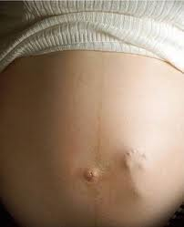
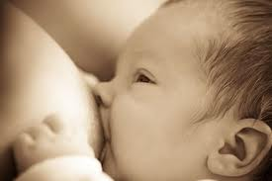
Don’t use fluoroquinolones for pregnant women nor to children under 18 because it might causes Cartilage erosion and arthropathy (have been reported).
Fluoroquinolones such as ciprofloxacin have traditionally not been used in infants because of concern about adverse effects on the infants' developing joints, and the calcium in milk might decrease absorption of the small amounts when fluoroquinolones in milk

