Slide 1
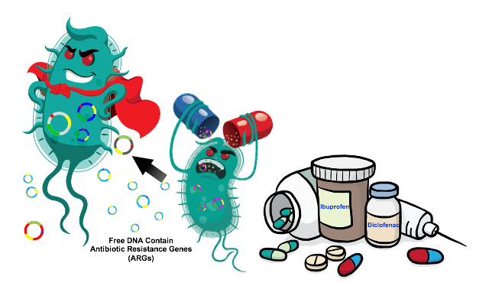
Mechanisms of Antimicrobial Resistance
Third Lecture
2022
Assist. Prof. Mohammed AboKsour

Slide 2
Why resistance is a concern
Antimicrobial resistance …
It is the ability of microbes to grow and multiply in the presence of antimicrobial agent that would normally kill them or limit their growth. The concentration of drug at the site of infection must inhibit the organism and remain below the level that is toxic to human cells.
Resistant organisms lead to treatment failure
Increased mortality
Resistant bacteria may spread in Community
Low level resistance can go undetected
Added burden on healthcare costs
Threatens to return to pre-antibiotic era
Selection pressure
Resistance might be directed by bacteria , viruses ,fungi and even cancer cell can develop resistance

Slide 3
Mechanism Antibiotic Resistance
Intrinsic (Natural)
Acquired
Genetic Methods
Chromosomal Methods
Mutations
Extra chromosomal Methods
Plasmids

Slide 4
Natural and acquired Resistance…
1
Intrinsic (natural) resistance might include:
Lack target: Mycoplasma is innately resistant to penicillin because it lacking cell wall.
Innate efflux pumps: Drug blocked from entering cell or export of drug (does not achieve in adequate internal concentration). Ex: as it happened E. coli, P. aeruginosa.
Drug inactivation: ex: Cephalosporinase in Klebsiella.
4. Extraordinary permeability barrier: which is represented by the cell envelop of the gram –ve bacyeria ex: the envelop of Pseudomonase aeruginosa ables this bacteria to stand against many chemicals, dyes disinfectants and antibiotics

Slide 5
Natural and acquired Resistance…
1
Acquired resistance :
A: By Mutation within the chromosome…
B: By Extra chromosomal genetic elements …
A: By Mutation within the chromosome…
It refers to the change in DNA structure of the gene.
Occurs at a frequency of one per ten million cells.
Eg. Mycobacterium.tuberculosis, Mycobacterium lepra , . . Methicillin resistance Staphylococcus aureus (MRSA) .
Often chromosomal mutants have reduced susceptibility to different antibiotics and in most cases the mutation occur due to alteration in the target sit of antibiotic action

Slide 6
B: By Extra chromosomal genetic elements …
Plasmids are double helix DNA exist in the cytoplasm. They can replicate independently from their chromosome, otherwise they integrate with it and replicate once the chromosome replicated.
Usually they Carrey resistant ( r-genes) are called R-plasmids.
These r-genes can be transferred from one to another plasmid or to chromosome.
Much of the drug resistance encountered in clinical practice is plasmid mediated

Slide 7
Mechanisms of Resistance Gene Transfer
A: Transfer of R-genes from one bacterium to another
Conjugation: Main mechanism for spread of resistance. The conjugative plasmids make a connecting tube between the 2 bacteria through which plasmid itself can pass
Transduction: Less common method. The plasmid DNA enclosed in a bacteriophage and transferred to another bacterium of same species. Seen in Staphylococci , Streptococci
Transformation: Also less common. Free DNA is picked up from the environment (i.e.. From a cell belonging to closely related or same strain.
B: Transfer of R-genes between plasmids within the bacterium
  By transposons: are sequences of DNA that can move around different positions within the genome of single cell and between plasmid and chromosome .
  By Integrons: Integron is a large mobile DNA can spread multidrug resistance. Each Integron is packed with multiple gene casettes, each consisting of a resistance gene attached to a small recognition site.

Slide 8
Mechanisms of antibiotic resistance…
1. Producing modifying enzymes
2. Target Site Modification and protection
3. Prevention of drug accumulation in the bacterium (via Efflux pump or permeability barrier)
4. Using an alternative pathways for metabolic/growth requirements
5. Quorum sensing

Slide 9
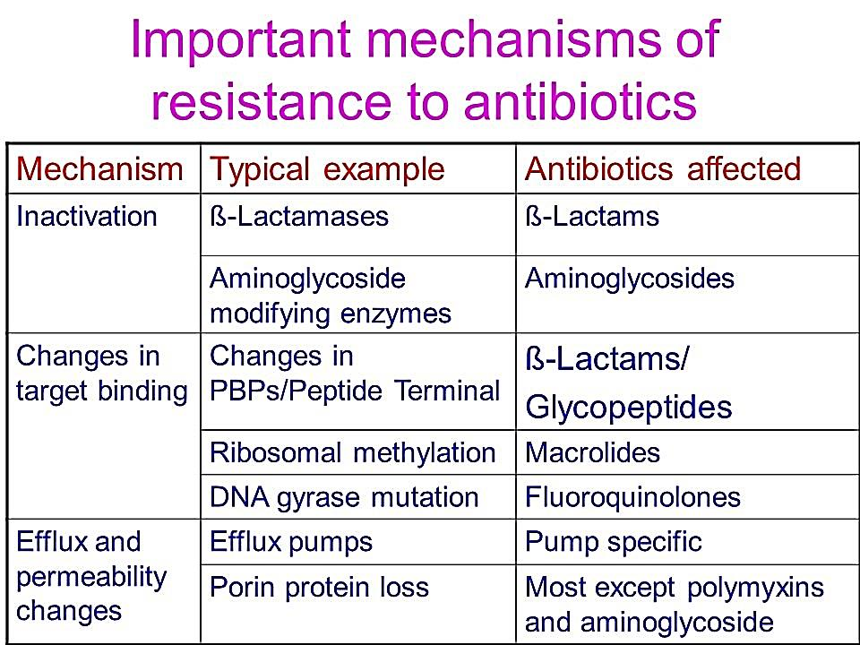

Slide 10
1
Producing modifying enzymes.
These include either hydrolysis the antibiotic molecules rendering them inactive , or transfer and addition of group and reduce their mechanisms.
β-lactamases enzymes.
Hydrolysis and Inactivation of β-lactam antibiotics ex: S. aureus , N. gonorrohoea , H. influenza, and most gr-ve bacteria produce B-lactamase which cleaves β-lactam ring.
β-lactamases such as penicillinase against penicillin and cephalosporinase against cephalosporine, and carbapenemase against carbapenems .
Penicillinase was the first β-lactamase to be identified: It was first isolated by Abraham and Chain in 1940 from Gram-negative E. coli even before penicillin entered clinical use.
Extended spectrum beta-lactamases (ESBLs) are beta-lactamases that hydrolyze extended-spectrum cephalosporins including cefotaxime, ceftriaxone, and ceftazidime, as well as monobactam ex: azztreonam. Members of family Enterobacteriaceae commonly express plasmid-encoded ESBLs (related to TEM and SHV β-lactamases family). More than 200 types related to different pathogenic bacteria have been identified

Slide 11
b) Aminoglycoside modifying enzymes
Addition of different group and Inactivation of Aminoglycosides group. Present in gram +ve and gram –ve. There are different type of these enzymes.
1- Aminoglycoside N-acetyltransferases (AACs)
AACs belong to the N-acetyl transferase superfamily of proteins. They catalyze the acetylation (adding acetyl group ) to −NH₂ groups in the acceptor aminoglycoside antibiotic.
2- Aminoglycoside O-nucleotidyltransferases (ANTs)
ANTs mediate inactivation of aminoglycosides by catalyzing the transfer of an AMP group from the donor substrate ATP to and hydroxyl group in the aminoglycoside molecule.
3- Aminoglycoside O-phosphotransferases (APHs)
APHs catalyze the transfer of a phosphate group to the aminoglycoside molecule

Slide 12
c) chloramphenicol acetyltransferase.
Addition of acetyl group & inactivation of chloramphenicol by chloramphenicol acetyltransferase. It is continuous produced in -ve bacteria (higher resistance), while it is inducible gram +ve.
d) Ciprofloxacin-Modifying Enzyme.
Plasmid-mediated quinolone resistance was first identified in a clinical isolate of Klebsiella pneumoniae. Recently, a new mechanism of quinolone resistance was identified: transfer from species to species of a plasmid encoding aac(6′)-Ib-cr, a variant of aminoglycoside acetyltransferase that reduced susceptibility to ciprofloxacin and norfloxacin by N-acetylation of the amino nitrogen on its piperazinyl substituent. Genes responsible for plasmid-mediated quinolone resistance are thought to be linked to extended-spectrum β-lactamase

Slide 13
2
Target Site Modification and protection.
Alteration in penicillin-binding protein (PBPs) leading to reduced affinity of beta-lactam antibiotics.
(Methicillin-Resistant Staphylococcus aureus, S. pneumoniae, Neisseria gonorrheae, Group A streptococci, Listeria monocytogenes)
Changes in peptidoglycan layer and cell wall thickness resulting to reduced activity of vancomycin.
Vancomycin-resistant S. aureus.
Alterations in subunits of DNA gyrase reducing activity of fluoroquinolones.
Alteration in subunits of topoisomerase IV leading to reduced activity of fluoroquinolones.
Many Gram +ve bacteria like S. aureus and Streptococcus pneumoniae

Slide 14
Changes in RNA polymerase leading to reduced activity of rifampicin. Mycobacterium tuberculosis
Alteration of target enzyme due to Spontaneous chromosomal Mutations in dihydrofolate reductase gene leading to reduced activity of antibiotics.
Trimethoprim.
Ribosomal point mutation.
Tetracyclines, Macrolides, Clindamycin.
Methylation in 23s rRNA causes antibiotic resistance.
Macrolides
Alteration in 30s rRNA target site:
Resistance against Aminoglycoside group

Slide 15
3
Efflux pump or permeability barrier.
A- Efflux pumps
They are Cytoplasmic membrane transport proteins localized in the cytoplasmic membrane of all kinds of cells. They are active transport, meaning that they require a source of chemical energy to perform their function.
The genetic elements encoding efflux pumps may be encoded on chromosome and/or plasmids ( both natural and acquired resistance respectively).
In many cases, efflux pump genes are part of an operon, with a regulatory gene controlling expression. . Expression of several efflux pumps in a given bacterial species may lead to a broad spectrum of resistance.
Efflux systems that contribute to antibiotic resistance have been described from a number of clinically important bacteria, including Campylobacter jejuni, E. coli , Pseudomonas aeruginosa ,Acinitobacter

Slide 16
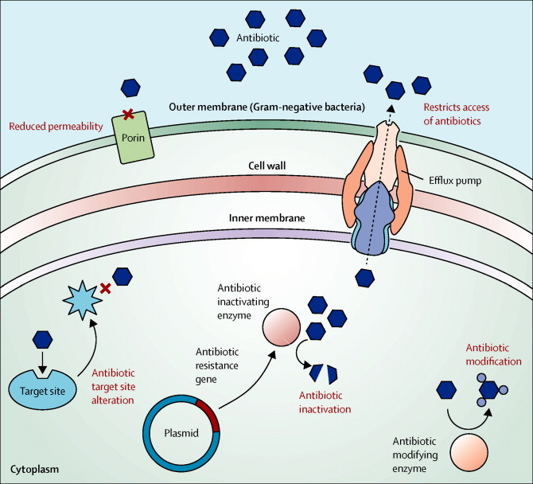
B- Reducing permeability barrier .
In this case the porin channels will change either by reducing number or change the shape or affinity of binding

Slide 17
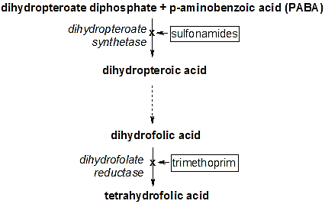
4
Using an alternative pathways for metabolic / growth requirements.
Trimethoprim binds to dihydrofolate reductase and inhibits the reduction of dihydrofolic acid (DHF) to tetra hydrofolic acid (THF).
THF is an essential precursor in the thymidine synthesis pathway and interference with this pathway inhibits bacterial DNA synthesis.
Trimethoprim's affinity for bacterial dihydrofolate reductase is several thousand times greater than its affinity for human dihydrofolate reductase.
Sulfamethoxazole inhibits
dihydropteroate synthase, an enzyme involved further upstream in the same pathway.

Slide 18
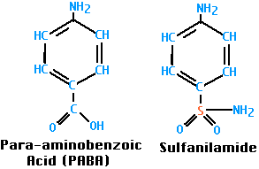
sulfa drugs inhibit a step in the pathway to make folic acid, an essential vitamin that bacteria need for their everyday functions. But some resistant bacteria have developed different metabolic pathways that allow them to make folic acid even in the presence of these drugs, or some microorganism produce large quantity of PABA (Para Amino Benzoic Acid ) thus overcome the inhibition of sulfa drug to folic acid cycle (Compotation to enter the synthesis pathway
Note :folic acid doesn’t synthesis in
human thus we take as a tablet and
specially given to pregnant women

Slide 19
5
Quorum sensing.
Recently discovered that the microbes communicate with each other and exchange signaling chemicals or so called Autoinducers. when its colony reaches a critical density, threshold of autoinduction is reached and gene expression starts.
These autoinducers allow bacterial population to coordinate gene expression for virulence, conjugation, apoptosis, mobility and resistance
Quorum sensing signal molecules AHL, AIP, AI-2 & AI-3 have been identified in Gm-ve bacteria, while AI-2 QS –system is shared by GM+ve bacteria.
Several quorum sensing inhibitors molecules has been synthesized which are analogues to AHL, AIP, and AI-2
Quorum sensing inhibitors have been synthesized and have been isolated from several natural extracts such as garlic extract.

