Slide 1
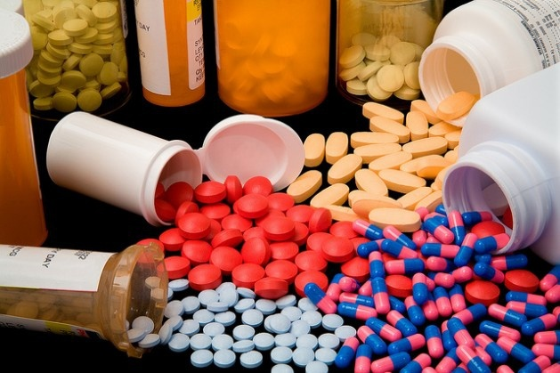
Antibiotics
First Lecture
2022
Assist. Prof. Mohammed AboKsour

Slide 2
Antibiotics and Antimicrobial Agents
The antibiotics is a low molecular substance produced by a microorganism that at low concentrations inhibits or kills other microorganisms (Ex. Penicillin).
The term antibiotics means (against life); in this case, against microbes. There are many types of antibiotics (like antibacterials, antivirals, antifungals, and antiparasitics).
They are characterized by physical, chemical, and biological properties which make them ideal potential chemotherapeutic agents for the treatment of infection.
The antimicrobial agent is any substance of natural, semisynthetic or synthetic origin that has the ability to kills or inhibits the growth of microorganisms but causes little or no damage to the host (Ex: sulfa drug).

Slide 3
Antibiotics producer microorganisms
Actinomycetes: they produce approximately 60-70 % of total kinds of antibiotics ex: Streptomyces spp
Fungi: fungi produce approximately 20 % of antibiotics ex: Penicillium
Bacteria: the bacteria produce about 10 % of different antibiotics ex: Bacillus spp
Hint…
All the antibiotics are antimicrobials, but not all antimicrobials are antibiotics.

Slide 4
History of antibiotics: the Antibiotic Era…
The beginning of the modern (antibiotic era) associated with the names of Paul Ehrlich and Alexander Fleming.
Ehrlich's idea of a (Magic bullet) that selectively targets only microbes that cause disease and not the host was based on an observation that synthetic dyes, which first became available at that time, could stain specific microbes but not others.
This idea led him to begin a large-scale and systematic screening program in 1904 to find a drug against syphilis, a disease that was endemic and almost incurable at that time. This sexually transmitted disease, caused by Treponema pallidium

Slide 5
History of antibiotics: Arsenicals…
In 1905 Ehrlich with chemist Alfred Bertheim and bacteriologist Sahachiro Hata, they synthesized hundreds of organoarsenic derivatives of a highly toxic drug Atoxyl and tested them in syphilis-infected rabbits.
In 1909 they came across the sixth compound in the 600th series tested, thus numbered 606, which cured syphilis-infected rabbits and showed significant promise for the treatment of patients with this disease in limited trials on humans.
In 1910, Ehrlich and Hata did name the new component was Salvarsan, was a great success and, together with Neosalvarsan, enjoyed the status of the most frequently prescribed drug until its replacement by penicillin in the 1940s.
Hint…
Neosalvarsan was more soluble and less toxic than Salvarsan.

Slide 6
History of antibiotics: Sulfa drug (Sulphanoamide)
During the earlier days of antibiotics research, a group of researchers discovered sulfa drugs, namely (Prontosil), which was used to treat Streptococcus pyogenes .
The active part of Prontosil is sulfanilamide. Sulfanilamide was cheap, and many companies started producing of sulfonamide derivatives.
Despite this, many continuously modified derivatives of this oldest class of synthetic antibiotics are still a viable option for therapy.
Two other classes of synthetic antibiotics successful in clinical use are the quinolones, such as ciprofloxacin, and oxazolidinones, such as linezoild).

Slide 7
Sulfanilamide was a great success in treating a whole range of bacterial infections, from puerperal sepsis to Pneumonococcal meningitis.
In 1899, Pyocyanase which was prepared by Emmerich & Löw from Pseudomonas aeruginosa (formerly Bacillus pycyaneus) and was used in many hospitals.
Emmerich and Löw noticed that the bacterium as well as the prepared extracts were active against a number of pathogenic bacteria, so they tried to use the extract for treatment of microbial diseases.
As the results of these treatments were not consistent and the preparation itself was quite toxic for humans, the treatment was eventually abandoned.

Slide 8
The period between 1950s and 1970s was indeed the golden era of discovery of novel antibiotics classes, with no new classes discovered since then.
Therefore, with the decreasing of the discovery rate, the main approach was dealing with modifying the existing antibiotics to control of the resistance against the discovered antibiotics.

Slide 9
Penicillin
Penicillin was discovered by Alexander Fleming in 1929. He noted that a fungal colony had grown as a contaminant on an agar plate streaked with the bacterium Staphylococcus aureus, and that the bacterial colonies around the fungus were transparent, because their cells were lysing.
Fleming had devoted much of his career to finding methods for treating wound infections, and immediately recognized the importance of a fungal metabolite that might be used to control bacteria. The substance was named penicillin, because the fungal contaminant was identified as Penicillium notatum.
However, Fleming found that it was effective against many Gram positive bacteria, and he even used locally applied, crude preparations of this substance, from culture filtrates, to control eye infections.
However, Fleming could not purify this compound because of its instability, and it was not until the period of the Second World War (1939-1945) that two other British scientists, Florey and Chain, working in the USA,

Slide 10
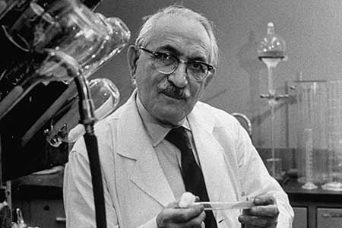
Selman Waksman: the father of antibiotic
The microbiologist who discovered streptomycin, first used the word "antibiotic" in the medical sense in 1943.
In 1952 he was awarded the Nobel Prize for his discovery of "streptomycin," the first antibiotic active against tuberculosis."
In 2005 Selman Waksman did isolate more than fifteen antibiotics, including streptomycin, which was the first effective treatment for tuberculosis.

Slide 11
Depending upon the killing or inhibiting ability of drugs, they can be classified into two categories; Bactericidal & Bacteriostatic
Physicians use either one of these agents or sometimes a combination of these two when treating an infection and it
depends on:
The type of infection.
Growth conditions of microorganisms.
Bacterial density.
Test duration.
Reduction rate of Bacteria.
Antibiotics can also be classified into bactericidal and bacteriostatic antibiotics based on their mechanism of action. However, in some cases, one antibiotic can be bactericidal for one strain of bacteria and may be bacteriostatic of a different strain. Therefore, all the aspects mentioned above should be clearly known before choosing an antibiotic.

Slide 12
1
Bactericidal antibiotics…
Bactericidal agents are used to kill microorganisms by inhibiting the synthesis of cell wall.
Usually, endocarditis and meningitis are treated by bactericidal drugs.
Examples for bactericidal antibiotics include; penicillin derivatives, cephalosporins, monobactams, and vancomycin. In addition, aminoglycosidic antibiotics are also considered as bactericidal, but they may also be bacteriostatic for some infections.
The minimum concentration of a drug that is needed to kill a certain strain of bacteria is called the ‘minimum bactericidal concentration’ or MBC.

Slide 13
2
Bacteriostatic antibiotics…
Bactericidal agents are used to inhibit microorganisms by interfering with their protein production, DNA replication, or other aspects of bacterial cellular metabolism.
Usually, urinary tract infections are treated by Bacteriostatic drugs.
Examples for bactericidal antibiotics include; tetracycline, sulfonamides, spectinomycin, trimethoprim, chloramphenicol, macrolides and lincosamides.
The minimum concentration of a drug that is needed to inhibit the growth of a certain strain of bacteria is known as ‘minimum inhibitory concentration’ or MIC.
Unlike the bactericidal agents, the bacteriostatic agents must works together with the immune system to inhibit the microorganisms’ activities. According to drug concentration, the activity may vary. For examples, if we use high concentrations of bacteriostatic agents, they may act as bactericidal, whereas low concentration of bactericidal agents may act as bacteriostatic.

Slide 14
Bactericidal vs Bacteriostatic
Bactericidal antibiotics | Bacteriostatic antibiotics
kill bacteria directly | Prevent bacteria from growing
Number of microorganisms decreases in the presence of bactericidal agents | Number of microorganisms remains the same when bacteriostatic agents are used
Microorganisms was killed when bactericidal agents are used | Microorganisms remain viable when bacteriostatic agents are used
Don’t allow the immune system to deal with infections | allow the immune system to deal with infections
If the doses of bactericidal agents are low, it may act as bacteriostatic agents | If the doses of bacteriostatic agents are high, it may act as bactericidal agents
Measured by MBC | Measured by MIC

Slide 15
Mode of activity…
Another important thing to remember about antibiotics is that they don't all work against all types of bacteria.
Narrow-spectrum antibiotics: they are only effective against a narrow range of bacteria it is effective against specific families of bacteria. Ex: penicillin G or erythromycin.
broad-spectrum antibiotics: they are effective against a broad range of bacteria. In this lesson, we'll look more closely at these general types of antibiotics, and we'll see what makes a given antibiotic fit into each category. EX: aminoglycoside group.

Slide 16
General properties of antimicrobial agents…
Selective Toxicity: drug harms the microbe without causing significant damage to the host. When searching for ways to treat disease, scientists look for differences between the human (or animal) host and the pathogen. Ex. Penicillin interferes with cell wall synthesis. Animal cells have no cell walls, so penicillin is not toxic to animals.
Spectrum of Activity: the range of different microbes against which an antimicrobial agent acts. Example: broad spectrum of G(+) and G(-) bacteria vs. narrow spectrum: G(-or + ) only.
Modes of Action: it means how do the drugs work?
Inhibition of Cell Wall Synthesis
Disruption of Cell Membrane Function
Inhibition of Protein Synthesis
Inhibition of Nucleic Acid Synthesis

Slide 17
Characteristics of the ideal antimicrobial agents…
Solubility in body fluids
Selective toxicity against microbes
Toxicity not easily altered (no food or drug interactions)
Non allergenic
Stability (should be degraded and excreted by the body slowly)
Resistance by microorganisms not easily acquired
Long shelf life.
Reasonable cost
Not evoke immune response
Reasonable side effects

