Slide 1
7- Microsoft Windows
Microsoft Windows
The Windows operating system refers to a family of operating systems. Microsoft Windows, also called Windows and (Windows OS), computer operating system (OS) developed by Microsoft Corporation to run personal computers (PCs). Featuring the first graphical user interface (GUI) for IBM-compatible PCs, the Windows OS soon dominated the PC market. Approximately 90 percent of PCs run some version of Windows. We look at the history of Windows OS from 1985 to present day

Slide 2
The first version of Windows, released in 1985, was simply a GUI offered as an extension of Microsoft’s existing disk operating system,
or MS-DOS (Microsoft Disk Operating System).
Based in part on licensed concepts that Apple Inc. Had used for its Macintosh System Software, Windows for the first time allowed DOS users to visually navigate a virtual desktop, opening graphical “windows” displaying the contents of electronic folders and files with the click of a mouse button, rather than typing commands and directory paths at a text prompt.

Slide 3
With the 2001 release of Windows XP, Microsoft united its various Windows packages under a single banner, offering multiple editions for consumers, businesses, multimedia developers, and others.
Windows XP abandoned the long-used Windows 95 for a more powerful code base and offered a more practical interface and improved application and memory management.

Slide 4
The highly successful XP standard was succeeded in late 2006 by Windows Vista, which experienced a troubled rollout and met with considerable marketplace resistance, quickly acquiring a reputation for being a large, slow, and resource-consuming system.
So, Microsoft in 2009, released Windows 7, an OS whose interface was similar to that of Vista but was met with enthusiasm for its noticeable speed improvement and its modest system requirements.

Slide 5
7-1 Windows 7
What is Windows 7 ?
Windows 7 is an Operating System software which tells the computer, what and how to do as it takes your instructions and passes them to the computer to get your work done by it.
An operating system allows your computer to manage software and perform essential tasks You can give instructions to the computer through different options. You can open programs by using small pictures called Icons.

Slide 6
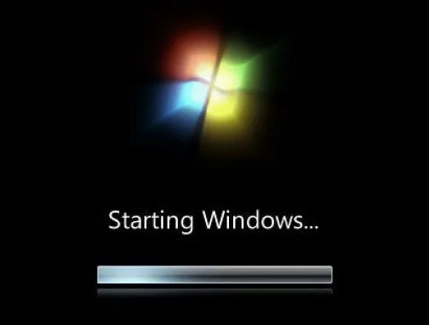
As everything on it is represented graphically in the forms of pictures or menus, that’s why it is called Graphical User Interface (GUI).
The (GUI) and allows you to visually interact with your computer’s functions in a logical, fun, and easy way.

Slide 7
If it is a shared PC; more than one user uses it, or one user with password protected, you will arrive at Welcome Screen.

Slide 8
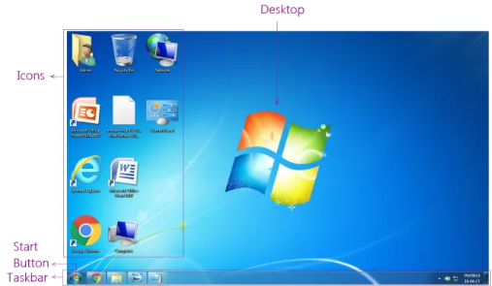
7-2 Components of Windows 7
The different components of windows, which help us to interact with computer are:

Slide 9
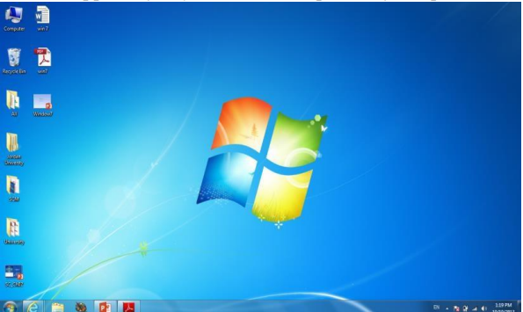
7-2-1 The Desktop
This is the first screen which appears when the Windows 7 is loaded in the computer’s memory.
The first screen appears after you turn on the power of computer is a desktop

Slide 10
It is the work area where dialog boxes, windows, icons, and menus appear.
the Windows 7 desktop contains items you can use to do your job.
For instance, from your desktop, you can perform file-management tasks and run software applications.
You can customize the appearance of the desktop to suit your preferences

Slide 11
7-3 The Desktop Components
The desktop for Windows 7 consists of two main components
1-Desktop: that contains many components like icons "file, folder, shortcut. etc.)

Slide 12
2. Task Bars
It helps to manage the various currently active programs opened in different windows.
We can switch between these programs by clicking their buttons on the taskbar.

