Slide 1
The Course of Atmospheric Thermodynamics
MUSTANSIRIYAH UNIVERSITY
COLLEGE OF SCIENCES
ATMOSPHERIC SCIENCES DEPARTMENT
2021-2022
Dr. Sama Khalid Mohammed
SECOND STAGE
Lecture 6

Slide 2
THIS LECTURE INCLUDING THE FOLLOWING ITEMS
Phase Change
Recall some terms that we learned in the first course of “Fundamentals of Thermodynamics”
Entropy

Slide 3
PHASE CHANGE
Water vapor is an invisible gas that becomes visible when it changes into larger liquid or solid (ice) particles.
This process of transformation is known as a change of state or, simply, a phase change.
The heat energy required to change a substance, such as water, from one state to another is called latent heat.
But why is this heat referred to as “latent”?

Slide 4
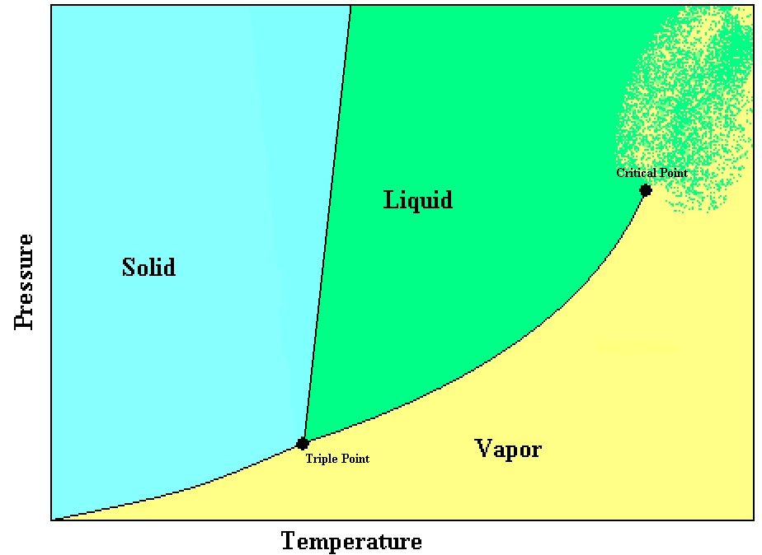
PHASE CHANGE
A phase change is a change between solid, liquid, or vapor (gas).
A system may even have more than one solid or liquid phase such as Carbon with two solid phases (graphite & diamond).
The phase of a system in equilibrium can be represented on a phase diagram.
The lines separating the phases represent points where the two phases can coexist.
The triple point represents the one and only point on the diagram where all three phases can coexist.

Slide 5
PHASE CHANGE
The critical point occurs at the end of the vapor-to-liquid transition line. At temperatures above the critical temperature, or pressures above the critical pressure there is no distinction between the liquid and vapor phases.
The slope of the solid-to-liquid transition line shows how the melting point changes with pressure.
An increase in pressure will increase the melting point.

Slide 6
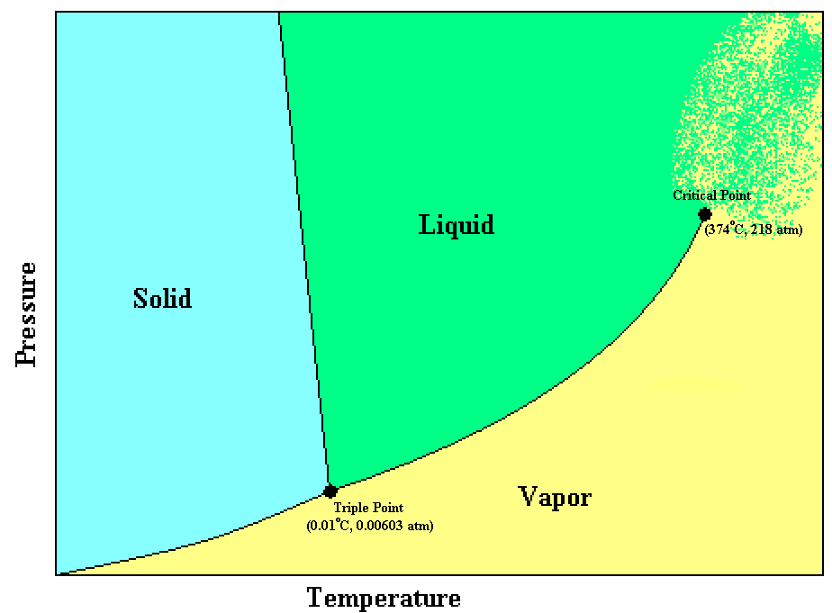
PHASE CHANGE
Water is one of the few substances that can exist in all three phases at the temperatures and pressures found in the Earth’s atmosphere.
The triple point of water is at 0.01°C and 6.03x10⁻³ atm (611 Pa).
A unique feature of water is that the solid-to-liquid transition line slopes upward to the left, instead of to the right.

Slide 7
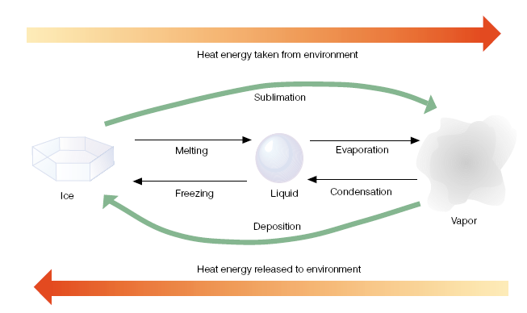
PHASE CHANGE
When the change of state is from left to right, heat is absorbed by the substance and taken away from the environment.
The processes of melting, evaporation, and sublimation (ice to vapor) all cool the environment.
Notes:
https://www.youtube.com/watch?v=aByuyfY5xcM&t=15s
https://www.youtube.com/watch?v=uEk9y99zd7k

Slide 8
PHASE CHANGE
When the change of state is from right to left, heat energy is given up by the substance and added to the environment.
The processes of freezing, condensation, and deposition (vapor to ice) all warm their surroundings.

Slide 9
Latent heat is an important source of atmospheric energy, why ??????
Once vapor molecules become separated from the earth’s surface, they are swept away by the wind rising to high altitudes where the air is cold, the vapor changes into liquid and ice cloud particles. During these processes, a huge amount of heat energy is released into the environment. Water vapor evaporated from warm, tropical water can be carried into polar regions, where it condenses and gives up its heat energy.
Thus, evaporation-transportation-condensation is an extremely important mechanism for the relocation of heat energy (as well as water) in the atmosphere.

Slide 10
FYI: A REVIEW OF STATE VARIABLES
The state of a system is defined by the position and momentum of every piece of matter in the system.
For a cubic meter of air at sea level this requires the knowledge of the position and momentum of every 2.56x10²⁵ molecules in the volume!
It is impossible to measure or know the state of the system as defined above. Therefore, we content ourselves with knowing something about the “average” or macroscopic properties of the system as a whole. This is what the subject of thermodynamics attempts to do.

Slide 11
FYI: A REVIEW OF STATE VARIABLES
In general:
For a one-component system in equilibrium we need 3 state variables.
For a two-component system in equilibrium we need 4 state variables.
For a three-component system in equilibrium we need 5 state variables.
For a j-component system in equilibrium we need j + 2 state variables.

Slide 12
A REVIEW OF STATE VARIABLES
The thermodynamic state of a simple system in thermodynamic equilibrium is completely characterized by specifying the internal energy (U), volume (V), and the number of moles, n_{i}, of each of its components.
As an example of a simple versus a non-simple (complex) system, imagine two systems:
System A is a mixture of two ideal gasses in a rigid container of volume V at a temperature T and pressure p. This is a simple system whose thermodynamic state is given by the total internal energy U, the total volume V, and the number of moles of the two gasses, n₁ and n₂.

Slide 13
A REVIEW OF STATE VARIABLES
If we take the same two gasses and separate them into separate compartments of the total system, and keep each gas at the same temperature and pressure as the previous simple system, the total internal energy U and total volume V of this system are the same as that of the simple system.
However, the thermodynamic states are not the same. We will find out later that the entropy, S, of the complex system is lower than the simple system. So, we need an additional thermodynamic state variable to completely characterize the state of the complex system.

Slide 14
A REVIEW OF STATE VARIABLES
As we said, the thermodynamic state of a one-component, closed system in equilibrium can be completely described by any two state variables (other than mass or moles).
The state variables have two important properties:
The change in any of the state variables (say U) doesn’t depend on the path of the system on a thermodynamic diagram.
It only depends on the endpoints.

Slide 15
A REVIEW OF STATE VARIABLES
Mathematically, this means that differentials of state functions are exact differentials.
Here the problem is going to appear, because HEAT & WORK is not a state variables !!!!!!
But Heat and work are modes of transfer of energy, thus how can we deal with them to know about the state of thermodynamic System ???

Slide 16
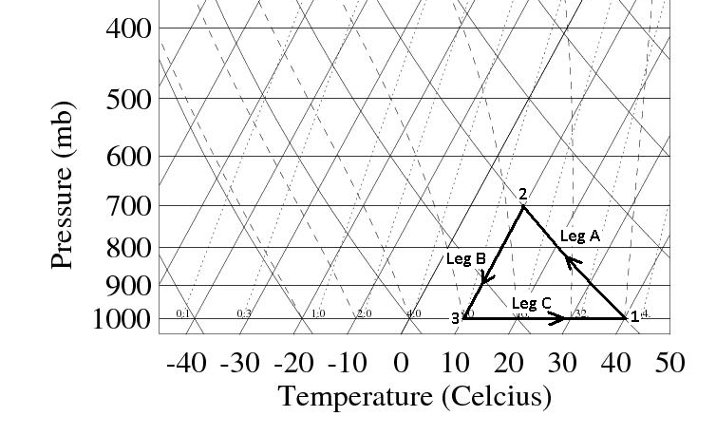
A REVIEW OF STATE VARIABLES
We know why work is not a state variable, but what about heat ????
Imagine that an air parcel starts out at Point 1 on the skew-T diagram shown below. The initial pressure and temperature are p1 and T1. The parcel moves in a reversible, closed cycle around the path shown. The three legs of the path are:
Leg A: Adiabatic expansion to pressure p2.
Leg B: Isothermal compression back to pressure p1.
Leg C: Isobaric heating back to temperature T1.
https://www.weather.gov/jetstream/skewt

Slide 17
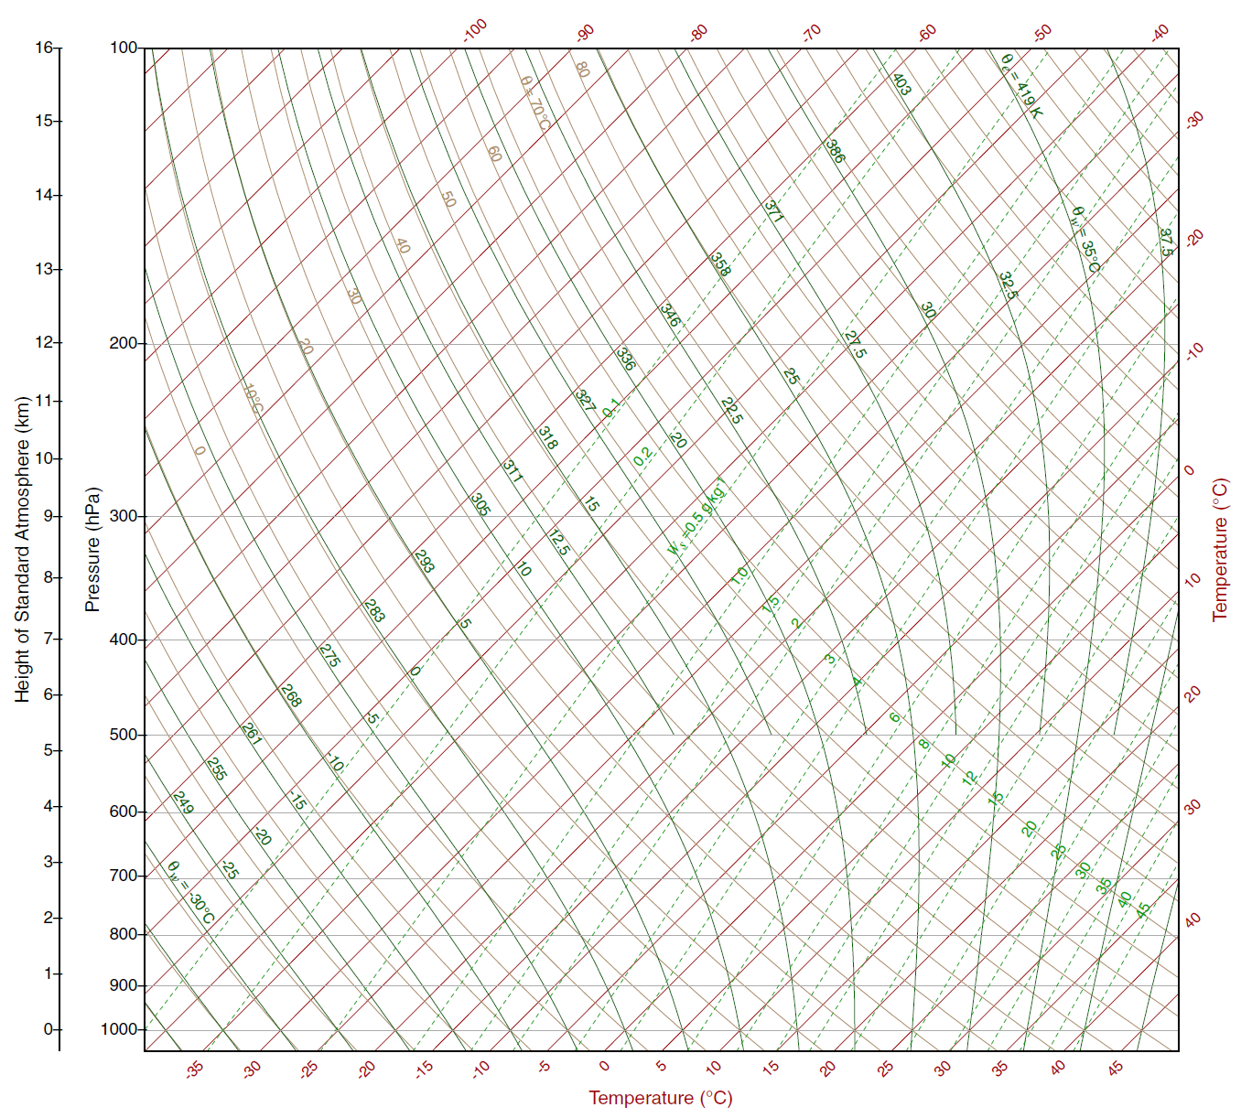
Leg A: Adiabatic expansion to pressure p2.
Leg B: Isothermal compression back to pressure p1.
Leg C: Isobaric heating back to temperature T1.
isobar
isotherm
dry adiabat
saturated adiabat
B
A
saturation mixing ratio
C

Slide 18
A REVIEW OF STATE VARIABLES

Slide 19
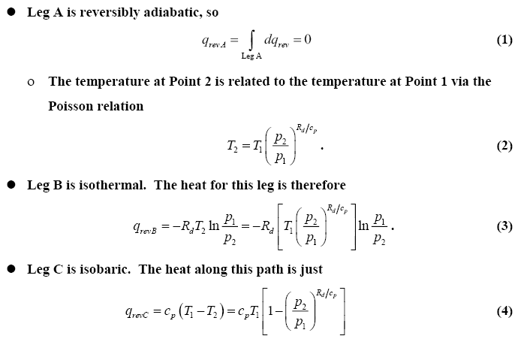
A REVIEW OF STATE VARIABLES

Slide 20
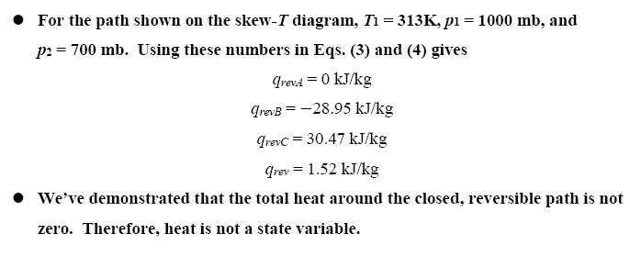
A REVIEW OF STATE VARIABLES
Thus, the total heat around the closed, reversible path is not zero. Therefore, heat is not a state variable.

Slide 21
A REVIEW OF STATE VARIABLES

Slide 22
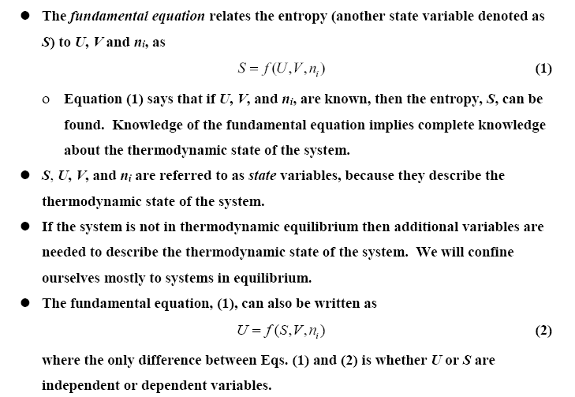
The Fundamental Equation and Entropy

Slide 23
The Fundamental Equation and Entropy
PAY ATTENTION WHY WE DIVIDED BY T ???

Slide 24
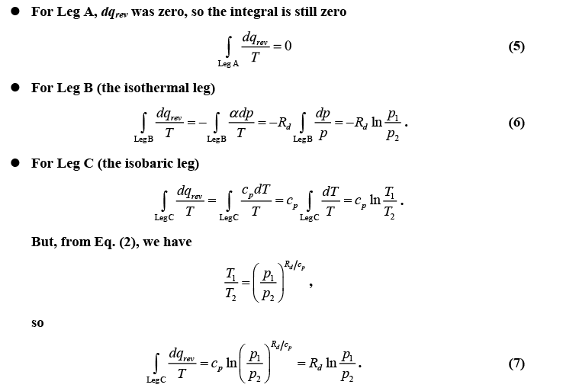
The Fundamental Equation and Entropy

Slide 25
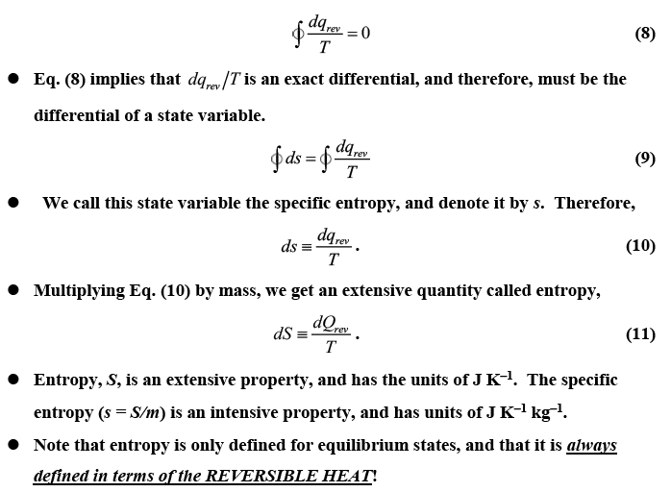
Entropy

Slide 26
Entropy

Slide 27
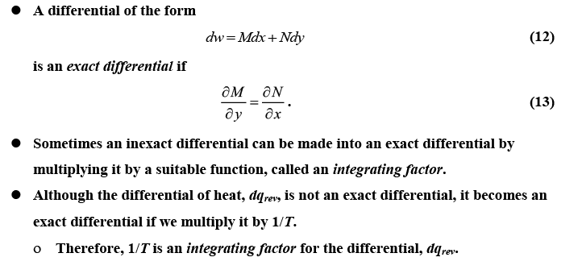
Why we divided the HEAT Q by T ?

Slide 28
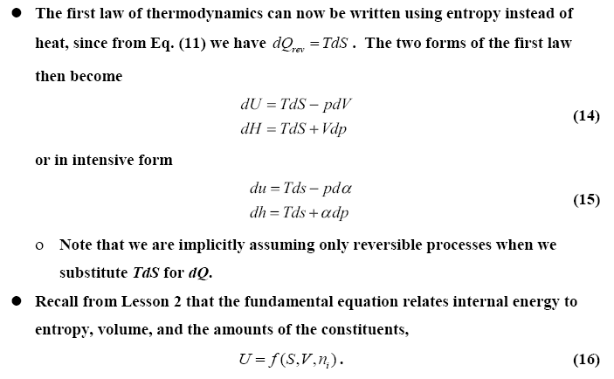
What are the thermodynamic definition of temperature & pressure using Entropy and 1st law of thermodynamics???

Slide 29
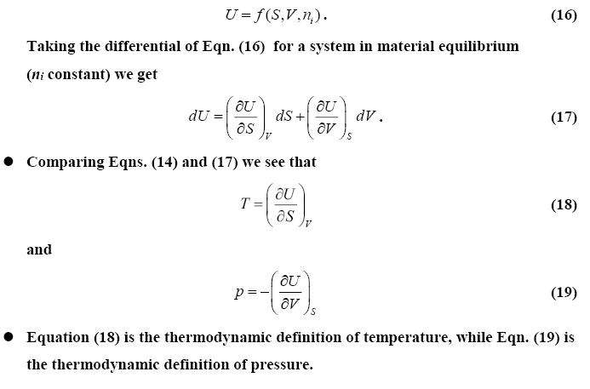
What are the thermodynamic definition of temperature & pressure using Entropy and 1st law of thermodynamics???

