Slide 1

The Course of Atmospheric Thermodynamics
MUSTANSIRIYAH UNIVERSITY
COLLEGE OF SCIENCES
ATMOSPHERIC SCIENCES DEPARTMENT
2021-2022
Dr. Sama Khalid Mohammed
SECOND STAGE
Lecture 4

Slide 2
This lecture including the following items
Stability Using Potential Temperature
STABILITY IN A DRY ATMOSPHERE
The Saturated Adiabatic Lapse Rate
Stability of Saturated Air

Slide 3
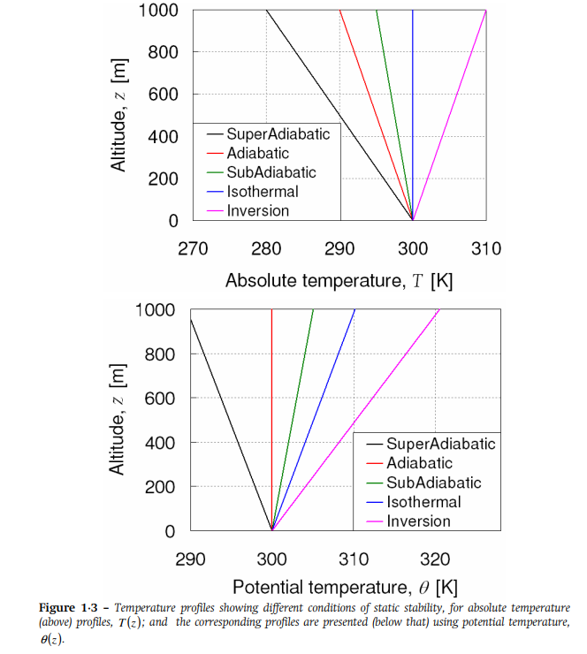
Potential Temperature
The potential temperature is useful because it remains constant as a parcel undergoes an adiabatic change of pressure. The vertical gradient of potential temperature determines the dry static stability of the atmosphere. If the potential temperature increases with height, then parcels raised adiabatically from their initial height will always be colder and thus denser than their environment and will sink back to their original pressure. If the potential temperature decreases with height, then parcels raised up will be warmer than their environment and will be accelerated upward by buoyancy; therefore, if the potential temperature decreases with height, the temperature profile is unstable.

Slide 4
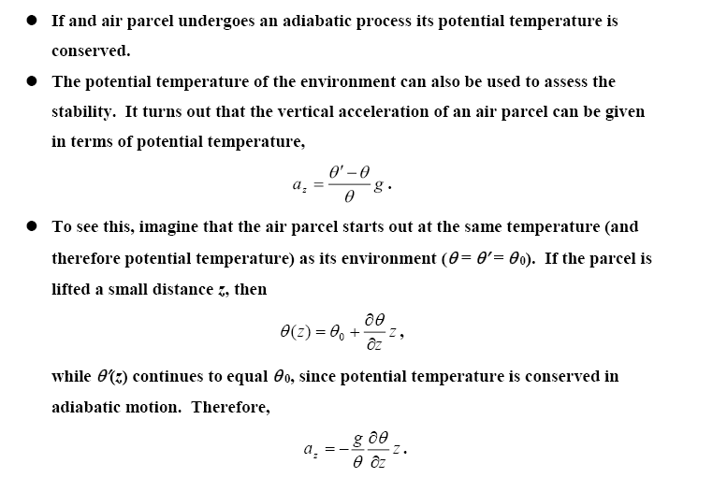
Stability Using Potential Temperature

Slide 5
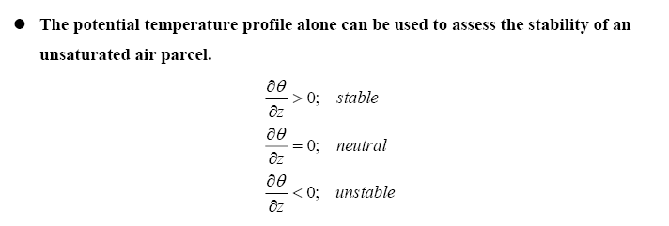
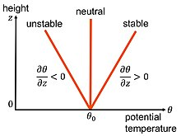
Stability Using Potential Temperature

Slide 6
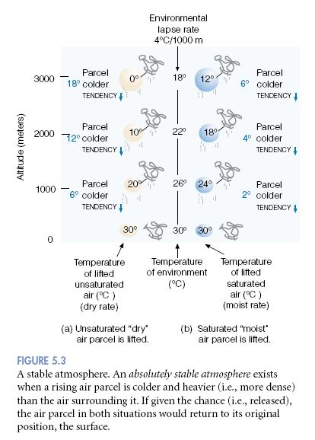
A stable atmosphere.
An absolutely stable atmosphere exists when a rising air parcel is colder and heavier (i.e., more dense) than the air surrounding it. If given the chance (i.e., released), the air parcel in both situations would return to its original position, the surface.

Slide 7
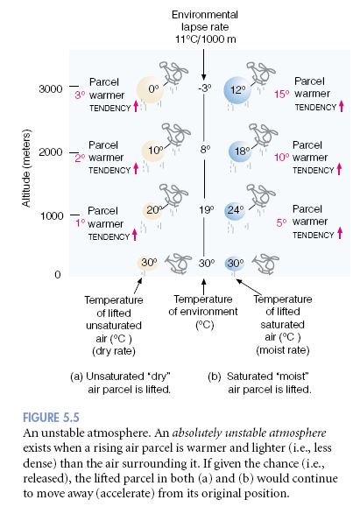
An unstable atmosphere.
An absolutely unstable atmosphere exists when a rising air parcel is warmer and lighter (i.e., less dense) than the air surrounding it. If given the chance (i.e., released), the lifted parcel in both (a) and (b) would continue to move away (accelerate) from its original position

Slide 8
The Saturated Adiabatic Lapse Rate
In contrast to the dry adiabatic lapse rate Γd, which is constant, the numerical value of the saturated adiabatic lapse rate Γs varies with pressure and temperature.
Because water vapor condenses when a saturated air parcel rises, it follows that Γs < Γd.
Actual values of Γs range from about 4 K/km near the ground in warm, humid air masses to typical values of 6-7 K/km in the middle troposphere.

Slide 9
Stability of Saturated Air
The parcels will be stable when γ < Γs, Neutral γ =Γs ,Unstable γ > Γs

