Slide 1

The Course of Atmospheric Thermodynamics
MUSTANSIRIYAH UNIVERSITY
COLLEGE OF SCIENCES
ATMOSPHERIC SCIENCES DEPARTMENT
2020-2021
Dr. Sama Khalid Mohammed
SECOND STAGE
Lecture 3

Slide 2
This lecture including the following items
VIRTUAL TEMPERATURE
Wet Bulb Temperature T_{w}
Wet Bulb Depression
POTENTIAL TEMPERATURE
DRY AIR DEFINITION
STABILITY OF DRY AIR / DRY ADIABATIC LAPSE RATE
BUOYANCY
STABILITY IN A DRY ATMOSPHERE
The Saturated Adiabatic Lapse Rate
Stability of Saturated Air

Slide 3

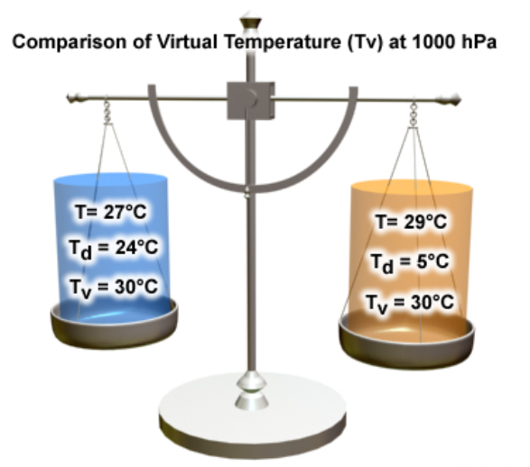
VIRTUAL TEMPERATURE
Moist air can be considered a mixture of two ideal gases (dry air and water vapor).
The ideal gas law for moist air is
By manipulate the above equation , we can define a new temperature, T_{v} ( the virtual temperature)
For moist air we can use the ideal gas law for dry air, only using the virtual temperature in place of the actual temperature.
The virtual temperature is the temperature that dry air would have if its density were equal to that of a given sample of moist air at constant pressure , and it can be expressed as:
T_{v} = (1 + 0.61 q ) T
Virtual temperature is always greater than or equal to the actual temperature.

Slide 4
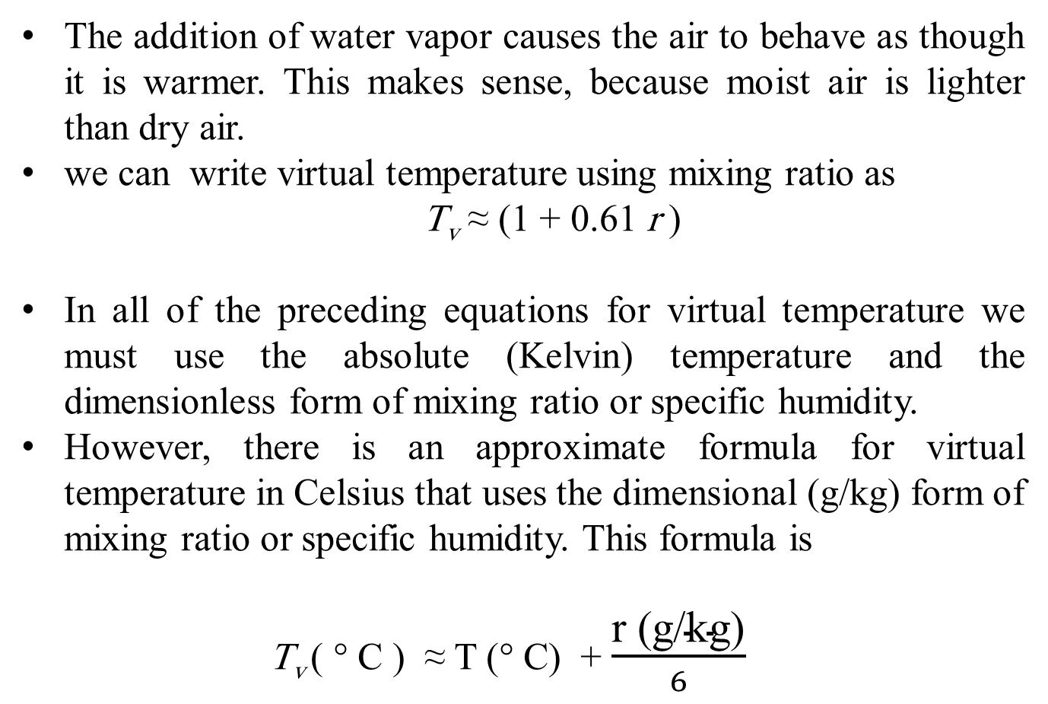
VIRTUAL TEMPERATURE
The addition of water vapor causes the air to behave as though it is warmer. This makes sense, because moist air is lighter than dry air.
we can write virtual temperature using mixing ratio as
T_{v} ≈ (1 + 0.61 r )
In all of the preceding equations for virtual temperature we must use the absolute (Kelvin) temperature and the dimensionless form of mixing ratio or specific humidity.
However, there is an approximate formula for virtual temperature in Celsius that uses the dimensional (g/kg) form of mixing ratio or specific humidity. This formula is
T_{v} ( ° C ) ≈ T (° C) + $\frac{\text{r}\text{ (}\text{g}\text{/}\text{kg}\text{)}}{6}$

Slide 5
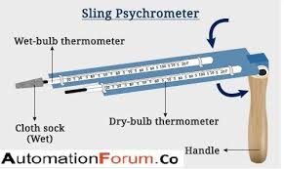
Wet Bulb Temperature T_{w}
Meteorologists commonly measure humidity by measuring the wet-bulb temperature.
The wet-bulb temperature is the lowest temperature that can be achieved by evaporating water into the air parcel at constant pressure (the evaporation requires heat, which is supplied by the air parcel).
It is measured using
A PSYCHROMETER.

Slide 6
Wet Bulb Depression
The difference between the air temperature (dry-bulb temperature) and the wet-bulb temperature is called WET-BULB DEPRESSION
The wet-bulb depression is a relative measure of the moisture content of the air.
Dry air can be cooled much further by evaporation than moist air, so a larger wet-bulb depression means less humidity (for the same dry-bulb temperature).
FYI: The dew-point temperature and relative humidity are found by using psychrometric tables, with dry-bulb temperature and wet-bulb depression as the independent variables ( watch this video and do the exercise using the charts in the following slides
https://www.youtube.com/watch?v=yC7EMtRCqBM

Slide 7
FYI: THE DEW-POINT TEMPERATURE AND RELATIVE HUMIDITY
The dew-point temperature and relative humidity are found by using
psychrometric tables, with dry-bulb temperature and wet-bulb depression as the independent variables ( watch this video and do the exercise using the charts in the following slides, assuming T=12°C and T_{w}=14°C and find the relative humidity and dew point temperture.
https://www.youtube.com/watch?v=yC7EMtRCqBM

Slide 8
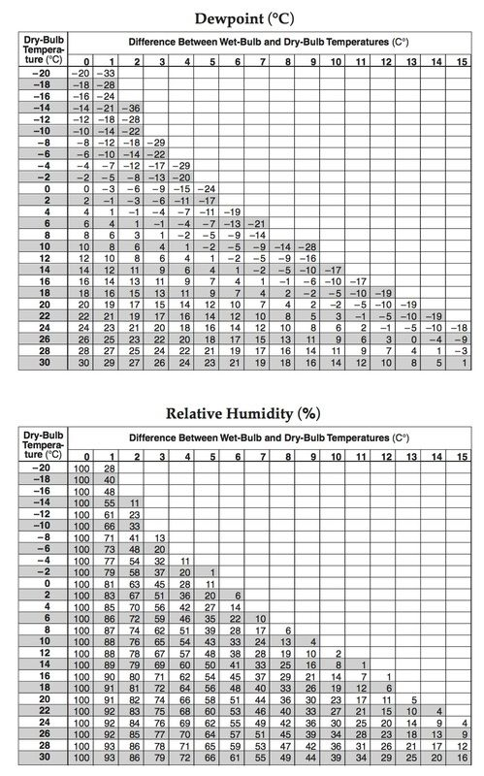
FYI: The relative humidity can be found using the dry bulb temperature and wet bulb depression

Slide 9
FYI: The dew point can be found using the dry bulb temperature and wet bulb depression

Slide 10


The relative humidity can be converted to dew point depression as follows:
Recall that,
So, A simple rule of thumb for converting RH to a dew point depression (T - T_{d}) for moist air (RH >50%) is that T_{d} decreases by 1 °C for every 5% decrease in RH (starting at T_{d} = T (dry bulb temperature), where RH = 100%).
For example, if the RH is 85%,
and the dew point depression is T - T_{d} = 3 °C.
e_{s}

Slide 11
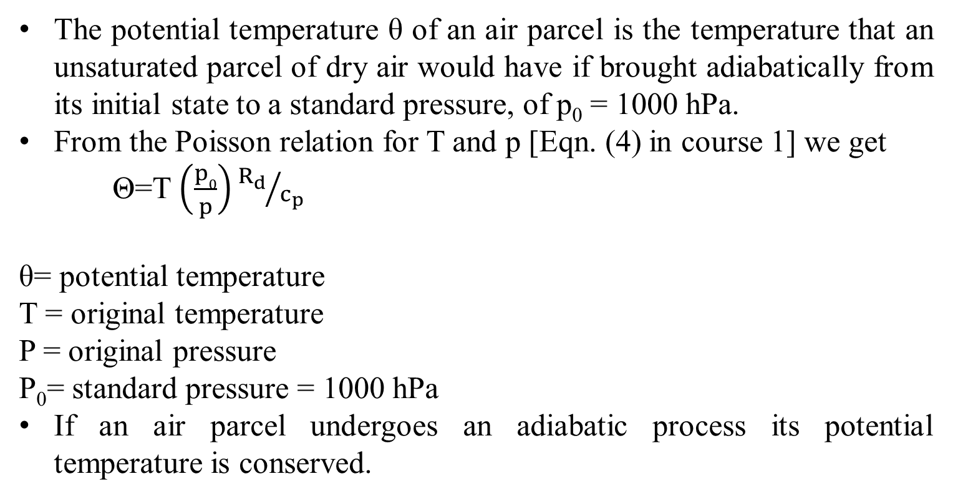
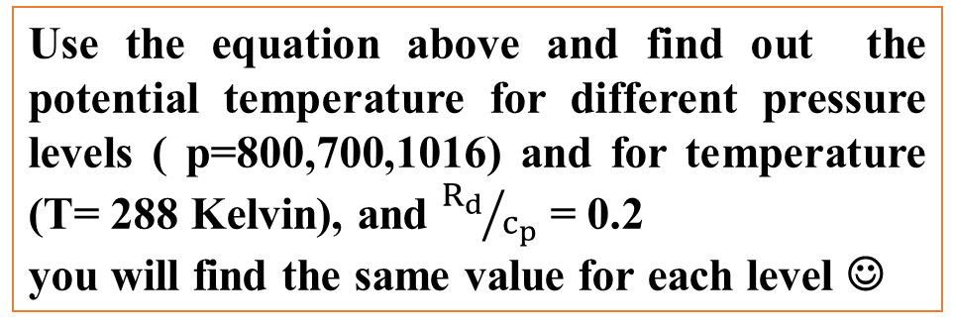
POTENTIAL TEMPERATURE
The potential temperature θ of an air parcel is the temperature that an unsaturated parcel of dry air would have if brought adiabatically from its initial state to a standard pressure, of p₀ = 1000 hPa.
From the Poisson relation for T and p [Eqn. (4) in course 1] we get
Θ=T $\left(\frac{p0}{p}\right){R_{d}}/{c_{p}}$
θ= potential temperature
T = original temperature
P = original pressure
P₀= standard pressure = 1000 hPa
If an air parcel undergoes an adiabatic process its potential temperature is conserved.
Use the equation above and find out the potential temperature for different pressure levels ( p=800,700,1016) and for temperature (T= 288 Kelvin), and ${R_{d}}/{c_{p}}$ = 0.2
you will find the same value for each level ☺
Notes:
The dry adiabatic lapse rate Γ=-dT/dz = g/cp = 9.8 c/km

Slide 12

Dry Air Definition
In meteorology, there are two ways in which dry air is referenced:
A sample of air that has no water vapor (The amount of water vapor in the air depends on the dewpoint of the air).
A sample of air that has a low relative humidity
At a temperature of 30° C with a relative humidity (RH) of 50% the dew point is 18.45 ° C.
For drier air with temperature of 30 ° C and RH of 20 the dew point is 4.61 ° C.
Notes:
The dewpoint may alternatively be defined as the temperature at which the saturation vapor pressure of the parcel is equal to the actual vapor pressure of the contained water vapor.
relative humidity: The ratio of the vapor pressure to the saturation vapor pressure with respect to water.
The dew point is a temperature. If the air has no moisture in then no matter how much you cool it there will not be any condensation.

Slide 13
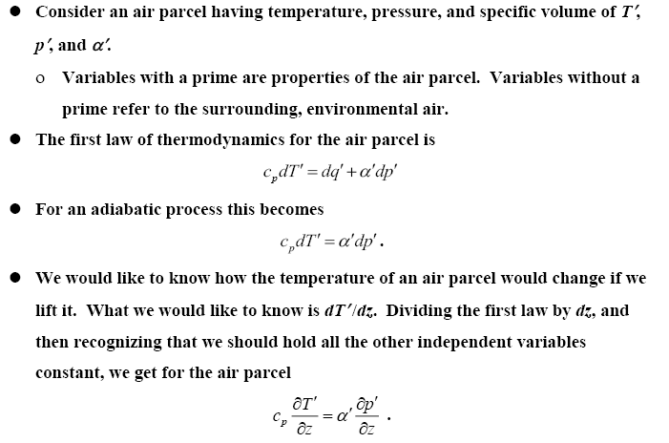
Stability of Dry Air
DRY ADIABATIC LAPSE RATE

Slide 14
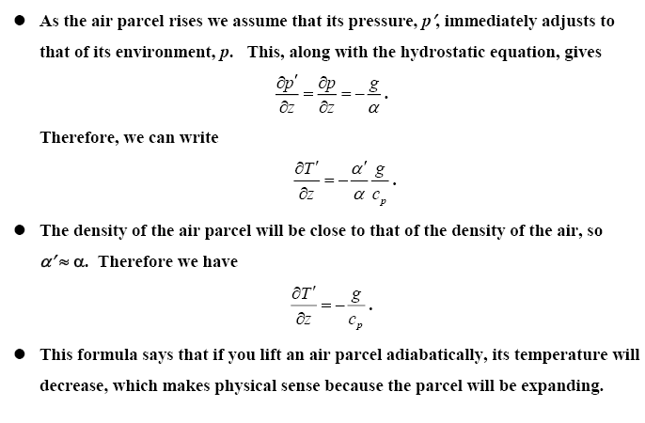
Stability of Dry Air
DRY ADIABATIC LAPSE RATE
This formula says that if you lift an air parcel adiabatically, its temperature will decrease, which makes physical sense because the parcel will be expanding.

Slide 15
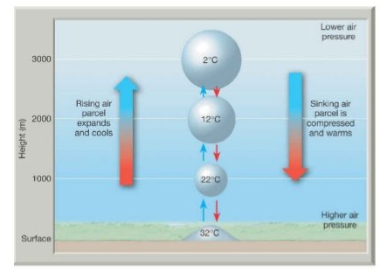
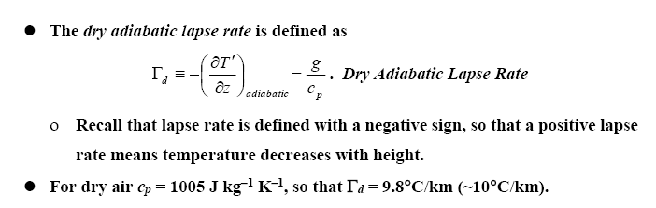
Stability of Dry Air
DRY ADIABATIC LAPSE RATE

Slide 16
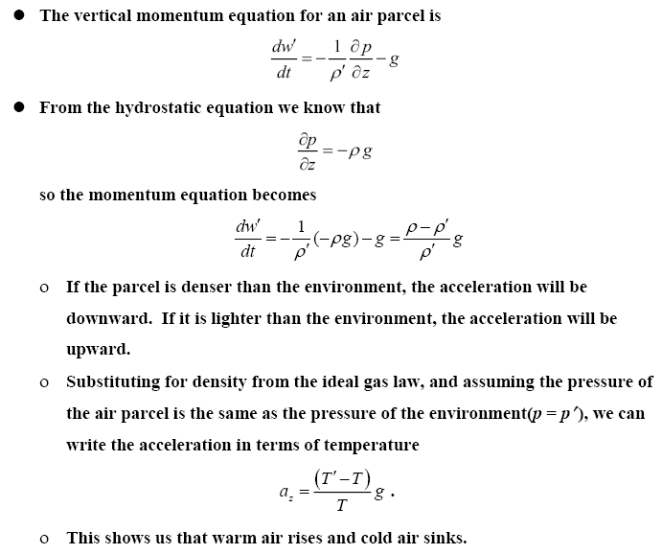
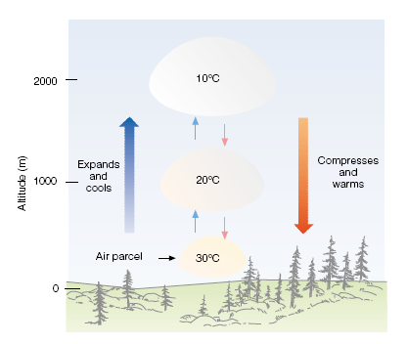
BUOYANCY

Slide 17
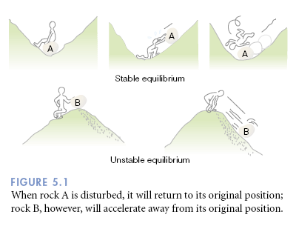
STABILITY IN A DRY ATMOSPHERE
Stability refers to whether an air parcel, one moved vertically, will continue to accelerate in the direction that it was pushed (unstable), or return in the direction from which it came (stable).

Slide 18
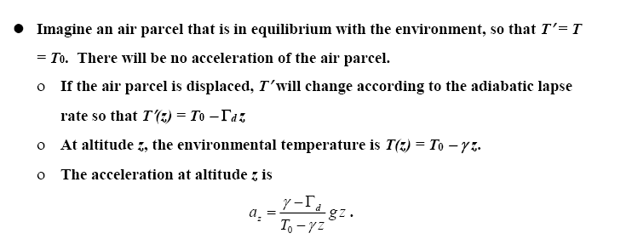
STABILITY IN A DRY ATMOSPHERE

Slide 19
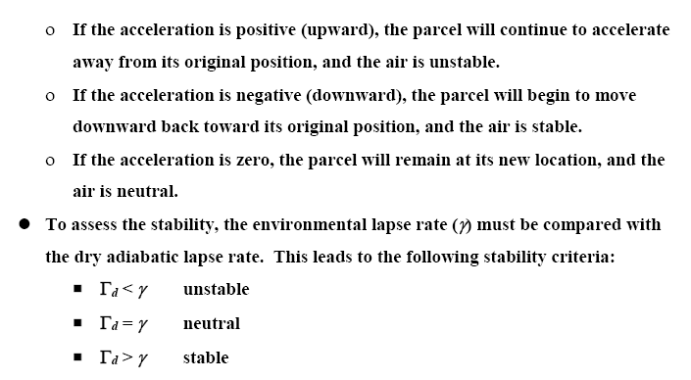
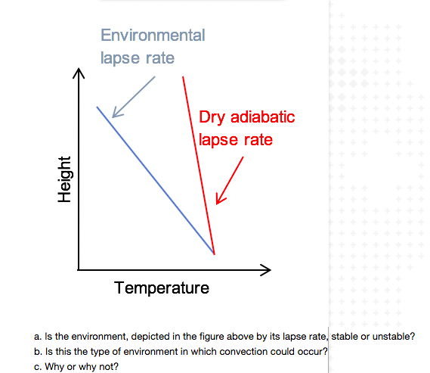
STABILITY IN A DRY ATMOSPHERE

