Slide 1
The Course of Atmospheric Thermodynamics
MUSTANSIRIYAH UNIVERSITY
COLLEGE OF SCIENCES
ATMOSPHERIC SCIENCES DEPARTMENT
2021-2022
Dr. Sama Khalid Mohammed
SECOND STAGE
Lecture 2

Slide 2
THIS LECTURE INCLUDING THE FOLLOWING ITEMS
MOIST AIR
Partial pressure
Vapor pressure
Saturation vapor pressure
Specific humidity and mixing ratio
Dew point temperature
Relative humidity
Key difference between the measures of humidity
Dew-point temperature & relative humidity
Exercises

Slide 3
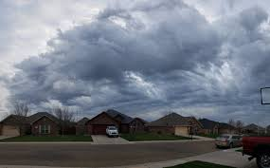
MOIST AIR
In atmospheric thermodynamics, moist air is a mixture of dry air and any amount of water vapor, in which dry air is assumed to contain no water vapor, or with low relative humidity.
There are many expressions that can be used for moist air and they are:
Vapor Pressure
Absolute Humidity
Specific Humidity
Mixing ratio
Dew point Temperature
Relative humidity

Slide 4
PARTIAL PRESSURE
In a mixture of gases, each gas species contributes to the total pressure.
The pressure exerted by a single gas species is known as the partial pressure for that species.
For a mixture of ideal gases, the partial pressure of any species can be found from the ideal gas law applied to that species only. For example, in air the partial pressures of O₂, N₂, and A_{r} would be
The densities used in the above equations are partial densities.

Slide 5
PARTIAL PRESSURE
The total pressure is equal to the sum of the partial pressures, and the total density is equal to the sum of the partial densities.
The partial pressure of a species is proportional to the number of moles of the species.
The partial pressure of a species can be found by multiplying the total pressure by the volume (or mole) fraction of the species.
For example, the partial pressure of O₂ is found by multiplying atmospheric pressure by 0.21 (21%).

Slide 6
VAPOR PRESSURE
If you have a substance in liquid form, some of the molecules will escape into the vapor phase. The partial pressure due to these vapor molecules is known as the vapor pressure.
Since the vapor pressure due to water molecules is proportional to the number of water vapor molecules in the atmosphere, vapor pressure is one measure of humidity, we usually denote vapor pressure as e
Absolute humidity is defined as the mass of water vapor per unit volume. It is merely the density of the water vapor, ρ_{v}
Vapor pressure is related to absolute humidity via the ideal gas law, e = ρ_{v} R_{v} T , where R_{v} is the specific gas constant for water vapor (461 J/kg K).
The higher the amount of water vapor, the higher the absolute humidity.

Slide 7
SATURATION VAPOR PRESSURE
The vapor molecules are colliding with each other. Some may stick together briefly to form tiny water droplets. However, these tiny water droplets are also constantly breaking apart.
If enough vapor molecules are present, there may be enough collisions to form a stable population of liquid water droplets. This is called saturation, and the vapor pressure at this point is called the saturation vapor pressure (e_{s}).
For unsaturated air, e < e_{s}
For saturated air, e =e_{s}
For supersaturated e > e_{s}
Notes:
Latent heat is an important source of atmospheric energy. Once vapor molecules become separated from the earth’s surface, they are swept away by the wind, like dust before a broom. Rising to high altitudes where the air is cold, the vapor changes into liquid and ice cloud particles. During these processes, a tremendous amount of heat energy is released into the environment

Slide 8
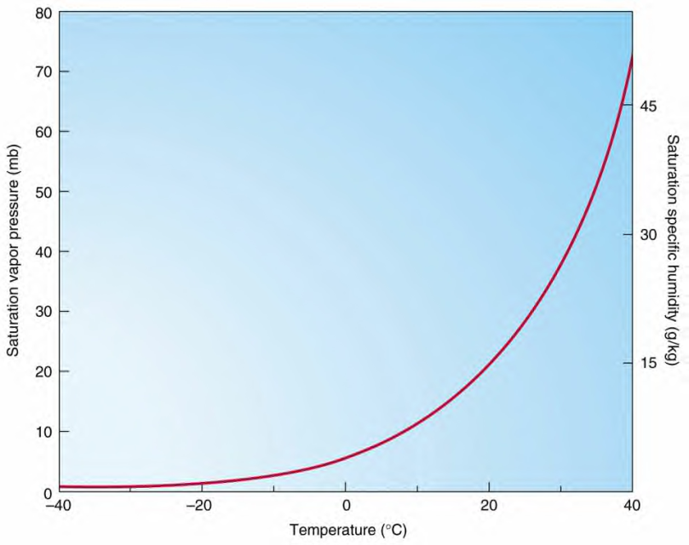
SATURATION VAPOR PRESSURE
The saturation vapor pressure is a function of temperature, and is given by the Clausius-Clapeyron equation
where e₀ is the vapor pressure at some known temperature T₀, and L is the latent heat of vaporization. We typically use T₀ = 273K, e₀ = 611 Pa, and L_{v} = 2.5x10⁶ J/kg.
Riddles
Heat energy ………(released /taken) in ……….. (evaporation/condensation) ……..(from/into) the environment.
SVP (saturation vapor pressure) Curve
Notes:
Internal energy associated with the phase of a system is called latent heat. The intermolecular forces are strongest in solids and weakest in gases.

Slide 9
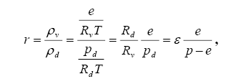
SPECIFIC HUMIDITY AND MIXING RATIO
Vapor pressure and absolute humidity are not very convenient expressions for humidity (at least for meteorologists).
We define some other measures of humidity.
Mixing ratio: The mass of water vapor per mass of dry air. This would be dimensionless (if expressed as kg/kg, or g/g). However, it is more often expressed as grams of water vapor per kg of dry air, so the units of mixing ratio are usually expressed as g/kg. Mixing ratio can be related to vapor pressure via
where ε = Rd/Rv.
The saturation mixing ratio, r_{s}, is found by using e_{s} in the formula.
where:
e: vapor pressure
P: total pressure

Slide 10
SPECIFIC HUMIDITY AND MIXING RATIO
Specific humidity: The mass of water vapor per mass of air, it is very close to mixing ratio, since r << 1 (expressed as g/g or kg/kg).
as shown in the following equation
In meteorology, mixing ratio is used far more than specific humidity, and for most purposes the two can be considered as equivalent.
Absolute and specific humidity are quite similar in concept.

Slide 11
DEW POINT TEMPERATURE
The saturation vapor pressure is a function of temperature, and decreases with decreasing temperature.
If you cool moist air, eventually the saturation vapor pressure will equal the vapor pressure, and saturation will be reached. The temperature at which this occurs is called the dew point, or dew point temperature.
The dew point temperature can be found from the Clausius-Clapeyron equation by using the actual vapor pressure instead of the saturation vapor pressure, and solving for T. This gives

Slide 12
FYI: STOP & THINK !
Specific humidity, mixing ratio, vapor pressure, and dew point remain unchanged if the air parcel is heated or cooled at constant pressure.
In other words, if I want to compare two air samples to find which has more water vapor, I can directly compare their mixing ratios, vapor pressures, specific humidity, or dew points. The one with the higher number will have more water vapor.
I can compare the samples without worrying about whether they are at the same temperature or not (however, vapor pressure will have to be compared at the same air pressure)!
This is not true of absolute humidity, which will change as the air parcel is heated or cooled.
Thus, we are going to use another expression !!!

Slide 13
RELATIVE HUMIDITY
Relative humidity, as its name implies, is a relative measure of humidity. It is defined as the ratio of the vapor pressure to the saturation vapor pressure,
In terms of mixing ratio, relative humidity becomes
This means we can use mixing ratio rather than vapor pressure to find relative humidity.
Relative humidity (RH) (expressed as a percent) also measures water vapor, but RELATIVE to the temperature of the air.
e_{s}

Slide 14
RELATIVE HUMIDITY
In other words, it is a measure of the actual amount of water vapor in the air compared to the total amount of vapor that can exist in the air at its current temperature.
It tells us how close an air parcel is to saturation( It does not directly tell us how much water vapor is in the parcel!)
A parcel with higher relative humidity may actually have less water vapor than another parcel with lower relative humidity!
Warm air can possess more water vapor (moisture) than cold air, so with the same amount of absolute/specific humidity, air will have a HIGHER relative humidity if the air is cooler, and a LOWER relative humidity if the air is warmer.
What we "feel" outside is the actual amount of moisture (absolute humidity) in the air.

Slide 15
KEY DIFFERENCE BETWEEN THE MEASURES OF HUMIDITY
There are two ways to change the relative humidity, or absolute humidity of an air parcel:
Add or subtract water vapor.
Change the temperature.
There is only one way to change mixing ratio, specific humidity, vapor pressure, or dew point (assuming pressure is constant):
Add or subtract water vapor.

Slide 16
THE DEW-POINT TEMPERATURE AND RELATIVE HUMIDITY
At the Earth’s surface, the pressure typically varies by only a few percent from place to place and from time to time. Therefore, the dew point is a good indicator of the moisture content of the air.
In warm, humid weather the dew point is also a convenient indicator of the level of human discomfort.
For example, most people begin to feel uncomfortable when the dew point rises above 20 °C, and air with a dew point above about 22 °C is generally regarded as extremely humid or “sticky.” Fortunately, dew points much above this temperature are rarely observed even in the tropics.
Notes:
High dew points indicate high water vapor content; low dew points, low water vapor content. Addition of water vapor to the air increases the dew point; removing water vapor lowers it.

Slide 17
THE DEW-POINT TEMPERATURE AND RELATIVE HUMIDITY
In contrast to the dew point, relative humidity depends as much upon the temperature of the air as upon its moisture content.
On a sunny day the relative humidity may drop by as much as 50% from morning to afternoon, just because of a rise in air temperature.
Neither is relative humidity a good indicator of the level of human discomfort.
For example, a relative humidity of 70% may feel quite comfortable at a temperature of 20 °C, but it would cause considerable discomfort to most people at a temperature of 30 °C.

Slide 18
FYI: THE DEW-POINT TEMPERATURE AND RELATIVE HUMIDITY
The highest dew points occur over warm bodies of water or vegetated surfaces from which water is evaporating.
In the absence of vertical mixing, the air just above these surfaces would become saturated with water vapor, at which point the dew point would be the same as the temperature of the underlying surface.
Complete saturation is rarely achieved over hot surfaces, but dew points in excess of 25 °C are sometimes observed over the warmest regions of the oceans.

Slide 19
Exercises
Q1/ Use the Clausius-Clapeyron equation to find the saturation vapor pressure at T = 1°C , and T₀ = 273K, e₀ = 611 Pa, and L_{v} = 2.5x10⁶ J/kg, R_{v} is 461 J/kg K) . Answer: 657 Pa
Q2/ An air sample at standard sea level pressure (1013 hPa), and with a volume of 1m³ at 20°C, contains 7 grams of water vapor, use the following when you need(T₀ = 273K, e₀ = 611 Pa, and L_{v} = 2.5x10⁶ J/kg, R_{v} is 461 J/kg K,R_{d}=287.1J/kg.k).
a. What is the vapor pressure (use the ideal gas law and don’t forget to convert to kg)? Answer: 946 Pa
b. What is the relative humidity (you need to find the saturation vapor pressure)? Answer: 39.9%
c. What is the absolute humidity? (Absolute humidity is merely the density of the water vapor, ρ_{v )} Answer: 7 g/m3
d. What is the mixing ratio? Answer: 0.0058 kg/kg
e. What is the specific humidity? (Use the equation $q=\frac{R_{d}}{R_{v}}\frac{e}{p}$), answer: 0.00581 kg/kg
f. What is the dew-point temperature? Answer: 279°K

