Slide 1

The Course of Atmospheric Thermodynamics
MUSTANSIRIYAH UNIVERSITY
COLLEGE OF SCIENCES
ATMOSPHERIC SCIENCES DEPARTMENT
2021-2022
Dr. Sama Khalid Mohammed
SECOND STAGE
Lecture 1

Slide 2
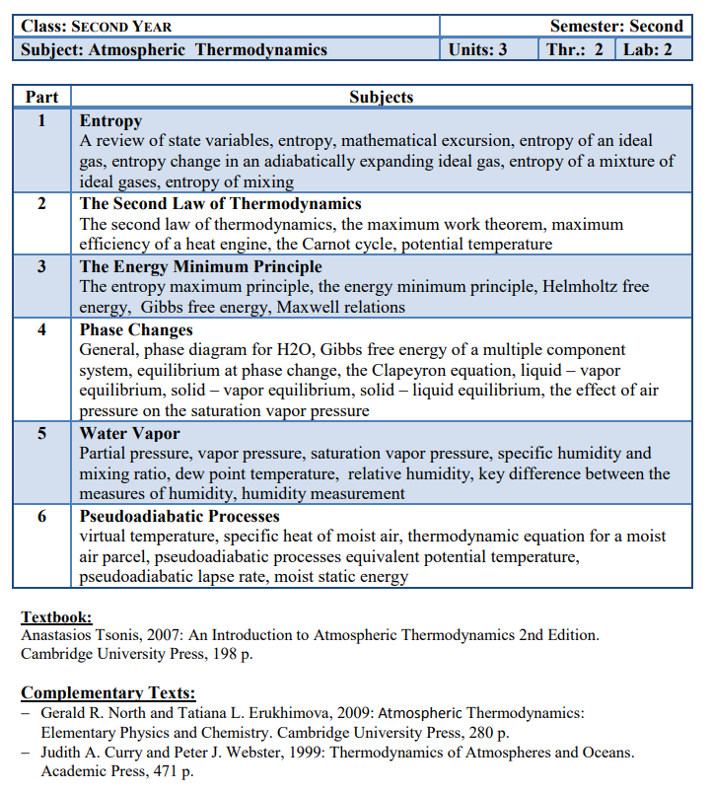

Slide 3
This lecture including the following items
Geopotential and Geopotential Height.
Thickness and the hypsometric equation.
Is the upper atmosphere well mixed?

Slide 4

GEOPOTENTIAL Φ(z)
  Since Earth is rotating, the force observed as Gravity is the resultant of the:
  Gravitational acceleration + Centrifugal acceleration from the Earth’s rotation.
The acceleration due to gravity is not constant, it depends on Altitude and Latitude, with the largest variation due to latitude.
Though small, the variation in gravity must be accounted via the concept of geopotential.
FYI: CHECK THIS PAGE
Notes:
https://byjus.com/jee/acceleration-due-to-gravity/#:~:text=The%20above%20acceleration%20is%20due,by%20%3D%20GM%2Fr2.

Slide 5
GEOPOTENTIAL Φ(z)
  Definition:
  The potential energy of a unit mass relative to sea level,
  Numerically:
  Work that must be done against the Earth’s gravitational field in order to raise a mass of 1 kg from sea level to that point.
  Units:
  Joules (J) ( it is the units of work)
  So the work to lift a mass a certain height is: J kg⁻¹. Since a Joule is also defined as a Newton * meter, where Newton = kg m s⁻², we can substitute for J above to yield an alternative unit for geopotential: m² s⁻²
Notes:
http://glossary.ametsoc.org/wiki/Main_Page

Slide 6
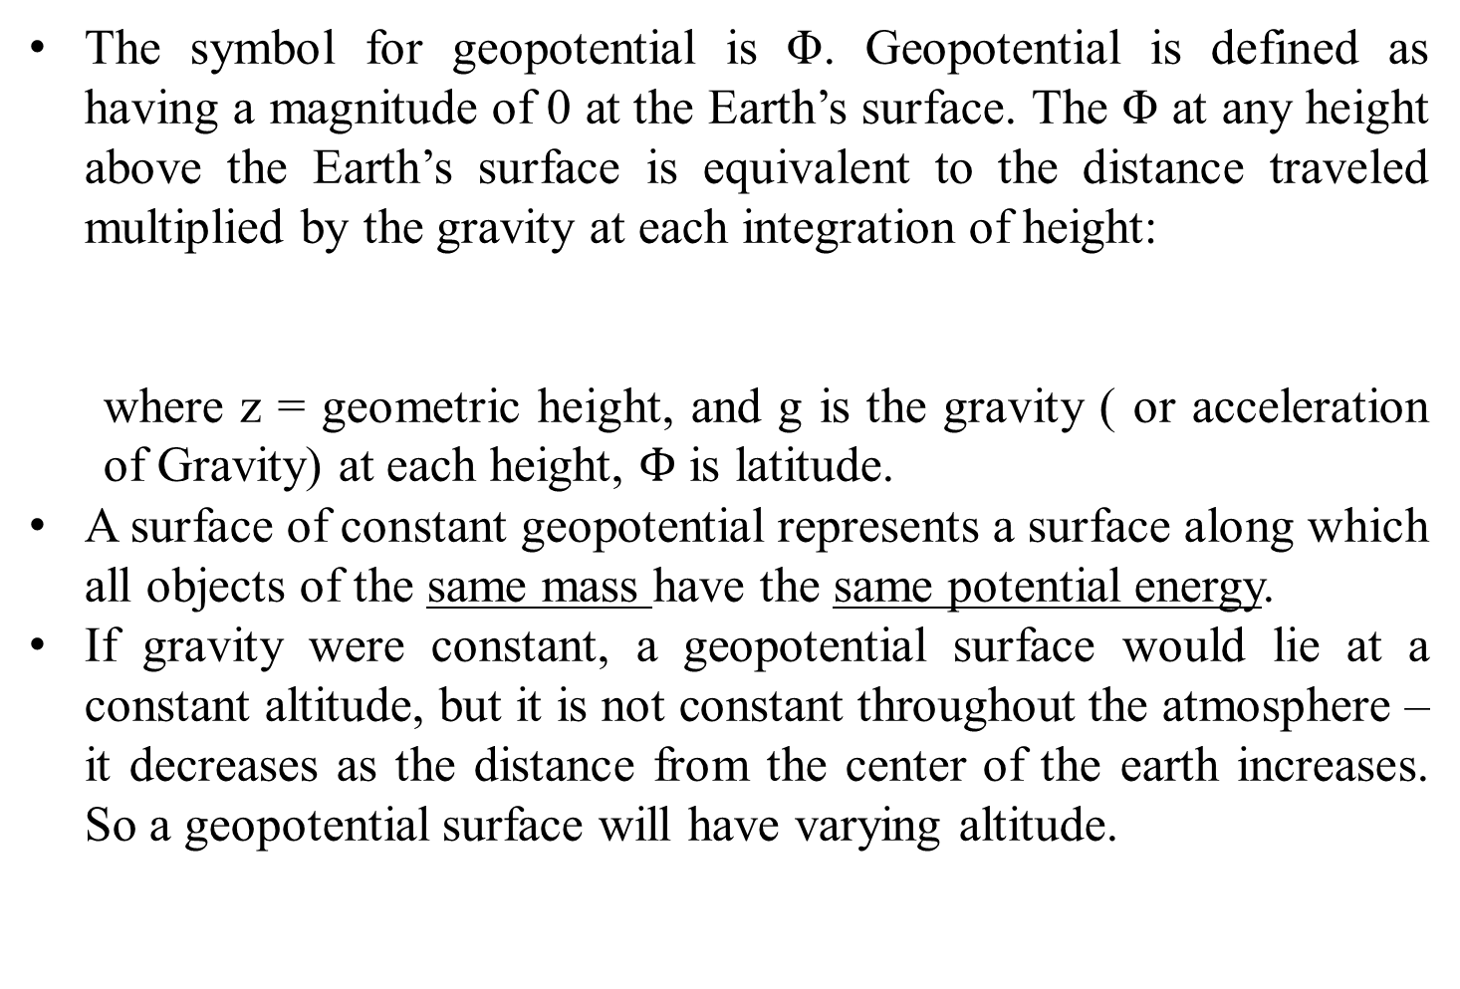
GEOPOTENTIAL Φ(z)
The symbol for geopotential is Φ. Geopotential is defined as having a magnitude of 0 at the Earth’s surface. The Φ at any height above the Earth’s surface is equivalent to the distance traveled multiplied by the gravity at each integration of height:
  where z = geometric height, and g is the gravity ( or acceleration of Gravity) at each height, $Φ$ is latitude.
A surface of constant geopotential represents a surface along which all objects of the same mass have the same potential energy.
If gravity were constant, a geopotential surface would lie at a constant altitude, but it is not constant throughout the atmosphere – it decreases as the distance from the center of the earth increases. So a geopotential surface will have varying altitude.
or
….. (1)
Notes:
http://glossary.ametsoc.org/wiki/Main_Page
https://home.chpc.utah.edu/~hallar/Thermo/Lectures/Lecture5.pdf
https://www.mathpages.com/home/kmath054/kmath054.htm

Slide 7
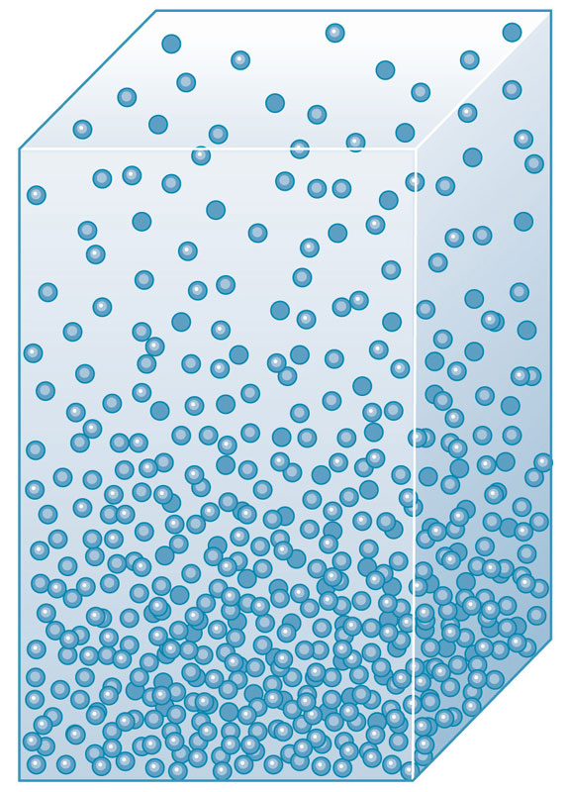
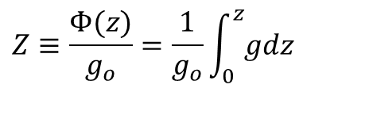
Geopotential Height Z
Geopotential height is a vertical coordinate referenced to Earth's mean sea level — an adjustment to geometric height (elevation above mean sea level) using the variation of gravity with latitude and elevation. Geopotential height is roughly defined as the height of a pressure surface in the atmosphere above mean sea level.
Z
The geopotential height is defined as the geopotential at height Z (Equation 1) divided by the Gravity (globally averaged acceleration of gravity at sea level (g_{o} = 9.806 65 m s⁻²).
It is represented as a capital ‘Z’.
dz
$$Z≡\frac{Φ(z)}{g_{o}}=\frac{1}{g_{o}}\int_{0}^{z}{gdz}$$
……(2)
Notes:
Geopotential (from the dynamic point of view) is a better measure of height in the atmosphere than geometric height, since energy is, in general, lost or gained when air moves along a geometrically level surface, but not when it moves along an equigeopotential surface.

Slide 8
Geopotential Height Z
Geopotential height is used as the vertical coordinate in most atmospheric applications in which energy plays an important role (e.g., in large-scale atmospheric motions). It is expressed in geopotential meters, abbreviated as gpm.
Note that as geometric height (z) increases, Z becomes increasingly less because the acceleration of Gravity is decreasing. This means less work is required (Φ(z) is getting smaller) to lift the mass to that point because the opposing force (g) is decreasing.
……(2)

Slide 9
Geopotential Height Z
In the lower atmosphere, Z is very close to z (called the ‘geometric or actual height’) where g_{o} ~ g, The table below shows how Z,z, and g vary with height at a typical mid-latitude location.
z(km) | Z(km) | g(ms⁻²)
0 | 0 | 9.802
1 | 1 | 9.798
10 | 9.986 | 9.771
20 | 19.941 | 9.741
30 | 29.864 | 9.71
60 | 59.449 | 9.62
90 | 88.758 | 9.531
120 | 117.795 | 9.443
160 | 156.096 | 9.327
200 | 193.928 | 9.214
300 | 286.52 | 8.94
400 | 376.37 | 8.677
500 | 463.597 | 8.427
600 | 548.314 | 8.186

Slide 10

Geopotential Height Z
If the change in gravity with height is ignored, geopotential height and geometric height are related via
If the g is stronger than g_{o}, then Z > z.
If the g is weaker than g_{o} , then Z < z.
Gravity varies, at the North Pole is approximately 9.83 m/s², while at the Equator it is about 9.78 m/s².
Therefore, g/g₀ ~ 1, and for many applications we can ignore the difference between geopotential and geometric height, since Z ~ z.
But, keep in mind that they are different, and at times this difference, though small, is very important and cannot be neglected.
FYI: the acceleration due to gravity is inversely proportional to the square of the radius of the earth, and it is more at poles and less at the equator. So if a person moves from the equator to poles his weight decreases as the value of g decreases
Notes:
The magnitude of the force of gravity at sea level decreases from the poles, where the centrifugal force is zero, to the equator, where the centrifugal force is a maximum but directed opposite to the force of gravitation.
Gravity is often assumed to be the same everywhere on Earth, but it varies because the planet is not perfectly spherical or uniformly dense. In addition, gravity is weaker at the equator due to centrifugal forces produced by the planet’s rotation. It’s also weaker at higher altitudes, further from Earth’s centre, such as at the summit of Mount Everest.

Slide 11

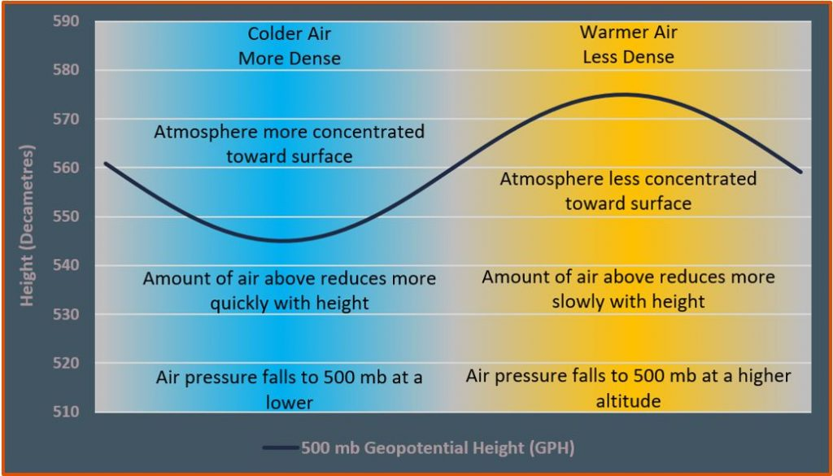
Thickness and the hypsometric equation
The hypsometric equation tells us that the thickness between two pressure levels is directly proportional to the average temperature within the layer.
We can use thickness as a measure of the average temperature of a layer.
We can use contours of thickness in a similar manner to how we use isotherms.
Colder layers are thinner, warmer layers are thicker.

Slide 12

Why using hypsometric equation
Weather observing stations measure station pressure, which must be converted to sea-level pressure for reporting and plotting on weather charts.
The method of calculating the sea-level pressure is called pressure reduction or reducing the pressure to sea-level
Sea-level pressure reduction is accomplished via the hypsometric equation, treating Z₁ = 0 as sea level, and Z₂ = Z_{sta} as the geopotential height of the station.
This means p1 = p_{sl}, the sea-level pressure, P₂ = P_{sta}, the station pressure, and by Rearranging hypsometric equation with these definitions give:
There are different formulas used in various applications according to the layer-average temperature in the hypothetical atmospheric layer between the surface and sea level.

Slide 13
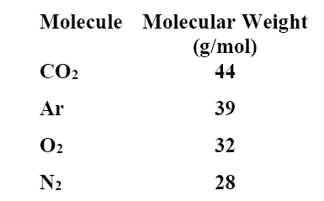
IS THE UPPER ATMOSPHERE WELL MIXED?
The atmosphere is a mixture of several different gases. The most abundant are N2, O2, Ar, and CO2.
In order of molecular weight we have
Notes:
http://apollo.lsc.vsc.edu/classes/met130/index.html

Slide 14
IS THE UPPER ATMOSPHERE WELL MIXED?
You would think that the atmosphere would stratify according to weight, with the heaviest molecules having the greatest concentration near the surface. Therefore, we would expect most of the CO2 and Ar to be found near the surface.
Without turbulence, molecular diffusion would dominate any vertical transport processes.
  Molecular diffusion favors lighter molecules over heavier ones. Therefore, the lighter molecules would be better mixed through a layer than would the heavier molecules, which would remain near the bottom due to gravity.
  Molecular diffusion is characterized by the mean free path, which is the average distance between collisions.
Notes:
http://apollo.lsc.vsc.edu/classes/met130/index.html

Slide 15
IS THE UPPER ATMOSPHERE WELL MIXED?
The shorter the mean free path, the less effective molecular diffusion becomes.
Mean free path increases as pressure (and density) decrease.
If turbulence is present, mixing is accomplished very efficiently.
  Turbulent mixing does not discriminate based on mass. All molecules are mixed just as effectively.
  Turbulent mixing is characterized by the mixing length, which is the average length that an air parcel can travel and still retain its identity.
If the mixing length is greater than the mean free path, turbulent mixing will dominate and all molecules will be well mixed.
Notes:
http://apollo.lsc.vsc.edu/classes/met130/index.html

Slide 16
IS THE UPPER ATMOSPHERE WELL MIXED?
If the mean free path is greater than the mixing length, molecular diffusion will dominate and the heavier molecules will be found toward the bottom.
Up to about 80 km or so, the mixing length is larger than the mean free path, so that turbulent mixing dominates and the atmosphere is well mixed.
Above 80 km the mean free path becomes larger than the mixing length (because density is decreasing with altitude). Therefore, above 80 km molecular diffusion dominates and the atmosphere is no longer well mixed. Instead, it becomes stratifies with the heavier molecules concentrated at the bottom.
The well-mixed region is called the homosphere.
The stratified region is called the heterosphere.
The transition layer between the two is called the turbopause.
Notes:
http://apollo.lsc.vsc.edu/classes/met130/index.html

Slide 17
Exercise
If the thickness of the 1000 – 500 hPa layer is 5400 gpm, what is the layer average temperature in kelvin?
What is the geopotential and why it is used?
How to reduce the pressure at the station to the pressure at MSL? Write down a formula.

