Slide 1

Turbulent kinetic energy
Basim ALknani

Slide 2
Turbulence is an intrinsic part of the atmospheric boundary layer that must be quantified in order to study it. The randomness of turbulence makes deterministic description difficult. Instead, we are forced to retreat to the use of statistics, where we are limited to average or expected measures of turbulence.
Statistical descriptors such as the variance or covariance are of limited usefulness unless we can physically interpret them. Variances are shown to be measures of turbulence intensity or turbulence kinetic energy, and covariances are shown to be measures of flux or stress.

Slide 3
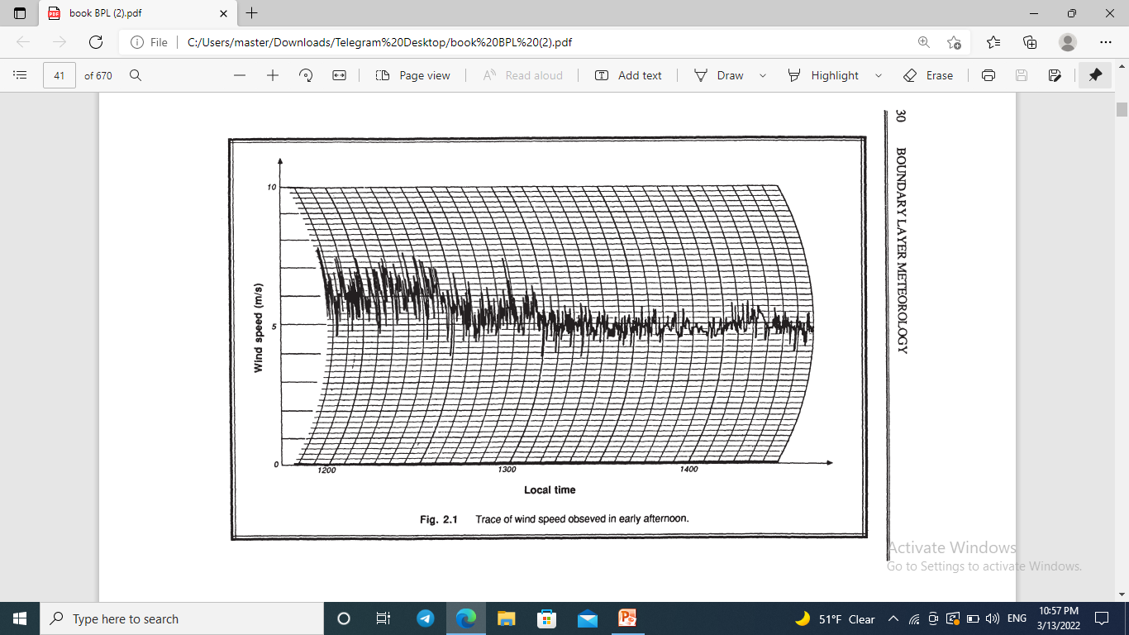
The wind speed varies in an irregular pattern - a characteristic signature of turbulence. This quasi-randomness is what makes turbulence different from other motions, like waves.
We can visually pick out a mean, or typical, value of the wind speed. For example, between noon and 1230 local time the average wind speed is about 6 m/s, while a bit later (between 1400 and 1430) the winds have decreased to about 5 m/s on the average. The ability to find a statistically-stable mean value suggests that
turbulence is not completely random.
Near noon the instantaneous wind speed is often 1 m/s faster or slower than the mean, while at 1400 the wind speed varies by only about 0.5 m/s about its mean. Such a bounded characteristic of the wind speed means that we can use statistics such as the variance or standard deviation to characterize the turbulence intensity.

Slide 4
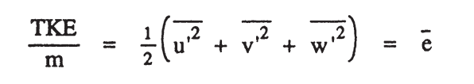
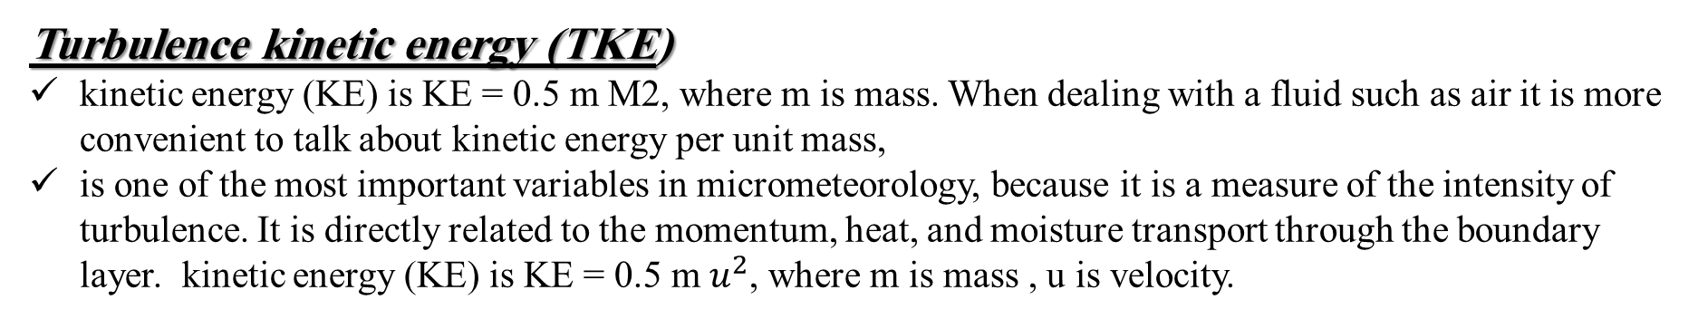
Turbulence kinetic energy (TKE)
kinetic energy (KE) is KE = 0.5 m M2, where m is mass. When dealing with a fluid such as air it is more convenient to talk about kinetic energy per unit mass,
is one of the most important variables in micrometeorology, because it is a measure of the intensity of turbulence. It is directly related to the momentum, heat, and moisture transport through the boundary layer. kinetic energy (KE) is KE = 0.5 m $u^{2}$, where m is mass , u is velocity.
The turbulence kinetic energy is one of the most important quantities used to study the turbulent BL.
We have already discussed in Chapter 1 that turbulence can be generated by buoyant thermals and by mechanical eddies.
By writing a budget for the equation for TKE, we can balance the production terms against the loss terms to determine
whether the BL will become more turbulent, or whether turbulence will decay in the BL.

Slide 5
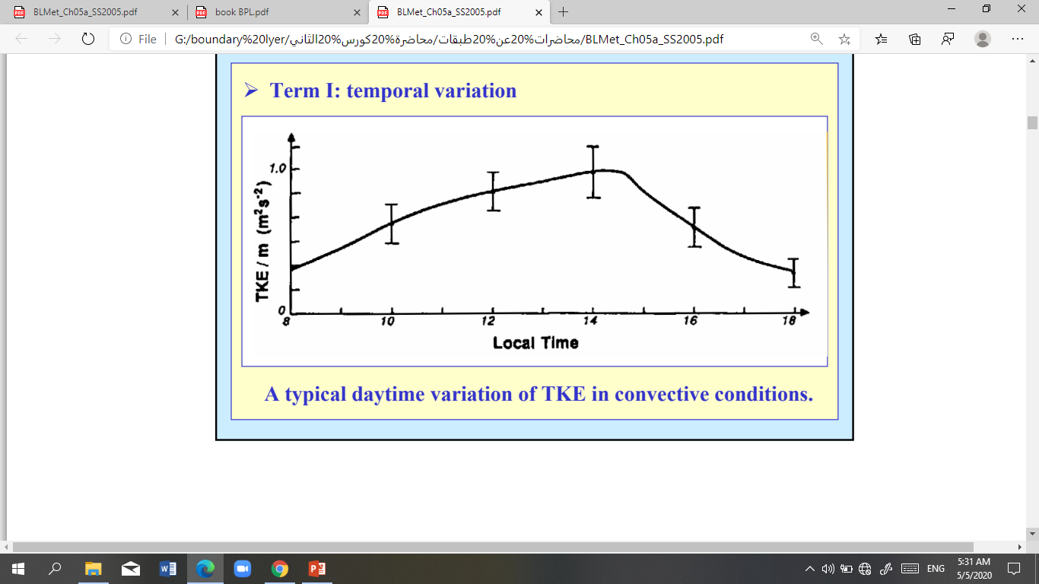
A typical daytime variation of TKE in convective conditions is shown in Fig 2.8.

Slide 6
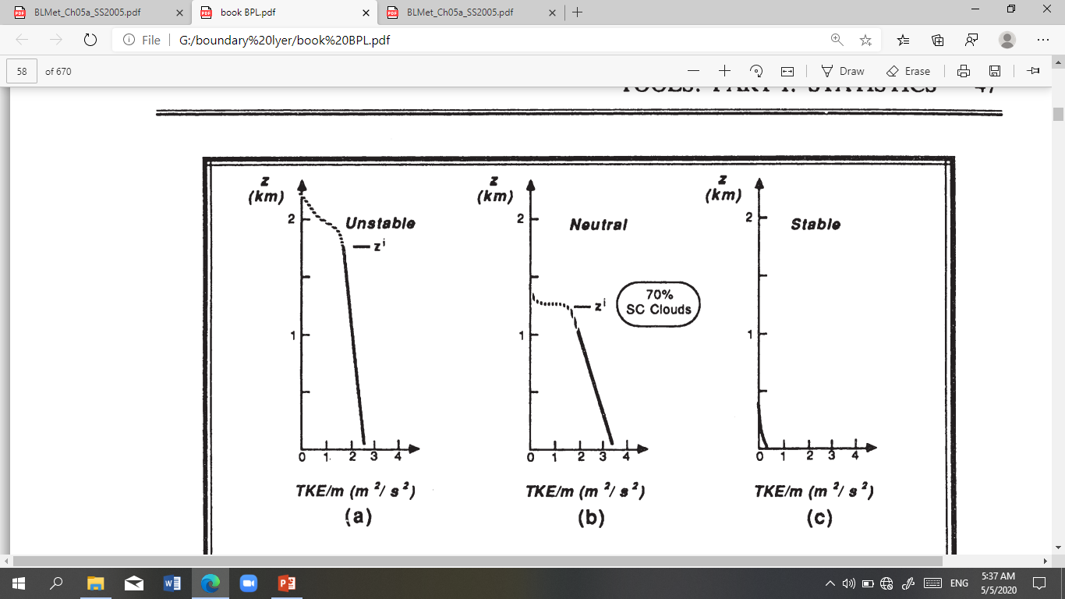
The vertical profile of TKE for various boundary layers are shown in Fig 2.9.
Fig. 2.9 of turbulence kinetic energy per unit mass (TKE/m = 1/2 ($U^{2}+V^{2}+W^{2}$) for various boundary layers: (a) Daytime convective mixed layer with mostly clear skies and light winds (b) Near neutral day with strong winds (10-15 m/s at surface) and broken clouds (c) Nocturnal stable boundary layer.
During the daytime, buoyancy allows air parcels to accelerate in the middle of the ML, allowing $\overline{W^{2} }$to be large there and contributing to the total TKE (Fig 2.9a).
On overcast days when there is little heating of the ground, wind shears and flow over obstacles create turbulence near the ground that gradually decreases intensity with height(Fig 2.9b). This turbulence is produced in primarily the$\overline{{ U}^{2}}$ and $\overline{V^{2}}$ components. Days of both strong winds and strong heating will have both sources of turbulence.
For night, Fig 2.9c shows how the static stability suppresses the TKE, causing it to decrease rapidly with height. Turbulence is produced primarily near the ground by wind shears. although the enhanced shears near the nocturnal jet can also generate turbulence.

Slide 7
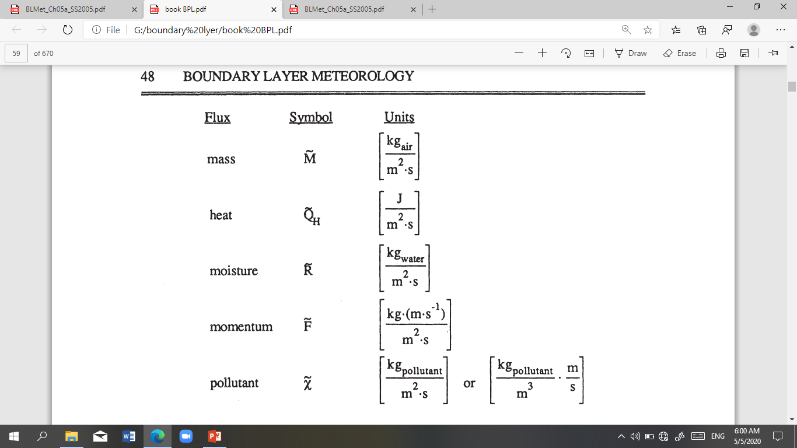
Kinematic Flux
Flux is the transfer of a quantity per unit area per unit time.
In BL meteorology, we are often concerned with mass, heat, moisture, momentum and pollutant fluxes. The dimensions of these fluxes are summarized below, using SI units as the example:

Slide 8
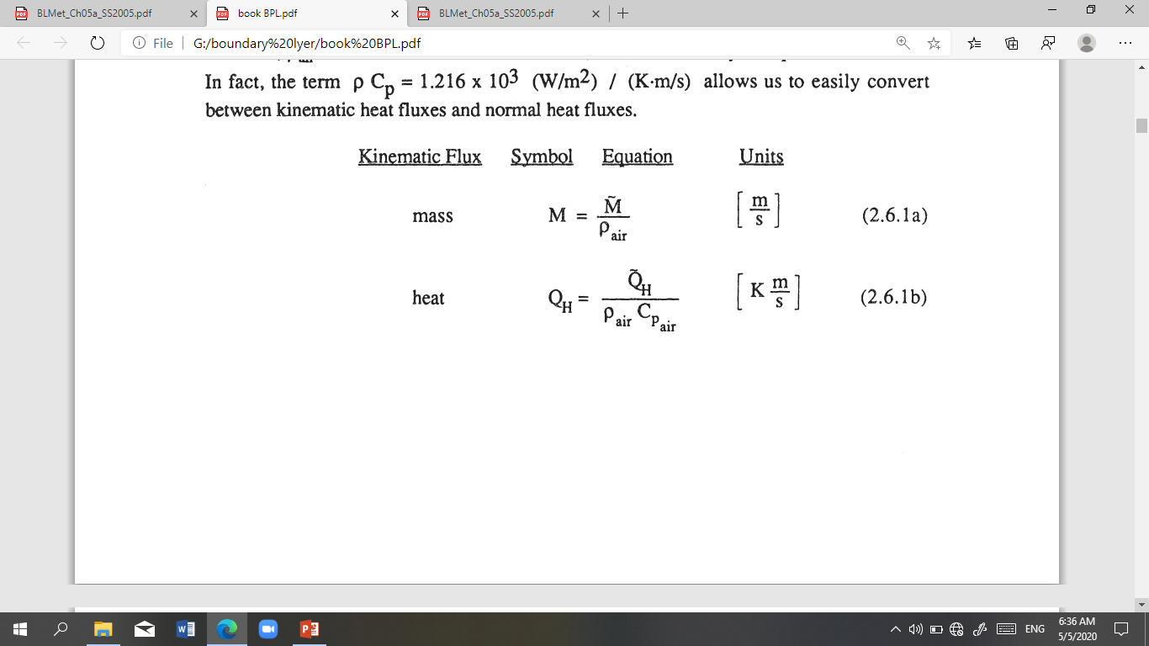
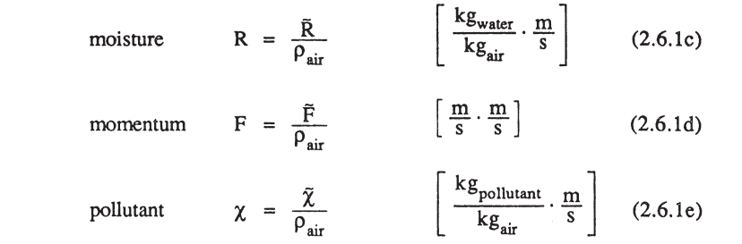
Momentum is mass times velocity (kg·m/s); thus, a momentum flux is (kg·m/s)/(${ m}^{2}$.s). These units are identical to N/${ m}^{2}$, which are the units for stress.
kinematic mass fluxes
kinematic heat fluxes
kinematic moisture fluxes
kinematic momentum fluxes

Slide 9
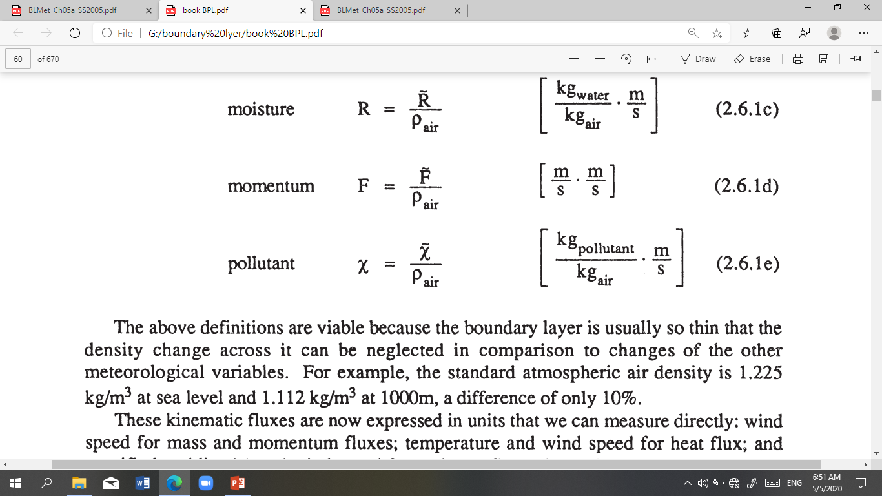
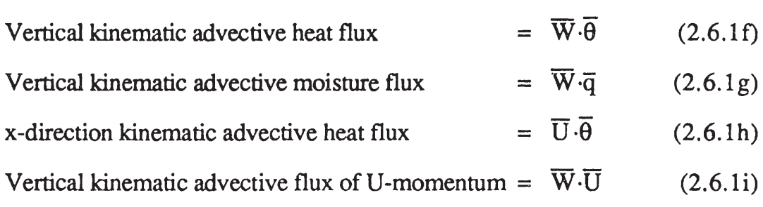
These kinematic fluxes are now expressed in units that we can measure directly: wind speed for mass and momentum fluxes; temperature and wind speed for heat flux; and specific humidity (q) and wind speed for moisture flux. The pollutant flux is frequently expressed in either form: concentration and wind speed, or mass ratio (like parts per million, ppm) and wind speed.
For the flux associated with the mean wind (advection). for example. that

Slide 10
