Slide 1
1-3 SOFTWARE AND HARDWARE
Software is the stuff that makes your computer do things for you. The computer without software would be like a home entertainment system with no tapes, CD is, or movies - you have the machine, but there is nothing to play on it.
Software is continually developed. Each time the software maker (Microsoft, Adobe, Corel, etc) develops a new version of their software they assign it a version number.
Before Microsoft Word 7, there was Microsoft Word 6.0.1, and before that Word 6.0. The larger the developments made to the software, the larger the version number changes. Usually, a large change will result in a whole number upgrade; a small change may `result in a tenth of a decimal place.

Slide 2
Hardware is the term given to the physical components of a computer: e.g., keyboard, monitor, system box or floppy disk drive.
Software, on the other hand, is electronic information: files, operating system, graphics, computer programs are all example of software.
The difference between hardware and software reflects the duality between the physical and mental worlds: for example, your brain is hardware, whereas your mind is software.

Slide 3
Hardware are those components or physical pieces (things you can touch) that make up the computer.
The different pieces of the computer’s hardware are monitor, speakers, mouse, CDROM, floppy drive, hard drive, keyboard, CPU, RAM, Processor, etc. Each piece plays a role in the operation of a computer.

Slide 4
3-2 DIFFERENT PARTS OF A COMPUTER AND THEIR USES
The standard computer consists of a monitor, a keyboard, a mouse and the system unit.
One can attach accessories such as printers and scanners by means of ports. Increasingly in the workplace, computers are connected to printers and other computers by means of a network.

Slide 5
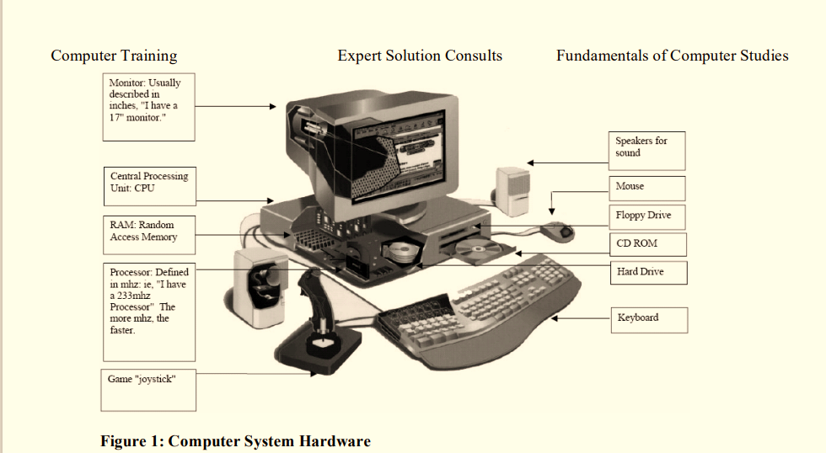

Slide 6
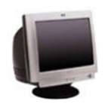
3-2-1The monitor
This is the Visual Display Unit (VDU).
There are various technologies for the display unit, cathode ray tube (CRT) or Liquid Crystal Display (LCD) or electro luminescent screens or the projector. The monitor or screen displays your work.
Facing it down reduces reflected glare from room lights.
This reflection may affect your sight. Monitors come in different sizes. The (most important) size of the monitor is measured diagonally on the screen (in inches). Based on this, the monitors range in sizes of 12", 14", 15", 17", 19", 21", 29", etc. Monitors are also characterized by the flatness of their screen. The flatter and the wider screens are usually the better

Slide 7
3-2-2 The system box or computer console
The system box is where all the computations that the computer performs take place. Inside are the CPU processor, the motherboard, the hard disk, any network or sound cards, memory chips (RAM), printer ports (at the back) and the drive bays for floppy disks, Zip disks or CDs. Outside the casings are the power buttons (ON/OFF and Restart) with some additional facilities like the casing USB ports, Webcams, etc.

