Slide 1
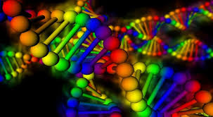
Molecular Biology Lecture 5
Post replication events
DNA proofreading and repair activity
While DNA replication errors are rare, they must be corrected by various DNA repair pathways.

Slide 2
Post replication events : DNA methylation
DNA methylation: is a biochemical process involving the addition of a methyl group (CH3) to the cytosine or adenine of DNA nucleotides. The main function of DNA methylation in bacteria is to provide a mechanism, which protects the cell from the effect of foreign DNA introduction.
Restriction endonucleases are group of enzymes found in the cytosol of the bacteria and are able to digest any foreign DNA. These enzymes differentiate between endogenous and foreign DNA by its methylation pattern. Introduced DNA which is not protected by methylation, is then eliminated by cleavage.
DNA methylation is observed in most of the organisms at the different stages of evolution, however some species, like Drosophilae melanogaster lack DNA methylation.

Slide 3
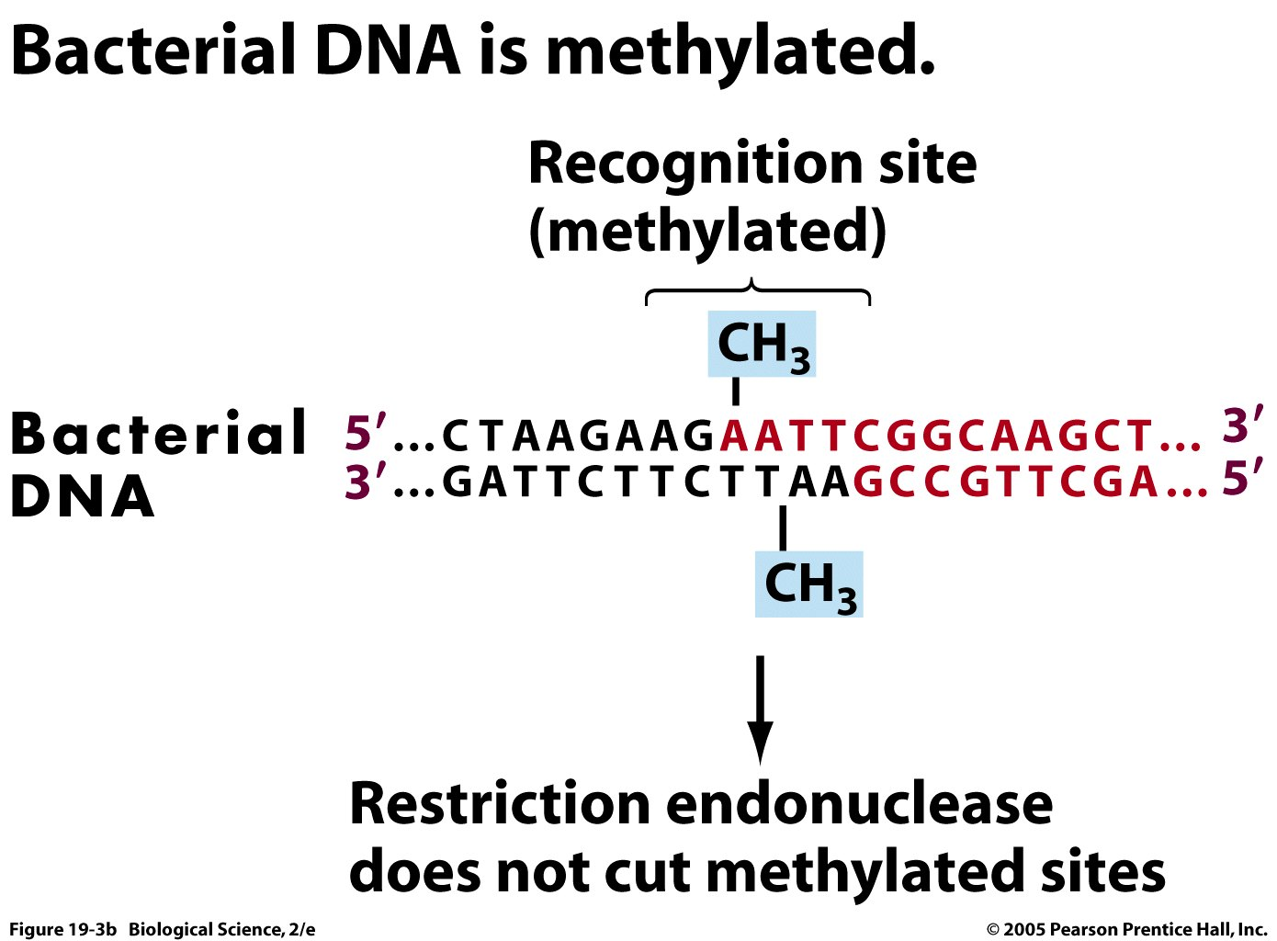
The responsible enzyme for adding methyl group is Methyltransferase. The combination of restriction endonuclease and methylase is termed the (restriction-modification System). The restriction/modification system in bacteria is a small-scale immune system for protection from infection by foreign DNA

Slide 4
Functions of DNA methylation in prokaryotes
1-The main function of DNA methylation in bacteria is to provide a mechanism, which protects the cell from the effect of foreign DNA introduction.
2-Another function of DNA methylation in prokaryotes is the involvement in the control of replication fidelity.
During DNA replication the newly synthesized strand does not get methylated immediately, but analyzed for mismatches by the Mismatch repair system. Since methylation occurs after replication, newly synthesized DNA strands are not methylated and thus can be specifically recognized. When a mutation is found, the correction takes place on the non methylated strand. Methylation of Adenine nucleotide is most predominant in prokaryotic cell.
The methylation occur at specific site of DNA sequences (N6 nitrogen position in adenine).

Slide 5
The newly synthesized complementary strand must be methylated as the parent strand.

Slide 6
Eukaryotic DNA methylation is an epigenetic mechanism involving the transfer of a methyl group onto the C5 position of the cytosine to form 5-methylcytosine and specific for CpG sequence (5'—C—phosphate—G—3). DNA methylation regulates gene expression by recruiting proteins involved in gene repression or by inhibiting the binding of transcription factor(s) to DNA.
DNA methylation is catalyzed by a family of DNA methyltransferases (Dnmts) that transfer a methyl group from S-Adenosyl methionine (SAM-e) to the 5th carbon of a cytosine residue to form 5-methylcytosine.

Slide 7
DNA proofreading and repair activity
DNA, like any other molecule, can undergo a variety of chemical reactions. Mutations can result from the incorporation of incorrect bases during DNA replication. In addition, various chemical changes occur in DNA either spontaneously or as a result of exposure to chemicals or radiation. Such damage to DNA can block replication or transcription.

Slide 8
DNA replication is a highly accurate process, but mistakes can occasionally occur, such as a DNA polymerase inserting a wrong base. Uncorrected mistakes may sometimes lead to serious consequences (such as cancer in eukaryotes).
DNA molecules have an error rate of one nucleotide for (10¹⁰) nucleotides added.
A major mechanism responsible for the accuracy of DNA replication is the Proofreading activity of DNA polymerase.
Proofreading depends on a 3’----5' exonuclease activity of some DNA polymerases. When an incorrect base is incorporated during DNA synthesis, base pairing between the 3' nucleotide of the nascent strand and the template strand does not occur. As a result, the polymerase pauses, and removes the incorrect mispaired base, and replaces it with the correct base.

Slide 9
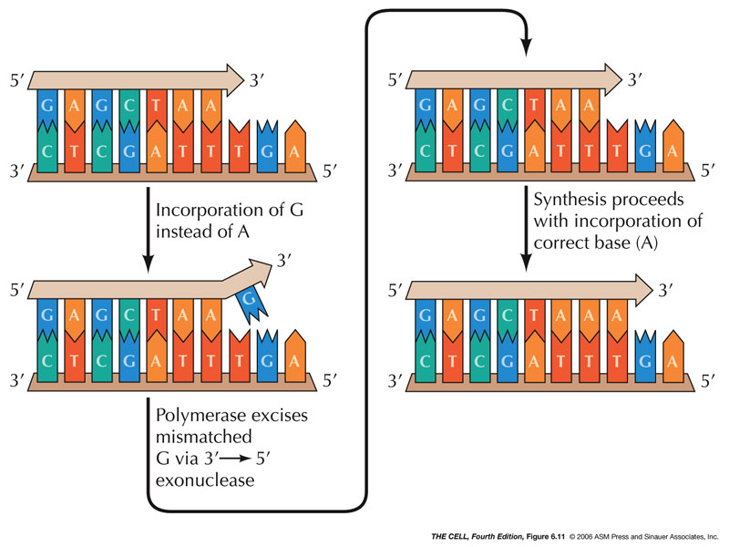
All three E. coli DNA polymerases have proofreading activity, as do the two eukaryotic DNA polymerases(Delta δ and epsilon ε) used for replication of most chromosomal DNA in animal cells

Slide 10
At least five major DNA repair pathways:
Mismatch repair (MMR), base excision repair (BER), nucleotide excision repair (NER), homologous recombination (HR) and non-homologous end joining (NHEJ)—are active throughout different stages of the cell cycle, allowing the cells to repair the DNA damage.
1- Mismatch repair : a system for recognizing and repairing some forms of DNA damage and erroneous insertion, deletion, or mis- incorporation of bases that can arise during DNA replication and recombination.
Occasionally mismatched nucleotides are not caught by proofreading and require a process called mismatch repair to remove and replace the incorrectly inserted nucleotide. DNA mismatch repair can recognize and repair insertions, deletions, and substitutions that may arise during replication.

Slide 11
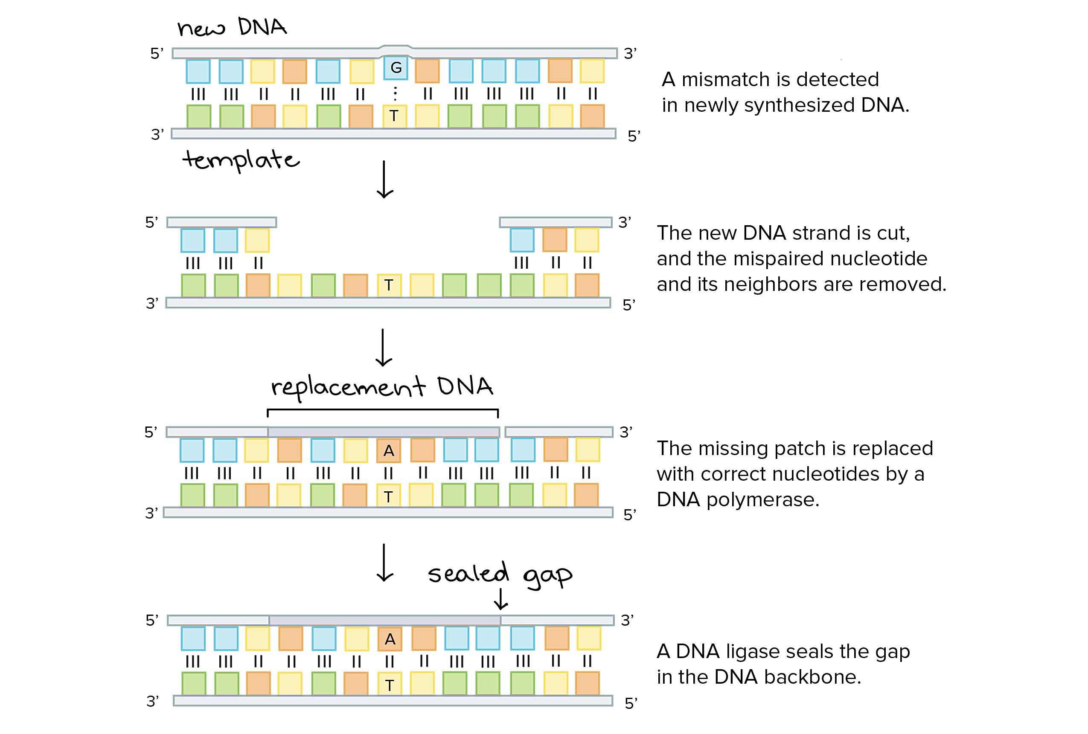
Mismatch repair system

Slide 12
2- Base Excision Repair Pathway
Base excision repair (BER) corrects small base lesions that do not significantly distort the DNA helix structure. A group of enzymes called glycosylases play a key role in base excision repair. Each glycosylase detects and removes a specific kind of damaged base. The incorrect base is flipped out of the DNA strand, cleaved, and the DNA polymerase then repairs the strand either with a single base (short-patch) or several bases that damage caused by chemical factors such as hydrolysis, methylation, and oxidation.

Slide 13
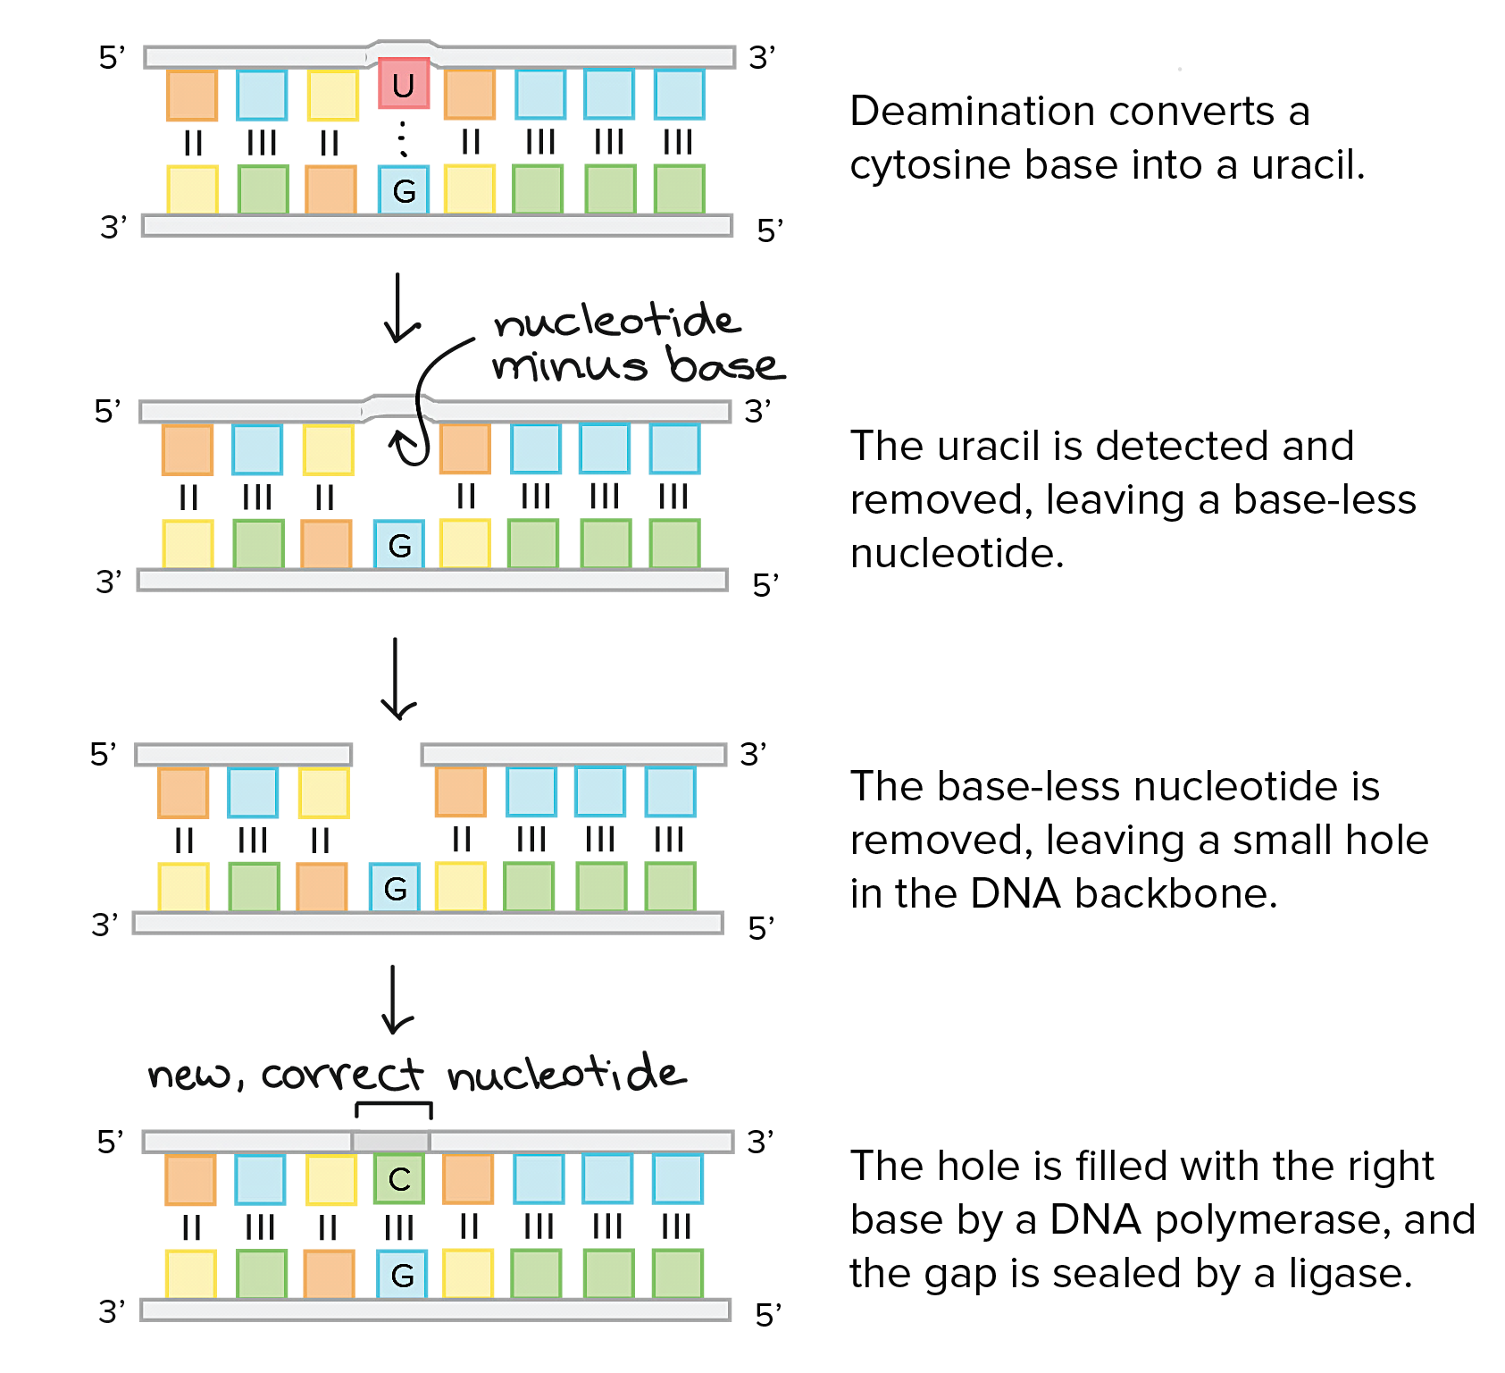
Base Excision Repair Pathway

Slide 14
3- Nucleotide Excision Repair Pathway(NER)
Nucleotide excision repair is another pathway used to remove and replace damaged bases. Nucleotide excision repair detects and corrects types of damage that distort the DNA double helix. In nucleotide excision repair, enzymes replace incorrect bases by making a cut on both the 3' and 5' ends of the incorrect bases. The segment of DNA is removed and replaced with the correctly paired nucleotides by the action of DNA polymerase. Once the bases are filled in, the remaining gap is sealed with a phosphodiester linkage catalyzed by DNA ligase. This repair mechanism is often employed when UV exposure causes the formation of pyrimidine dimers., in which adjacent pyrimidines on the same strand of DNA are joined.

Slide 15
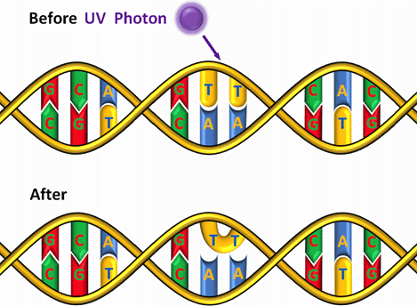
UV light causes thymine dimers. consists of two thymine bases that react with each other and become chemically linked. Cytosine and thymine bases react with neighboring bases that are also Cs or Ts, forming bonds that distort the double helix and cause errors in DNA replication.
The damaged section is cut and removed by an enzyme called nuclease. The gap is filled with the corrected nucleotides by DNA polymerase, and then the newly filled gap is sealed with the rest of the strand by DNA ligase.

Slide 16
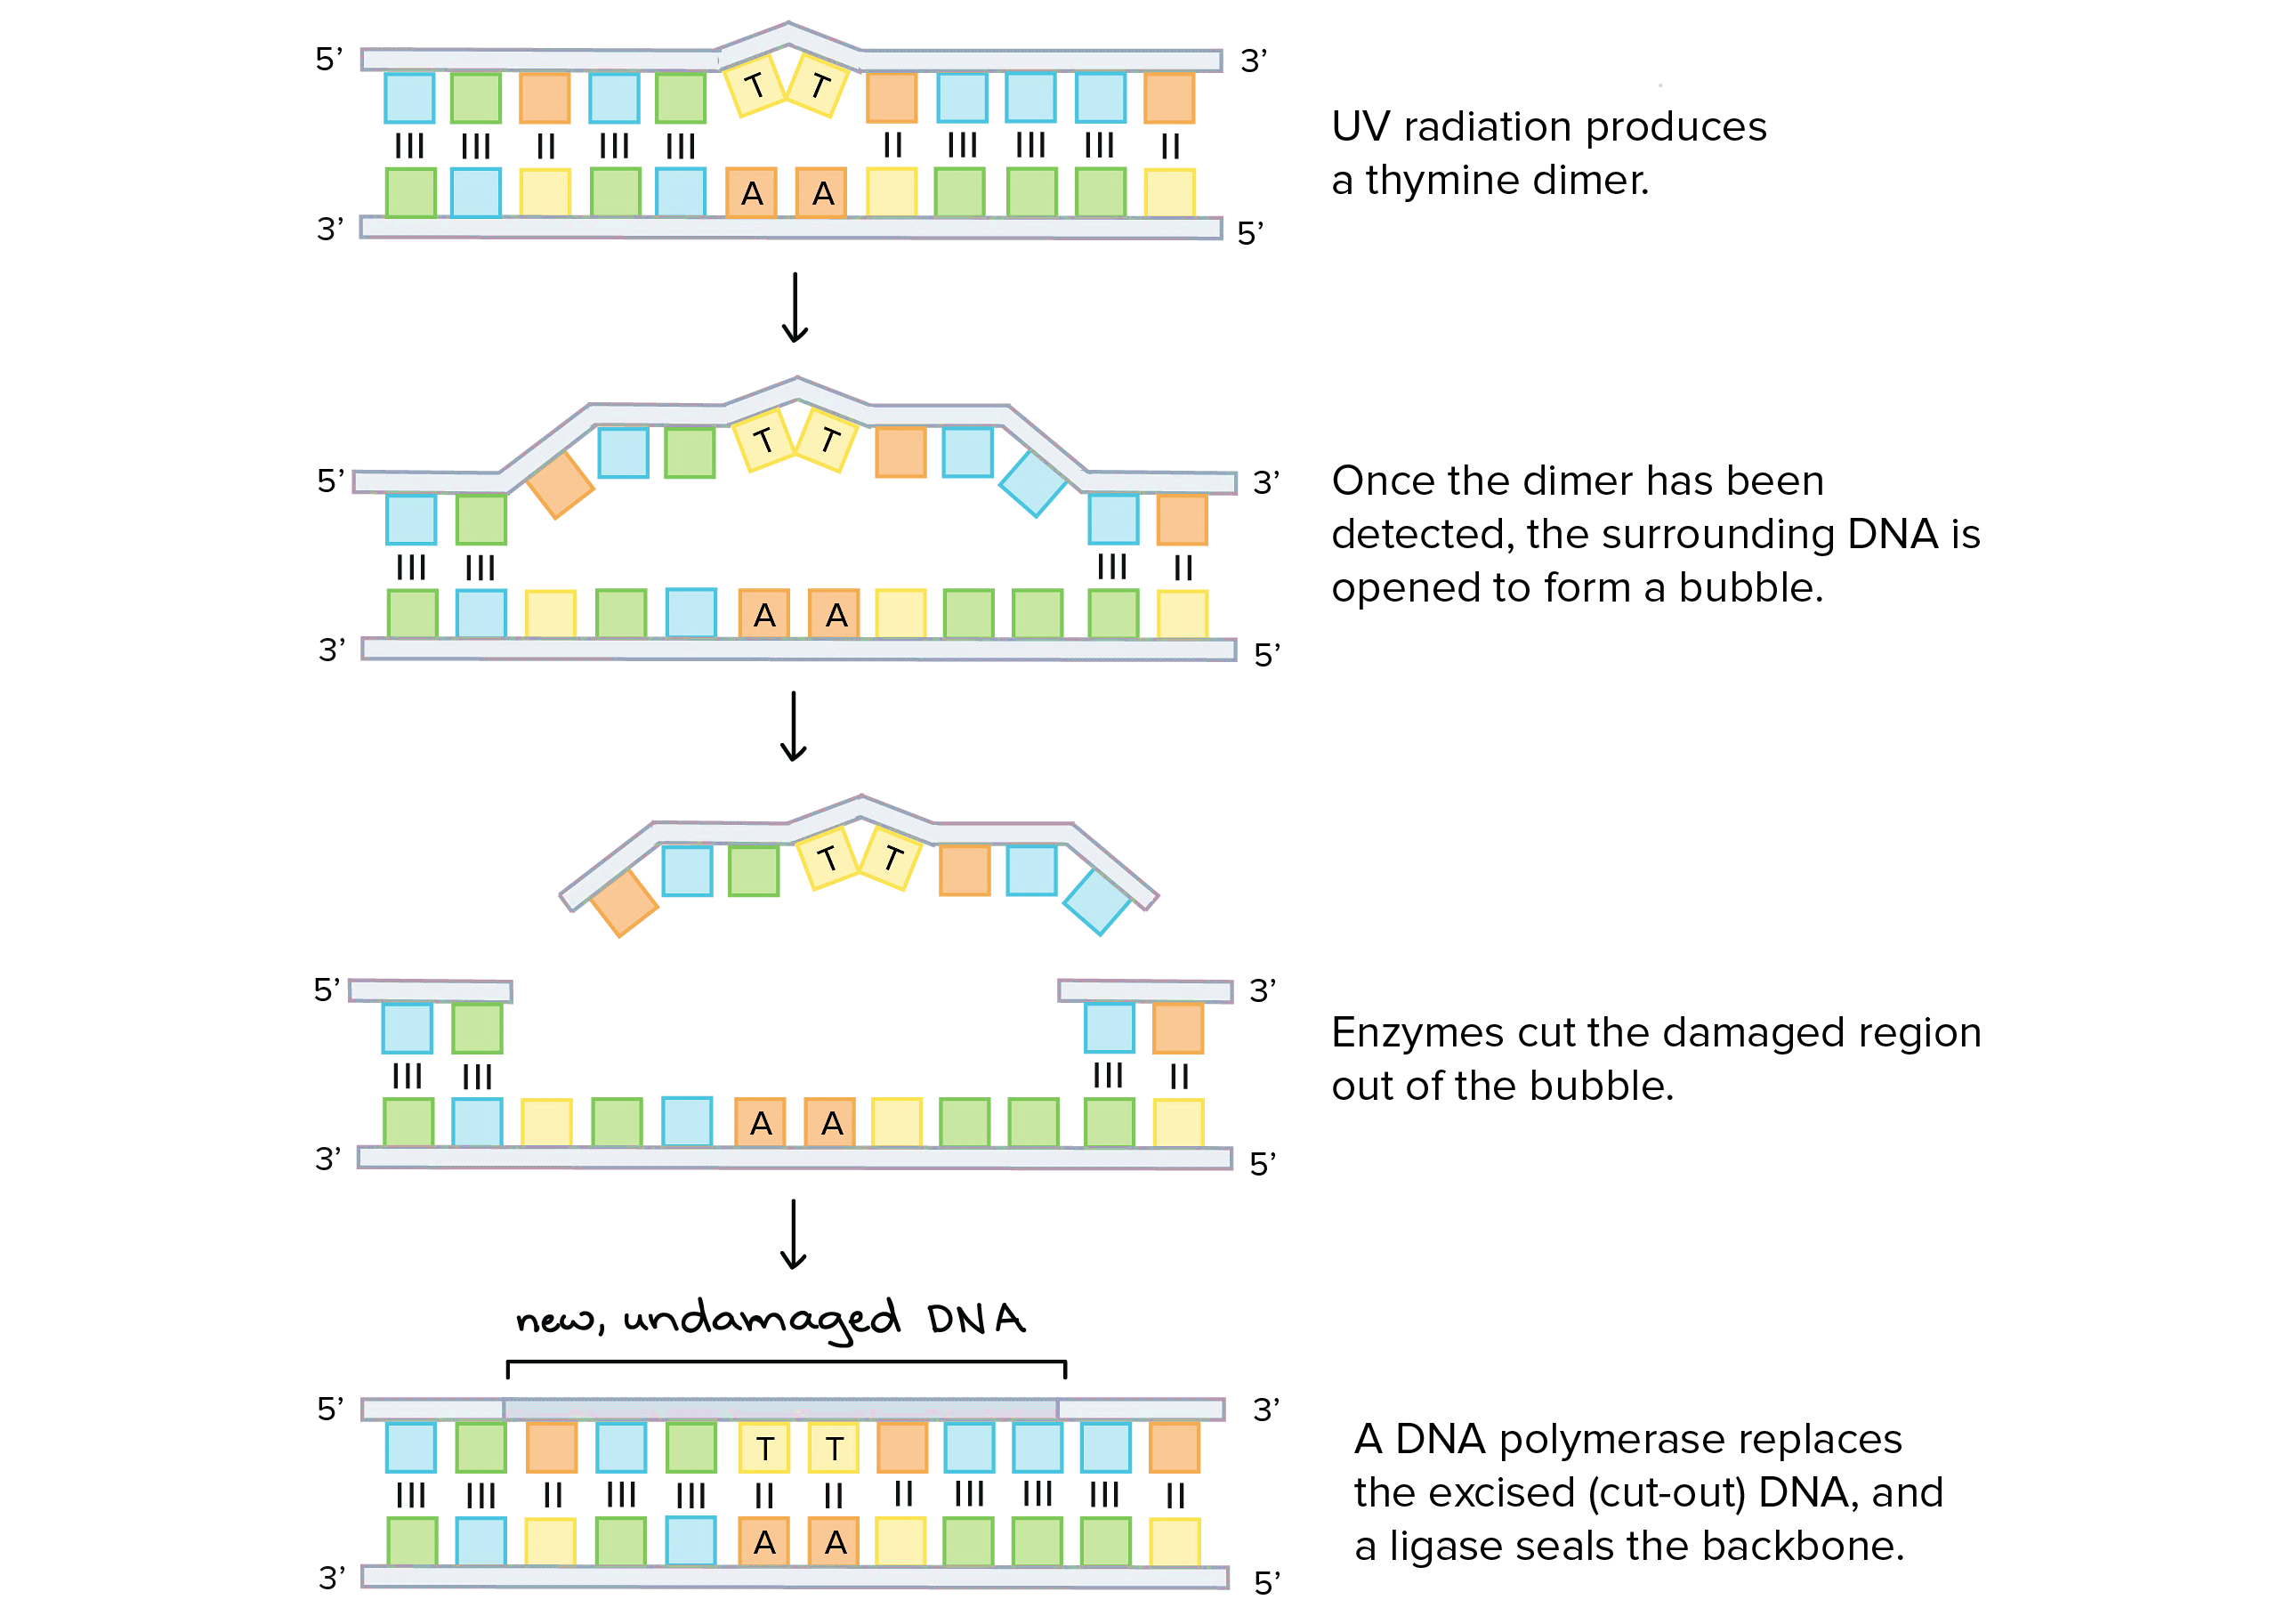
Nucleotide Excision Repair Pathway(NER)

Slide 17
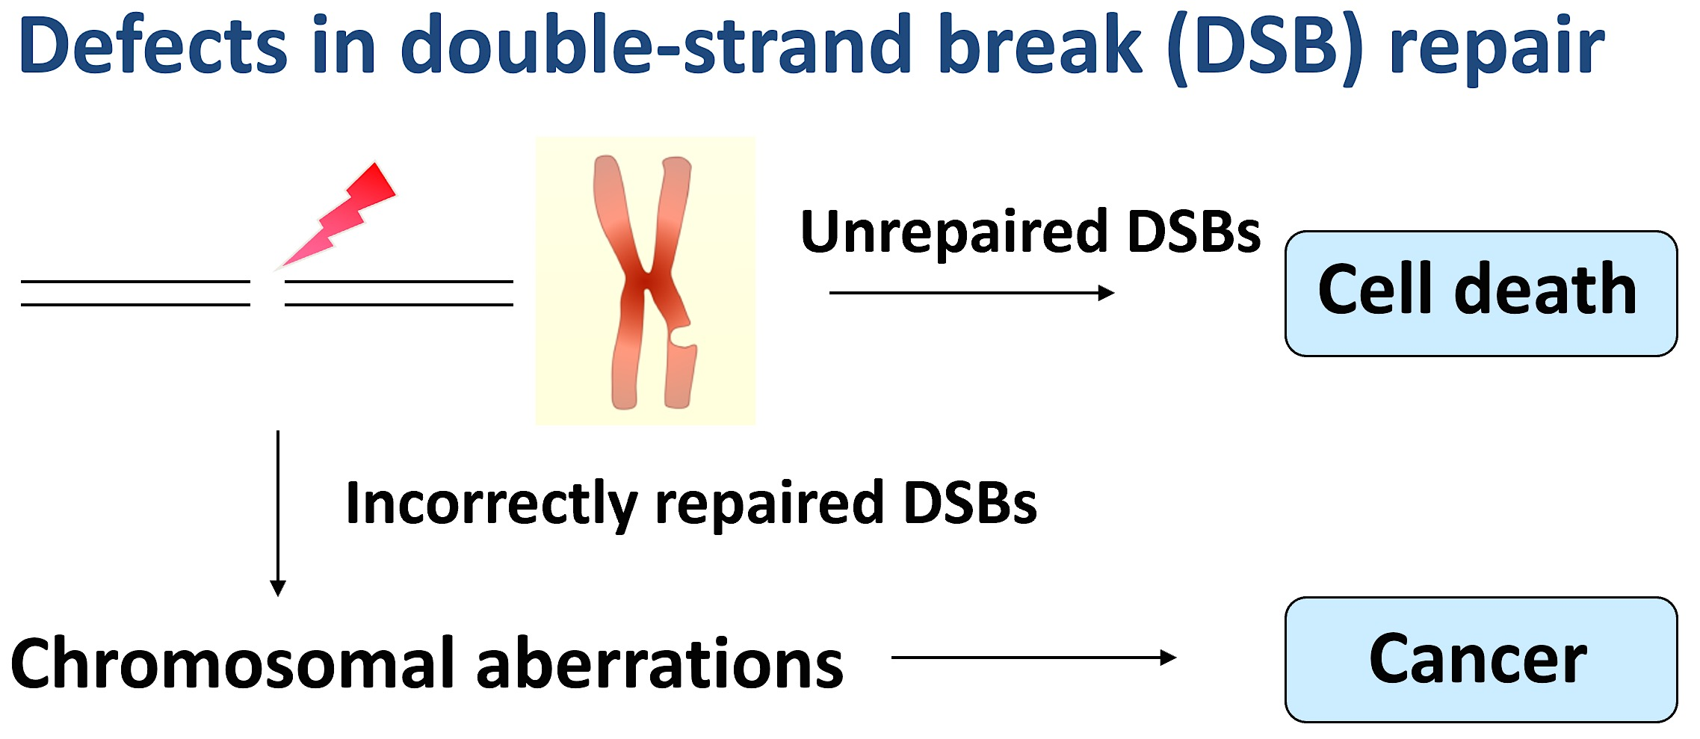
Homologous recombination (HR) and non-homologous end joining (NHEJ)
DNA double-stranded breaks (DSB) are among the most dangerous forms of DNA damage. two major pathways, non-homologous end joining and homologous recombination, are used to repair double-stranded breaks in DNA (that is, when an entire chromosome splits into two pieces).
Double-stranded breaks are dangerous because large segments of chromosomes, and the hundreds of genes they contain, may be lost if the break is not repaired
DSBs are caused by ionizing radiation, including gamma rays and X-rays. These breaks are highly deleterious.

Slide 18
4- In non-homologous end joining, the two broken ends of the chromosome are simply linked back together. This repair mechanism typically involves the loss, or sometimes addition, of a few nucleotides at the cut site. So, non-homologous end joining tends to produce a mutation, but this is better than loss of an entire chromosome arm.

Slide 19
5- Homologous recombination (HR) repair
Homologous recombination repair has been found in all organisms examined from bacteria to human. It has an important role in repairing DNA damage with high fidelity by correcting damage with the use of information copied from a homologous undamaged molecule. HR uses homologous sequences as repair templates.
Sister chromatids (duplicated chromosomes following DNA replication) or the paternal and maternal copies of chromosomes provide the required homology (sequence identity or near-identity over a few hundred DNA base pairs)

Slide 20
Proofreading, which corrects errors during DNA replication
Mismatch repair, which fixes mispaired bases right after DNA replication
DNA damage repair pathways, which detect and correct damage throughout the cell cycle

Slide 21
