Slide 1
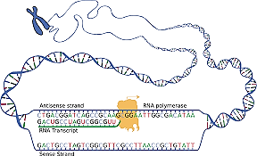
Transcription Lec 6th

Slide 2
According to central dogma , the genetic information flow from DNA the RNA via transcription process then it will translate later to functional protein.

Slide 3
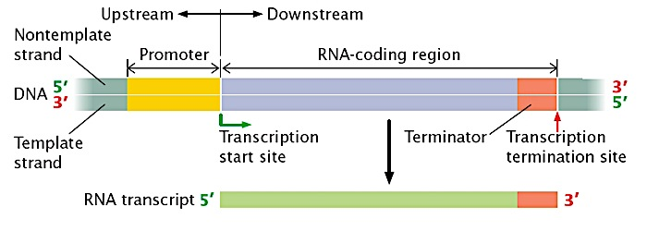
Transcription is a process of making an RNA strand from a DNA template, and the RNA molecule that is made is called transcript. Transcription like replication need free 3́ end to add the complementary nucleotide ,also the direction of movement and polymerization of RNA polymerase from 5́→3́ .

Slide 4
Identifications :
1- promoter: regulatory nucleotide sequences of DNA (40-60 nts) at the beginning of every gene locate upstream (towards the 5' region) of a gene on the template. In this site, the two DNA strands will be opened but not translated. The promoter provides a control point for regulated gene transcription. In prokaryotes, the promoter is recognized by RNA polymerase (δ sigma subunit) because it has a great affinity to bind to this region. There are great differences between the promoter area of prokaryotic and eukaryotic cell as it is divided into many sub-regions.
2- Coding region: Nucleotide sequences which will detriment the genetic code then will be translated to amino acid. It starts with ATG triplet initiation codon (AUG in mRNA). The length of coding region depend on the type of produced protein
3- Terminator: Nucleotide sequences exist after the coding region rich with poly G followed by poly C then poly A (in Prokaryotes), while in eukaryotic cells, termination begins when a polyadenylation signal appears in the RNA transcript. This is a sequence of nucleotides that marks where an RNA transcript should end. The polyadenylation signal is recognized by an enzyme that cuts the RNA transcript nearby, releasing it from RNA polymerase.

Slide 5
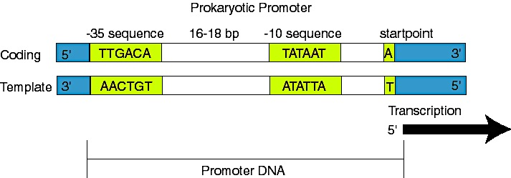
Difference between Eukaryotic and Prokaryotic Promoters
1- Prokaryotic promoter
The promoter consists of two short sequences known as -10 box and -35 box positions upstream from the transcription start site.
The sequence at -10 box is also called the Pribnow box (according to David Pribnow who discover this elements 1975) , or the -10 element, and usually consists of the six nucleotides TATAAT. The Pribnow box is absolutely essential to start transcription in prokaryotes since it rich with T & A nitrogenous bases .
The other sequence is -35 box (-35 element) that consists of the six nucleotides TTGACA. RNA polymerase attached here via its sigma subunit. The two boxes separated by 17 ±1 base pairs .

Slide 6
There are differences between the promoter region in pro and Eukaryotic cells and for sure this promoter region will not translate to protein. Eukaryotic promoters more complicated and divided into many sub regions 1- regulatory promoter to regulate promoter activity. 2-core promoter: divided into many region as with prokaryotic promoter A- recognition element at -35 box (in other reference -30 or -75 )in all cases it is rich with GC nts thus DNA will not be opened here. B- TATA box at -25 box (in other references at -26 or -29 ) as with -10 box in prokaryotic it is rich with AT nts thus the two DNA strand will be opened here (it located 25 nts far away from the start point +1). Discovered by David Hogness in 1977 thus it is called Hogness box. RNA polymerase will bind to -35 box but the two strand is opened here. C-initiator elements (Inr) : represent transcription start point (from -2 to +4) including +1 D-Downstream core promoter element (DPE): at +20 to +32 region

Slide 7
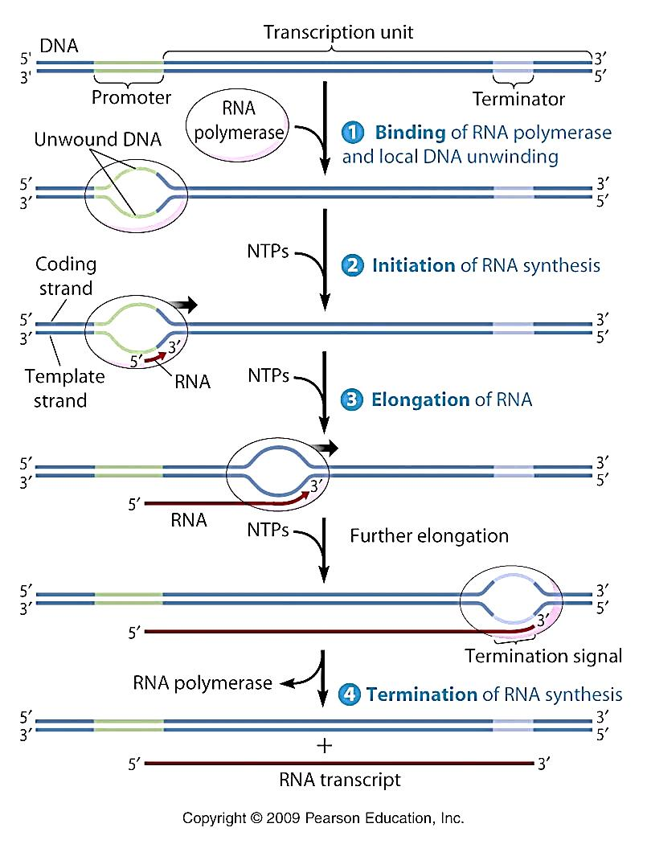
Transcription steps :As with replication ,the 3 steps are: 1-Initiation 2- Elongation 3- Termination

Slide 8
The RNA polymerase (RNAP) enzyme is composed of a core and a holoenzyme structure. The core enzyme consist from ββ’α2ω subunits. The holoenzyme is composed of core enzyme and a specific component known as sigma δ⁷⁰ which is more predominant type in E. coli.
When all the 6th subunits are present, RNA polymerase is in its active form and is referred to as the holoenzyme, but when the σ-factor detaches, it is in core polymerase form. Each subunit plays a role in the initiation of transcription, and the σ-factor must be present for initiation to occur. The sigma factor functions in aiding in promoter recognition, correct placement of RNA polymerase, and beginning unwinding at the start site.

Slide 9
First step: Initiation stage
In bacteria, binding of RNAP involves recognizing promoter region by sigma factor then binding to -35 box forming closed complex. The α subunit C-terminal domain (αCTD) helps in binding to promoter upstream elements. Usually in E. coli, σ⁷⁰ is expressed under normal conditions and recognizes promoters for genes required under normal conditions (house-keeping genes), while σ³² recognizes promoters for genes required at high temperatures (heat-shock genes).
After binding to the DNA, the RNAP switches from a closed complex to an open complex at -10 box. This change involves the separation of the DNA strands to form an unwound DNA strand of approximately 13 bp, referred to as the transcription bubble. Only one strand of DNA, called the template strand (also called the noncoding strand or nonsense/antisense strand), gets transcribed. Ribonucleotides are base-paired to the template DNA according to Watson-Crick base-pairing interactions.
Super coiling plays an important part in polymerase activity because of the unwinding and rewinding of DNA. Usually regions of DNA in front of RNAP are unwound while regions behind RNAP are rewound and negative super coiled are present.

Slide 10
RNAP
DNA
Schematic representation of bacterial RNAP holoenzyme, σ factor structure, and representative promoter structure.

Slide 11
-35 -10
Coding strand
Template strand

Slide 12
Second step: Elongation
Transcription elongation involves the further addition of ribonucleotides and change of the open complex (at -10 box) to transcriptional complex. RNAP cannot start forming full length RNA transcript because of its strong binding to the promoter. Therefore, it must leave promoter region and further progress. Transcription at this stage primarily results in short RNA fragments of around 10-9 bp. Once the RNAP starts forming longer transcript after leaving the promoter. The σ factor falls off RNAP that allows the core RNA polymerase to move forward.
Ribonucleosides are attached to the OH- molecule on the 3' end of the RNA, transcription always occurs in the 5’→3' direction. Multiple RNA polymerases can be active at once, meaning many strands of mRNA can be produced very quickly. RNAP moves down the DNA rapidly at approximately 40 bases per second.
Although RNAP does not seem to have the 3’ exonuclease activity that characterizes the proofreading activity found in DNA polymerase, there is evidence of that RNAP will halts at mismatched base-pairs and correct it.

Slide 13
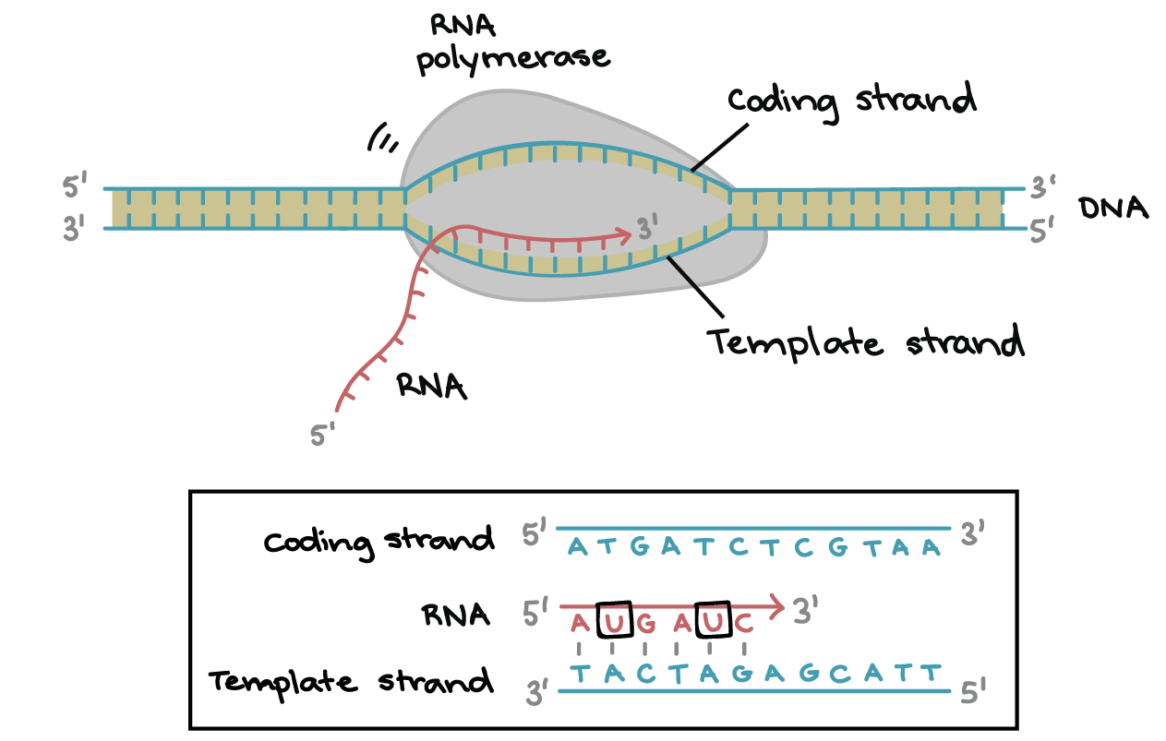
This figure shows transcriptional bubbles moving along the DNA template and the nascent RNA gets longer, growing from 5→3 direction. Notice that all T nitrogen base will replace by U in the transcribed RNA

Slide 14
Third step : Termination In prokaryotes can be rho-independent or rho-dependent
1-Rho-independent transcription termination:
Intrinsic termination (also called Rho-independent termination) is a mechanism in prokaryotes that causes RNA transcription to be stopped without the aid of rho protein.
This process is controlled by specific sequences known as terminator or attenuator in the DNA template strand. As the polymerase reaches the end of the gene being transcribed, it encounters a region rich in C–G nucleotides followed by the poly-A region.
The mRNA folds back on itself, and the complementary C–G nucleotides bind together, making it more stable than the DNA-RNA hybrid itself.
The result is a stable “hairpin” structure that causes the polymerase to stall as soon as it begins to transcribe a region rich in A–T nucleotides called stem-loop. The complementary U–A region of the mRNA transcript forms only a weak interaction with the template DNA leading to lower the energy of destabilization for the RNA-DNA duplex, allowing it to unwind and dissociate from the core enzyme to break away and liberate the new mRNA transcript.

Slide 15
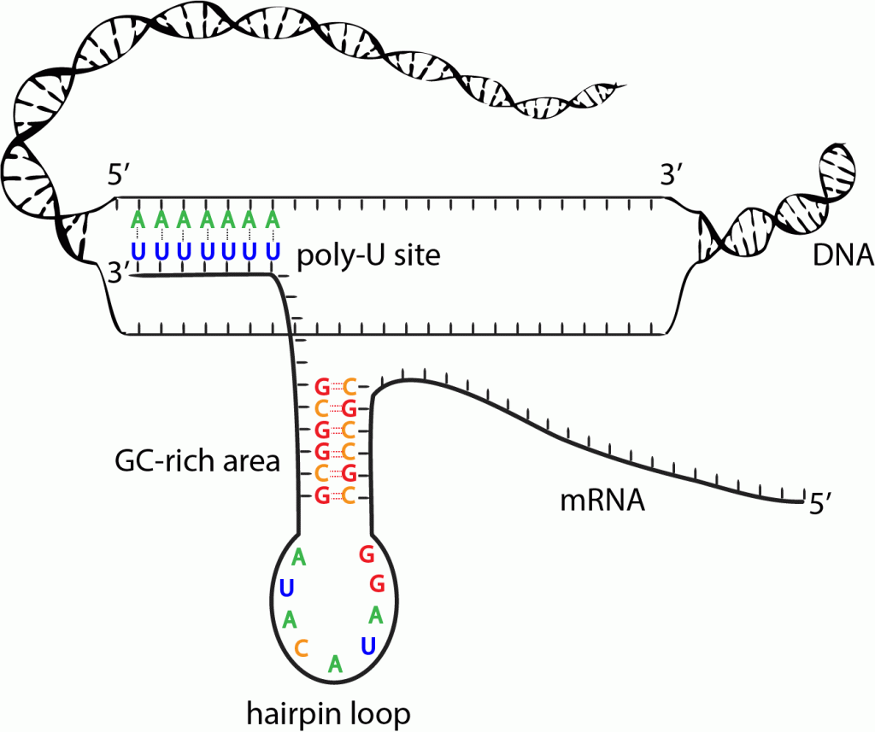
Intrinsic Termination: An inverted repeat sequence near the end of the newly synthesized strand of RNA causes the formation of a hairpin loop.

Slide 16
2- Rho-dependent transcription termination (Rho factor):
is a prokaryotic ATP-dependent unwinding enzyme involved in termination transcription.
In this mechanism, Rho protein is necessary to induce termination. Rho protein activity depends on the Rho Utilizing sequence (rut sequences); ~40 nucleotides long rich with C) and uses the energy obtained from the ATP hydrolysis to translocate along the RNA.
Bacterial Rho protein is a hexameric (ring-shaped protein) RNA-DNA helicase that serves as a general bacterial transcription termination. It binds to ssRNA and uses its ATPase activity to induce termination.
Rho binds to RNA and then uses its ATPase activity to provide the energy to translocate along the RNA until it reaches the RNA–DNA helical region, where it unwinds the hybrid duplex structure.

Slide 17
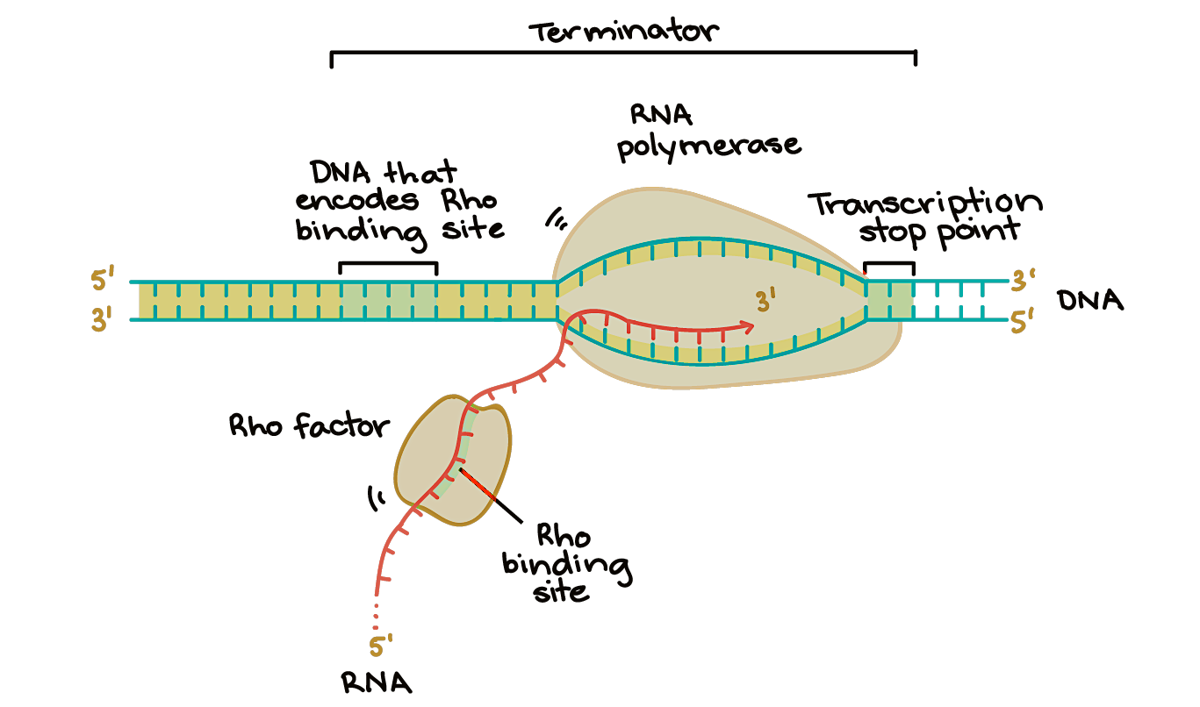
(rut sequences)

Slide 18
General differences between transcription and replication:
 | Replication | Transcription
purpose | The purpose of replication is to conserve the entire genome for next generation. | The purpose of transcription is to make RNA copies of individual genes that the cell can use in the metabolic activity
Definition | DNA replication is the replication of a strand of DNA into two daughter strands, each daughter strand contains half of the original DNA double helix. | synthesis of RNA from a DNA template. 3 types will transcribed ,rRNA and tRNA are final product ,mRNA will translated to protein
products | One strand of DNA becomes two daughter strands. | mRNA, tRNA, rRNA and non-coding RNA( like microRNA)
Timing | It happened once the cell start division | At any time in the cell as required
Enzyme and results | The two strands are separated and then each strand's complementary DNA sequence is synthesized by DNA polymerase. The process required primers. | the codons of a gene are copied into messenger RNA by RNA polymerase. By the help of tRNA, which carries amino acids and rRNA the codon will translated to protein. The process required promoter

Slide 19
differences | Replication | Transcription
Initiation need | primer ,DnaA box & initiation protein | Require promoter region
Template | The 2 strands serve as a template | Only template strand(3→5)
Involved area | The total genome will replicate | precise part will transcribed

