Slide 1
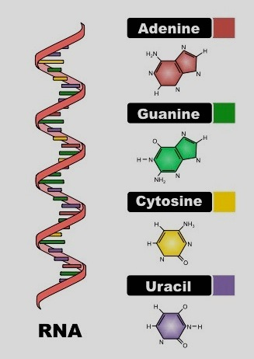
Post transcriptional regulation
&
RNA structure and functions
Lec 7th
Molecular biology

Slide 2
Expression of essential genes is required under all growth conditions but the expression of other genes is conditional. Thus, cells must regulate gene expression using transcription regulation to determine which genes are transcribed and to what extent. Transcription regulation is the most common mechanism to control gene expression in bacteria.
post-transcriptional regulation can be used to regulate the active amount of RNA by degradation or modification. It occurs between the transcription phase and the translation phase of gene expression, each of transcript RNA type (messenger RNA (mRNA), Ribosomal RNA (rRNA) and Transfer RNA (tRNA)) will subjected to modification events after ending transcription.

Slide 3
1- Modification of messenger RNA (mRNA): In prokaryotic cell, RNA transcripts are ready to act as mRNAs and get translated into proteins right away. In E. coli, the 5’ terminus is triphosphorylated, a situation that appears to inhibit the binding of certain endoribonucleases, but in Eukaryotic cell, pre-mRNA needs to go through a few more steps to become an actual mRNA. These modifications include:- 1- processing includes Additions of 5' cap and poly-A tail. Both the cap and the tail protect the transcript and help it get exported from the nucleus and translated on the ribosomes (protein-making "machines") found in the cytosol A- Adding cap structure: A 7-methylguanosine cap is added to the 5′ end of the growing transcript by a phosphate linkage. The cap protects the transcript from being broken down and helps the ribosome attach to the mRNA and start reading it to make a protein. B- Polyadenylation (poly Adenine residue): Once elongation is complete, the pre-mRNA is cleaved by an endonuclease between an AAUAAA consensus sequence and a GU-rich sequence, leaving the AAUAAA sequence on the pre-mRNA. An enzyme called poly-A polymerase then adds a string of approximately 100 - 200 A residues, called the poly-A tail. The tail makes the transcript more stable and helps it get exported from the nucleus to the cytosol.

Slide 4
2- splicing : Eukaryotic genes are composed of exons, which correspond to protein-coding sequences (ex-on signifies that they are expressed), and intervening sequences called introns (sequences in mRNA do not encode functional proteins).
The process of removing introns and reconnecting exons is called splicing. Introns are removed and degraded while the pre-mRNA is still in the nucleus.
The splicing process is catalyzed by protein complexes called spliceosomes that are composed of proteins and RNA molecules called small nuclear RNAs (snRNAs).
Spliceosomes recognize sequences at the 5′ and 3′ end of the intron. Usually the transcript mRNA is shorter than the origin gene it-self.
Splicing includes:-
1-The first cleavage occur by splicesome machine at 5́ end of the intron region rich with GU residue
2- then the intron bend back to form lariat structure via 5́→3́ phosphodiester bond
3- cleavage at 3́ end of the intron to completely released
4- joining the exons by ligase enzyme to give arise to mature mRNA .

Slide 5
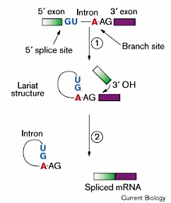

Slide 6
Mature mRNA is a single-stranded RNA molecule, carries information from DNA to the ribosome, the sites of protein synthesis (translation) in the cell. The coding sequence of the mRNA determines the amino acid sequence in the protein .
The basic differences in mRNA structure in prokaryotic and eukaryotic
(1) The mRNAs of many bacteria and bacteriophage are polycistronic .
A polycistronic mRNA means the presence of multiple open reading frames (ORFs) in a single transcript with one operator and one terminator called operon. It contains several sites for initiating and terminating for more than a polypeptide product .
On the other hand, all known eukaryotes have only one site for initiation one protein synthesis. Thus eukaryote mRNAs are monocistronic.

Slide 8
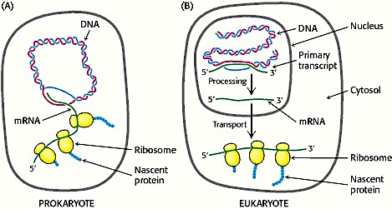
(2) prokaryote mRNA is very short lived in E. coli half-lives range from 10s-20 min. Therefore it is degraded primarily after translation has been initiated. Short life span of mRNA enables prokaryotes to synthesize different proteins or enzymes in response to changes in the external environment. On other hand, Eukaryote mRNAs are more stable in yeast half-lives range from 1 – 60 min.
(3) In prokaryotes, transcription and translation processes are closely coupled. Indeed, the translation of bacterial mRNA begins while the transcript is still being synthesized. In eukaryotes, transcription and translation take place in different cellular compartments: transcription takes place in the membrane-bounded nucleus, whereas translation takes place outside the nucleus in the cytoplasm.
(4) In prokaryotes the mRNAs undergo very little processing after being transcribed. However, In eukaryotes the transcribed mRNA undergoes considerable processing before mature mRNA is formed.

Slide 9
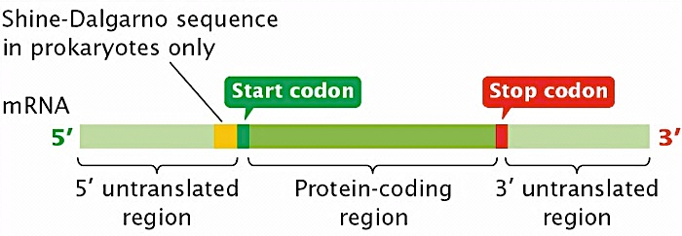
(5) in prokaryotic mRNA cells start (5́ end) with Leader sequence (upstream region; 5′ UTR) that contains a ribosome binding site (RBS), also known as the Shine–Dalgarno sequence, which is usually 3–10 base pairs upstream from the initiation codon. The mRNA ends (3’ end) with un-translated region (3′-UTR or tailer sequence) is the section of mRNA that immediately follows the translation termination codon. The 3′-UTR often contains regulatory regions that post-transcriptionally influence gene expression.

Slide 10
The Shine–Dalgarno (SD) sequence is a ribosomal binding site in mRNA, generally located around 8 bases upstream of the start codon AUG. The SD is named after its discover. The SD sequence exists in bacteria but rare in archaea, also present in some chloroplast and mitochondrial transcripts. The six-base consensus sequence is AGGAGG; in E. coli, for example, the sequence is AGGAGGU. The SD sequence helps recruit the ribosome to the mRNA to initiate protein synthesis by aligning it with the start codon.
The SD sequence in E. coli

Slide 11
In contrast, the eukaryotic 5′ UTR contains the Kozak consensus sequence (ACCAUGG), which contains the initiation codon. The eukaryotic 5′ UTR also contains cis-acting regulatory elements called upstream open reading frames (uORFs) and upstream AUGs (uAUGs), which have a great impact on the regulation of translation. For the mRNA in Eukaryotic cell it start with cap structure at 5’ end then the leader sequence (un-translated region) followed by start codon then the coding region, at the 3’ end there is the poly A tail (250-300 Adenine residue )

Slide 12
2- modification of Ribosomal RNA (rRNA)
The genes for rRNAs are present in multiple copies, from seven in E. coli to several hundred in higher eukaryotes.
In Eukaryotic cell, there are four types of rRNA, three of them (18S, 5.8S and 28S) are made by chemical modification and cleaving a single precursor unit (45S pre-rRNA), which is transcribed by RNA polymerase I. The eukaryotic 5.8S rRNA, which is absent in prokaryotes, lies between the 18S and the 28S rRNA. The fourth type (5S rRNA) is transcribed from a separate gene.
Non-transcribed spacer regions between the transcription units are removed to convert to mature 18S, 5.8S, and 28S rRNA. In addition to these cleavages, rRNA processing involves the addition of methyl groups to the bases and sugar moieties of specific nucleotides.

Slide 13
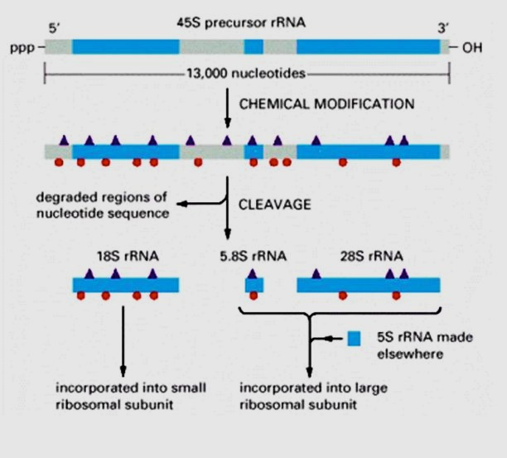
Eukaryotic cells (e.g., human cells) contain four rRNAs. One of these (5S rRNA) is transcribed from a separate gene; the other three (18S, 28S, and 5.8S) are derived from a common pre-rRNA. Following cleavage, the 5.8S rRNA (which is unique to eukaryotes) becomes hydrogen-bonded to 28S rRNA.

Slide 14
There are 3 main types of Eukaryotic RNA polymerase, which are I,II, III
Type of Polymerase | Responsible to Produce | Location
RNA Polymerase I | rRNA (18 s , 5.8s, 28s) | nucleolus
RNA Polymerase II | mRNA and small nuclear RNA | nucleoplasm
RNA Polymerase III | tRNA and 5s r RNA | nucleoplasm
The same events will happen to prokaryotic rRNA. Prokaryotic cells contain three rRNAs (16S, 23S, and 5S), which are formed by cleavage of a 30s pre-rRNA transcript by endonuclease and exonuclease enzyme to convert it to mature 16s,23s and 5s beside the transcript tRNA.

Slide 15
Prokaryotic cells contain three rRNAs (16S, 23S, and 5S), which are formed by cleavage of a pre-rRNA transcript.

Slide 16
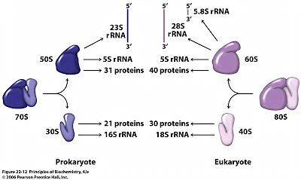
In the cytoplasm, ribosomal RNA (rRNA) and protein combine to form a nucleoprotein called a ribosome. The ribosome binds mRNA and carries out protein synthesis. Several ribosome's may be attached to a single mRNA at any time.

Slide 17
3- Modification of Transfer RNA (tRNA)
Mature tRNA is a small RNA chain about 70-90 nucleotides that transfers a specific amino acid to a growing polypeptide chain at the ribosomal site of protein synthesis during translation.
Modifications include:-
1- Removel of leader sequence from 5’ end
2- replcament of nucleotides at 3’-end with CCA3́ OH (Amino acid attachment acceptor arm) 3- Chemical modification of some nitrogen base like Pseudouridine (Ψ), and ribo thymidine (T), which are found in various places specially TΨC loop of tRNA. Another notable modified base is Dihydroxy uracil in DUH2 loop.
The third loop is the anti-codon loop that contains the complementary sequences to mRNA triplet codon through hydrogen bonding. 4- Excision of intron region
Generally, the function of tRNA (uncharged) is to attached to Amino Acid via Aminoacyl tRNA transferase enzyme and the reaction require ATP, once the attachment complete the tRNA become charged.
tRNA(uncharged)+ A.A→ AA-tRNA complex (charged or acylated t RNA)

Slide 18
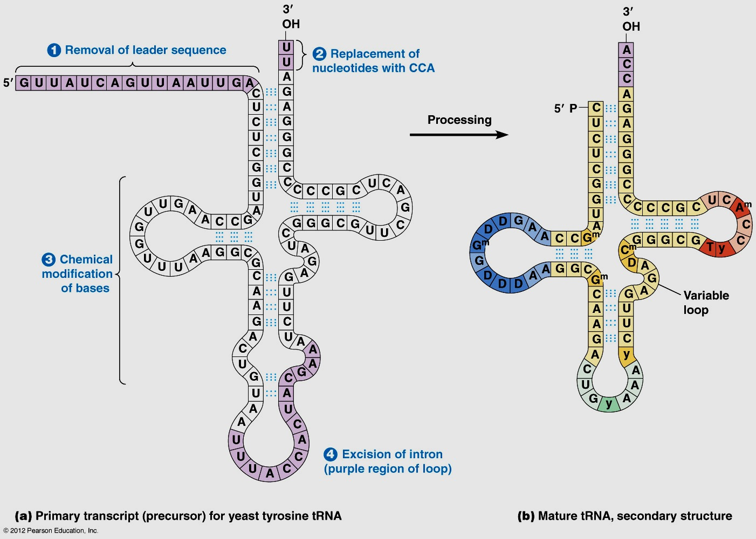
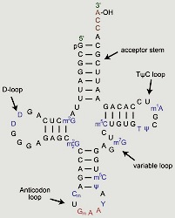

Slide 19
