Slide 1
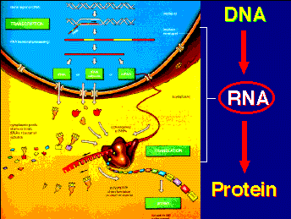
Lecture 13 :Protein synthesis
TRANSLATION

Slide 2
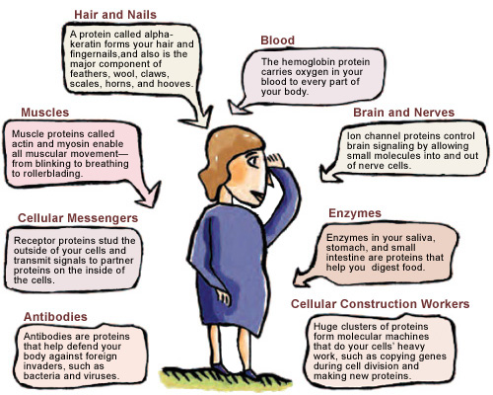
Proteins involve in many body structures

Slide 3
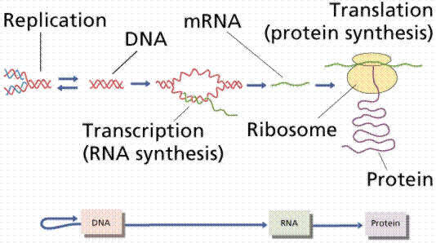
According to central dogma , the genetic information flow from DNA the RNA via transcription process then it will translate later to functional protein.

Slide 4
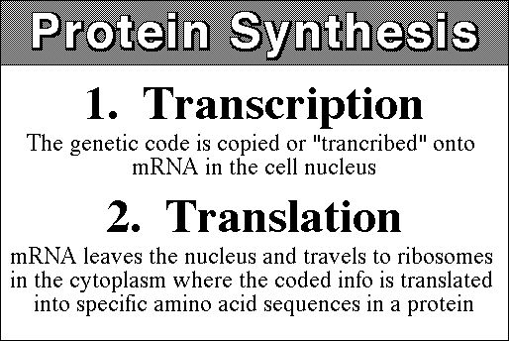

Slide 5
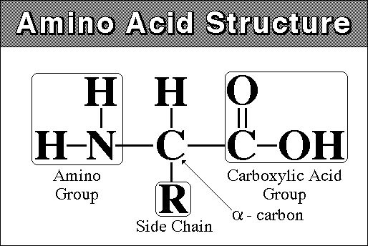
Basic structure of protein: the structural unit of protein is amino acid (A.A).The main structure of A.A is
1- central C atom called α- carbon. .
2-Amino group gives the positive charge
3- carboxylic acid group gives the negative charge
4- R side chain which differ from one amino acid to another, the simplest R side group is H only to form glycin

Slide 6

The bond which bind the two adjacent A.A is called peptide bond with releasing of water molecules .

Slide 7
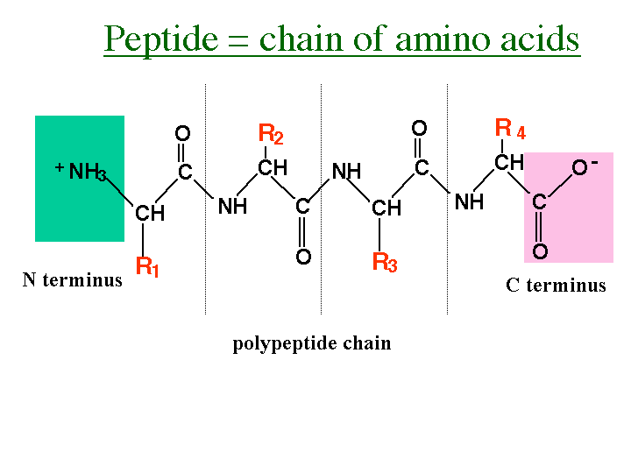
Usually the protein chain start with amino group (NH3) and end with Carboxyl group (COOH).binding 2-10 A.A give a rise to oligopeptide while binding more than that will form the polypeptide chain . This linear chain represent 1- the primary structure to the protein .

Slide 8
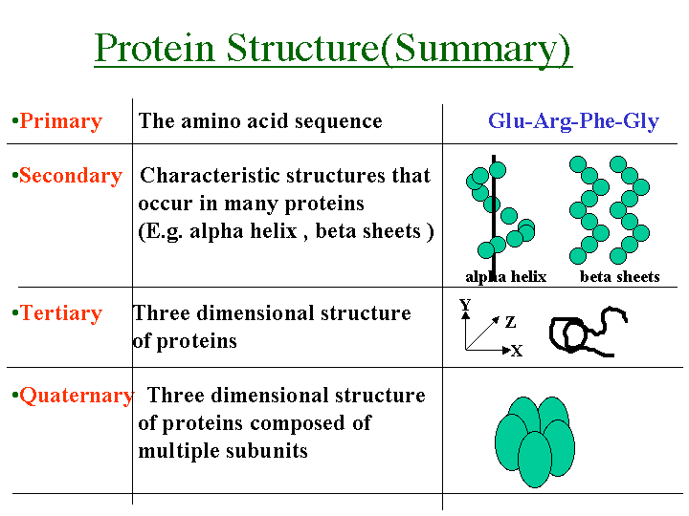
According to structure and configuration ,proteins can be divided to 4 types

Slide 9
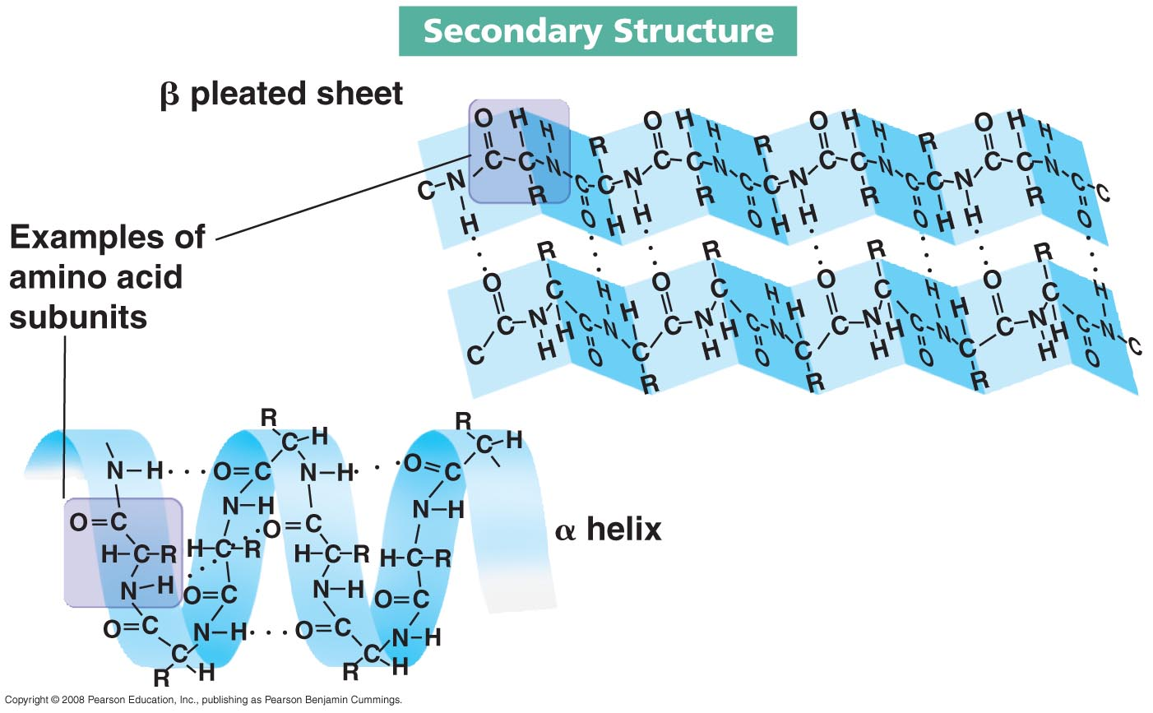
2- the secondary structure formed due to folding of the primary structure via hydrogen bonds . Two types are well studied as secondary structure 1- α helix 2- β pleated sheet

Slide 10
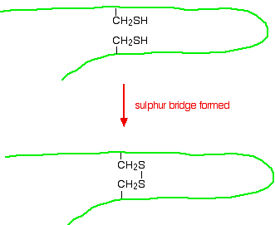
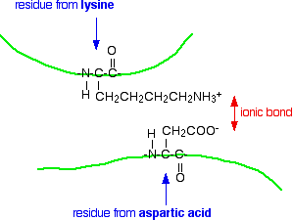
3- Tertiary structure is more complicated and we could find α helix and β pleated sheet in the same structure ,other types of bonds exist here like disulfide bond between cystine A.A ,ionic bond ,hydrophobic bond

Slide 11
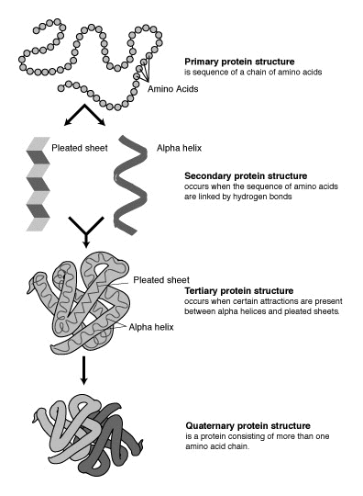

Slide 12
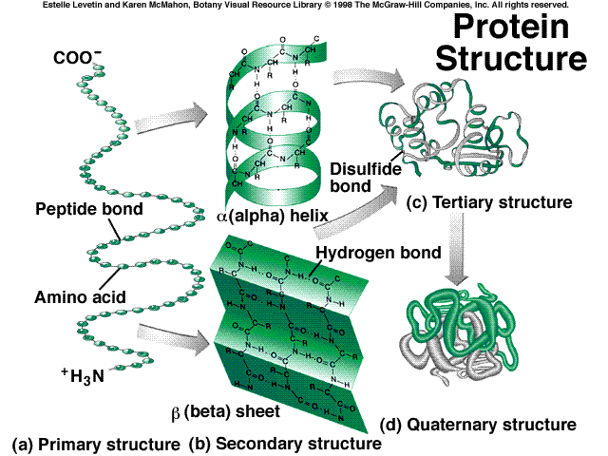
4- Quaternary structure :more complicated result from folding the other structures and from more than subunits

Slide 13
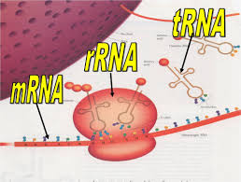
TRANSLATION
In this process the three types of RNA are involved each one of them play important role to complete protein synthesis . The Translation also involve
1-Initiation 2- Elongation 3- Termination step

Slide 14
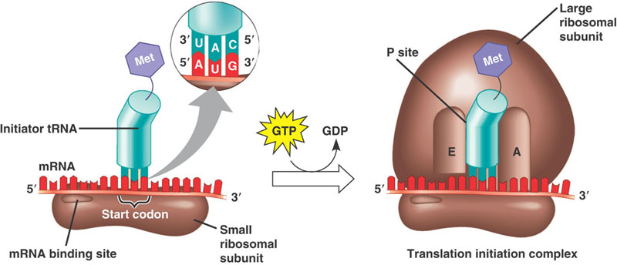
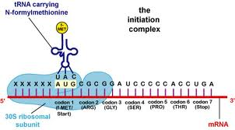
Step one :initiation , it requires 1- m RNA (processed in Eukaryotic cell) 2- t RNA which will come charged (bind to A.A) and the first A.A is methionin cose the first codon is AUG (usually become as n formayl methionin ) .the AUG first codon in m RNA will face the triplet codon in anti codon arm in t RNA .3- small 30S ribosomal sub units thus the m RNA will bind to 16s r RNA via its ribosomal binding site .

Slide 15
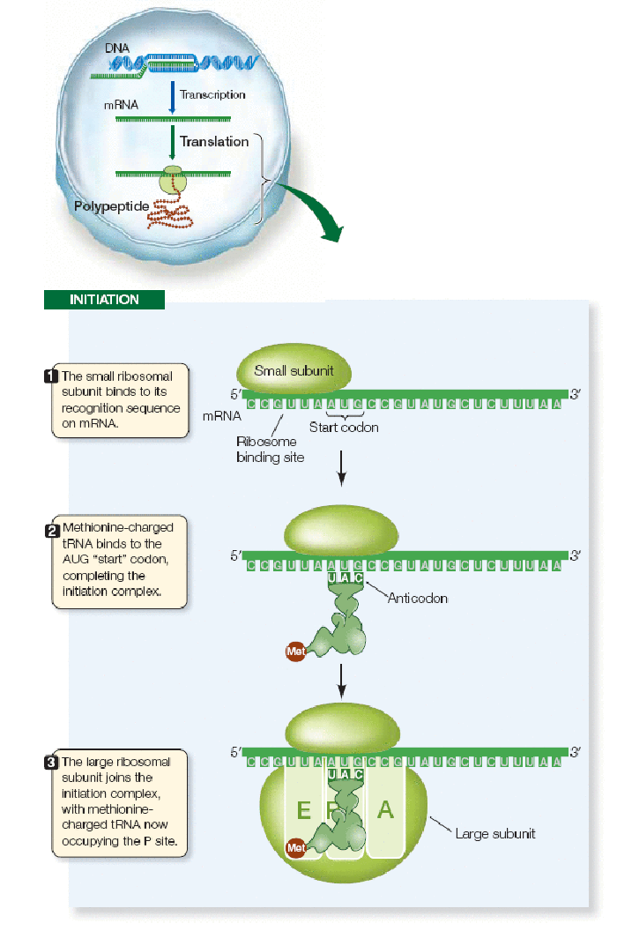

Slide 16
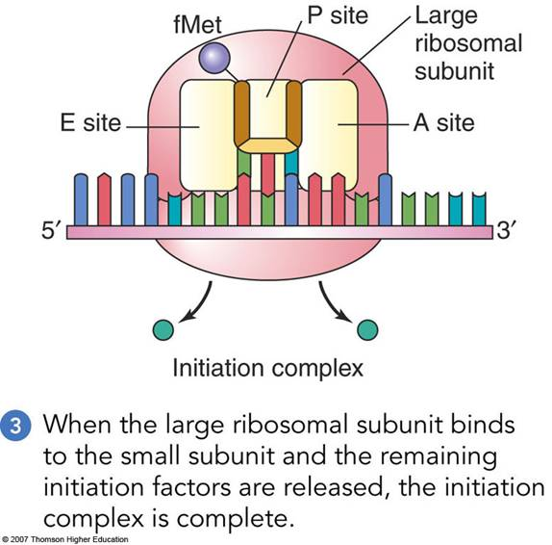
The initiation step requires initiation factors then the large sub unit bind the complex forming 70s initiation complex . The large subunit contain P site (peptidyl sit ) and A site (Amino -acyl site ).

Slide 17
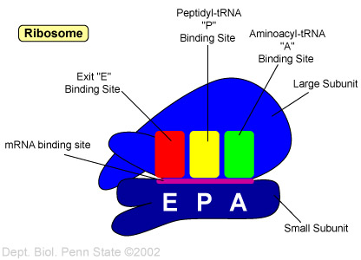
The complete binding sites in the ribosome

Slide 18
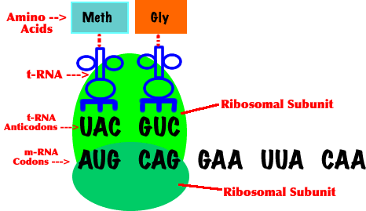
The first occupied site by the charged tRNA is P site followed by introducing A site and the triplet codon will determine the next incorporated A,A

Slide 19
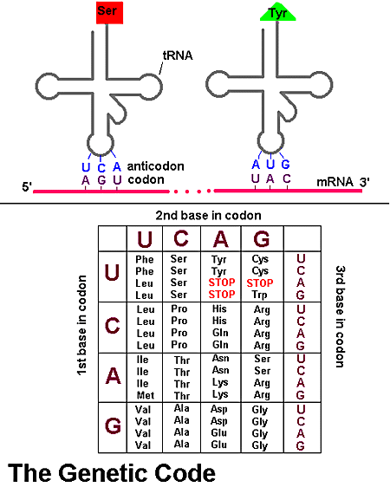

Slide 20
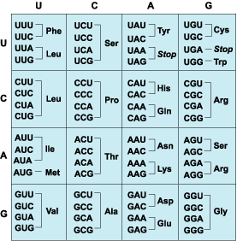
The 4 nitrogen base will form 64 possibilities and we have 20 A.A thus 2-3 triplet codon will code to the same A,A. beside we have one start codon (AUG) and 3 stop codon (UAA, UAG ,UGA) that they will not translated to any A.A.

Slide 21
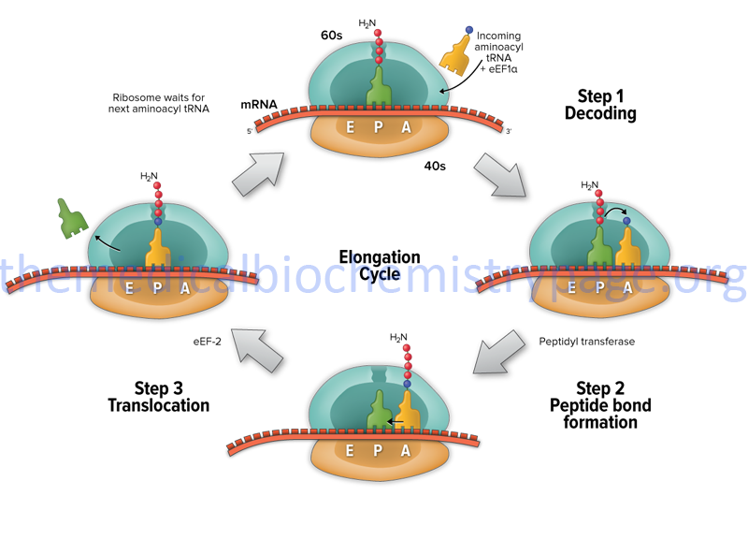
2- Elongation step :here the peptide chain will elongate with the help of elongation factors .the A.A in the p site will bind with the A.A in A site via peptide bond with the aid of peptidyl transferase .t RNA in p site now is empty ,convert to uncharged and leave the ribosome from Exit site .then the tRNA translocat from A to P site with 2 A.A . Now the A site empty and the complex will move for another triplet codon

Slide 22
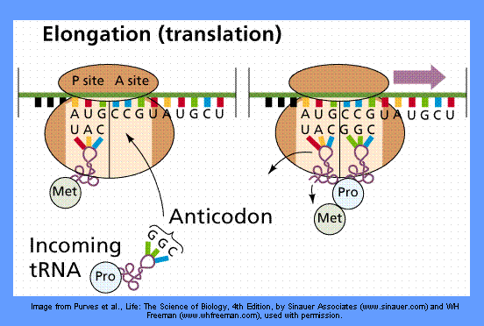

Slide 23
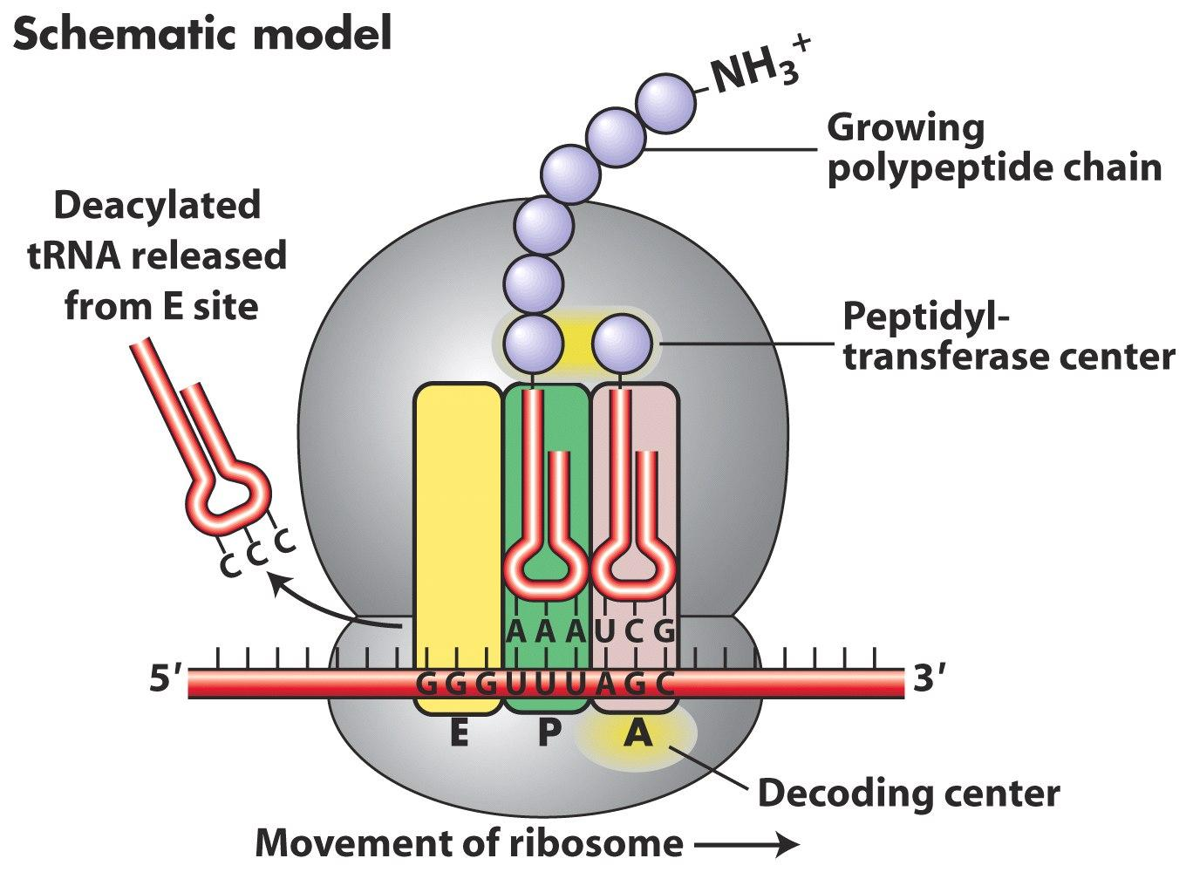
The figure shows ribosome movement (from 5→3) as each 3 nitrogen base form one triplet codon and will translate to one A.A. the growing peptide chain will continue movning between P and A site along them RNA till reaching the stop codon.

Slide 24
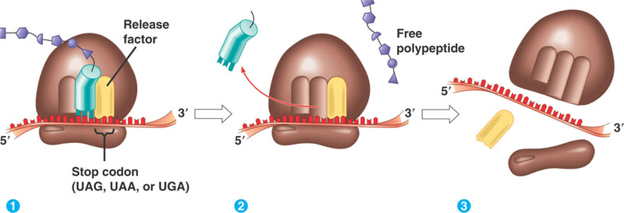
Termination step: when the ribosome reached stop codon (UAG, UAA,UGA) and there is no anticodon in tRNA so A site will remain empty causes releasing of free polypeptide and dissociation of the 2ribosomal subunits. note: mRNA will degraded once it translated thus its concretion is low while m RNA in Eukaryotic cell more stable cos it contain cap structure at 5 end and poly A tail in 3 end .

Slide 25
