Slide 1

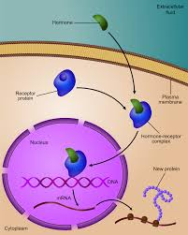
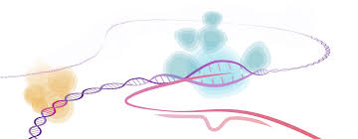
Gene regulation

Slide 2
Control of Gene Expression
Controlling gene expression is often accomplished by controlling transcription initiation.
Regulatory proteins bind to DNA to either block or stimulate transcription, depending on how they interact with RNA polymerase.
Prokaryotic organisms regulate gene expression in response to their environment.
Eukaryotic cells regulate gene expression to maintain homeostasis in the organism.
Gene expression is often controlled by regulatory proteins binding to specific DNA sequences.
  regulatory proteins gain access to the bases of DNA at the major groove
  regulatory proteins possess DNA-binding motifs (regions of regulatory proteins which bind to DNA)

Slide 3
Bacterial genes
Bacterial genes can be classified according to their expression into:
A constitutive gene is a gene that is transcribed continually as opposed to an inducible gene, which is only transcribed when needed.
A housekeeping gene is typically a constitutive gene that is transcribed at a relatively constant level. The housekeeping gene's products are typically needed for the maintenance of the cell. It is generally assumed that their expression is unaffected by experimental conditions.
An inducible gene is a gene only transcribed when needed as opposed to a constitutive gene. An inducible gene is a gene whose expression is either responsive to environmental change or dependent on the position in the cell cycle.

Slide 4
Gene regulation
• Constitutive Genes = unregulated
essentially constant levels of expression (often required in the cell all the time )
• Regulation can occur at:
− Transcription (regulatory proteins; attenuation)
– Translation (repressors; antisense RNA)
– Post translational (feedback inhibition)

Slide 5
Transcriptional Regulation
Control of transcription initiation can be:
  positive control – increases transcription when activators bind DNA
  negative control – reduces transcription when repressors bind to DNA regulatory regions called operators
Prokaryotic cells often respond to their environment by changes in gene expression.
Genes involved in the same metabolic pathway are organized in operons.
Some operons are induced when the metabolic pathway is needed.
Some operons are repressed when the metabolic pathway is no longer needed

Slide 6
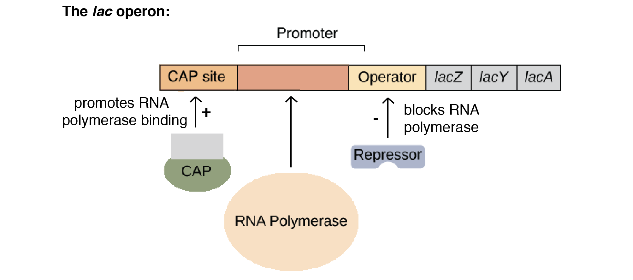
Operon
is a functioning unit of DNA containing a cluster of genes under the control of a single promoter. The genes are transcribed together into an mRNA strand and either translated together in the cytoplasm called polycistronic mRNA, or undergo splicing to create monocistronic mRNAs that are translated separately, i.e. several strands of mRNA that each encode a single gene product. The result of this is that the genes contained in the operon are either expressed together or not at all.

Slide 7
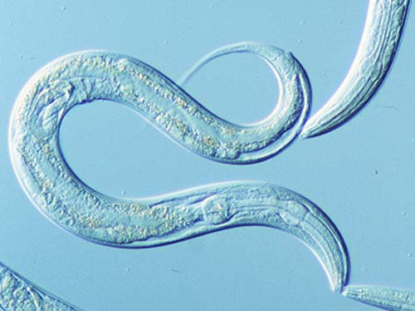
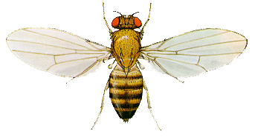
operons were thought to exist solely in prokaryotes, but operons exist also in eukaryotes ( nematodes such as Caenorhabditis elegans and the fruit fly, Drosophila melanogaster). In general, the expression of prokaryotic operons leads to the generation of polycistronic mRNAs(a single mRNA molecule that codes for more than one protein), while eukaryotic operons lead to monocistronic mRNA (a single mRNA molecule that codes for one protein). Operons are also found in viruses such as bacteriophages

Slide 8
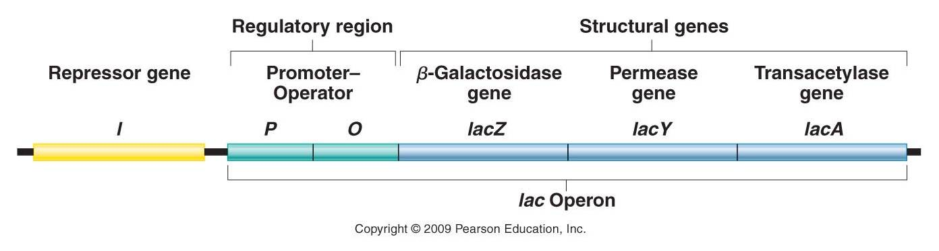
General structure of operon:
Promoter – a nucleotide sequence recognized by RNA polymerase, which then initiates transcription. In RNA synthesis, promoters indicate which genes should be used for messenger RNA creation – and, by extension, control which proteins the cell produces.
Operator – a segment of DNA that a repressor binds to. It is classically defined in the lac operon as a segment between the promoter and the genes of the operon. In the case of a repressor, the repressor protein physically obstructs the RNA polymerase from transcribing the genes.
Structural genes – the genes that are co-regulated by the operon.

Slide 9
Lac operon
The lac operon (lactose operon) is an operon required for the transport and metabolism of lactose in Escherichia coli and many other enteric bacteria. Although glucose is the preferred carbon source for most bacteria, the lac operon allows for the effective digestion of lactose when glucose is not available. Bacterial operons are polycistronic transcripts that are able to produce multiple proteins from one mRNA transcript. In this case, when lactose is required as a sugar source for the bacterium, the three genes of the lac operon can be expressed and their subsequent proteins translated: lacZ, lacY, and lacA. The gene product of lacZ is β-galactosidasewhich cleaves lactose, a disaccharide, into glucose and galactose. lacY encodes lactose permease, a protein that becomes embedded in the cytoplasmic membrane to enable the transport of lactose into the cell. Finally, lacA encodes galactoside O-acetyltransferase.

Slide 10
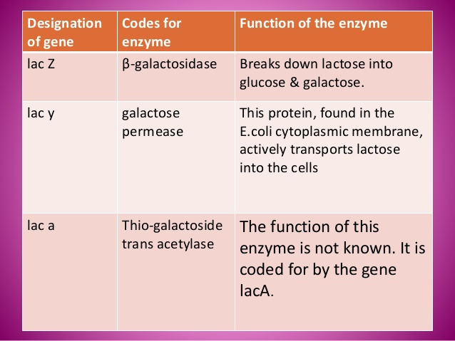
Enzymes of Lac operon

Slide 11
The lac Operon Is Regulated By a Repressor Protein
• The lac operon can be transcriptionally regulated
– 1. By a repressor protein
– 2. By an activator protein
• The first method is an inducible, negative control mechanism
– It involves the lac repressor protein
– The inducer is allolactose
It binds to the lac repressor and inactivates it

Slide 12
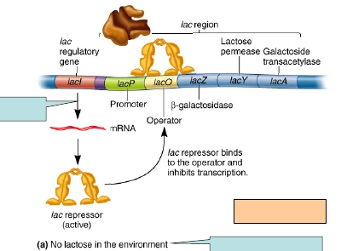
Constitutive
expression
The lac operon now is
repressed
Therefore no allolactose

Slide 13
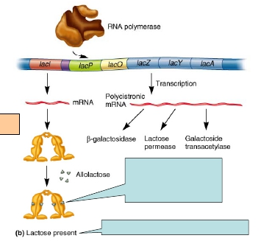
The lac operon now is induced
The conformation of the repressor is now altered Repressor can no longer
bind to operator
Some gets converted to allolactose

Slide 14
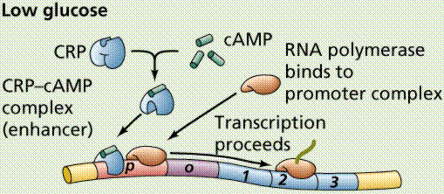
The lac Operon Is Also Regulated By an Activator Protein
catabolite repression
• When exposed to both lactose and glucose
– E. coli uses glucose first, and catabolite repression prevents the use of lactose
– When glucose is depleted, catabolite repression is alleviated, and the lac operon is expressed
• The sequential use of two sugars by a bacterium is termed diauxic growth

Slide 15
Regulation involves a small molecule, cyclic AMP (cAMP)
– produced from ATP via the enzyme adenylyl cyclase
– cAMP binds an activator protein known as the Catabolite Activator
Protein (CAP)
•cAMP-CAP complex is an example of genetic regulation that is inducible
and under positive control
– The cAMP-CAP complex binds to the CAP site near the lac promoter and increases transcription
•In the presence of glucose, the enzyme adenylyl cyclase is inhibited
– This decreases the levels of cAMP in the cell
– Therefore, cAMP is no longer available to bind CAP
– And Transcription rate decreases

Slide 16
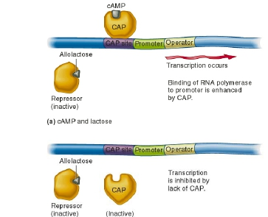
b) Lactose but no cAMP

Slide 17
