Slide 1
The Course of Fundamentals of Thermodynamics
MUSTANSIRIYAH UNIVERSITY
COLLEGE OF SCIENCES
DEPARTMENT OF ATMOSPHERIC SCIENCES
2021-2022
Dr. Sama Khalid Mohammed
SECOND STAGE
Lecture 9

Slide 2
Welcome Students In The New Course
And In The eighth Lecture ☺

Slide 3
This lecture including the following items
Overview of the Earth’s Atmosphere
Composition of the Atmosphere
Vertical Structure of the Atmosphere
Pressure (hydrostatic eq. )
Temperature
Pressure decrease in an isothermal atmosphere
Density
Geopotential and Geopotential Height
Thickness and the hypsometric equation
IS THE UPPER ATMOSPHERE WELL MIXED?
Exercise

Slide 4
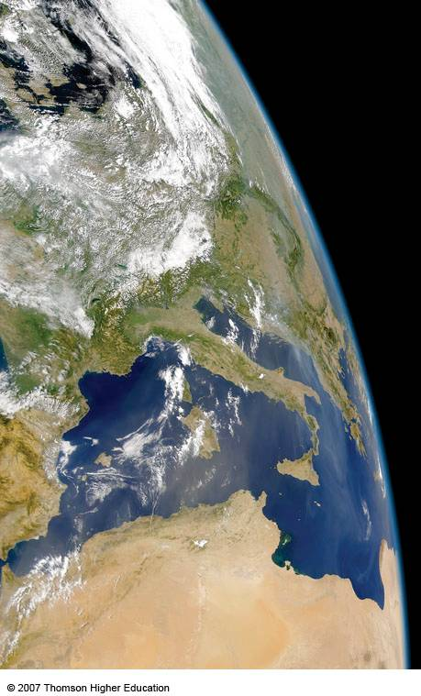
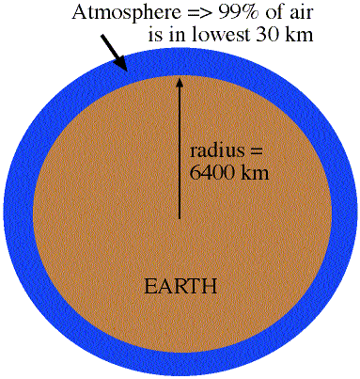
Overview of the Earth’s Atmosphere
The Atmosphere is really a thin envelope surrounding the earth
99% of atmosphere is in lowest 30 km
earth's radius is about 6400 km
So, the atmospheric depth is 30 km/6400 km= 0.5% of earth's radius

Slide 5
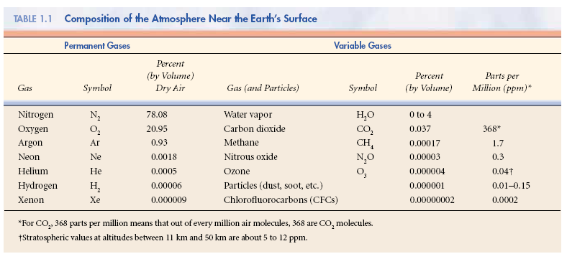
Composition of the Atmosphere
The earth’s atmosphere is a thin, gaseous envelope comprised mostly of nitrogen (N₂) and oxygen (O₂), with small amounts of other gases, such as water vapor (H₂O) and carbon dioxide (CO₂). Nested in the atmosphere are clouds of liquid water and ice crystals.

Slide 6
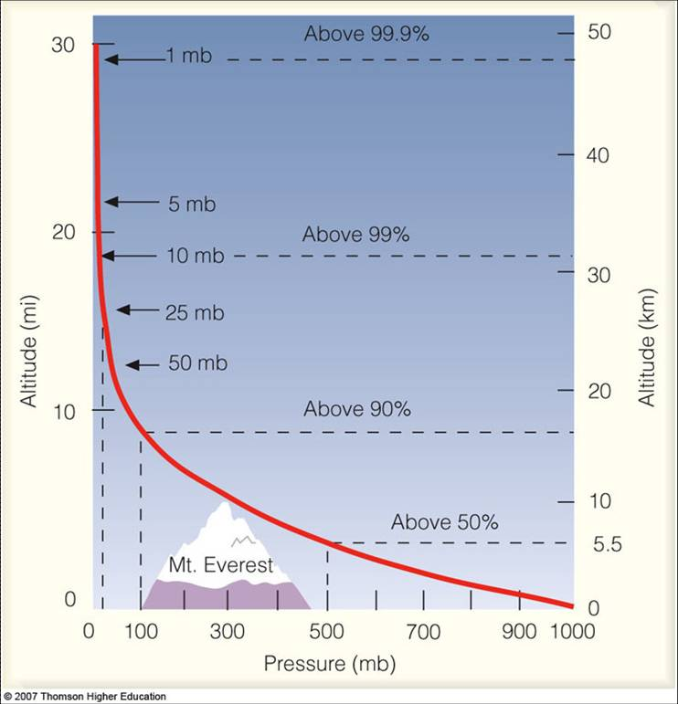
Vertical Structure of the Atmosphere
Vertical Profile of Pressure
Atmospheric Pressure decreases with height.... in a similar manner as density, WHY?

Slide 7
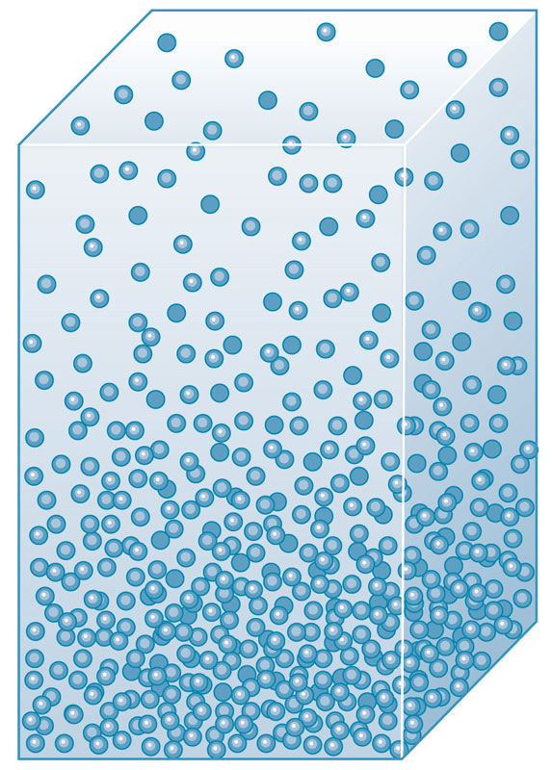
The Hydrostatic Equation
Air pressure at any height in the atmosphere is due to the force per unit area exerted against a surface by the weight of the air molecules above that surface. This “weight” results from the pull of gravity
That explains why pressure decreases with increasing height above the ground
P2
P1 > P2
However, pressure gradients cause a force that points from regions with high pressure towards regions with low pressure (vertical Gradient Pressure).
That explains why the atmosphere does not collapses on the ground and does not escape to the space
P1

Slide 8
The Hydrostatic Equation
Consider “g” the gravity acceleration (m/s²)
Consider that δp is negative ( that is, z increases p decreases)
Vertical Gradient Acceleration=Force/mass
In a hydrostatic equilibrium, and considering the limit as δz → 0
or:
pressure p + δp
pressure p
δz
Z
Gravity acceleration
Hydrostatic Equation: represents the balance between gravity and the vertical pressure gradient force. If these forces are equal, there is hydrostatic equilibrium and thus no vertical motion.

Slide 9
Vertical Structure of the Atmosphere
There are two types of pressure:
Hydrostatic pressure, which is just due to the weight of the air above you.
Dynamic pressure, which is due to the motion of the air.
In meteorology, dynamic pressure is usually very small, and we will assume for now that atmospheric pressure is solely due to hydrostatic pressure.
To find how pressure changes with height we start with the hydrostatic equation

Slide 10
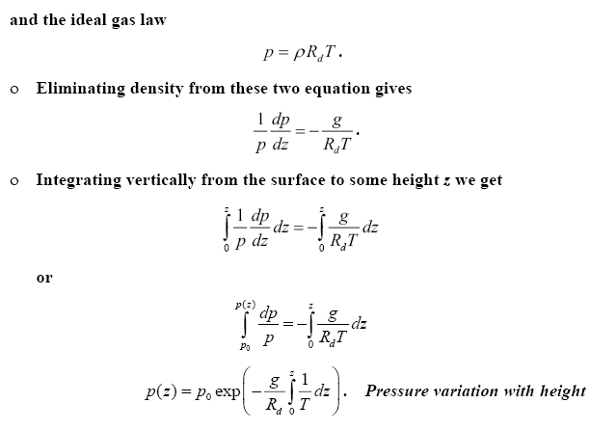
Vertical Structure of the Atmosphere
This Equation is used to obtain a relationship between pressure and height, used by altimeters to measure pressure and calculate altitude above sea level, in which Aircraft altimeters are essentially barometers that are calibrated to read altitude above mean sea level

Slide 11
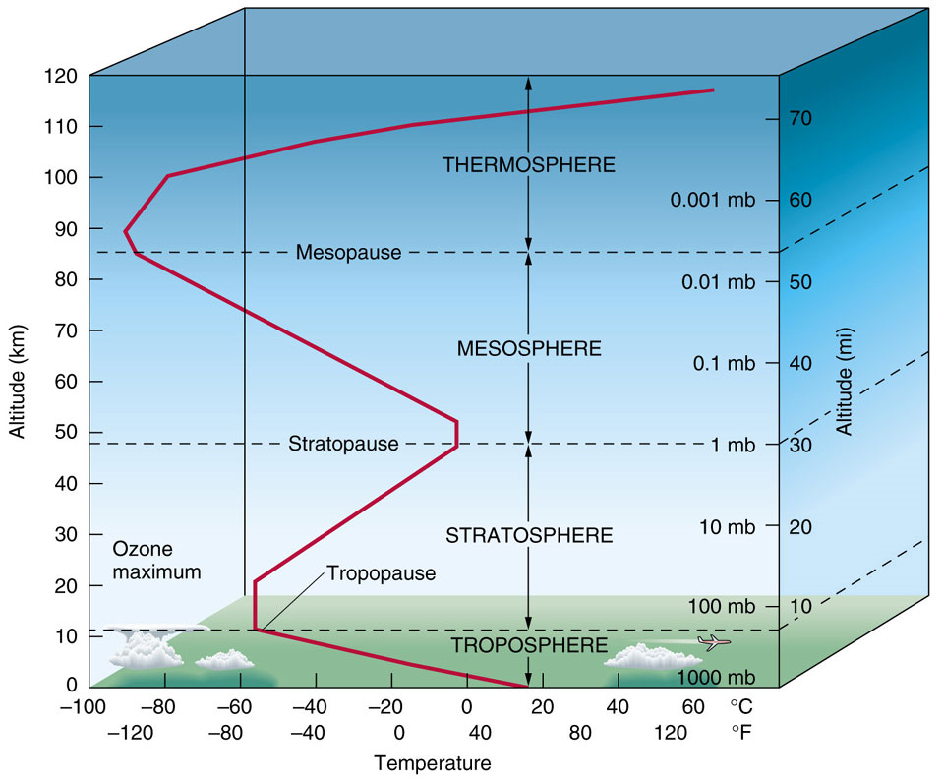
Vertical Structure of the Atmosphere
Vertical Profile of Temperature
There are distinct layers in the atmosphere where the temperature either increases or decreases with height.

Slide 12
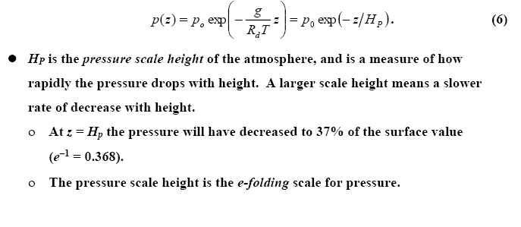
Vertical Structure of the Atmosphere
Pressure decrease in an isothermal atmosphere
Absolute temperature varies by only 20% or so through the troposphere, so we can get an idea how pressure changes with height by assuming a constant temperature (isothermal atmosphere). If this is done, the expression for the pressure profile becomes
Notes:
Scale height is a general way to describe how a value fades away and it is commonly used to describe the atmosphere of a planet. It is the vertical distance over which the density and pressure fall by a factor of 1/e. These values fall by an additional factor of 1/e for each additional scale height H. Thus, it describes the degree to which the atmosphere “hugs” the planet.
Scale height is extremely useful for making “back of the envelope calculations”.

Slide 13
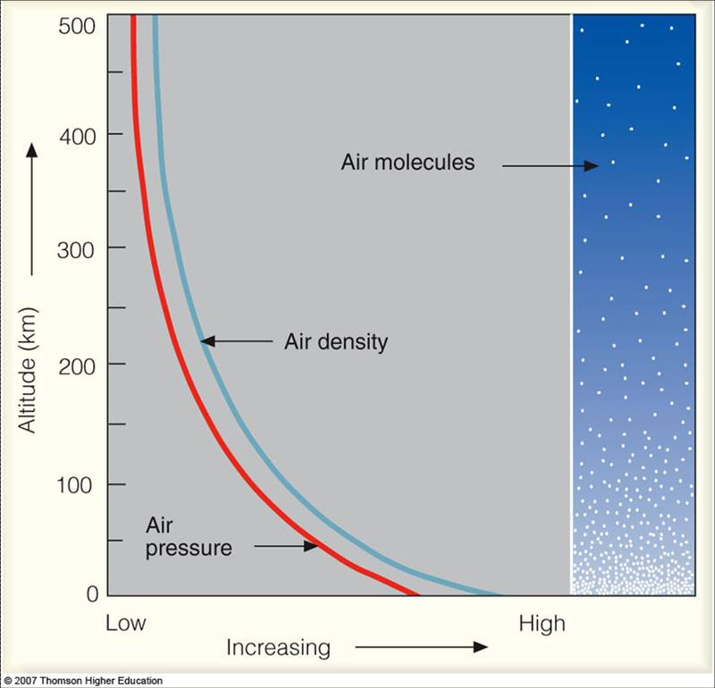
Vertical Structure of the Atmosphere
Vertical Profile of Density
The density of air is computed by determining the mass of air in a given volume.
The density of air decreases with height.
Riddles: Why are there more air molecules near the ground than higher in the atmosphere?
Notes:
http://apollo.lsc.vsc.edu/classes/met130/index.html

Slide 14
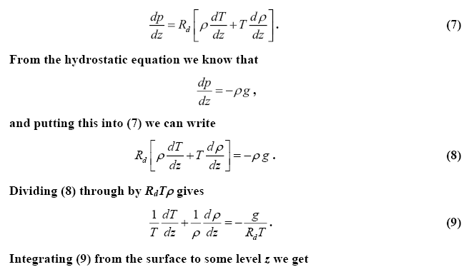
Vertical Structure of the Atmosphere
Vertical Profile of Density
We can also use the hydrostatic equation and the equation of state to find how density changes with height. We first start by differentiating the ideal gas law with respect to height to get
p=ρR_{d} T
Notes:
http://apollo.lsc.vsc.edu/classes/met130/index.html

Slide 15
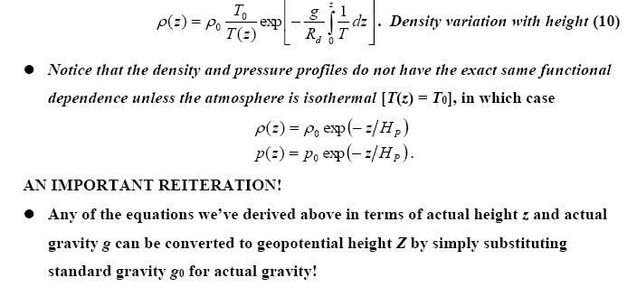
Vertical Structure of the Atmosphere
Notes:
http://apollo.lsc.vsc.edu/classes/met130/index.html

Slide 16
GEOPOTENTIAL Φ(z)
Since Earth is rotating, the force observed as Gravity is the resultant of the:
Gravitational acceleration + Centrifugal acceleration from the Earth’s rotation.
The acceleration due to gravity is not constant, it varies from place to place, with the largest variation due to latitude.
Though small, the variation in gravity must be accounted via the concept of geopotential.

Slide 17
GEOPOTENTIAL Φ(z)
Definition: the potential energy of a unit mass relative to sea level, numerically Work that must be done against the Earth’s gravitational field in order to raise a mass of 1 kg from sea level to that point.
Units: ‘Work’ is defined as force * distance. It has units of Joules (J). So the work to lift a mass a certain height is: J kg⁻¹. Since a Joule is also defined as a Newton * meter, where Newton = kg m s⁻², we can substitute for J above to yield an alternative unit for geopotential: m² s⁻²
The symbol for geopotential is Φ. Geopotential is defined as having a magnitude of 0 at the Earth’s surface. The Φ at any height above the Earth’s surface is equivalent to the distance traveled multiplied by the gravity at each integration of height:
…….(1)
Notes:
http://glossary.ametsoc.org/wiki/Main_Page

Slide 18
GEOPOTENTIAL Φ(z)
or
where z = height above the surface, and g is the gravity at each height, and be calculated via the following equation
A surface of constant geopotential represents a surface along which all objects of the same mass have the same potential energy.
If gravity were constant, a geopotential surface would lie at a constant altitude, but it is not constant throughout the atmosphere – it decreases as the distance from the center of the earth increases. So a geopotential surface will have varying altitude.
Notes:
http://glossary.ametsoc.org/wiki/Main_Page

Slide 19
Geopotential Height Z
The geopotential height is defined as the geopotential at height Z (Equation 1) divided by the gravitational acceleration at the surface of the Earth (g_{o}). It is represented as a capital ‘Z’.
Z
……(2)
Where g_{o} is the globally averaged acceleration due to gravity at the Earth’s surface called standard gravity (~ 9.81m/s²), g is acceleration of gravity.
dz

Slide 20
Geopotential Height Z
Geopotential height is used as the vertical coordinate in most atmospheric applications in which energy plays an important role (e.g., in large-scale atmospheric motions). It is expressed in geopotential meters, abbreviated as gpm.
Note that as geometric altitude (z) increases, Z becomes increasingly less because the gravitational acceleration is decreasing. This means less work is required (Φ(z) is getting smaller) to lift the mass to that point because the opposing force (g) is decreasing.
……(2)

Slide 21
Geopotential Height Z
In the lower atmosphere, Z is very close to z (called the ‘geometric or actual height’) where g_{o} ~ g, The table below shows how Z,z, and g vary with height at a typical mid-latitude location.
z(km) | Z(km) | g(ms⁻²)
0 | 0 | 9.802
1 | 1 | 9.798
10 | 9.986 | 9.771
20 | 19.941 | 9.741
30 | 29.864 | 9.71
60 | 59.449 | 9.62
90 | 88.758 | 9.531
120 | 117.795 | 9.443
160 | 156.096 | 9.327
200 | 193.928 | 9.214
300 | 286.52 | 8.94
400 | 376.37 | 8.677
500 | 463.597 | 8.427
600 | 548.314 | 8.186

Slide 22
Geopotential Height Z
If the change in gravity with height is ignored, geopotential height and geometric height are related via
If the local gravity is stronger than standard gravity, then Z > z.
If the local gravity is weaker than standard gravity, then Z < z.
Gravity varies, at the North Pole is approximately 9.83 m/s², while at the Equator it is about 9.78 m/s².
Therefore, g/g₀ ~ 1, and for many applications we can ignore the difference between geopotential and geometric height, since Z ~ z.
But, keep in mind that they are different, and at times this difference, though small, is very important and cannot be neglected.
Notes:
The magnitude of the force of gravity at sea level decreases from the poles, where the centrifugal force is zero, to the equator, where the centrifugal force is a maximum but directed opposite to the force of gravitation.
Gravity is often assumed to be the same everywhere on Earth, but it varies because the planet is not perfectly spherical or uniformly dense. In addition, gravity is weaker at the equator due to centrifugal forces produced by the planet’s rotation. It’s also weaker at higher altitudes, further from Earth’s centre, such as at the summit of Mount Everest.

Slide 23
Geopotential Height Z
So why care about Z and Φ?
It can be used to derive the hypsometric equation.
Effective gravity (g) is perpendicular to lines of constant geopotential surfaces, not geometric height
It is frequently used to convert surface pressures to mean sea level pressures, through manipulation of the hypsometric equation.

Slide 24
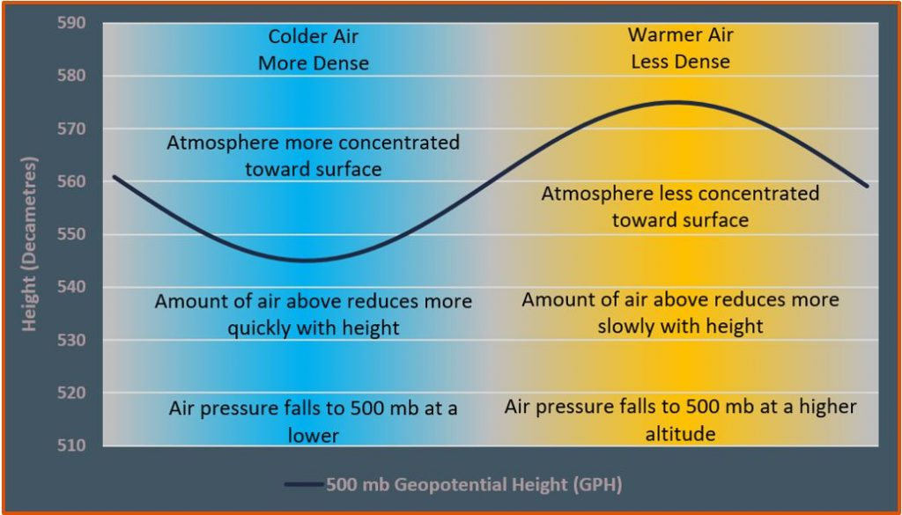
Thickness and the hypsometric equation
The hypsometric equation tells us that the thickness between two pressure levels is directly proportional to the average temperature within the layer.
We can use thickness as a measure of the average temperature of a layer.
We can use contours of thickness in a similar manner to how we use isotherms.
Colder layers are thinner, warmer layers are thicker.

Slide 25
Why using hypsometric equation
Weather observing stations measure station pressure, which must be converted to sea-level pressure for reporting and plotting on weather charts.
The method of calculating the sea-level pressure is called pressure reduction or reducing the pressure to sea-level
Sea-level pressure reduction is accomplished via the hypsometric equation, treating Z₁ = 0 as sea level, and Z₂ = Z_{sta} as the geopotential height of the station.
This means p1 = p_{sl}, the sea-level pressure, P₂ = P_{sta}, the station pressure, and by Rearranging hypsometric equation with these definitions give:
There are different formulas used in various applications according to the layer-average temperature in the hypothetical atmospheric layer between the surface and sea level.

Slide 26
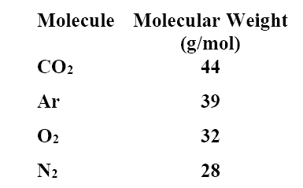
IS THE UPPER ATMOSPHERE WELL MIXED?
The atmosphere is a mixture of several different gases. The most abundant are N2, O2, Ar, and CO2.
In order of molecular weight we have
Notes:
http://apollo.lsc.vsc.edu/classes/met130/index.html

Slide 27
IS THE UPPER ATMOSPHERE WELL MIXED?
You would think that the atmosphere would stratify according to weight, with the heaviest molecules having the greatest concentration near the surface. Therefore, we would expect most of the CO2 and Ar to be found near the surface.
Without turbulence, molecular diffusion would dominate any vertical transport processes.
Molecular diffusion favors lighter molecules over heavier ones. Therefore, the lighter molecules would be better mixed through a layer than would the heavier molecules, which would remain near the bottom due to gravity.
Molecular diffusion is characterized by the mean free path, which is the average distance between collisions.
Notes:
http://apollo.lsc.vsc.edu/classes/met130/index.html

Slide 28
IS THE UPPER ATMOSPHERE WELL MIXED?
The shorter the mean free path, the less effective molecular diffusion becomes.
Mean free path increases as pressure (and density) decrease.
If turbulence is present, mixing is accomplished very efficiently.
Turbulent mixing does not discriminate based on mass. All molecules are mixed just as effectively.
Turbulent mixing is characterized by the mixing length, which is the average length that an air parcel can travel and still retain its identity.
If the mixing length is greater than the mean free path, turbulent mixing will dominate and all molecules will be well mixed.
Notes:
http://apollo.lsc.vsc.edu/classes/met130/index.html

Slide 29
IS THE UPPER ATMOSPHERE WELL MIXED?
If the mean free path is greater than the mixing length, molecular diffusion will dominate and the heavier molecules will be found toward the bottom.
Up to about 80 km or so, the mixing length is larger than the mean free path, so that turbulent mixing dominates and the atmosphere is well mixed.
Above 80 km the mean free path becomes larger than the mixing length (because density is decreasing with altitude). Therefore, above 80 km molecular diffusion dominates and the atmosphere is no longer well mixed. Instead, it becomes stratifies with the heavier molecules concentrated at the bottom.
The well-mixed region is called the homosphere.
The stratified region is called the heterosphere.
The transition layer between the two is called the turbopause.
Notes:
http://apollo.lsc.vsc.edu/classes/met130/index.html

Slide 30
Exercise
Why pressure decreases with increasing height above the ground
Why the atmosphere does not collapses on the ground and does not escape to the space?
Where the hydrostatic equation is used for?
What are the types of pressure? And which one we use in thermodynamics?
Explain why airplane cabins are pressurized.
If the thickness of the 1000 – 500 hPa layer is 5400 gpm, what is the layer average temperature in kelvin?
What is the geopotential and why it is used?
How to reduce the pressure at the station to the pressure at MSL? Write down a formula.

