Slide 1

The Course of Fundamentals of Thermodynamics
MUSTANSIRIYAH UNIVERSITY
COLLEGE OF SCIENCES
DEPARTMENT OF ATMOSPHERIC SCIENCES
2021-2022
Dr. Sama Khalid Mohammed
SECOND STAGE
Lecture 7

Slide 2

Welcome Students In The Seventh Lecture ☺

Slide 3
This lecture including the following items
Heat capacities and specific heats
Relation between c_{v} and c_{p}
Specific heats for ideal gases
The first law of thermodynamics for ideal gases
Exercises

Slide 4
HEAT CAPACITIES AND SPECIFIC HEATS
Heat capacity is the amount of heat Q needed to raise the temperature of a substance T by one degree.
The heat capacity of most systems is not a constant. In particular, it is dependent on
  Thermodynamic variables: temperature, pressure and the volume of the system.
  The ways in which pressures and volumes have been allowed to change while the system has passed from one temperature to another.
The reason for this is that pressure-volume work done to the system raises its temperature by a mechanism other than heating, while pressure-volume work done by the system absorbs heat without raising the system’s temperature
Notes:
Note that bodies (systems) contain internal energy and not heat.
pressure. At constant pressure, some of the heat supplied goes into doing work of expansion and less is available with the system (to raise it temperature).

Slide 5
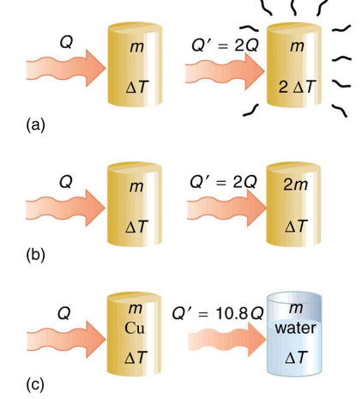
HEAT CAPACITIES AND SPECIFIC HEATS
Experiments show that the transferred heat depends on three factors: (1) The change in temperature, (2) the mass of the system, and (3) the substance and phase of the substance. The last two factors are encapsulated in the value of the specific heat.
To double the temperature change of a mass m, you need to add twice the heat.
To cause an equivalent temperature change in a doubled mass, you need to add twice the heat.
If it takes an amount Q of heat to cause a temperature change ΔT in a given mass of copper, it will take 10.8 times that amount of heat to cause the equivalent temperature change in the same mass of water assuming no phase change in either substance.

Slide 6

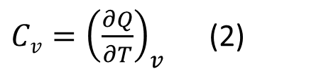

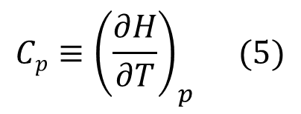
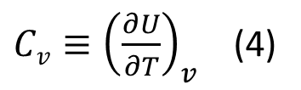
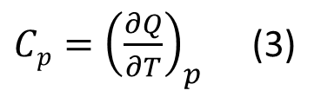
HEAT CAPACITIES AND SPECIFIC HEATS
Heat capacity is defined in terms of either a constant volume process or a constant pressure process (At constant pressure, some of the heat supplied goes into doing work of expansion and less is available with the system )
${Cv=\left(\frac{∂Q}{∂T}\right)}_{v}$ (2)
${Cp=\left(\frac{∂Q}{∂T}\right)}_{p}$ (3)
From the two forms of the first law (dH = dQ), and (dU = dQ), we can show that:
so that the definitions for heat capacity can also be written as
$${{\left(\frac{∂Q}{∂T}\right)}_{v}=\left(\frac{∂U}{∂T}\right)}_{v}$$
$${{\left(\frac{∂Q}{∂T}\right)}_{p} =\left(\frac{∂H}{∂T}\right)}_{p}$$
${Cv≡\left(\frac{∂U}{∂T}\right)}_{v}$ (4)
$${Cp≡\left(\frac{∂H}{∂T}\right)}_{p} (5)$$
Notes:
Note that bodies (systems) contain internal energy and not heat.
pressure. At constant pressure, some of the heat supplied goes into doing work of expansion and less is available with the system (to raise it temperature).

Slide 7
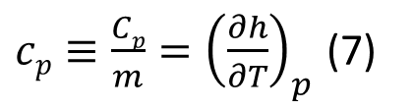
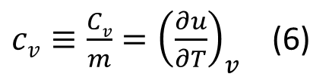
HEAT CAPACITIES AND SPECIFIC HEATS
The units of heat capacity are J K⁻¹.
Heat capacity is an extensive property (depends on ‘amount of matter’), its intensive counterpart is called specific heat, and is defined as
The units of specific heat are J K⁻¹ kg⁻¹.
If a substance has higher heat capacity, then more heat has to be added to raise its temperature.
${cv≡\frac{Cv}{m}=\left(\frac{∂u}{∂T}\right)}_{v}$ (6)
${cp≡\frac{Cp}{m}=\left(\frac{∂h}{∂T}\right)}_{p}$ (7)
Riddles: What is the difference between heat capacity and Enthalpy?

Slide 8

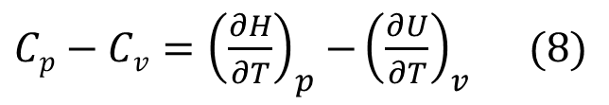
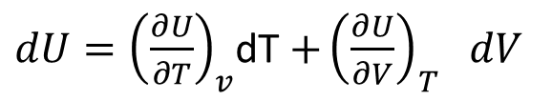
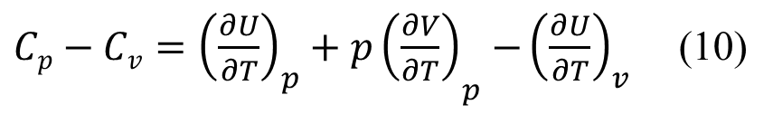
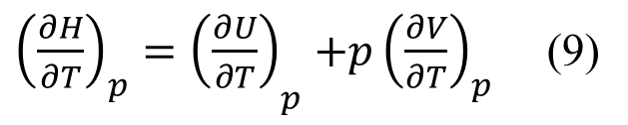
RELATION BETWEEN Cv and Cp
To see the relation between C_{v} and C_{p} we start with the:
From the definition of enthalpy,
H =U + pV ,
we take the partial derivative with respect to T at constant pressure to get:
Substituting (9) into (8) we get
The differential of U is:
${Cp−Cv=\left(\frac{∂H}{∂T}\right)}_{p}$ ${−\left(\frac{∂U}{∂T}\right)}_{v} (8)$
${{\left(\frac{∂H}{∂T}\right)}_{p}=\left(\frac{∂U}{∂T}\right)}_{p}$ ${+p\left(\frac{∂V}{∂T}\right)}_{p}$ (9)
${{Cp−Cv=\left(\frac{∂U}{∂T}\right)}_{p}+p\left(\frac{∂V}{∂T}\right)}_{p}$ ${−\left(\frac{∂U}{∂T}\right)}_{v}$ (10)
${dU=\left(\frac{∂U}{∂T}\right)}_{v}$dT ${+\left(\frac{∂U}{∂V}\right)}_{T} dV$
Notes:
الاشتقاق الجزئي (بالإنجليزية: Partial derivative)‏ في علم الرياضيات هو اشتقاق دالة رياضية مكونة من عدة متغيرات بحيث يكون ذلك الاشتقاق بالنسبة لأحد هذه المتغيرات مع معاملة باقي المتغيرات كثوابت
the full derivative and the partial derivative are equivalent only if x and y are independent, so that dy dx is zero.

Slide 9
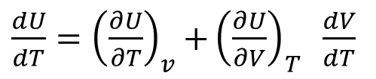
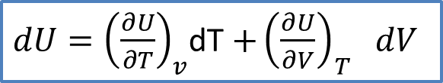

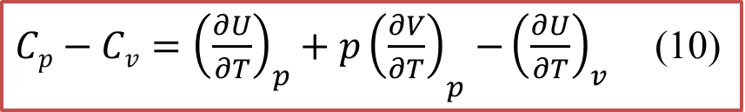
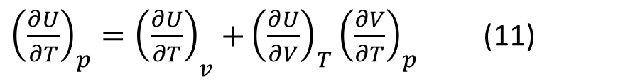
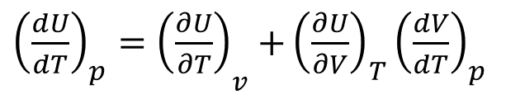
RELATION BETWEEN Cv and Cp
${dU=\left(\frac{∂U}{∂T}\right)}_{v}$dT ${+\left(\frac{∂U}{∂V}\right)}_{T} dV$
Dividing by dT gives:
and assuming constant pressure we get:
Or
Substituting this into (10)
$\text{gives} Cp−Cv=\left[{\left(\frac{∂U}{∂V}\right)}_{T}+p\right]$ ${\left(\frac{∂V}{∂T}\right)}_{P} (12)$
${\frac{dU}{dT}=\left(\frac{∂U}{∂T}\right)}_{v}$ ${+\left(\frac{∂U}{∂V}\right)}_{T} \frac{dV}{dT}$
${{\left(\frac{dU}{dT}\right)}_{p}=\left(\frac{∂U}{∂T}\right)}_{v}$ ${+\left(\frac{∂U}{∂V}\right)}_{T}{\left(\frac{dV}{dT}\right)}_{p}$
${{\left(\frac{∂U}{∂T}\right)}_{p}=\left(\frac{∂U}{∂T}\right)}_{v}$ ${+\left(\frac{∂U}{∂V}\right)}_{T}{\left(\frac{∂V}{∂T}\right)}_{p}$ (11)
${{Cp−Cv=\left(\frac{∂U}{∂T}\right)}_{p}+p\left(\frac{∂V}{∂T}\right)}_{p}$ ${−\left(\frac{∂U}{∂T}\right)}_{v}$ (10)

Slide 10
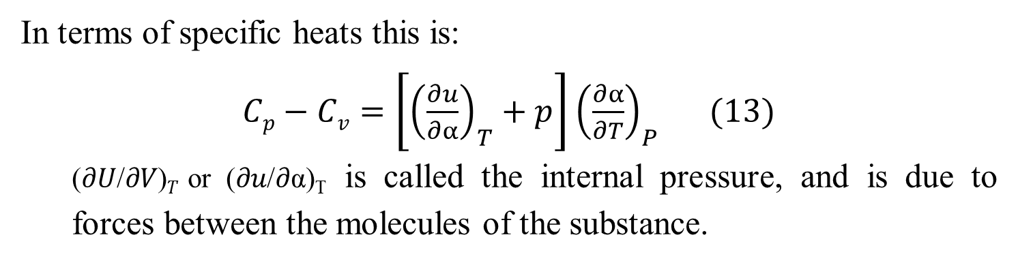
RELATION BETWEEN Cv AND Cp
In terms of specific heats this is:
$Cp−Cv=\left[{\left(\frac{∂u}{∂α}\right)}_{T}+p\right]$ ${\left(\frac{∂α}{∂T}\right)}_{P} (13)$
  (𝜕𝑈/𝜕𝑉)_{𝑇} or (𝜕𝑢/𝜕α)_{T} is called the internal pressure, and is due to forces between the molecules of the substance.
Riddles
For gases, C_{p} > C_{v}, why?
Notes:
For gases, C_{p} is greater than C_{v}. This is because in a constant pressure process some of the heat added will be used to do work as the system expands, so the internal energy cannot increase as much as in a constant volume process.

Slide 11
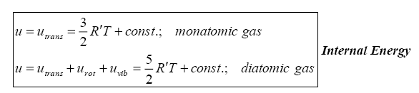
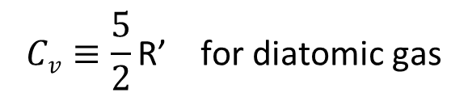

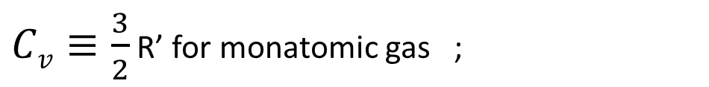



SPECIFIC HEATS FOR IDEAL GASES
Recall that the specific heat at constant volume and the specific heat at constant pressure was defined as:
Since the internal energy and enthalpy of an ideal gas depend only on
temperature, then for an ideal gas we don’t have to write the specific heats as partial derivatives, but can instead use full derivatives
From the expressions for the internal energy of ideal gases,
we get that
$${Cv≡\left(\frac{∂u}{∂T}\right)}_{v}$$
$${Cp≡\left(\frac{∂h}{∂T}\right)}_{p}$$
$$Cv≡\frac{du}{dT}$$
$$Cp≡\frac{dh}{dT}$$
$$Cv≡\frac{5}{2}\text{R}\text{’ }\text{for} \text{di}\text{atomic} \text{gas}$$
$Cv≡\frac{3}{2}$ R’ for monatomic gas ;
Notes:
the full derivative and the partial derivative are equivalent only if x and y are independent, so that dy dx is zero.
when f is a function of a single variable, the total derivative is the same as the ordinary derivative of the function

Slide 12
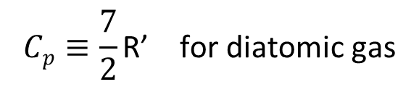
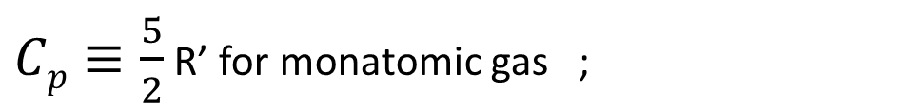
SPECIFIC HEATS FOR IDEAL GASES
The expression relating the specific heats at constant pressure and at constant volume is also greatly simplified for an ideal gas. The general expression [Eqn. (13)] becomes, for an ideal gas,
C_{p}-C_{v}=R’ (14)
which tells us that:
99% of the atmosphere is composed of diatomic molecules (N₂ and O₂), and has a specific gas constant of 287.1 J-kg⁻¹-K⁻¹. This leads to values of C_{v} and C_{p} of 718 J-kg⁻¹-K⁻¹ and 1005 J-kg⁻¹-K⁻¹. These values are extremely close to the measured values for the atmosphere.
$$Cp≡\frac{7}{2}\text{R}\text{’ }\text{for} \text{di}\text{atomic} \text{gas}$$
$Cp≡\frac{5}{2}$ R’ for monatomic gas ;

Slide 13

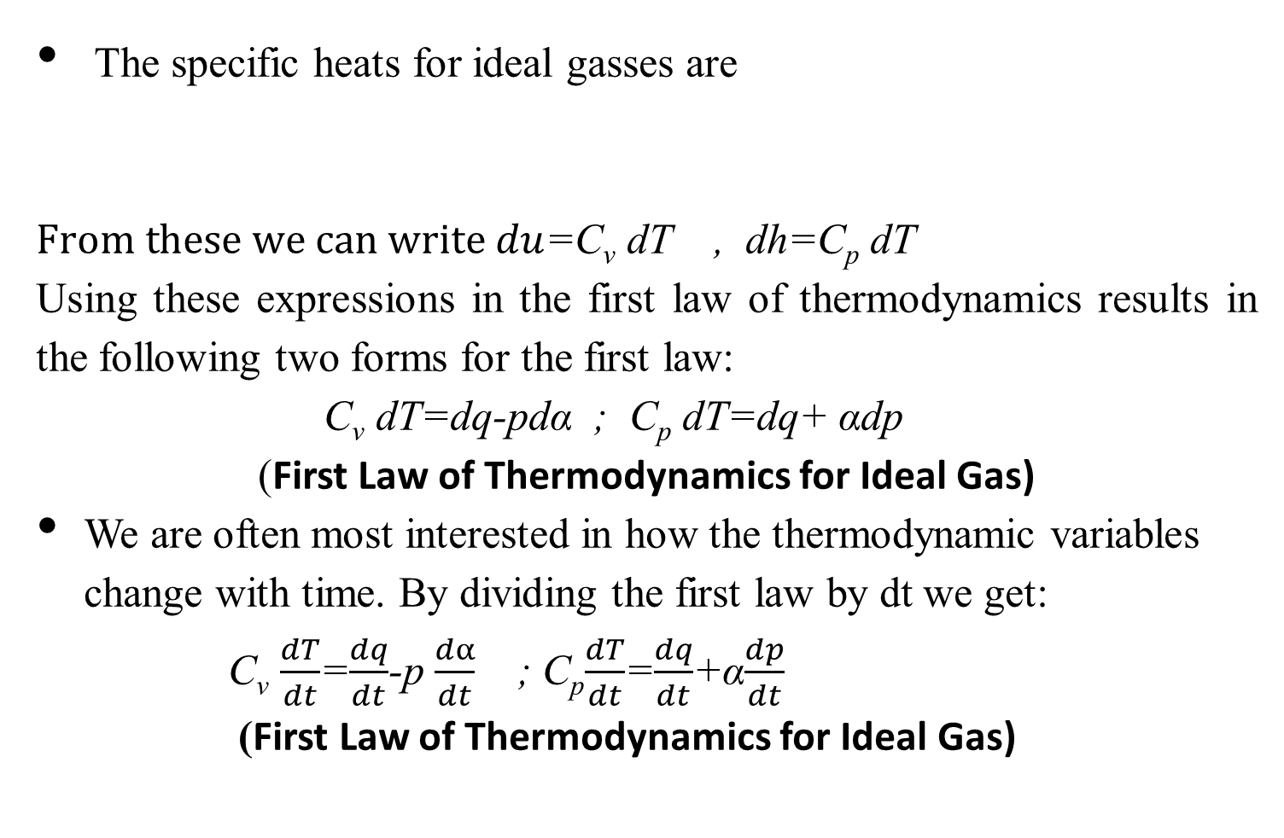

THE FIRST LAW OF THERMODYNAMICS FOR IDEAL GASES
The specific heats for ideal gasses are
$From these we can write du$=C_{v} dT , dh=C_{p} dT
Using these expressions in the first law of thermodynamics results in the following two forms for the first law:
C_{v} dT=dq-pdα ; C_{p} dT=dq+ αdp
(First Law of Thermodynamics for Ideal Gas)
We are often most interested in how the thermodynamic variables change with time. By dividing the first law by dt we get:
      C_{v} $\frac{dT}{dt}$=$\frac{dq}{dt}$-p $\frac{dα}{dt}$ ; C_{p}$\frac{dT}{dt}$=$\frac{dq}{dt}$+α$\frac{dp}{dt}$
      (First Law of Thermodynamics for Ideal Gas)
$$Cv=\frac{du}{dT}$$
$$Cp=\frac{dh}{dT}$$

Slide 14

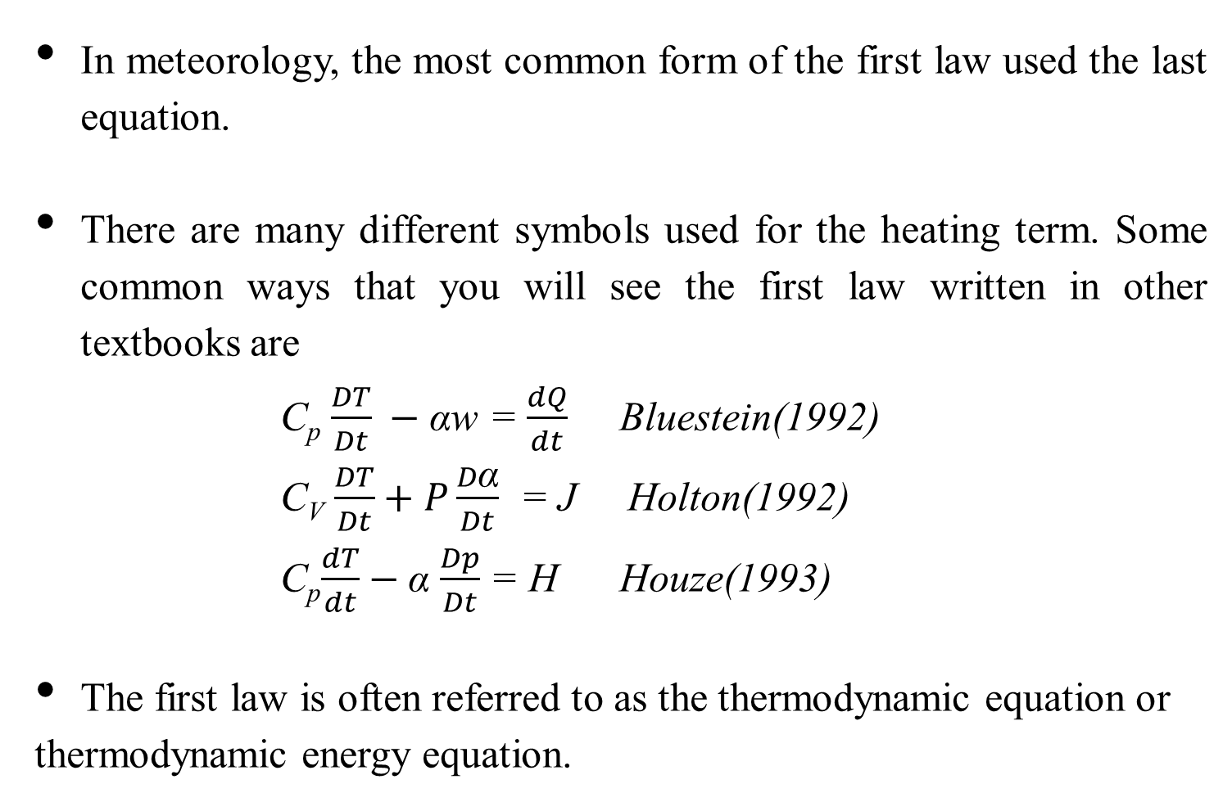
THE FIRST LAW OF THERMODYNAMICS FOR IDEAL GASES
In meteorology, the most common form of the first law used the last equation.
There are many different symbols used for the heating term. Some common ways that you will see the first law written in other textbooks are
        C_{p} $\frac{DT}{Dt} −$αw = $\frac{dQ}{dt}$ Bluestein(1992)
        C_{V} $\frac{DT}{Dt}+P\frac{D\text{α}}{Dt}$ = J Holton(1992)
        C_{p}$\frac{dT}{dt}$ $−$α $\frac{Dp}{Dt}$ = H Houze(1993)
The first law is often referred to as the thermodynamic equation or
thermodynamic energy equation.
      C_{v} $\frac{dT}{dt}$=$\frac{dq}{dt}$-p $\frac{dα}{dt}$ ; C_{p}$\frac{dT}{dt}$=$\frac{dq}{dt}$+α$\frac{dp}{dt}$

