Slide 1
The Course of Fundamentals of Thermodynamics
MUSTANSIRIYAH UNIVERSITY
COLLEGE OF SCIENCES
DEPARTMENT OF ATMOSPHERIC SCIENCES
2021-2022
Dr. Sama Khalid Mohammed
SECOND STAGE
Lecture 6

Slide 2
Welcome Students In The New Course
And In The Sixth Lecture ☺

Slide 3
This lecture including the following items
Riddles
Kinetic theory of heat.
Internal Energy of an Ideal Gas.
Enthalpy and why it is used.

Slide 4
Riddles
Imagine that at the beginning of a journey a truck tire has a volume of 30,000 cm³ and an internal pressure of 170 kPa. The temperature of the tire is 16∘C. By the end of the trip, the volume of the tire has increased to 32,000 cm³ and the temperature of the air inside the tire is 40∘C. What is the tire pressure at the end of the journey?
Hint: use the gas law (equation of state(The Combined Gas Law)
Solution: 173 kPa

Slide 5
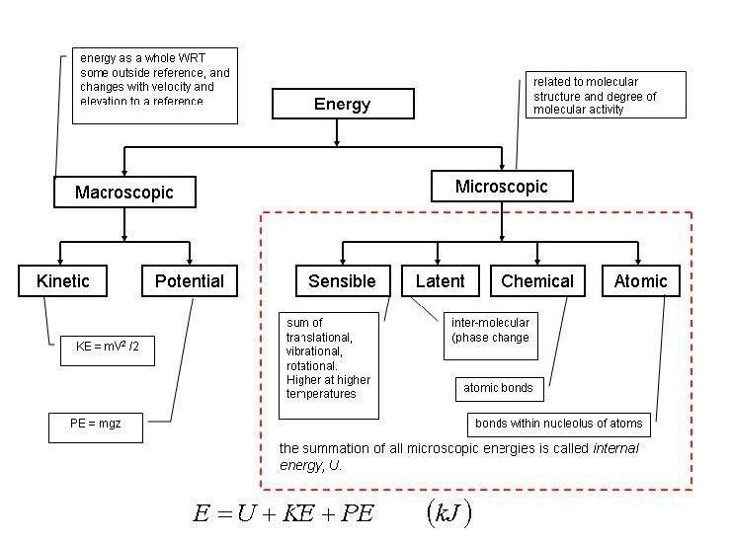
As You Remember !!! Forms of Energy

Slide 6
Kinetic theory
The kinetic theory of gases describes a gas as a large number of small particles (atoms or molecules), all of which are in constant, random motion.
In kinematic theory of gases, macroscopic quantities (such as press and temperature) are explained by considering microscopic (random) motion of molecules.
Describe relationship between temperature and energy of molecules in an ideal gas?
hotter air suggests faster movement of air molecules. In this atom, we will derive an equation relating the temperature of a gas (a macroscopic quantity) to the average kinetic energy of individual molecules (a microscopic quantity). This is a basic and extremely important relationship in the kinetic theory of gases.

Slide 7
Kinetic theory of heat
Let us consider a system at a temperature T, consisting of N point masses (molecules). According to the kinetic theory of heat, these molecules move randomly at all directions (Brownian motion), and due to this randomness, the internal energies of the point-masses are not equal to each other, but they change in time. However, if we calculate the mean internal energy, we will find that it remains constant in time.
Thus, the mean internal energy of each point-mass, U, is proportional to the absolute temperature of the system T
Ū = A × T , A is a universal constant (A=k/2 where k is Boltzmann’s constant (k = 1.38×10⁻²³ JK⁻¹) , thus Ū = k T / 2
Assume that N = 1, Then the point has only three degrees of freedom which here are called thermodynamic degrees of freedom and are equal to the number of independent variables needed to completely define the energy of the point, then the total internal energy is equal to its kinetic energy. Thus,
but what about the potential internal energy ?
U= $\frac{m_{p}v^{2}}{2}$

Slide 8
Kinetic theory of heat
The mean kinetic energy of a point with three degrees of freedom is called thermal energy, and equal to
Note: you will need to the following relations to reach to the next equation:
R=k N_{A} and Rʹ = R/M and M=n N_{A} m
R is the universal gas constant
m is the individual mass of a gas
M is the Molecular weight
Rʹ is the specific gas constant
n is the no. of moles

Slide 9
Internal Energy of an Ideal Gas
Since there are no intermolecular forces in an ideal gas, there is no internal potential energy. The internal energy of a monatomic gas is therefore due solely to the translational kinetic energy of the molecules (Recall from Lec.1 : Internal energy – The sum of the the kinetic energy and any potential energy due to the forces between the molecules of a substance).
If the molecules have more than one atom, then there is also kinetic energy due to rotation and vibration.
Though technically not an ideal gas, at normal temperatures and pressures the main atmospheric gasses closely follow the ideal gas law, so we can still speak of air as an ideal gas.
The translational kinetic energy has a value of

Slide 10
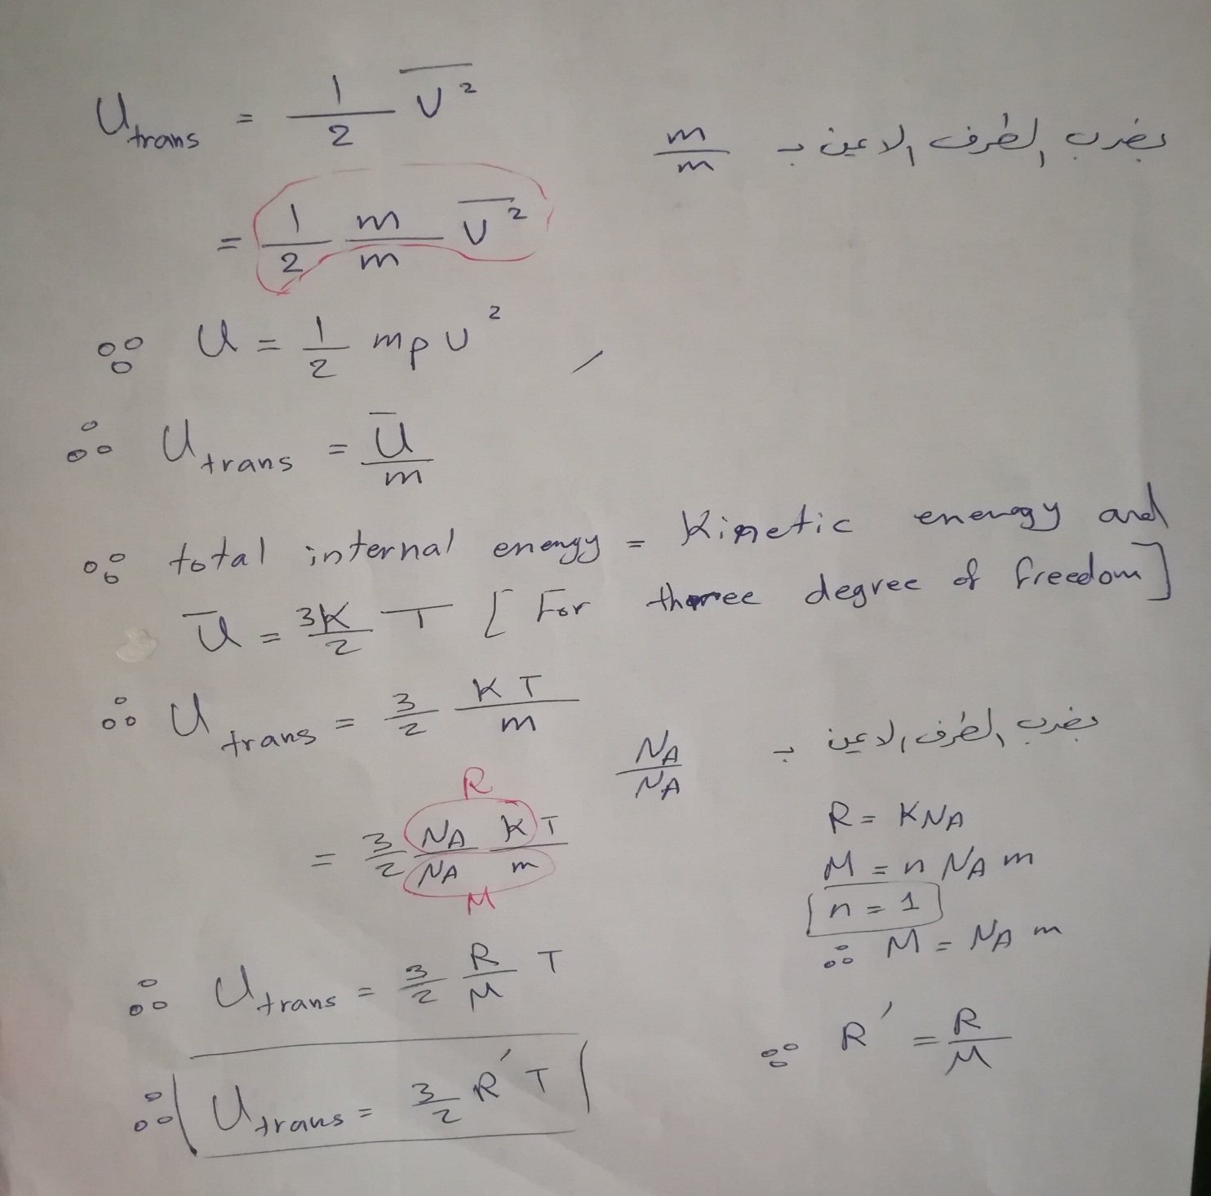

Slide 11
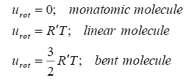
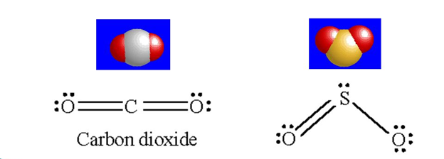
Internal Energy of an Ideal Gas
The rotational kinetic energy depends on whether the molecule is monatomic or multi-atomic, and whether it is linear or bent. It is
Monoatomic particles do not vibrate, and their rotational energy can be neglected because atomic moment of inertia is so small. Also, they are not electronically excited to higher energies except at very high temperatures. Therefore, practical internal energy changes in an ideal gas may be described solely by changes in its translational kinetic energy.
Notes:
A diatomic molecule (H₂, O₂, N₂, etc.) has 5 degrees of freedom (3 for translation in x, y and z directions, and 2 for rotation). Therefore, the internal energy for diatomic gases is U=52NkTU = \frac{5}{2}NkT.
https://courses.lumenlearning.com/boundless-physics/chapter/kinetic-theory/

Slide 12
Internal Energy of an Ideal Gas
The vibrational kinetic energy is a complicated function of temperature. For light diatomic molecules (such as N₂ and O₂) it can be considered a constant except at extremely high temperatures.
Thus, the internal energies for most monatomic and diatomic molecules are:
Note that when temperature is 0K, there is still some kinetic energy. Motion does not cease at absolute zero.
An important point to notice is that, for an ideal gas, the internal energy is a function of temperature only.

Slide 13
As You Remember !!!
The first law of thermodynamics expresses the conservation of energy. It is given as:
dU = dQ + dW
The first law states that the internal energy of a system can be changed either through heating or through work.
Using intensive properties, the first law becomes
du = dq + dw.
Our convention will be that heat added to the system and work done on the system will be positive.
Thus, work done by the system on its surroundings will be negative.

Slide 14
ENTHALPY
If heat is added to a material at constant pressure so that the specific volume of the material increases from α₁ to α₂, the work done by a unit mass of the material is p(α₂ - α₁).
as we know that:
Then the finite quantity of heat Δq added to a unit mass of the material at constant pressure is given by :
where u1 and u2 are, respectively, the initial and final internal energies for a unit mass of the material.
Therefore, at constant pressure,
where h is the enthalpy of a unit mass of the material,which is defined by
Because u, p, and α are functions of state, h is a function of state. Differentiating the last equation, we obtain

Slide 15
ENTHALPY
It is one of the state variables, and is defined as
H ≡ U + pV
The differential of H is given as
dH = dU + pdV + Vdp
This makes it possible to write the first law of thermodynamics as:
dH = dQ +Vdp (1)

Slide 16
WHY USING ENTHALPY?
The reason enthalpy is convenient to use is that for constant pressure processes, dp = 0 and so dH = dQ.
Since many thermodynamic processes in the atmosphere occur at constant pressure, change in enthalpy and heat are equivalent and are used interchangeably in such processes.
In an isobaric (constant pressure) process, dW = dU − dH , which states that the work is the difference in the changes of internal energy and enthalpy.
From the first form of the first law, dU = dQ – pdV, we see that at constant volume, dU = dQ.
For constant volume processes, heat and change in internal energy are interchangeable.
For constant pressure processes, heat and enthalpy change are equivalent.
For constant volume processes, heat and internal energy change are equivalent.
Notes:
Note that bodies (systems) contain internal energy and not heat.
pressure. At constant pressure, some of the heat supplied goes into doing work of expansion and less is available with the system (to raise it temperature).

