Slide 1
Residual Layer and Stable Boundary Layer
(4)

Slide 2
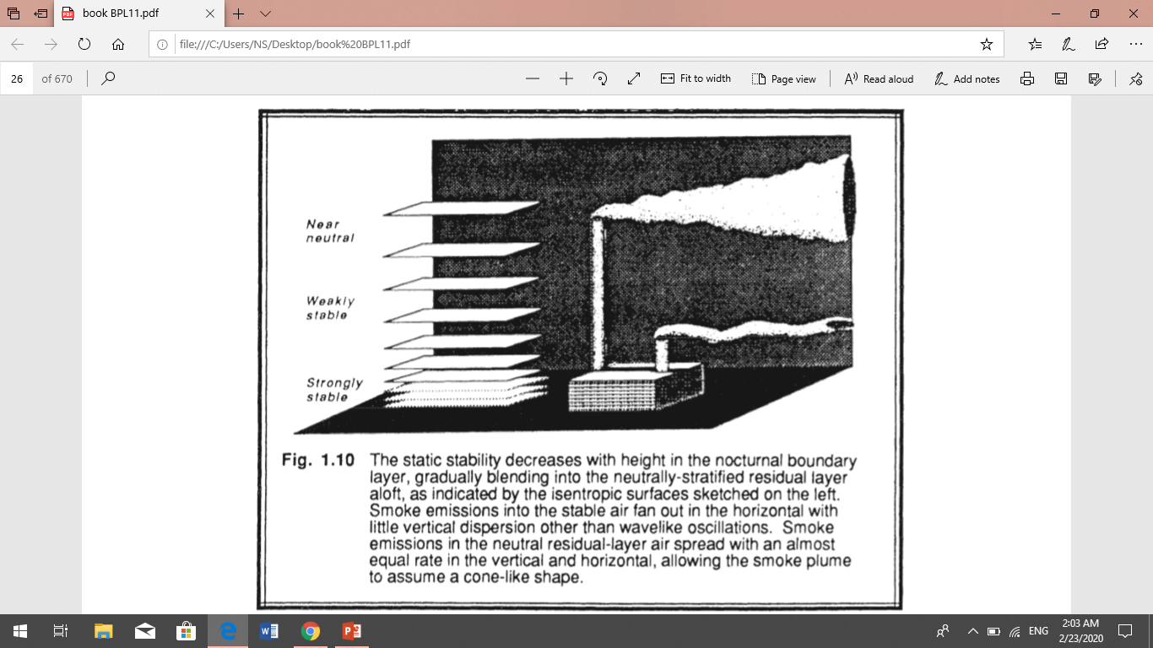
Residual Layer
About a half -hour before sunset the thermals cease to form (in the absence of cold air advection), allowing turbulence to decay in the formerly well-mixed layer. The resulting layer of air is sometimes called the residual layer.
The RL is neutrally stratified, resulting in turbulence that is nearly of equal intensity in all directions. As a result, smoke plumes emitted into the RL tend to disperse at equal rates in the vertical and lateral directions, creating a cone-shaped plume. Variables such as virtual potential temperature usually decrease slowly during the night because of radiation divergence. This cooling rate is on the order of 1 °C/100m. The cooling rate is more-or-less uniform throughout the depth of the RL, thus allowing the RL virtual potential temperature profile to remain nearly adiabatic. The RL does not have direct contact with the ground. During the night, the nocturnal stable layer gradually increases in thickness.

Slide 3
The static stability decreases with height in the nocturnal boundary layer. gradually blending into the neutrally-stratified residual layer Aloft. Smoke emissions into the stable air fan out in the horizontal with little vertical dispersion other than wavelike Oscillations. Smoke emissions in the neutral residual-layer air spread with an almost equal rate in the vertical and horizontal, allowing the smoke plume to assume a cone-like shape.
The RL often exists for a while in the mornings before being entrained into the new ML.
During this time solar radiation may trigger photochemical reactions among the constituents in the RL.
Variables such as virtual potential temperature usually decrease slowly during the night because of radiation divergence. This cooling rate is on the order of 1 °C/d. The cooling rate is more-or-less uniform throughout the depth of the RL, thus allowing the RL virtual potential temperature profile to remain nearly adiabatic.
When the top of the next day's ML reaches the base of the RL, the ML growth becomes very rapid. The RL does not have direct contact with the ground. During the night, the nocturnal stable layer gradually increases in thickness by modifying the bottom of the RL.

Slide 4
Stable Boundary Layer
As the night progresses, the bottom portion of the residual layer is transformed by its contact with the ground into a stable boundary layer. This is characterized by statically stable air with weaker, sporadic turbulence.
Although the wind at ground level frequently becomes lighter or calm at night, the winds aloft may accelerate to super geostrophic speeds in a phenomenon that is called the low-level jet or nocturnal jet.
The statically stable air tends to suppress turbulence, while the developing nocturnal jet enhances wind shears that tend to generate turbulence. As a result, turbulence sometimes occurs in relatively short bursts that can cause mixing throughout the SBL. the daytime ML which has a clearly defined top, the SBL has a poorly defined top that smoothly blends into the RL above.
The top of the ML is defined as the base of the stable layer, while the SBL top is defined as the top of the stable layer or the height where turbulence intensity is a small fraction of its surface value. Pollutants emitted into the stable layer disperse relatively little in the vertical. They disperse more rapidly in the horizontal. This behavior is called fanning.
Wave motions are a frequent occurrence in the SBL. SBLs can also form during the day, as long as the underlying surface is colder than the air. These situations often occur during warm-air advection over a colder surface, such as after a warm frontal passage.

Slide 5
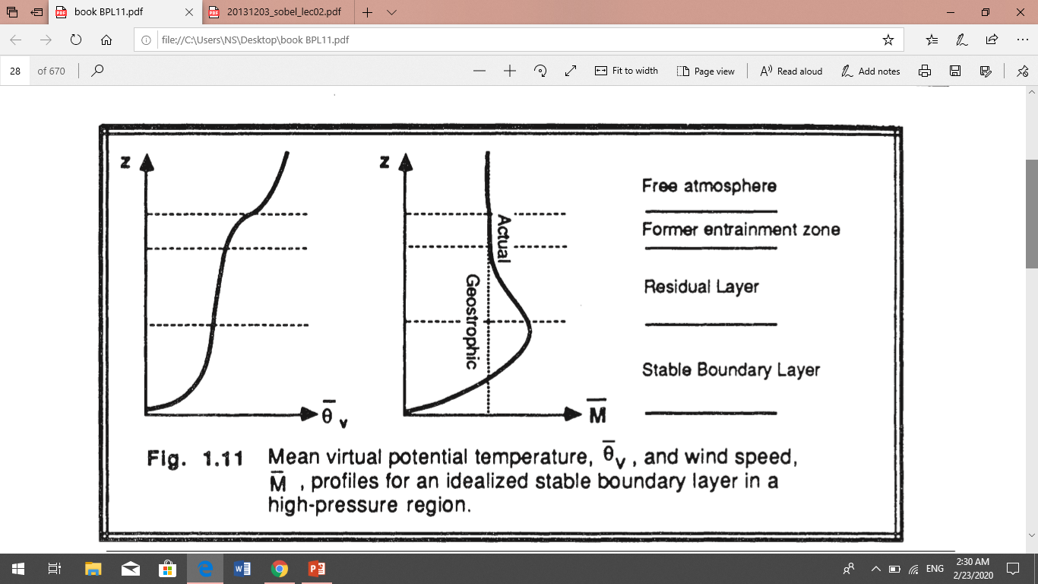
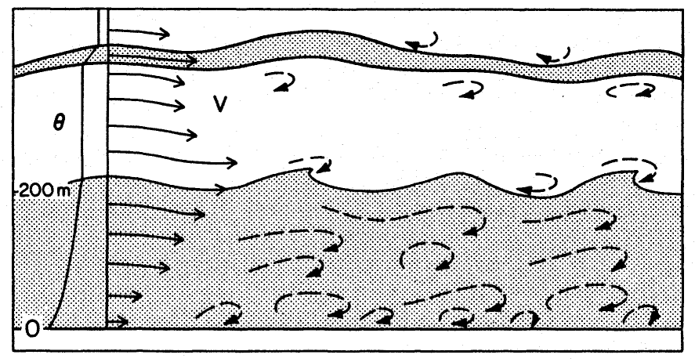
Winds exhibit a very complex behavior at night. Just above ground level the wind speed often becomes light or even calm. At altitudes on the order of 200 m above ground, the wind may reach 10-30 m/s in the nocturnal jet. Another few hundred meters above that, the wind speed is smaller and closer to its geostrophic value. Touching the ground, however, is a thin (order of a few meters) layers of katabatic or drainage winds.
These winds are caused by the colder air, adjacent to the ground, flowing downhill under the influence of gravity.

Slide 6
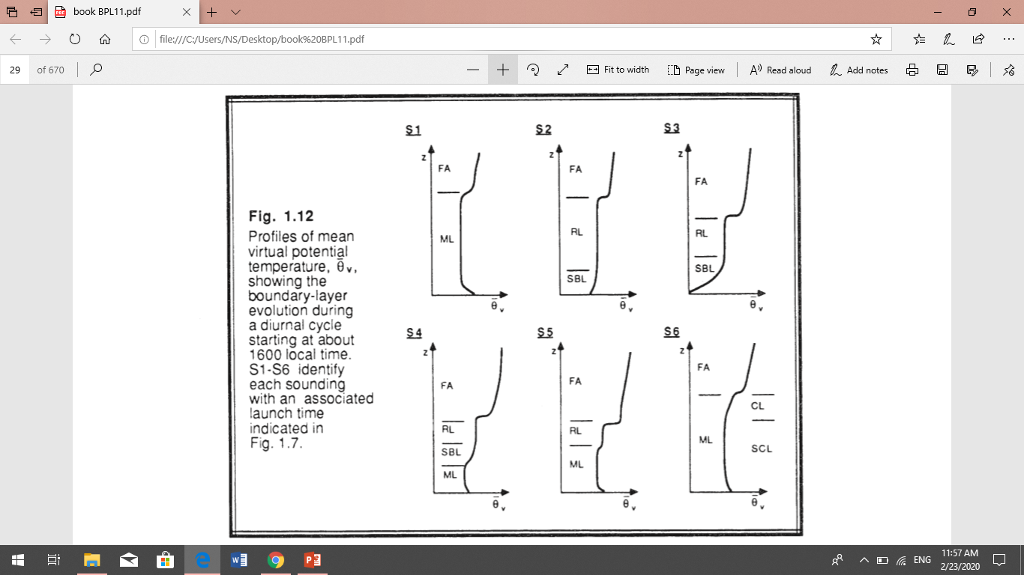
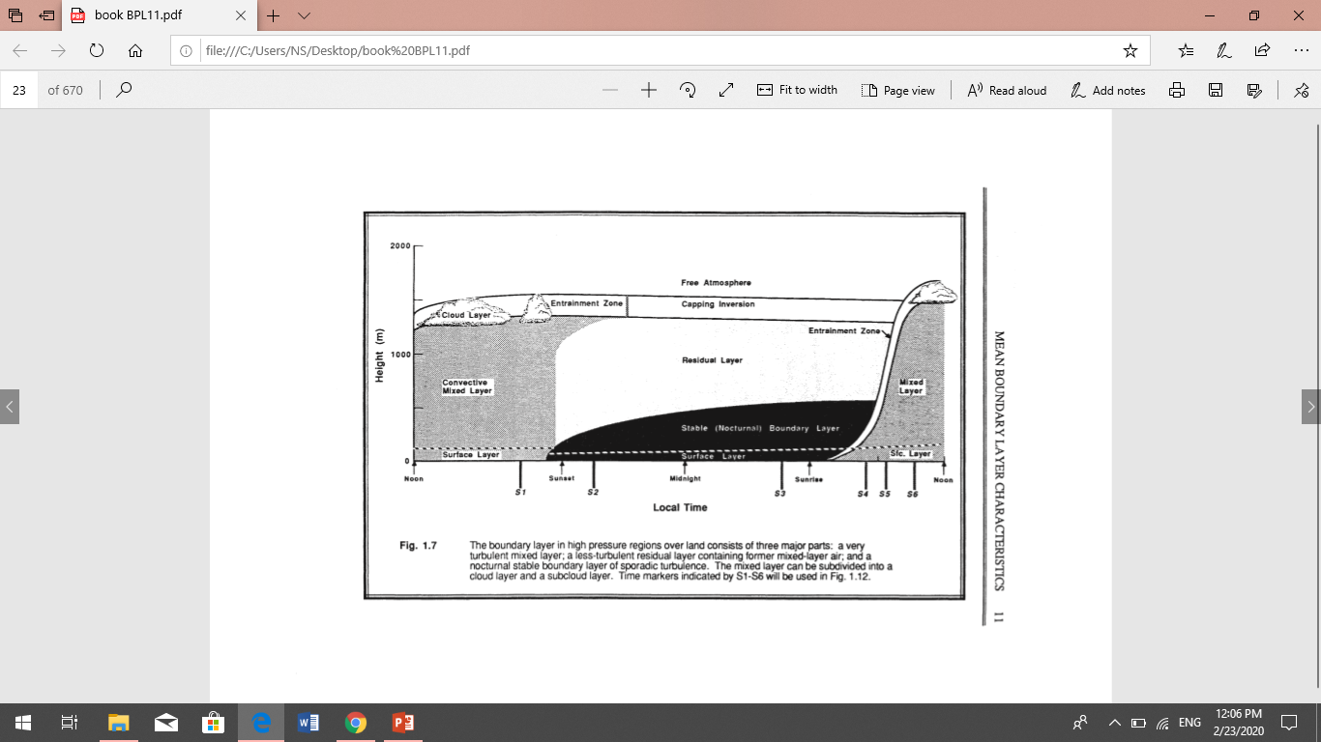
Virtual Potential Temperature Evolution
the virtual potential temperature profile is usually sufficient to identify the parts of the boundary layer. The structure of the BL is clearly evident. Fig 1.12 shows the resulting virtual potential temperature profile evolution.
Fig. 1.12 Profiles of mean virtual potential temperature. Showing the SBL boundary-layer evolution during a diurnal cycle starting at about 1600 local time. S1-S6 identify each sounding with an associated launch time indicated in Fig.

Slide 7
the virtual potential temperature lapse rate is usually sufficient for determining the static stability. An exception to this rule is evident by comparing the lapse rate in the middle of the RL with that in the middle of the ML. Both are adiabatic; yet, the ML corresponds to statically unstable air while the RL contains statically neutral air.
At and shortly after sunrise, surface heating causes turbulent eddies to develop, producing a mixed layer whose depth grows to a maximum depth in late afternoon. In this mixed layer, potential temperature and water vapor mixing ratio are nearly uniform.
At the sunset, the deep surface cooling creates a stable (nocturnal) boundary layer, above which is a residual layer, basically the leftover part of the daytime mixed layer
Q/
a) Draw the profile of mean virtual potential temperature at sunrise and sunset times, and explain the processes that occurred during these times.
b) Draw the profile of mean virtual potential temperature at midnight time, and then sketch the virtual potential temperature profile that you might expect at next four hours.

Slide 8
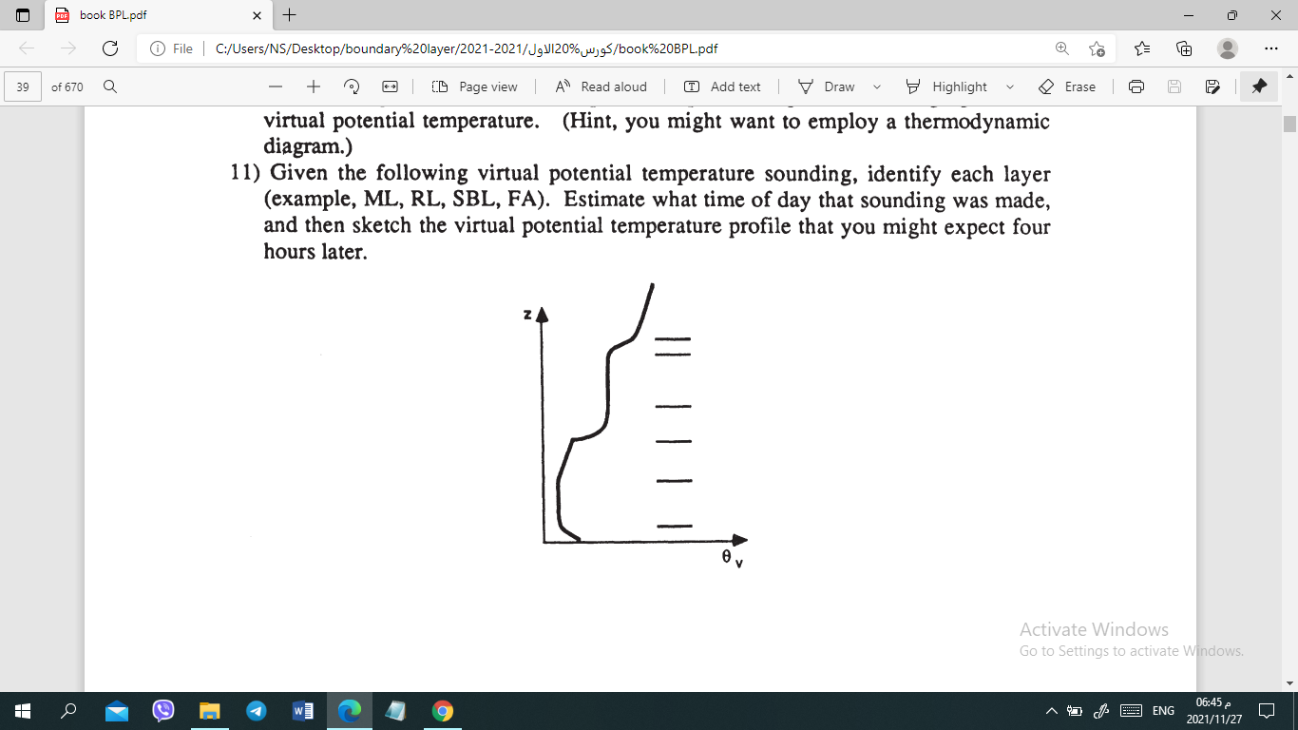

Slide 9
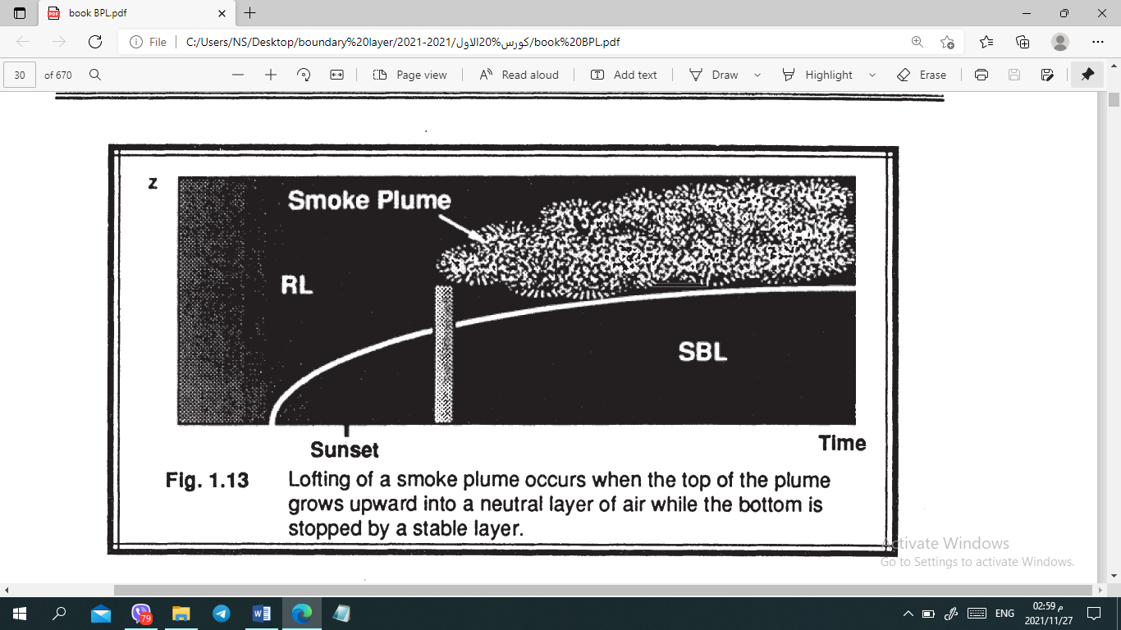
it is obvious that as the virtual potential temperature profile evolves with time, so must the behavior of smoke plumes. For example, smoke emitted into the top of the NBL or into the RL rarely is dispersed down to the ground during the night because of the limited turbulence. These smoke plumes can be advected hundreds of kilometers downwind from their sources during the night. Smoke plumes in the RL may disperse to the point where the bottom of the plume hits the top of the NBL. The strong static stability and frequent reduction in turbulence reduces the downward mixing into the NBL. The top of the smoke plume sometimes can continue to rise into the neutral air. This is called lofting (see Fig 1.13).

Slide 10
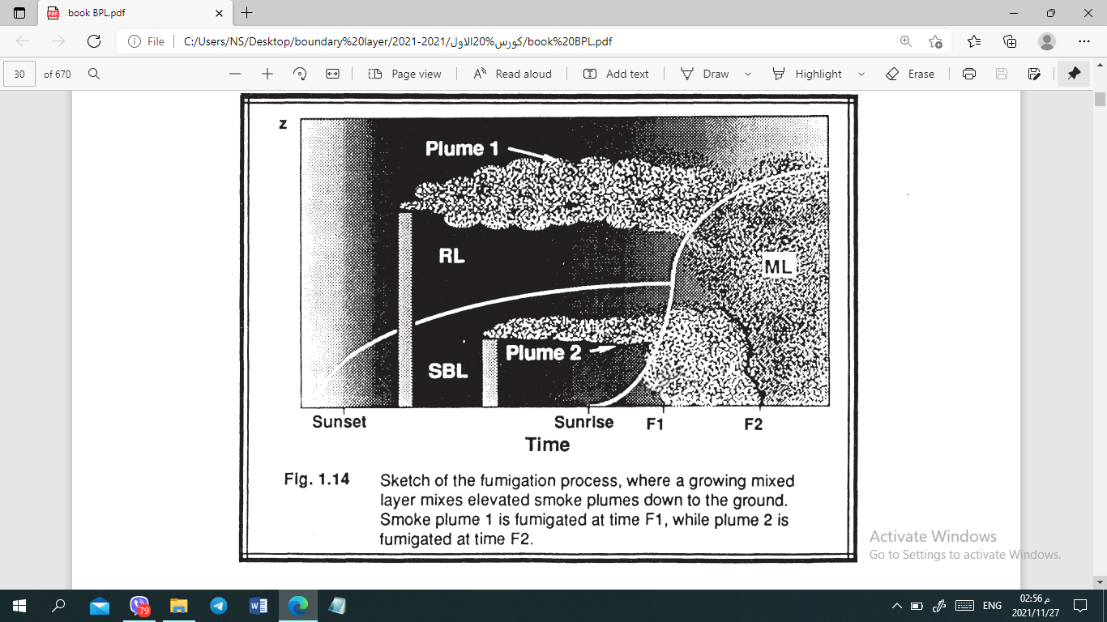
After sunrise a new ML begins to grow, eventually reaching the height of the elevated smoke plume from the previous night. At this time, the elevated pollutants are mixed down to the ground by ML entrainment and turbulence in a process that is called fumigation. A sketch of this process is shown in Fig 1.14.

