Slide 1
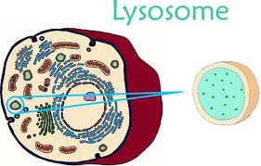
Lysosomes and microbodies
Lysosomes are spherical bodies enclosed by a single membrane. They are produce by the Golgi apparatus. It is found in both plant and animal cells, but is more common in animal cells, Lysosomes are not visible under a light microscope.

Slide 2
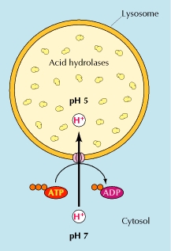
They contain different kinds of hydrolytic enzymes including Lipase, which digests lipids Amylase, which digest carbohydrates Protease, which digest proteins ,Nuclease, which digest nucleic acids
Lysosomes are involved in the digestion of macromolecules during endocytosis, phagocytosis and autophagy.
The size of lysosomes varies from 0.1–1.2 μm. At pH 4.8, the interior of the lysosomes is acidic compared to the slightly basic cytosol (pH 7.2).
This pH differential is maintained
by pumping H+ ions from the
cytosol across the lysosomal
membrane using proton
pumps and chloride ions channels.

Slide 3
They are frequently nicknamed "suicide-bags" or "suicide-sacs" by cell biologists due to their role in autolysis.
Why the contents of the cell are protected from the digestive enzymes of the lysosome?
First, the enzymes are enclosed in the lysosomal membrane .
second, the enzymes were to leak out of the lysosome, they would not be active at the neutral pH of the cytosol.

Slide 4
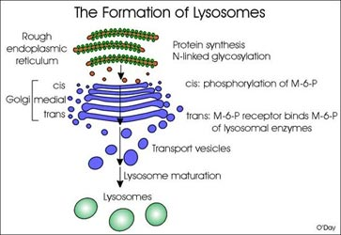
Formation of lysosomes
Lysosomal protein genes are transcribed in the nucleus. mRNA transcripts exit the nucleus into the cytosol, where they are translated by ribosomes. The peptide chains are translocate into the rough endoplasmic reticulum, where they are modified. Upon exiting the endoplasmic reticulum and entering the Golgi apparatus via vesicular transport, a specific lysosomal tag, mannose -6-phosphate, is added to the peptides. The presence of these tags allow for binding to mannose 6-phosphate receptors in the Golgi apparatus, a phenomenon that is crucial for proper packaging into vesicles destined for the lysosomal system.

Slide 6
Lysosome divided into groups according to stages of development
Primary lysosome is formed and secreted by Golgi body. It obtains over 60 hydrolases without activity. When the lysosome was broken or substance entered the lysosome,
the enzymes can be activated immediately.
Secondary lysosomes: primary lysosomes fused with
  Autophagosome , heterophagosomes,
1- Autophagy :refers to a process whereby the cell digests its own contents For example, when a mitochondrion comes to the end life.
2-Heterophagy: refers to a process whereby lysosmes in the intracellular digestion of material gathered from outside of the cell by some kind of endocytotic mechanism. Heterophagy are of two types namely phagocytosis and pinocytosis.

Slide 7
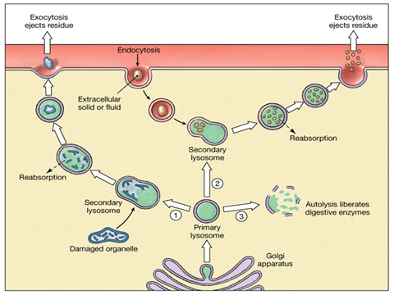

Slide 8
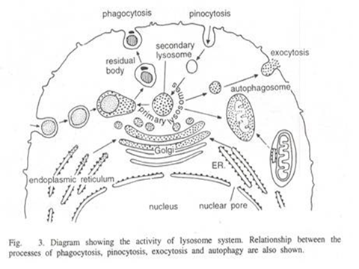

Slide 9
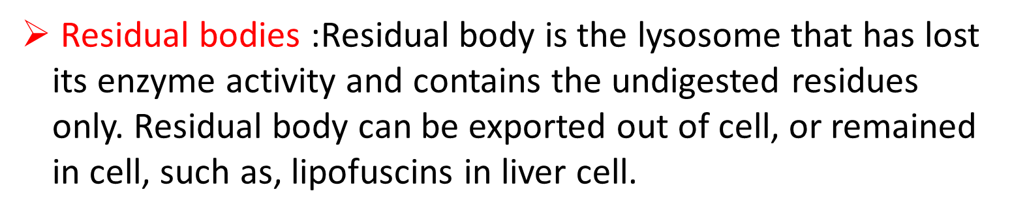

Slide 10
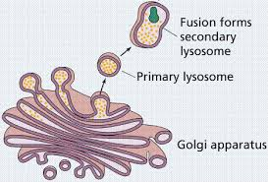

Slide 11
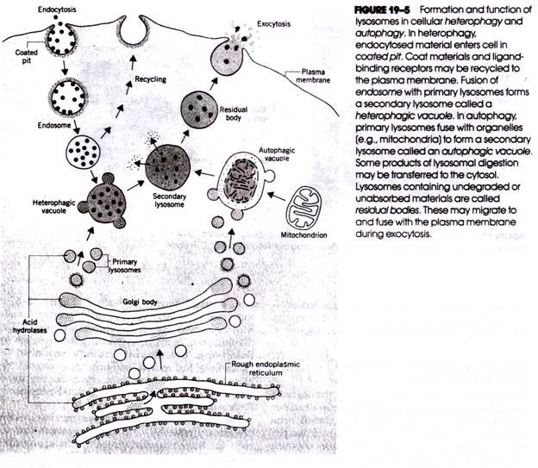

Slide 12
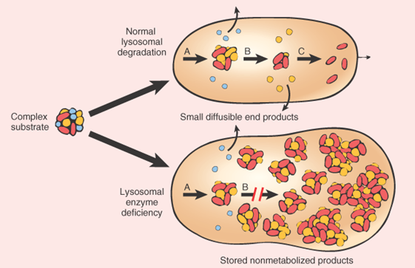
Lysosomal Storage Disease
Lysosomal storage diseases are caused by the accumulation of macromolecules (proteins, polysaccharides, lipids) in the lysosomes because of a genetic failure to manufacture an enzyme needed for their breakdown. Neurons of the central nervous system are particularly susceptible to damage. The accumulated materials damage or kill cells, resulting in skeletal or muscular defects, mental retardation(تخلف العقلي), or even death.

Slide 13


Slide 14

Function of lysosome:
Digestion in cell: The macromolecules entered by phagocytosis can be digested by lysosome to be utilized by cell.
Apoptosis: Lysosomes are also involved in programmed cell death . Autolysis: which is a catabolic process involving degradation of the cells own components. This is the reason why lysosomes are often known as "suicide-bags" or "suicide-sacs".
Defense: Macrophage kills pathogens using its lysosome.
Regulation to endocrine: Thyroglobulin can be digested in lysosome as thyroxin.
Formation of acrosome of sperm: Acrosome helps sperm to enter ovum.
Repair the damages to the plasma membrane. They serve as membrane patch and help in sealing the wound in the plasma membrane

Slide 15
Origin of Lysosomes:
1-Origin from Golgi complex : Their similar function and structure with Golgi complex support this view
2-Origin from endoplasmic reticulum: lysosomes originate directly from granular endoplasmic reticulum, by a process of blabbing.

Slide 16
Microbodies
Another class of membrane bound organelles found in both plants and animal cells are called microbodies. These bodies appear to be bounded by a single unit membrane and are characterized by the presence within the of specific enzymes, Two main types of microbodies They are peroxisomes and glyoxysomes.
Peroxisomes a small organelle present in the cytoplasm of many cells, .usually a vesicle with a spherical shape, ranging from 0.2-1.5 μm in diameter, They are surrounded by a single membrane ,peroxisomes originates from the endoplasmic reticulum, not the Golgi apparatus (that is the source of lysosomes).

Slide 17
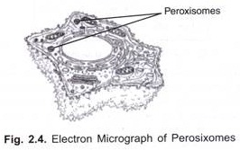
Peroxisomes Peroxisome contains oxidative enzymes, such as catalase. defined as organelles that perform oxidation reactions leading to the production of hydrogen peroxide(H2O2), Because hydrogen peroxide is harmful to the cell, peroxisomes contain the enzyme catalase, which decomposes hydrogen peroxide to water and oxygen . catalase molecule can convert millions of hydrogen peroxide molecules to water and oxygen each second.

Slide 18
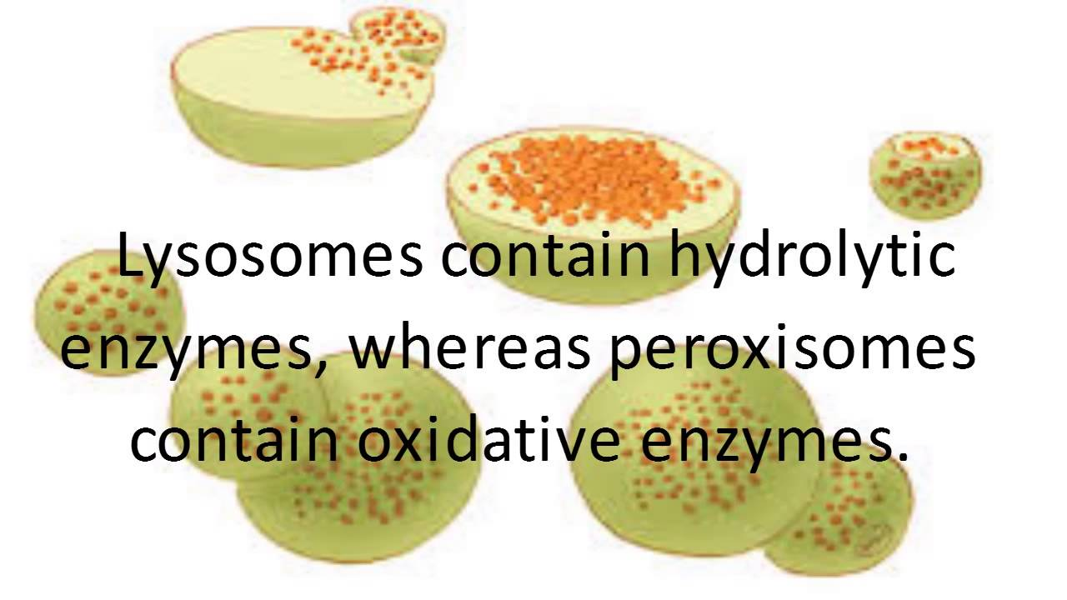

Slide 19
Some of the functions of the peroxisomes:
Hydrogen peroxide(H2O2) is a poison, but peroxisomes has enzyme catalase which convert H2O2 to water and oxygen.
Break down Fatty acids and amino acids.
Neutralize Free radicals, which cause cellular damage and cell death.
Chemical detoxification Such as alcohol and other harmful compounds ,it exists extensively in liver cell, The liver is the organ primarily responsible for detoxifying the blood before it travels throughout the body; as a result, liver cells contain large amounts of peroxisomes.
Initiate the production of phospholipids, which are typically used in the formation of membranes.

Slide 20
Peroxisomes play important roles in plants. peroxisomes in seeds are responsible for the conversion of stored fatty acids to carbohydrates, This occurs via a series of reactions termed the glyoxylate cycle.
Note :In animal cells, fatty acids are oxidized in both peroxisomes and mitochondria, but in yeasts and plants oxidation of fatty acid is restricted to peroxisomes.
How are different between lysosomes and peroxisomes?
Lysosomes contain hydrolase enzymes that is responsible for digestion. Peroxisomes contain oxidative enzymes such as catalase, D-amino acid oxidase, and uric acid oxidase.
Lysosomes are responsible for the digestion of cells while peroxisomes are responsible for the protection of cells against hydrogen peroxide.

Slide 21
Glyoxysomes They are very small spherical bodies with single unit membrane found only in plants (particularly in the fat storage tissue of germination seeds )and filamentous fungi but not found in animals . They contain enzymes for glyoxylate cycle . possess the enzymes to produce intermediate products for the synthesis of sugars by gluconeogenesis. The seedling uses these sugars synthesized from fats until it is mature enough to produce them by photosynthesis. In glyoxysomes the fatty acids are hydrolyzed to acetyl-CoA by peroxisomal β-oxidation enzymes.

Slide 22
How are different between peroxisomes and Glyoxysome?
peroxisomes | Glyoxysome
1. Peroxisomes are single membrane microbodies found in photosynthetic cells of plants and liver and kidney cells of vertebrates. | 1-Glyoxysomes are also single membrane microbodies but found only in plant cells.
2. It contains enzymes like peroxide oxidases and catalases. | 2. It contains many enzymes like isocratic lyase, malate synthase, glycolate oxidases etc. for glyoxylate cycle
3. It is involved in formation and degradation of hydrogen peroxide and detoxification of poisons in the cell. | 3. It is involved in photorespiration and conversion of fats into carbohydrates.

Slide 23
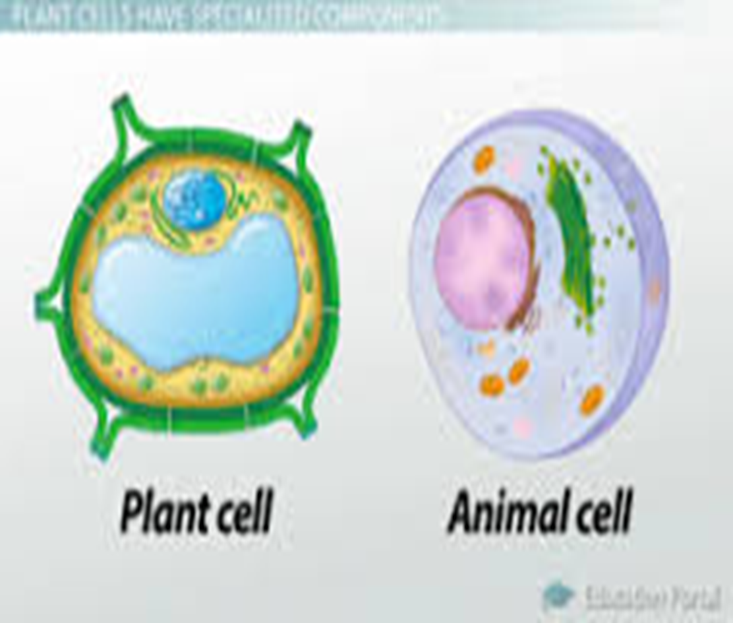
Vacuoles
vesicle within the cytoplasm of a cell, enclosed by a membrane and typically containing fluid , but vacuoles are larger than vesicles.
Type of vacuoles
Contractile vacuoles : found in protists for ridding the cell of excess water.
Food vacuoles :from phagocytosis fuse with lysosomes for digestion
Storage Vacuoles, such as nutrients or ions. Plant vacuoles contain not only water, sugars, and salts, and also pigments and toxic molecules.

Slide 24
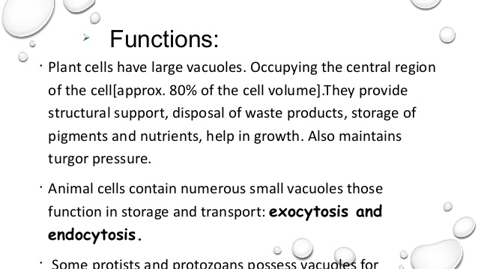

Slide 25


