Slide 1

Depth and Structure of Boundary Layer
Basim Alknani

Slide 2
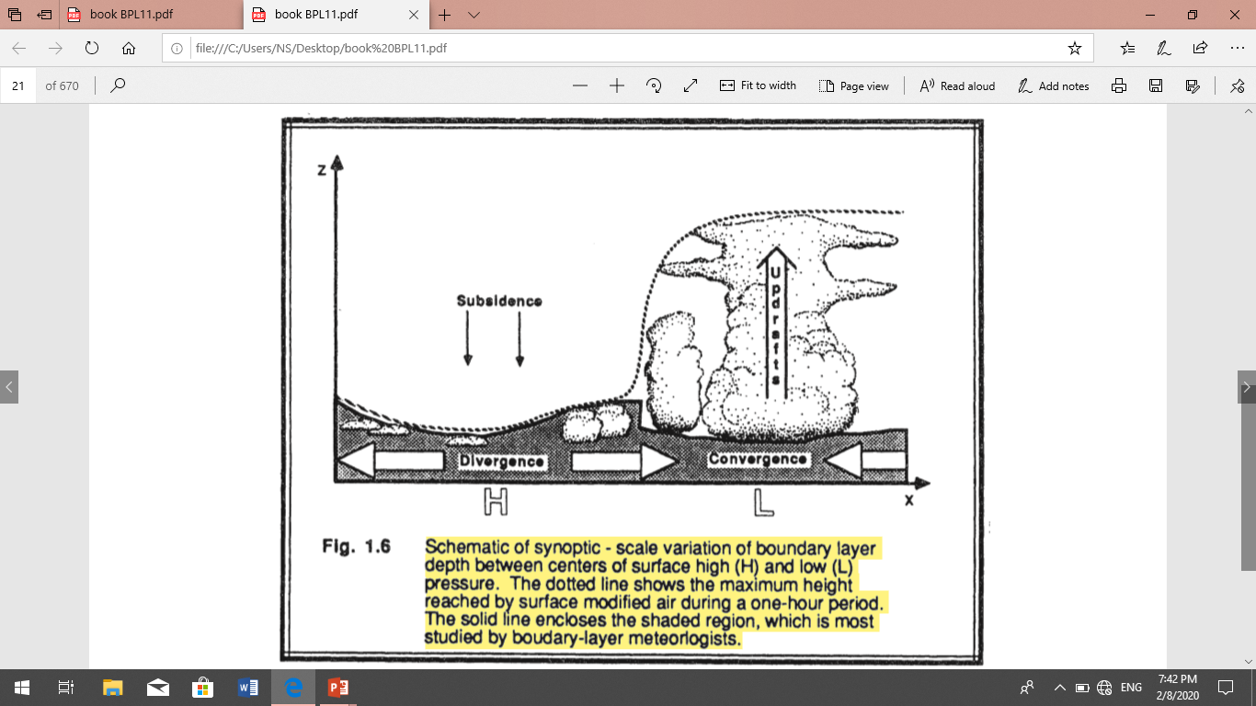
Depth and Structure of Boundary Layer :-
Over oceans
In the oceans, the depth of the boundary layer varies relatively slowly in space and time. The sea surface temperature changes little during the diurnal cycle because of due to mixing within the upper part of the ocean. Also, water has a large heat capacity, which means that it can absorb large amounts of heat from the sun with a relatively small change in temperature. Thus, a slowly varying sea surface temperature means a slowly varying forcing into the bottom of the boundary layer. Most changes in boundary layer depth over oceans are caused by synoptic and mesoscale processes of vertical motion and advection a of different air masses above the sea surface.
Over both land and oceans,
the general nature of the boundary layer is to be thinner in high-pressure regions than in low-pressure regions
(Fig 1.6). The subsidence and low-level horizontal divergence associated with synoptic high-pressure moves boundary layer air out of the high towards lower pressure regions. The shallower depths are often associated with cloud-free regions.
In low-pressure regions the upward motions carry boundary-layer air away from the ground to large altitudes throughout the troposphere.

Slide 3
above the Earth surface in high pressure regions the boundary layer has a well - defined structure that develops with the diurnal cycle (Fig 1.7).
The three main components of this structure are the mixed layer, the residual layer, and the stable boundary layer. ​When clouds are present in the mixed layer, they are divided into a cloud layer and a sub - cloud layer.
The surface layer is the region at the bottom of the boundary layer where the thickness of this layer is usually 100 m. ( 10% of the depth of the ABL). Wind speed , temperature and humidity vary rapidly with altitude, and turbulence properties are affected by the surface.
A thin layer called a microlayer or interfacial layer has been identified in the lowest few centimeters of air, where molecular transport dominates over turbulent transport.
At the sunset, the deep surface cooling creates a stable (nocturnal) boundary layer, above which is a residual layer, At sunset, deep surface cooling creates a stable (nocturnal or night) boundary layer, above which is a residual layer, which is the remainder of the mixed layer during the day. The mixing is caused by wind friction. The thickness of this layer depends on the prevailing wind speed as well as on the roughness of the surface, but it rarely exceeds 500 m.
When the sun rises, the atmosphere begins to heat from below and convective movements quickly overtake wind shear turbulence. Penetrative convection follows, gradually eroding the stratified layer created during the night and replacing it with the convective boundary layer (CBL).
Turbulence induced by wind is much weaker than turbulence caused by convection, except at the base of the CBL where both have equal intensity.
The suppression of heat input from the surface at sunset spots the convection, and what used to be the CBL becomes an unchanged mixed layer, called the residual layer.

Slide 4
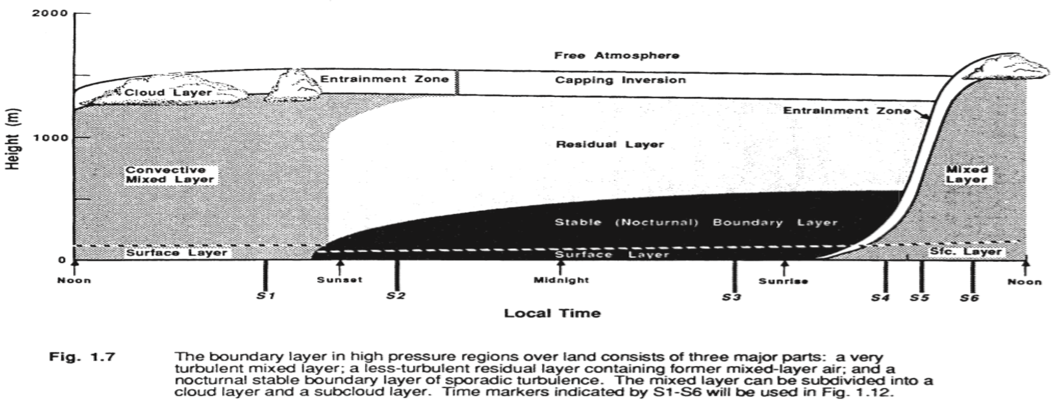

Slide 5
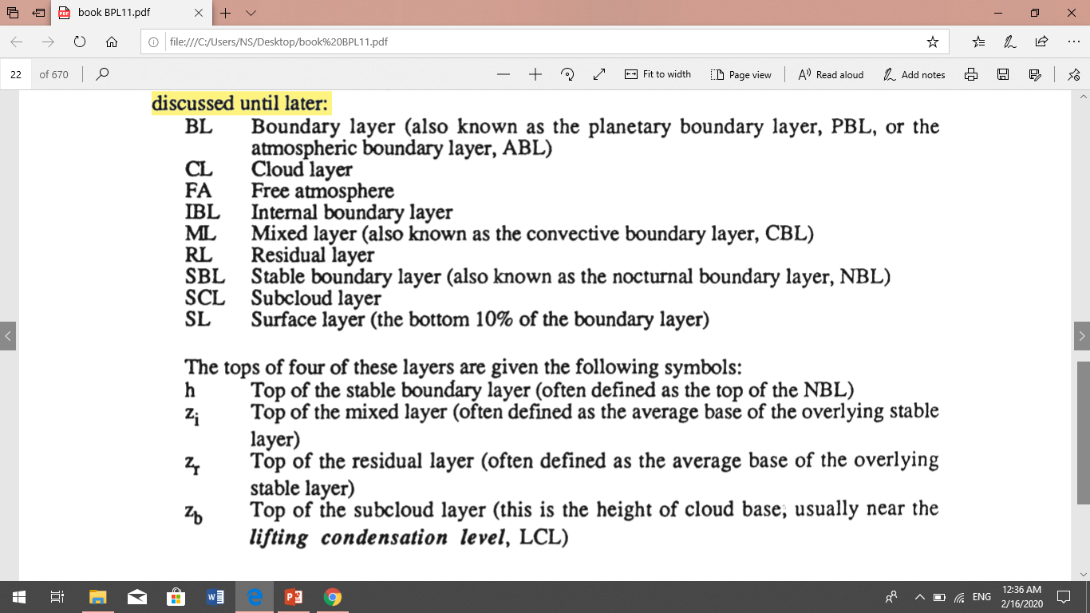
The following shorthand notation is often used for the various parts of the boundary layer.

Slide 6
Boundary Layer : extends from the surface to height between 500 and 3,000 m. It is located within the troposphere
Mixed Layer: The area of air moving upward and downward resulting in a very well mixed layer of air.
Very unstable
Entrainment Zone: The area between the boundary layer and the free atmosphere.
Free Atmosphere: The area above the boundary layer.
Cloud Layer: The area within the boundary layer where clouds appear.
Sub cloud Layer: The area underneath the cloud layer
Nocturnal Boundary layer: The part of the mixed layer that loses its buoyancy at night. Very stable.
Residual layer: the remaining portion of the mixed layer at night

Slide 7
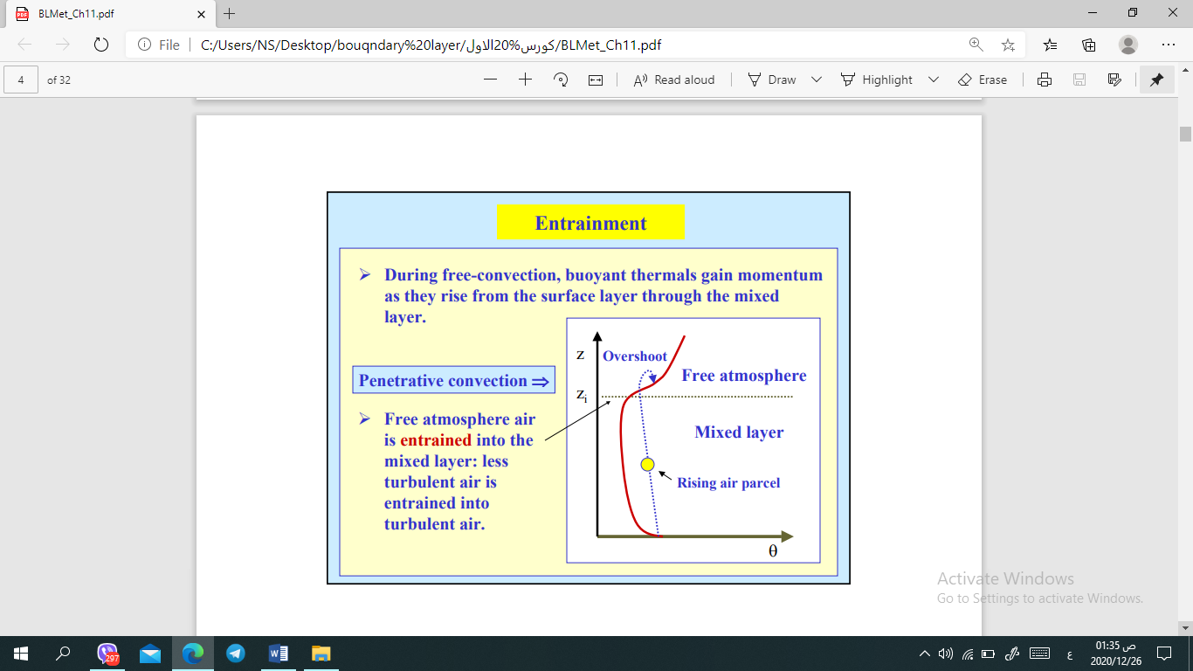
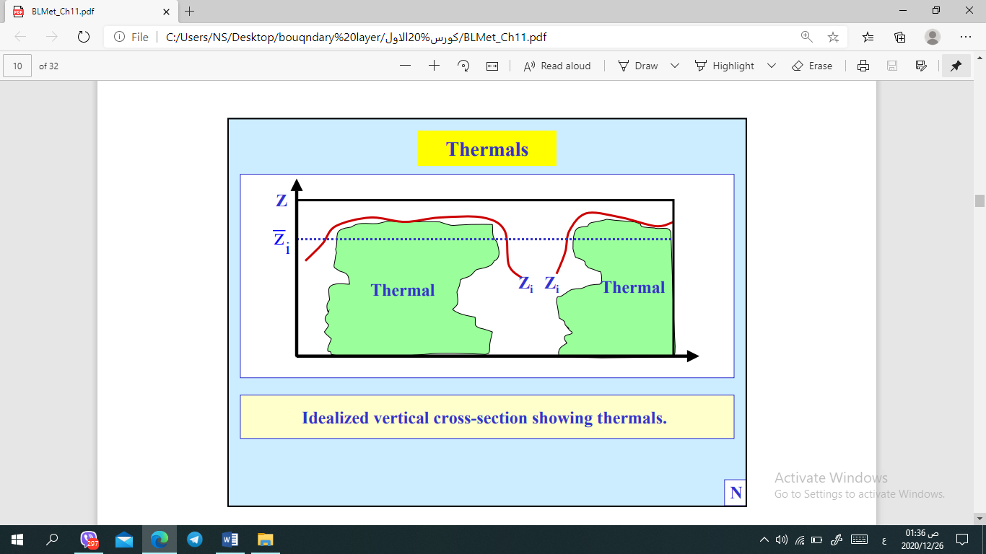
Boundary layers are classified as unstable if the air moving upward in turbulent motions near the surface tends to be buoyant ( less dense) than in the downdrafts, and stable if the reverse is true.
If there is negligible buoyancy transport within the BL, it is called neutral.

Slide 8
