Slide 1

The Course of Fundamentals of Thermodynamics
MUSTANSIRIYAH UNIVERSITY
COLLEGE OF SCIENCES
DEPARTMENT OF ATMOSPHERIC SCIENCES
2021-2022
Dr. Sama Khalid Mohammed
SECOND STAGE
Lecture 3

Slide 2

Welcome Students In The New Course
And In The Third Lecture ☺

Slide 3
This lecture including the following items
Thermodynamic variables
Heat and Work
The laws of thermodynamics
The first law of thermodynamics
p-v work.
Exercise

Slide 4
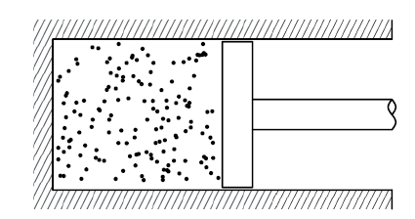
THERMODYNAMIC VARIABLES
Consider a volume of gas in a closed cylinder with a piston, in this way we can control certain properties of the gas, such as its volume or temperature, and perform experiments on it.
At the macroscopic level, the gas has some familiar properties:
volume V (units: m³)
mass M (units: kg)
density = M/V (units: kgm⁻³)
temperature T (units: K, Kelvin)
pressure p (units: Pa = Nm⁻², Pascal)
The gas is made up of molecules with individual mass M₁, so the total mass of gas M is equal to M = n µ, where
n is the number of moles
µ is the molar mass , µ = N_{A} M_{1,}
N_{A} is Avogadro number

Slide 5
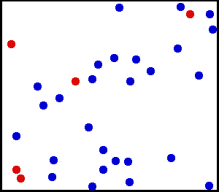
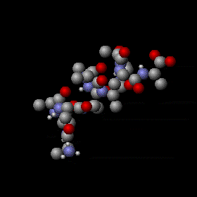
Temperature
In microscopic level, temperature measures the average kinetic energy of its atoms as they move.
In macroscopic level, it a physical property of a system that underlies the common notions of hot and cold.

Slide 6
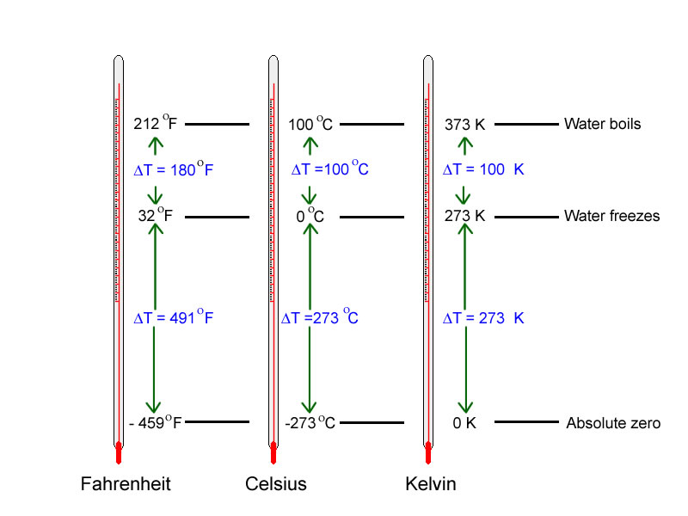
Temperature scales
 | boiling water | mixture of water and ice
Celsius (Centigrade) | 100 ° C | 0 ° C
Fahrenheit | 212 ° F | 32 ° F
Fahrenheit temperature (F)
Absolute temperature (Kelvin)

Slide 7
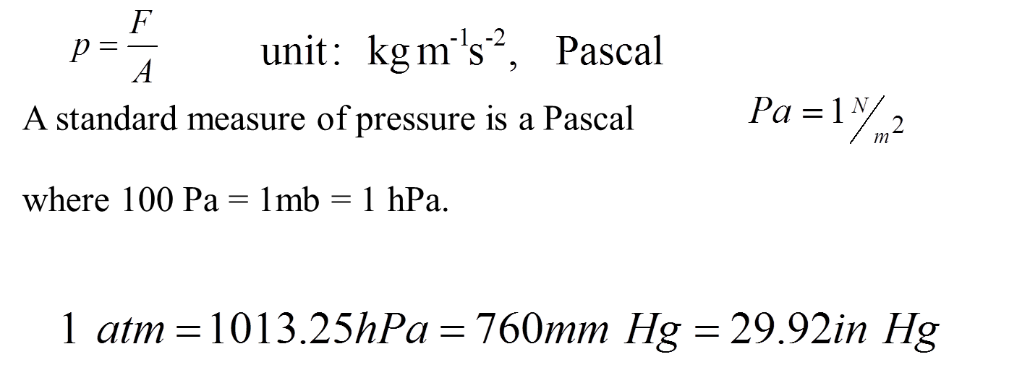
Pressure
Force F acting on unit area due to the weight of the atmosphere
Pressure is the force a gas exerts on its bounding walls per unit area. This does not mean that gas only has a pressure defined at the bounding walls: the internal pressure of a gas can in principle be measured by inserting some probe and measuring the force per unit area on the probe.
Wall of a container
Pressure and temperature do not correspond to a property of individual molecules. They are bulk properties that can only be defined as a statistical property of a large number of molecules.

Slide 8
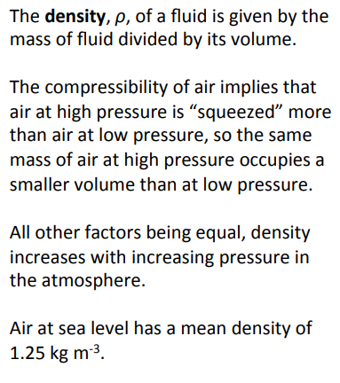
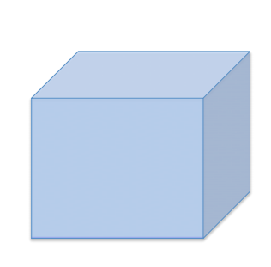
Density

Slide 9
Heat and Work
Heat and work are modes of transfer of energy and not ‘energy’ itself.
Heat and work are two different ways of transferring energy from one system to another.
Heat is the transfer of thermal energy between systems, while work is the transfer of mechanical energy between two systems
Once inside the system, it does not matter how the energy entered the system* (i.e. work and heat are terms associated with the surrounding and once inside the system there is no ‘memory’ of how the input was received and the energy is stored as potential energy (PE) and kinetic energy (KE).
This energy can be withdrawn as work or heat from the system.

Slide 10
Work & Heat
Work (W) in mechanics is displacement (d) against a resisting force (F).
W = F × d (in units of Joule, J (units of energy))
Work can be expansion work (PΔV), electrical work, magnetic work etc.
Maximum work will be done if the compression (or expansion) is carried out in a reversible manner.
Work is coordinated (harmonious) flow of matter.
➢ Lowering of a weight can do work
➢ Motion of piston can do work
➢ Flow of electrons in conductor can do work.

Slide 11
Work & Heat
Heat is NOT a form of energy; it is a mode of transfer of energy”. The transfer is done due to temperature difference
Bodies contain internal energy and not heat (nor work!).
Heat involves random motion of matter
➢ Like gas molecules in a gas cylinder
➢ Water molecules in a cup of water
➢ Atoms vibrating in a block of Cu.

Slide 12
Heat and work each have their own distinct properties, and they differ in how they affect a system. These are listed and compared below
 | Work (W) | Heat (Q)
Interaction | Mechanical | Thermal
Requires | Force and Displacement | Temperature difference
Process | Macroscopic pushes and pulls | Microscopic collisions
Positive value | W > 0 when a gas is compressed. Energy is transferred into system. | Q > 0 when the environment is at a higher temperature than the system. Energy is transferred into system.
Negative value | W < 0 when a gas expands. Energy is transferred out of system. | Q < 0 when the system is at a higher temperature than the environment. Energy is transferred out of system.
Equilibrium | A system is in mechanical equilibrium when there is no net force or torque on it. | A system is in thermal equilibrium when it is at the same temperature as the environment.

Slide 13
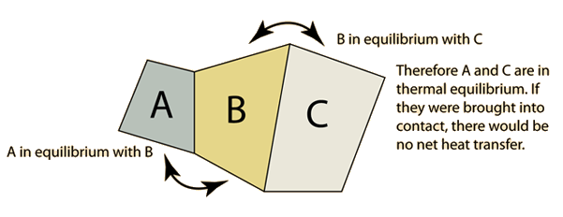
THE LAWS OF THERMODYNAMICS
The four ‘laws’ of thermodynamics are essentially postulates that are
assumed to be true, and have never (so far) been seen to fail.
ZEROTH LAW
The Zeroth Law of Thermodynamics states that if two systems are each separately in equilibrium with a third system, then the first two systems are also in equilibrium with each other

Slide 14
THE LAWS OF THERMODYNAMICS
FIRST LAW
The First law of Thermodynamics can be summarized in a statement that energy is conserved, and it will be explained in details later on.
SECOND LAW
The Second Law of Thermodynamics has several possible equivalent statements, two of them are:
The entropy of an isolated system can never decrease.
It is impossible for an engine operating in a cyclic process to convert energy into work with 100% efficiency.

Slide 15
THE LAWS OF THERMODYNAMICS
THIRD LAW
There are several different statements of the Third Law, among them are:
The entropy change of a substance goes to zero as temperature approaches absolute zero.
The entropy of a pure substance is zero at absolute zero.
A consequence or result of the First, Second, and Third Laws is that:
It is impossible to reduce the temperature of a substance to absolute zero (0 K) in a finite number of steps, in other words, it would take an infinite number of steps to reach absolute zero, so therefore, it is unattainable.

Slide 16
THE FIRST LAW OF THERMODYNAMICS
The first law of thermodynamics expresses the conservation of energy. It is given as:
dU = dQ + dW
The first law states that the internal energy of a system can be changed either through heating or through work.
Using intensive properties, the first law becomes
du = dq + dw.
Our convention will be that heat added to the system and work done on the system will be positive.
Thus, work done by the system on its surroundings will be negative.

Slide 17

P-V WORK
Work is defined as force acting over a distance,
If a gas expands quasi-statically against a pressure, p, the work done by the gas is given by the pressure multiplied by the change in volume, V, or
Equation (1) is only valid if the process is quasi-static with respect to
mechanical equilibrium.
The system does not have to be near thermal equilibrium in order to use
Eqn. (1), as long as it is close to being in mechanical equilibrium.
The negative sign is included because work is being done by the system.
The first law is then written

Slide 18
In terms of specific quantities, the first law is
The first law in this form tells us that if a gas expands then its internal energy must either decrease, or heat must be added to it in order to keep the internal energy from decreasing.
In an adiabatic process, no heat is added or subtracted. Therefore dq = 0.
This means that if a gas expands adiabatically its internal energy (and hence, its temperature) will decrease.

Slide 19
Reversible P-V work on a closed system
In a closed system (piston for example figure below), if infinitesimal pressure increase causes the volume to decrease by ΔV, then the work done on the system is:
The system is close to equilibrium during the whole process
thus making the process reversible.
work done on the system is positive, work done by the system is negative
As ΔV is negative, the work done is positive.
If the piston moves outward under influence of P (i.e. ‘P’ and ΔV are in opposite directions, then work done is negative.
1
Note that the ‘P’ is the pressure inside the container. For the work to be done reversibly the pressure outside has to be P+ΔP (~P for now). Since the piston is moving in a direction opposite to the action of P, the work done by the surrounding is PΔV (or the work done by the system is −PΔV, i.e. negative work is done by the system).
P
(P+ΔP)
2

Slide 20
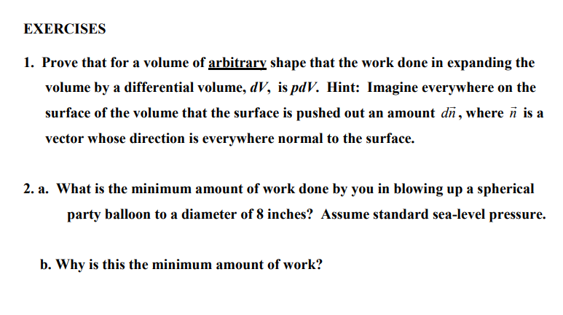
Notes:
http://snowball.millersville.edu/~adecaria/ESCI341/esci341_answers_exercises_lesson03.pdf

Slide 21
THE END OF LECTURE THREE

