Slide 1
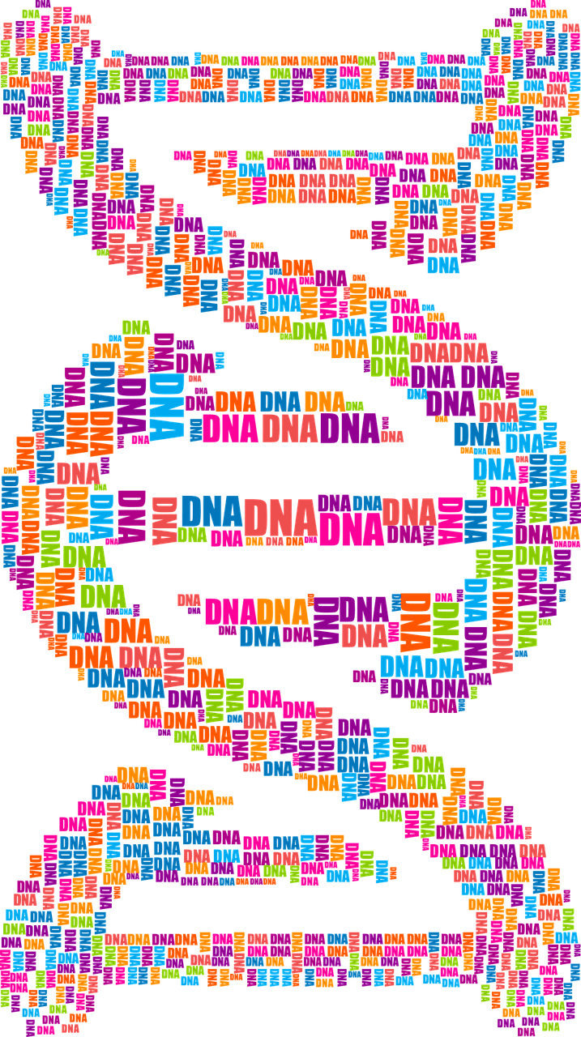
Molecular Biology Lec 2
DNA & RNA
Basic structure and roles

Slide 2
Types of extra -chromosomal DNA
The Nucleic Acids (DNA & RNA):
DNA (Deoxyribonucleic acid) is the most important molecule in living cells and contains all the information that the cell need to live and to propagate itself. With RNA (Ribonucleic acid)they maintain the cell through gene expression.
Nearly all of the DNA present in eukaryotic cells can be found in the cell nucleus (chromosomes), but also there are other amounts are present out of chromosomes. While the in prokaryotic cell (such as bacteria), DNA is found in cytoplasm.
1
Plasmid DNA
2
Chloroplast DNA
3
Mitochondrial DNA

Slide 3
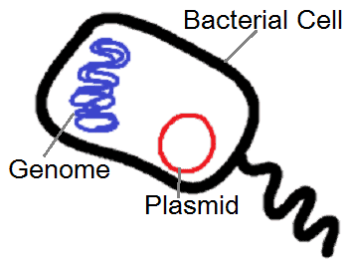
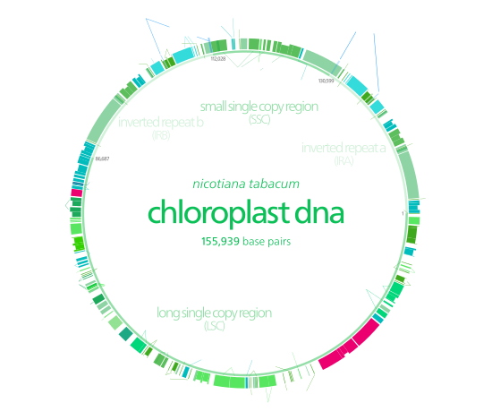
1: Plasmid DNA.
It is a double stranded super helix DNA (extra chromosomal genetic material) usually found in bacterial cytoplasm. Plasmid are not confined to bacteria but they have been isolated from yeast, protozoa and plants
2: Chloroplast DNA.
It is present inside chloroplast responsible for its activity.

Slide 4
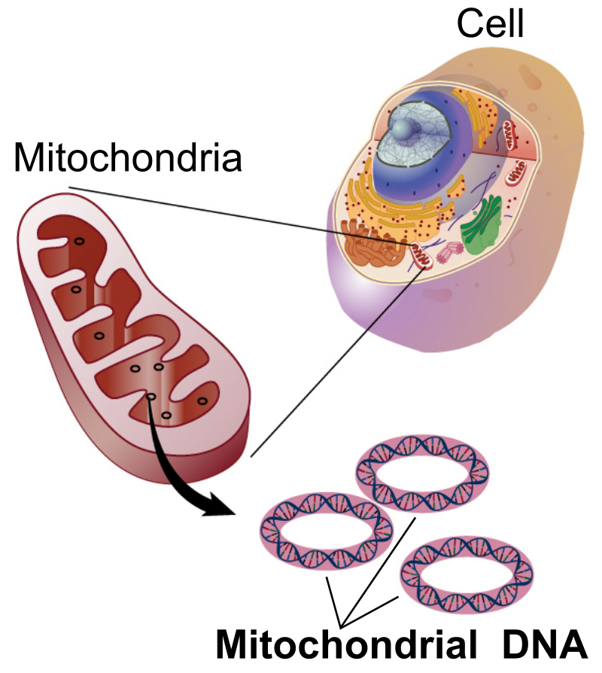
3: Mitochondrial DNA (myDNA or mDNA).
It is the DNA located in organelles called mitochondria, which found in eukaryotic cells and acts in convert chemical energy from food into a form that cells can use which is adenosine triphosphate (ATP).
In humans, mitochondrial DNA can be assessed as the smallest chromosome coding for only 37 genes.

Slide 5
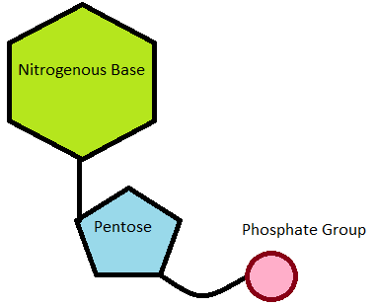
Basic Structure of Nucleic Acids.
A Nucleic Acid is a polymer consisting from nucleotides (the main structural units in nucleic acid) each nucleotide has the 3 following components:
The Nucleotide
1
Ribose
(five carbon sugar)
2
Nitrogen base
Purines & Pyrimidine
3
Phosphate group

Slide 6
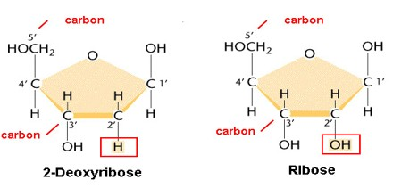
1
Ribose (five carbon sugar)
Both ribose and deoxyribose sugar are essential components of nucleotides, and are found in both RNA and DNA, respectively. The sugars found in nucleic acids are pentose sugars (has five carbon atoms).
Ribose, found in RNA, is a "normal" sugar, with one oxygen atom attached to each carbon atom, while Deoxyribose, found in DNA, is a modified sugar, lacking one oxygen atom (hence the name "deoxy").

Slide 7
2
Nitrogen base
A nitrogenous base is an organic molecule that contains the element nitrogen and play an important role as building blocks of both DNA and RNA. Nitrogenous bases are typically classified into two groups; pyrimidines (which consist of one ring and contains cytosine C, thymine T and uracil U ) and purines (which consist of two ring and contains adenine A and guanine G ). Uracil is found only in RNA, while thymine is found only in DNA.
Found in DNA & RNA
Found in DNA & RNA
Found in DNA & RNA
Found in DNA
Found in RNA

Slide 8
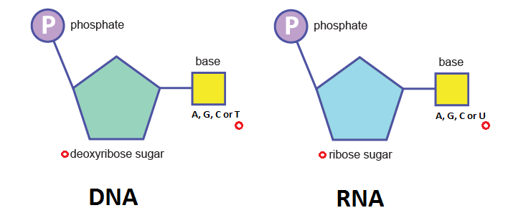
3
Phosphate group
A phosphate group (phosphoric acid) attached to the 5 carbon atom of the sugar by a phosphoester bond, this phosphate group is responsible for the strong negative charge of nucleic acid

Slide 9
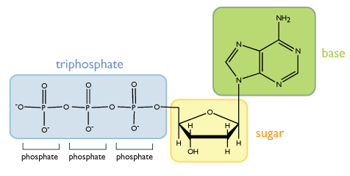
Nucleotide structure
5
4
1
3
2

Slide 10
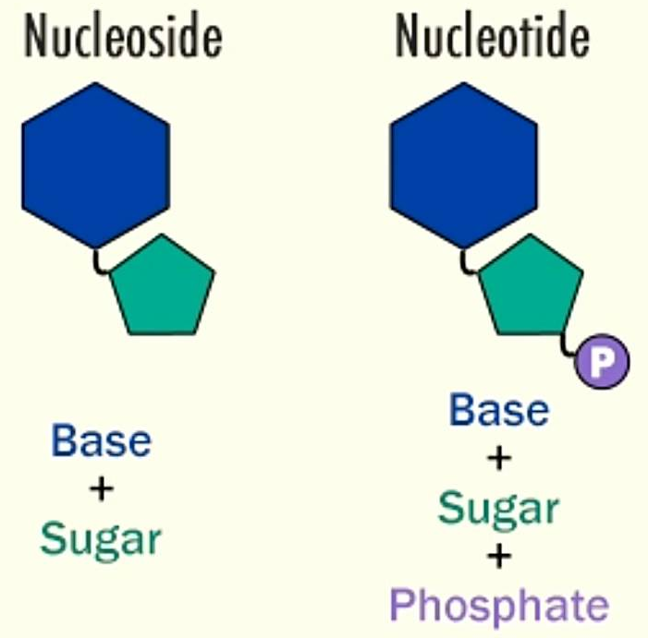
Nucleoside & Nucleotide
Nucleoside
Nitrogen base
+
Sugar
by N-β- glycosidic bond
Nucleotide
Nitrogen base
+
Sugar
+
Phosphate group
by phosphoester bond

Slide 11
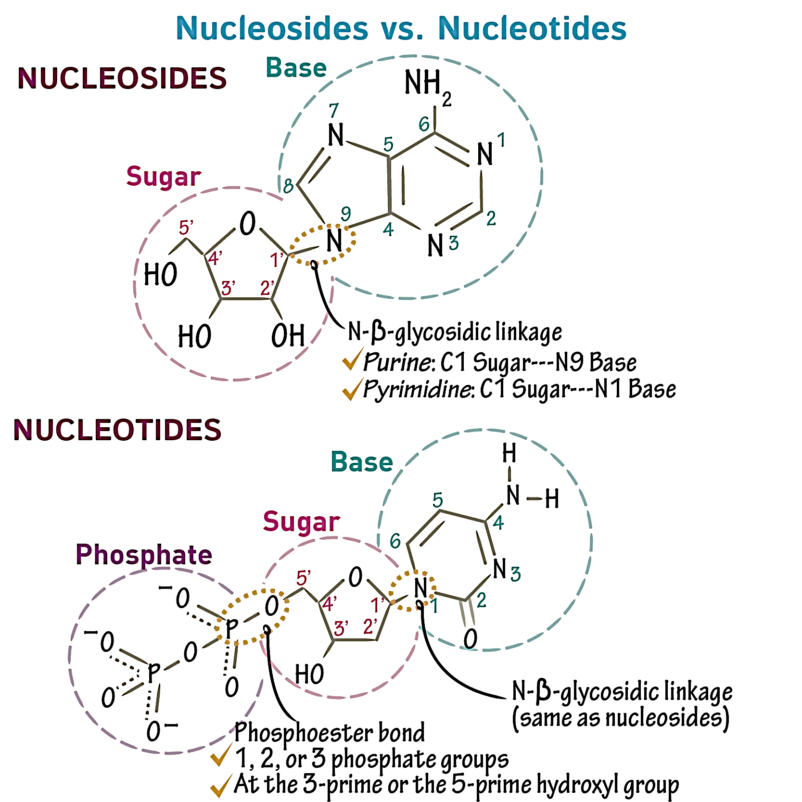

Slide 12
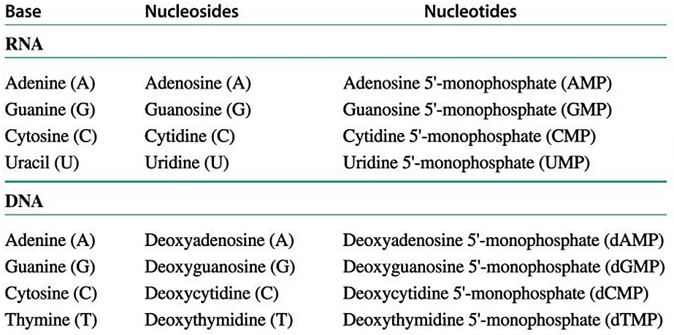
Names of Nucleosides and Nucleotides

Slide 13
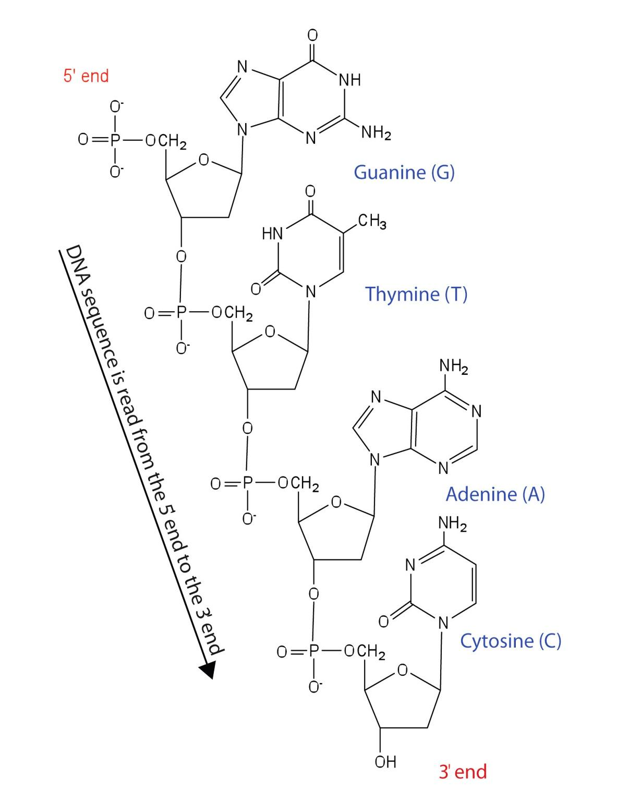
Structure of DNA
1: Primary DNA structure
The primary DNA structure is a single strand and is formed when nucleotides are joined together through the phosphate group of one nucleotide connecting to the OH group on the third carbon atom of the sugar unit of a second nucleotide, this binding occurs via an ester bond. The second nucleotide joins to a third nucleotide, and the process is repeated to produce a long nucleic acid chain.

Slide 14
Due to that processes of binding to create primary single strand of DNA, the two ends of the DNA strands were called 3́ OH free end and 5́ P end, and the bond between two adjacent nucleotide is called 3́ 5́ phosphdiester bond .
The backbone of the chain consists of alternating phosphate and sugar units (2-deoxyribose in DNA and ribose in RNA). The purine and pyrimidine bases branch off this backbone.

Slide 15
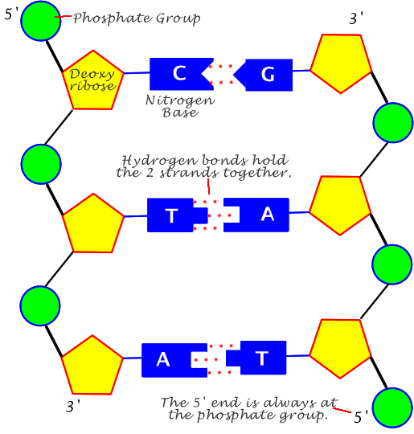
The secondary structure of DNA represent by binding two single strand via two hydrogen bond between adenine and thymine (A=T) and three hydrogen bond between cytosine and guanine (G≡C).the two strand are anti parallel to each in opposite direction (3́ end of one strand face the 5́ end of other strand) twisted together .
2: Secondary DNA structure

Slide 16
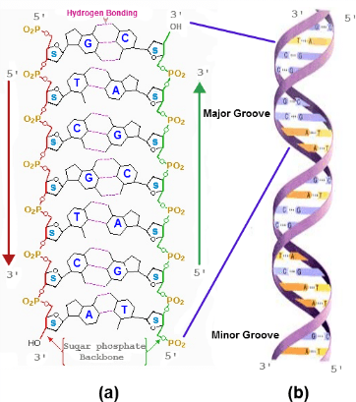

Slide 17
Hint…
DNA in E. coli bacteria is made up of 4 million base pairs and the whole genome is thus one millimeter long. The single-cell bacterium can copy its genome and divide into two cells once every 20 minutes.
The DNA of humans, on the other hand, is composed of approximately 3 billion base pairs, making up a total of almost a meter-long stretch of DNA in every cell in our bodies.
In order to fit, the DNA must be packaged in a very compact form. In E. coli the single circular DNA molecule is curled up in a condensed fashion, whereas the human DNA is packaged in 23 distinct chromosome pairs. Here the genetic material is tightly rolled up on structures called histones.

Slide 18
The main difference between DNA and RNA is that the DNA is double strand while the latter is normally single strand, and thymine is replaced by Uracil in RNA, as well as the deoxyribose sugar in DNA comparing with ribose in RNA.

Slide 19
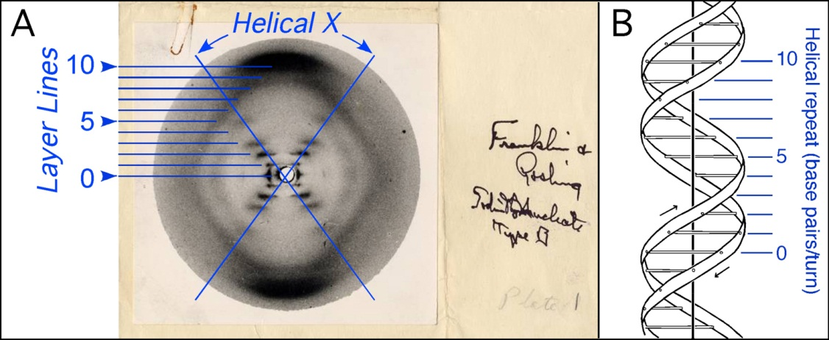
Watson and Crick used stick-and-ball models to test their ideas on the possible structure of DNA. They depend on the structure shape proposed Rosalind Franklin and Maurice Wilkins, who were using X-ray diffraction to know the physical structure of the DNA molecule.
Watson and Crick DNA
In addition, Watson and Crick used another facts to build their DNA structure model (double helix B), such as:
purines equal to pyrimidine bases within the anti parallel strand.
The DNA double helix is stabilized primarily by two forces; hydrogen bonds and base-stacking interactions.
It contain 2 groove, the major groove, is 22 Å wide and the minor groove, is 12 Å wide.
the backbone directed outside the helix while N.B oriented inside

Slide 20
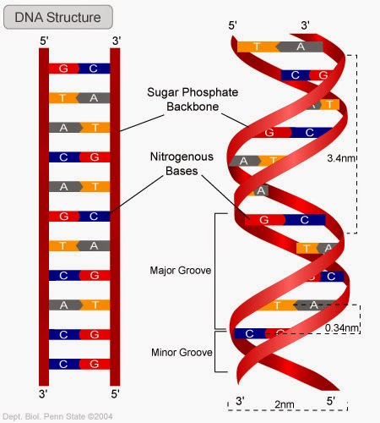
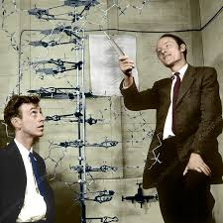
Watson and Crick DNA
The double helix of DNA

Slide 21
The DNA double helix has many features
The backbone of each consists of alternating deoxyribose and phosphate groups.
The phosphate group bonded to the 5' carbon atom of one deoxyribose is bonded to the 3' carbon of the next
The two strands are "antiparallel"; that is, one strand runs 5′ to 3′ while the other runs 3′ to 5 ′
The purine and pyrimidine attached to each other according to complementary base pair (each adenine bind with thymine via two hydrogen bonds & each cytosine bind with guanine via three hydrogen bonds) .
The length of helix could be any measure, but its diameter is 20 Å.
The double helix makes a complete turn in just over 10 nucleotide pairs, and the distance of each one turn is 34 Å.
The double helix of DNA has two grooves; major and minor.

Slide 22
The DNA three forms
Helix has right handed sense.
Most common DNA conformation in vivo.
Narrower, more elongated helix than A.
Wide major groove & narrow minor groove.
Favored conformation at high water concentrations
B-form
Helix has right handed sense.
Most RNA and RNA-DNA duplex in this form
shorter, wider helix than B.
Narrow major groove & wide minor groove.
favored conformation at low water concentrations
A-form
Helix has left-handed sense
Can be formed in vivo, but function remains obscure.
Narrower, more elongated helix than A or B.
Major groove is not really groove and narrow minor groove.
favored by high salt concentrations.
Z-form

Slide 23
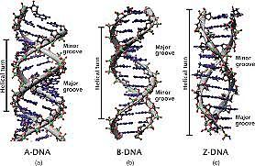
DNA forms
A-DNA
B-DNA
Z-DNA

