Slide 1
cARBOHYDRATE
Dr.Najlaa Qassim

Slide 2
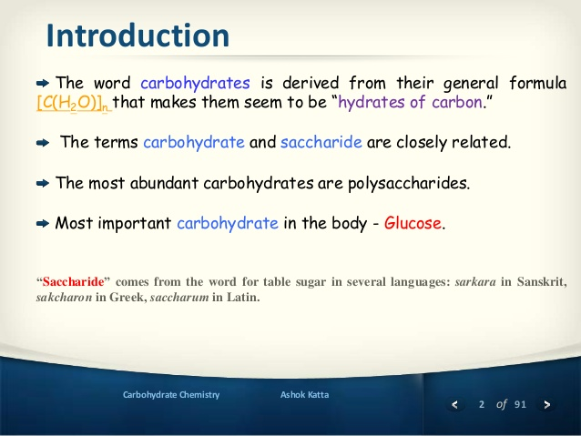

Slide 3
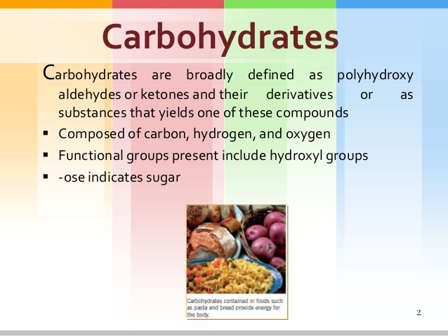

Slide 4
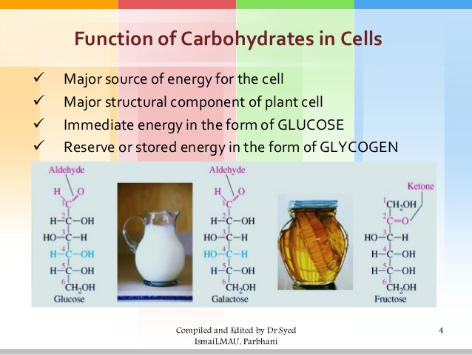

Slide 5
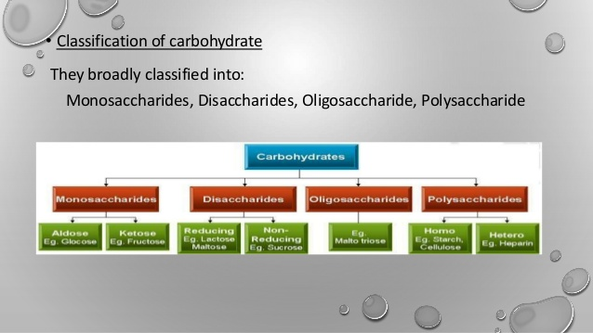

Slide 6
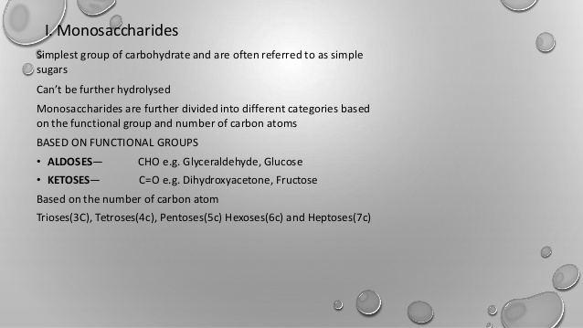

Slide 7
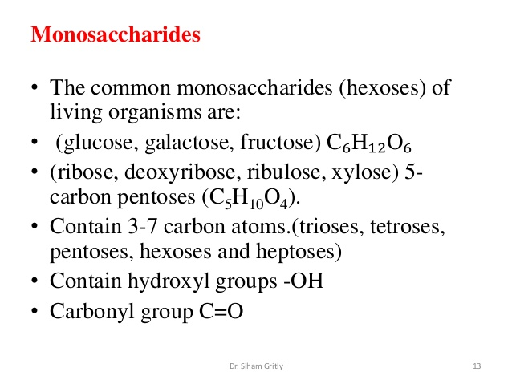

Slide 8
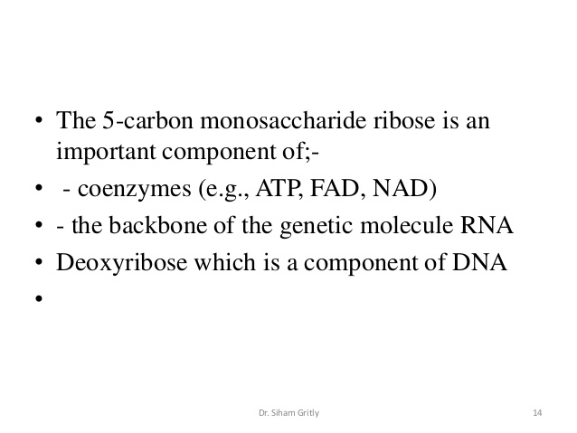

Slide 9
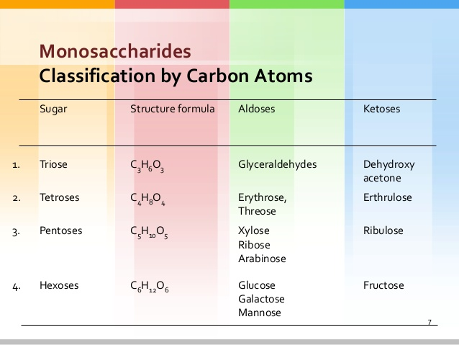

Slide 10
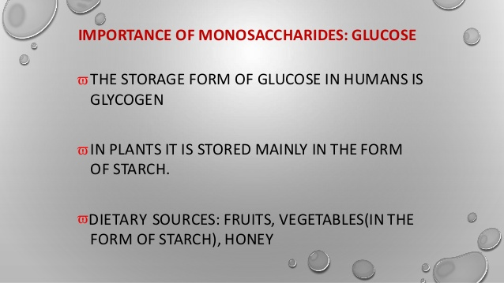

Slide 11
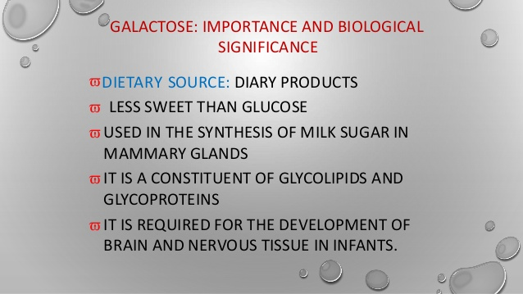

Slide 12
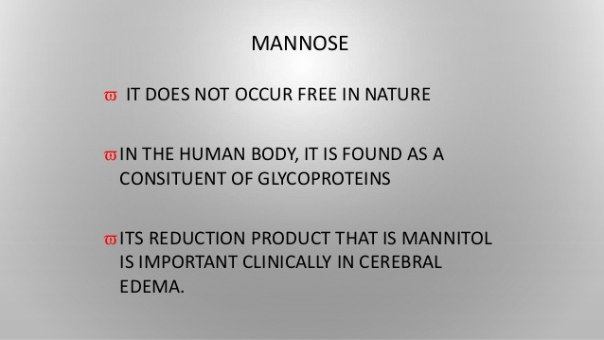

Slide 13
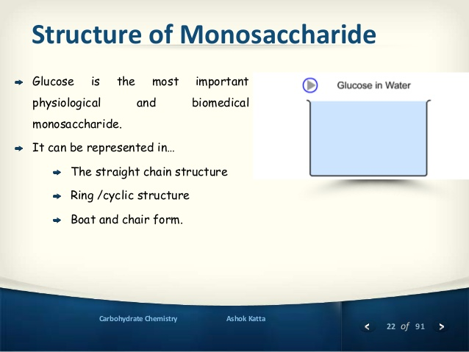

Slide 14
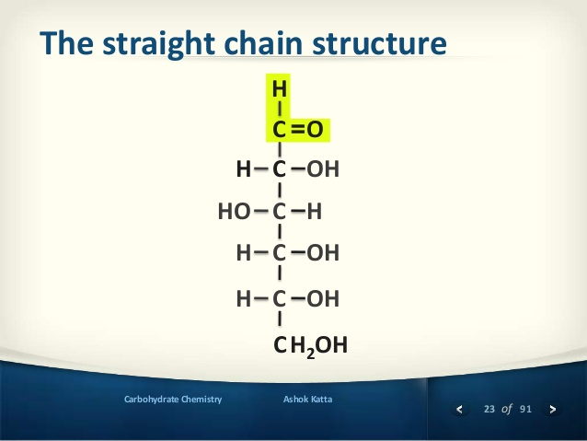
Notes:
23 of 91
Ashok KattaCarbohydrate Chemistry
The straight chain structure
C
C
H2OH
=O
H
H OH
CHO H
CH OH
CH OH
C

Slide 15
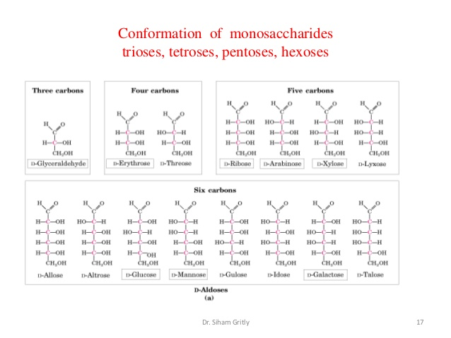

Slide 16
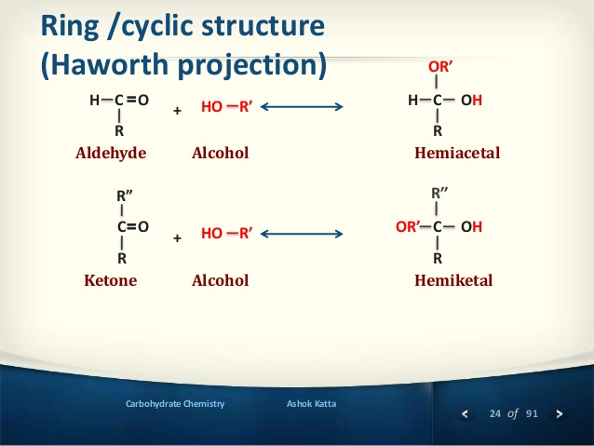

Slide 17
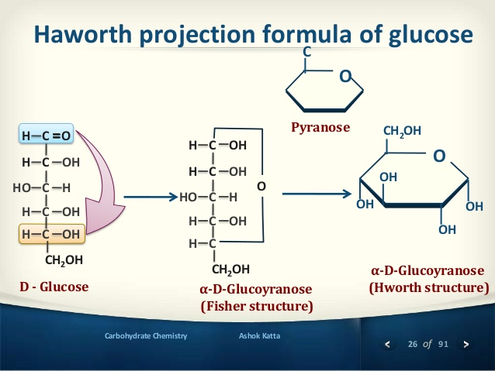

Slide 18
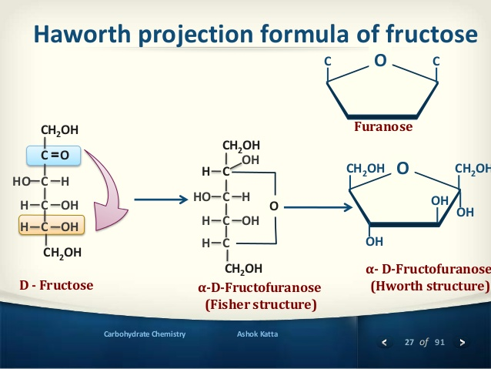
Notes:
27 of 91
Ashok KattaCarbohydrate Chemistry
Haworth projection formula of fructose
OCH2OH CH2OH
OH
OH
OH
OC C
CH2OH
C
CH2OH
H
OH
CHO H
CH OH
CH
O
CH2OH
C
CH2OH
=O
CHO H
CH OH
CH OH
D - Fructose
Furanose
Î±-D-Fructofuranose
(Fisher structure)
Î±- D-Fructofuranose
(Hworth structure)

Slide 19
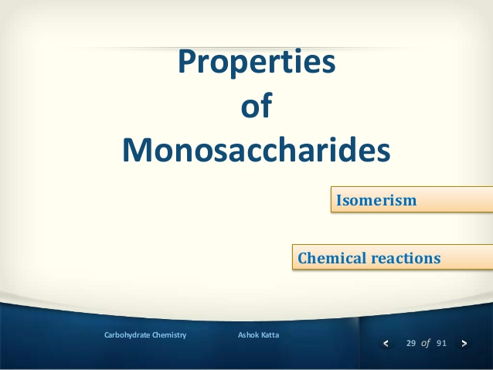

Slide 20
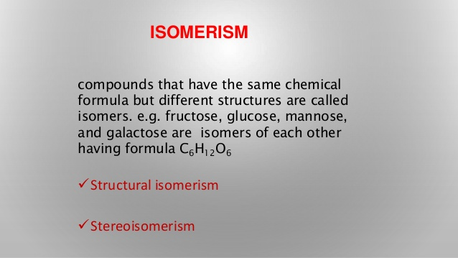

Slide 21
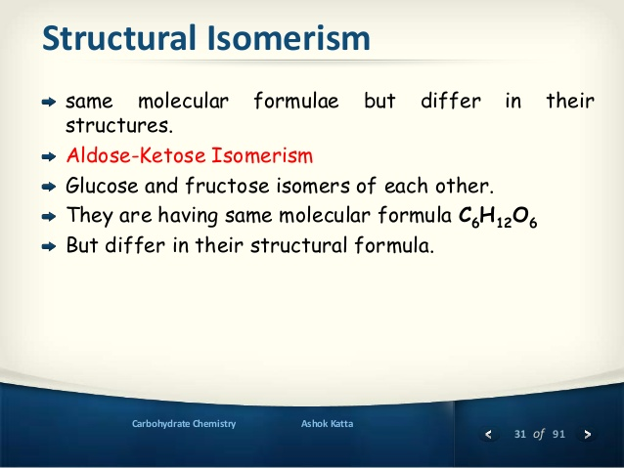

Slide 22
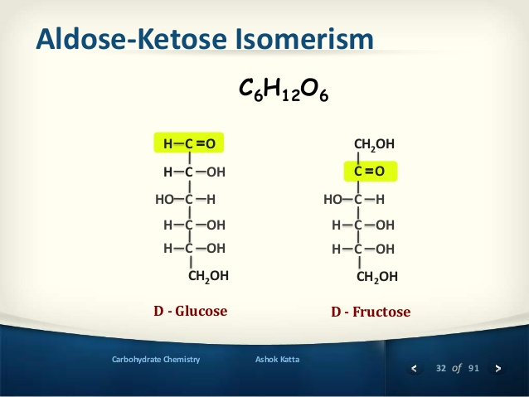

Slide 23
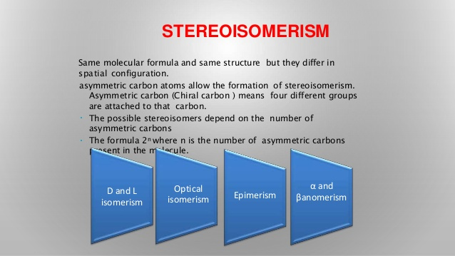

Slide 24
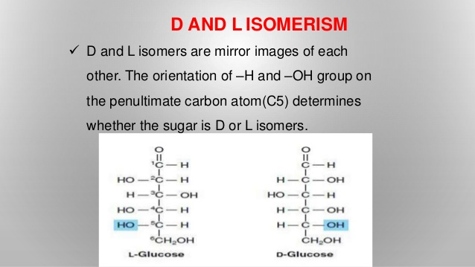

Slide 25
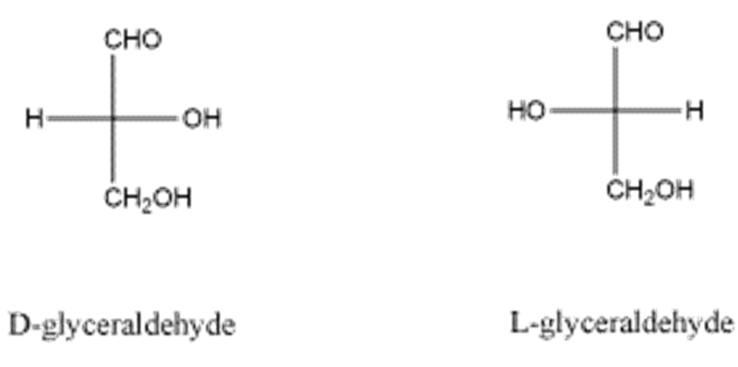
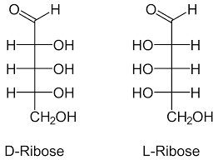
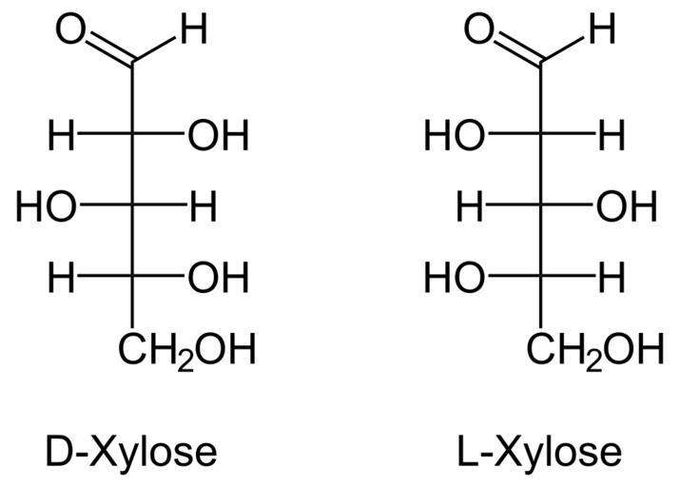

Slide 26
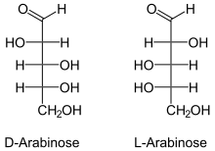
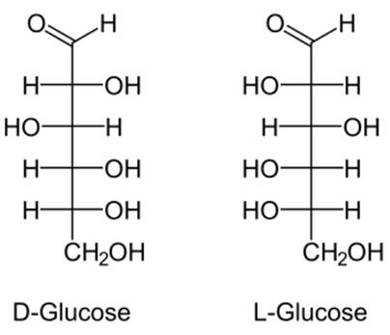
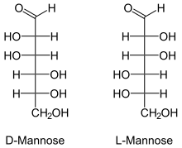

Slide 27
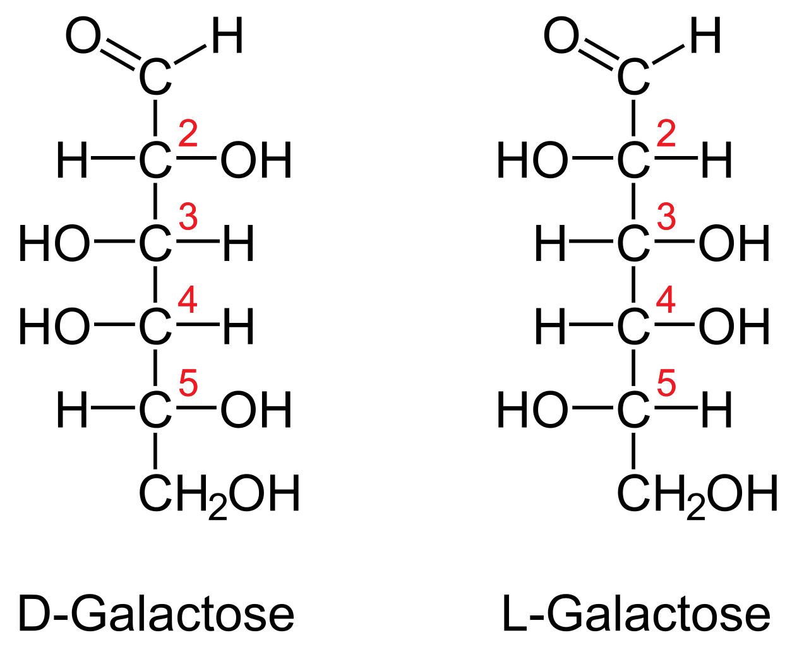

Slide 28
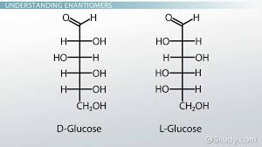
Enantiomers
Enantiomers are chiral molecules that are mirror images of one another. Furthermore, the molecules are non-superimposable on one another.

Slide 29
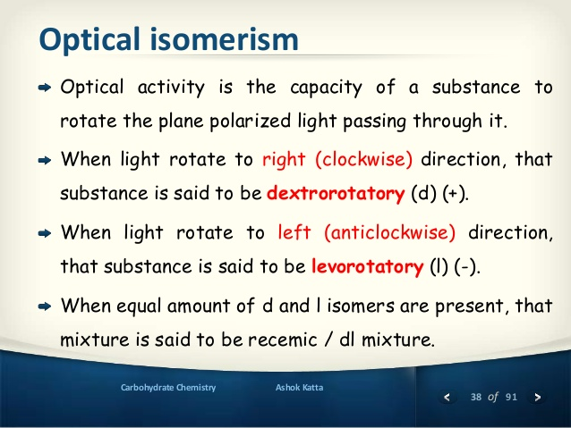

Slide 30
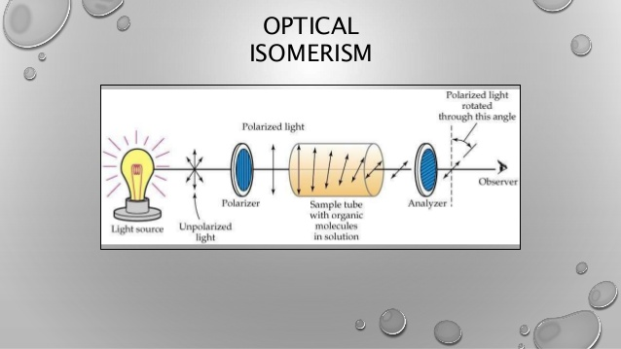

Slide 31
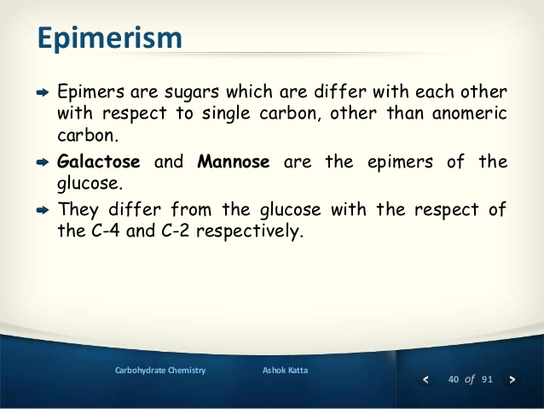

Slide 32
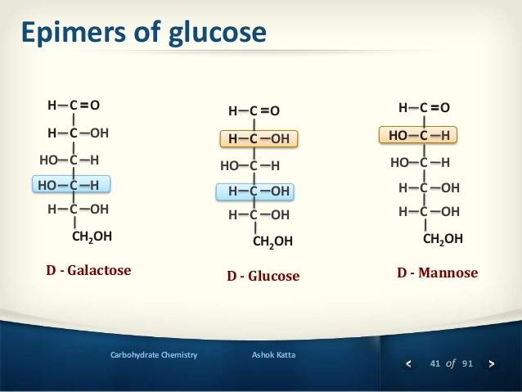

Slide 33
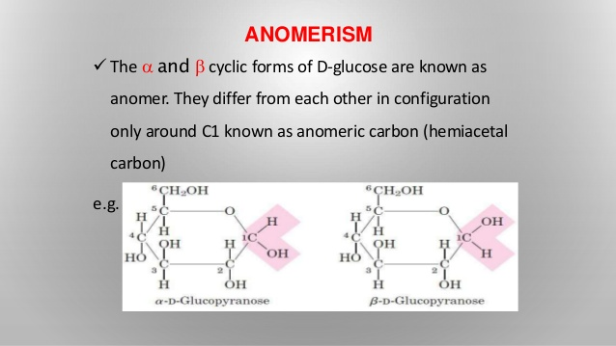

Slide 34
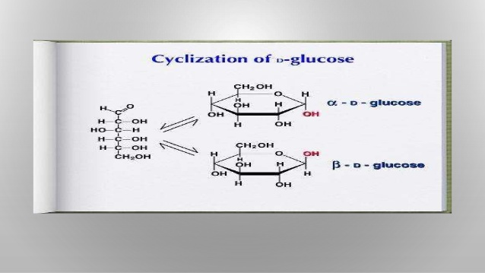

Slide 35
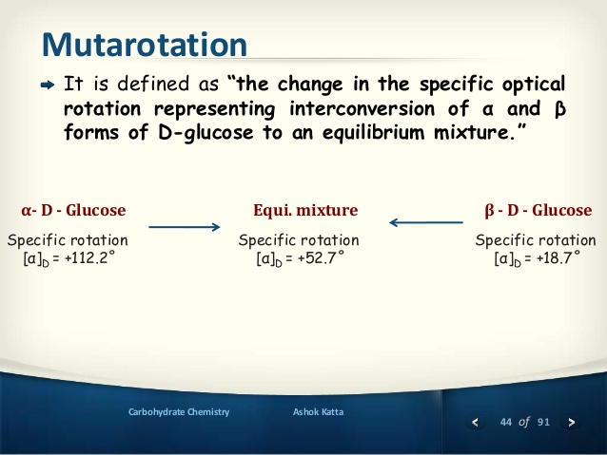

Slide 36
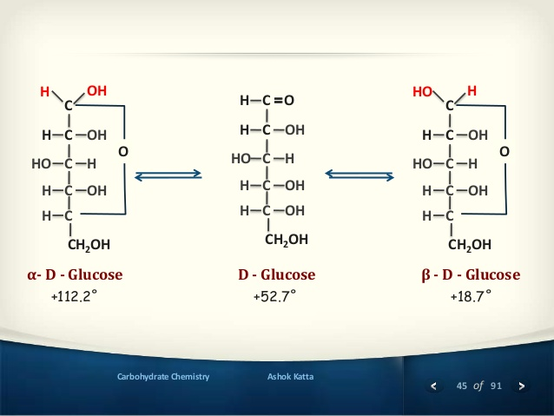

Slide 37
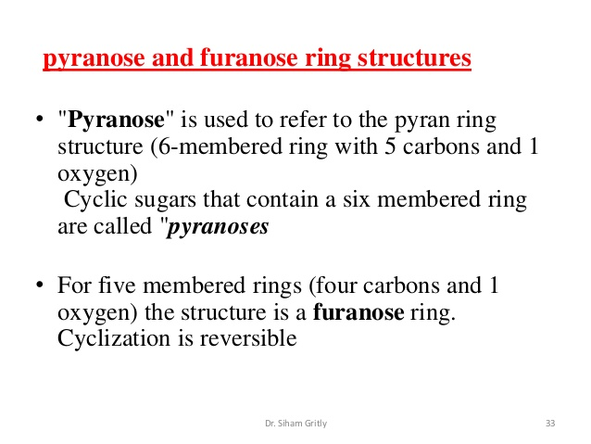

Slide 38
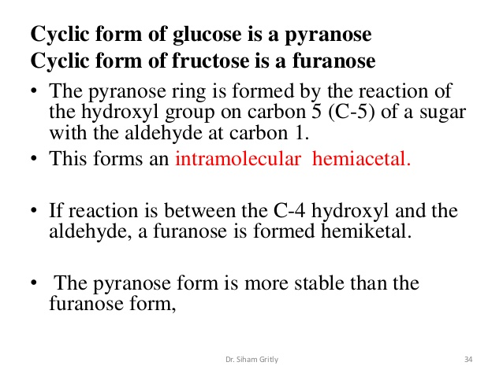

Slide 39
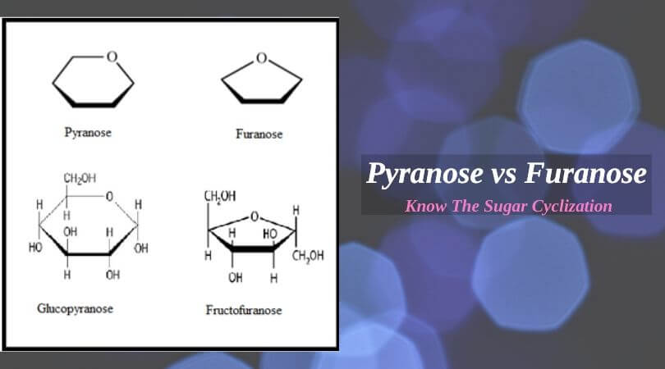

Slide 40
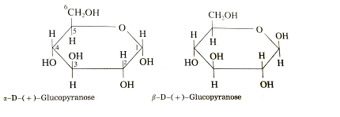
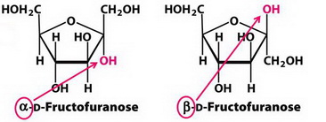

Slide 41
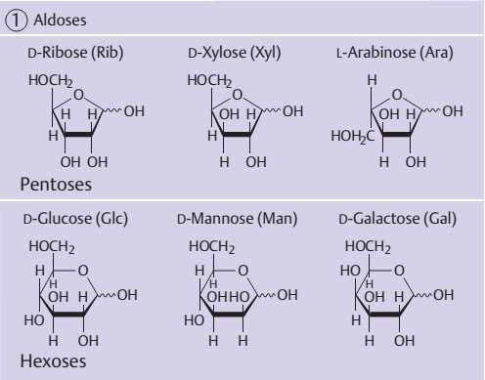

Slide 42
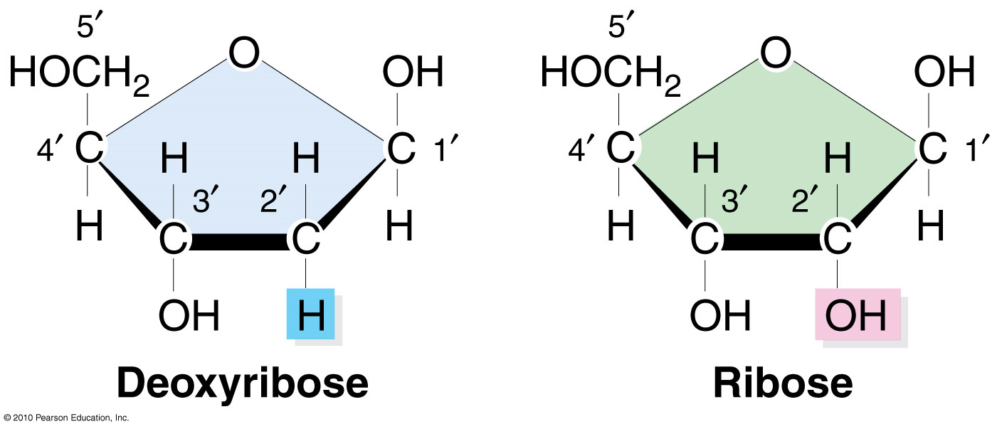
PENTOSE SUGER

Slide 43
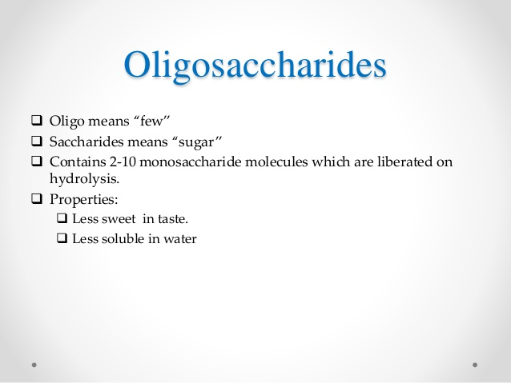
It can subdivided into
Disaccharide
Trisaccharide example maltotriose
Tetrasaccharide
Penta saccharide

Slide 44
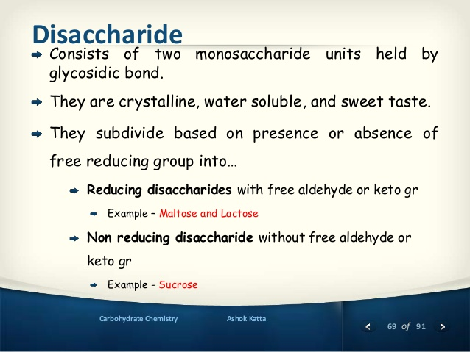

Slide 45
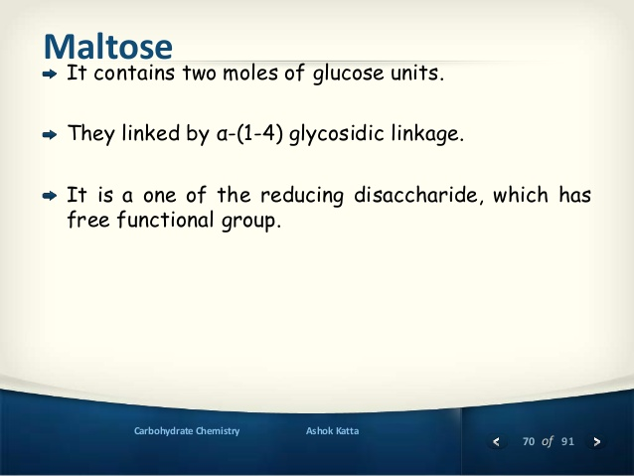
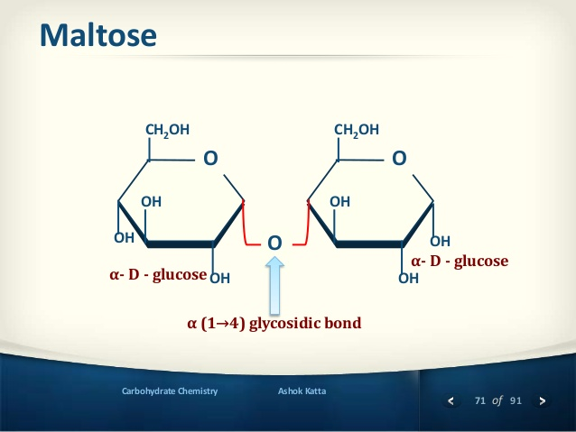

Slide 46



Slide 47


Slide 48


Slide 49


Slide 50


Slide 51


Slide 52


Slide 53


Slide 54



Slide 55


Slide 56

B(1-4)glycosidic bond

Slide 57


Slide 58


Slide 59


