Slide 1
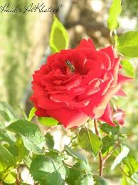
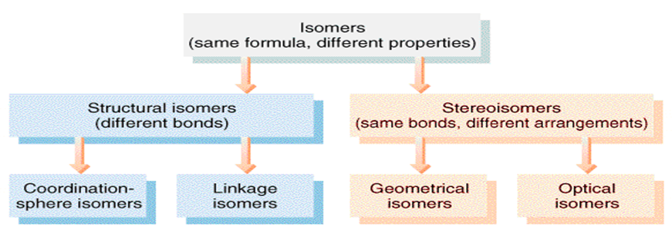
مراجعة الايزومرات الترابطية
مختبر الكيمياء اللاعضوية
مرحلة ثالثة(التعليم الألكتروني )
صباحي / أ. م. ايناس زهير الهاشمي
م .م . يسرى جليل

Slide 2
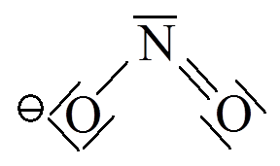
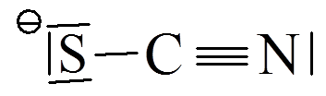
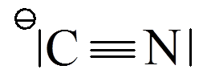
Linkage Isomers
Linkage isomer appears when the ligand has two different atoms having the ability to coordinate (i.e., the ligand has more than one donor atom); the coordination will be between the metal and the ligand via one of the two atoms and other isomer via the other atom for the same ligand, as follows:
bonding via N nitro-
bonding via O nitrito-
bonding via S → thiocyanato-
bonding via N → isothiocyanato-
bonding via C → cyano-
bonding via N → isocyano-

Slide 3
Linkage nature depends on several factors:
Reaction temperature.
Method of adding the reacted materials.
pH of the reaction (adding the ligand in an acidic or alkaline or neutral).
Metal nature and type, for instance the first transitional elements prefer linkage through nitrogen atom, while the second transitional elements prefer linkage via sulfur of oxygen.

Slide 4
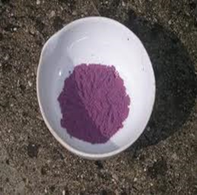
طلابنا الاعزاء في هذا الموضوع سوف يكون مركب اولي starting material محضر هو :
Pentaamminechlorocobalt(III) chloride
[Co(NH₃)₅Cl]Cl₂
من هذا المركب سوف يتم تحضير معقدين من نوع ايزومرات ترابطية

Slide 5
Preparation of Nitropentaamminecobalt(III) chloride [Co(NH₃)₅NO₂]Cl₂
Procedure:
Dissolve (1.25g) of the purple chloropentaaminecobalt(III) chloride complex that is previously prepared in (10ml) of distilled water in Erlenmeyer flask.
Add (1ml) of the concentrated Ammonia, then heat the contents with continuous stir for not less than (5) minutes. using water bath at 50ºC.
Filter the resulted hot mixture, and neglect the sediment to get rid of insoluble part of chloropentaaminecobalt(III) chloride .
Cool down the filtrate at lab. Temperature, and acidize it using diluted HCl (2M) drop wise.
Weight (1.5g) of sodium nitrite NaNO₂, and add it partially, you will notice after minutes of finishing the addition red precipitation formation, leave the mixture at lab. Temperature for not less than (5) minutes to complete precipitation.
Heat the mixture to dissolve the red precipitation, if did not completely dissolved; get rid of insoluble by filtration.
Slowly add to the filtrate the concentrated HCl drop wise for not less than 30 minutes.
Cool down the mixture using icy bath, you notice yellowish brown precipitation, collect it by filtration.
Dry the precipitation by oven, weight it, calculate its ratio, and draw its structure.

Slide 6
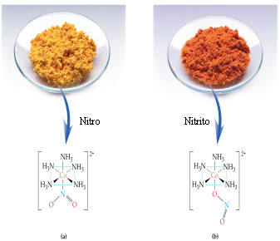
Reaction equation:
[Co(NH₃)₅Cl]Cl₂ + H₂O + NH₃ + HCl_{dil.} + NaNO₂
[Co(NH₃)₅(NO₂)]Cl₂ + NaCl + NH₄Cl + H₂O
Questions:
What is the medium used for
preparing the isomer?
What is the reason behind using
water bath at 50ºC in the second step?

Slide 7
Preparation of Nitritopentaamminecobalt(III) chloride [Co(NH₃)₅ONO]Cl₂
Procedure:
Dissolve (1.25g) of the purple chloro pentaaminecobalt(III) chloride complex that previously prepared in a warm mixture consists of (20) ml of distilled water and (4.5ml) of concentrated ammonia in an Erlenmeyer flask.
Filter the solution to get rid of insoluble chloropentaaminecobalt(III) chloride.
Neutralize the filtrate by adding diluted HCl (2M) drop wise, and neglect the precipitation.
Weight (1.2g) of sodium nitrite NaNO₂, dissolve it in the solution with continuous stir.
Add to the product (1.2ml) of HCl (6M).
Leave the mixture aside to cool down to room temperature for not less than (15) minutes, so reddish orange precipitation will be formed.
Filter the solution and wash the precipitation with (5ml) of cold distilled water.
Dry the sediment by oven at 60ºC for not less than 1 hr., weight it and calculate its ratio.

Slide 8
Reaction equation:
[Co(NH₃)₅Cl]Cl₂ + (H₂O+NH₃)_{mixture}+ HCl_{dil.}+ NaNO₂
[Co(NH₃)₅(ONO)]Cl₂ + NaCl + NH₄Cl + H₂O
Questions:
What is the reason behind using the following:
Warm mixture of concentrated
ammonia and water.
B. Sodium nitrite.
Compare between [Co(NH₃)₅(NO₂)]Cl₂
and [Co(NH₃)₅(ONO)]Cl₂.

Slide 9
ماهو ناتج المعادلتين .علما ممكن ان تستفاد من معلومات النظري ؟؟؟
2CoCl₂⋅6H₂O(s) + 2NH₄Cl(s) + 10NH₃(aq) + H₂O₂(aq) + 3H₂O(l) charcoal
2CoCl₂⋅6H₂O(s) + 2NH₄Cl(s) + 8NH₃(aq) + H₂O₂(aq) + 3H₂O(l) →
?

