Slide 1
Preparation of Sodium Tricarbonatocobaltate(III) Trihydrate Na₃[Co(CO₃)₃].3H₂O
Theory:
Carbonate ion (co₃) ²⁻ is considered one of the bidentate ligands due to two coordination connection with the central metal, which is a plane regular molecule whose structure:
In this ion, carbon associates with oxygen atom by π double bond and with two oxygen atoms by σ single bond, as each atom has one negative charge by which it coordinates with the metal ion. The complex is olive green powder, does not dissolve in water, stable when it is dry and decomposes at 93ºC without melting.
Procedure:
Dissolve (1.5g) of aqueous cobalt nitrate (Co(NO₃)₂·6H₂O) in (2.5ml) of distilled water, and then add (0.5ml) of Hydrogen peroxide (30%).
In another packer, dissolve (1g) of sodium carbonate (NaHCO₃) in (7.5ml) of distilled water (if did not completely dissolved, heat the solution until completely dissolves).
Cool down the solution prepared in step (2) using icy bath until it reach 0ºC, then add the solution prepared in step (1) drop wise throughout (10) minutes. with continuous stirring, continue stir for (30) mints. keeping the mixture in the icy bath (0ºC).
Filter the formed dark green precipitation, wash it with ethanol, and then dry the precipitation (be careful not to leave any humidity as it would be decomposed into black solid material.
Calculate the ratio of the resulted complex.

Slide 2
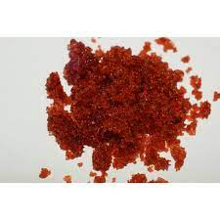

Slide 3
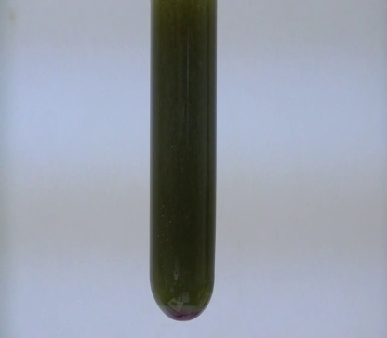
Reaction Equation:
Co(NO₃)₂.6H₂O + H₂O₂ + 10NaHCO₃ ⎯→ 2Na₃[Co(CO₃)₃].3H₂O + 4NaNO₃ + 4CO₂ + 12H₂O
Questions:
-Why hydrogen peroxide and sodium bicarbonate are added?
-Why we wash using ethanol and then using
ether?
- Is there complex optical isomers ?
Explain ?

Slide 4
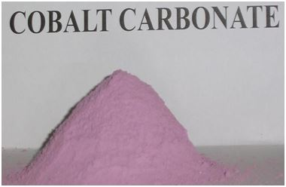
ماهي العلاقة بين المركبين اللذين في الصورتين , مبينا الاسم باللغة العربية والأنكليزية لهما ؟
Na₃[Co(CO₃)₃].3H₂O

