Slide 1
2nd lecture in Antibiotics
Mode of Antibiotics action against microorganism
Prepared by
Dr. Sawsan Sajid AL-Jubori
Dr. Saad L. Hammed
Dr. Ibtessam K. Auda

Slide 2
Mechanisms of antibacterial action
There are five main mechanisms by which antibacterial agents act.
  1-Inhibition of cell wall synthesis
  2-Inhibition to the cell membrane
  3-Inhibition of protein synthesis
  4-Interference with metabolism process
  5-Inhibithion the synthesis of nucleic acids (DNA & RNA)

Slide 3
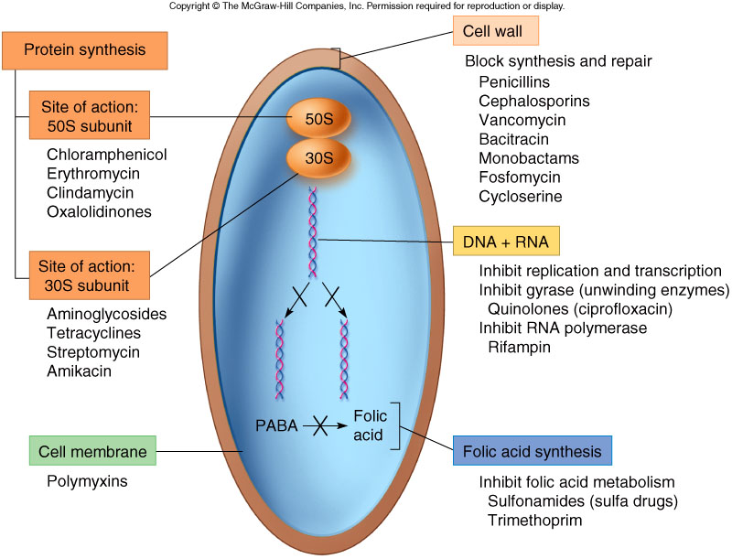

Slide 4
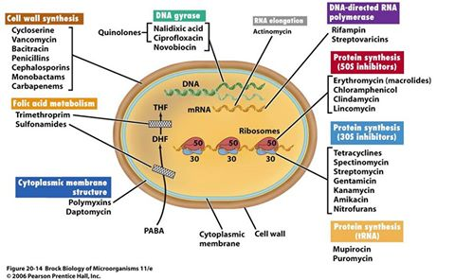

Slide 5
1- inhibition of cell wall synthesis (Bactericidal agents)
Bacterial cell wall consist from a protective peptidoglycan layer which is a polymer of N-acetylmuramic acid (NAM) & N-acetylglucosamine (NAG).
There are two important enzymes working in this place
Autolysine: which break the cross link of peptides
Transpeptidase: Also called (penicillin binding proteins PBPs) cross link the peptidase (opposite action )

Slide 6
1- inhibition of cell wall synthesis
1- The penicillins and cephalosporins, as well as other beta-lactam antibiotics ,they act by inhibiting transpeptidase enzyme .thus the bacteria will loss the integrity of bacterial cell wall , Leak its cellular component and Bacterial cell perish . Usually they attact the D-alanyl-D-alanine (D-Ala-D-Ala) groups found at the terminus of the pentapeptide in most newly synthesized peptidoglycan monomers. Binding of the drug to the transpeptidas ( penicillin binding protein-BPB) ties up the enzyme and prevents it from reforming the peptide cross-links between the rows and layers of new peptidoglycan monomers are added during bacterial cell growth

Slide 7
1- inhibition of cell wall synthesis
2-The Vancomycin : Bacteriocidal , stopped peptidoglycan elongation. effective against many gram-positive bacteria; used for resistant infectionsm Useful in treatment of Staphylococcus aureus
3- Cycloserine – inhibits the formation of the basic peptidoglycan subunits
4-Bacitracin Disrupts the bacterial cell wall and is effective against gram-positive bacteria Used topically (skin, mucous membranes, eyes) and as a feed additive Toxic to kidneys

Slide 8
2-Inhibition of Cell Membrane
Inhibitors of cell membrane function. Cell membrane is important barriers that regulate the intra- and extracellular flow of substances. A disruption or damage to this structure could result in leakage of important solutes essential for the cell’s survival. Because of high similarity of this structure in both eukaryotic and prokaryotic cells, the action of this class of antibiotic are often poorly selective and can be toxic for the mammalian host(systemic use ). Most clinical usage is topical applications.
Examples: polymixin B and colistin
  Works by attacking the cell membrane of bacteria used as an ointment or wet dressing Often combined with neomycin and bacitracin (triple ABX ointment)

Slide 9
3- inhibition of protein synthesis
Inhibitors of protein synthesis.. Protein synthesis is an essential process necessary for the multiplication and survival of all bacterial cells since all enzymes and most cellular structures are made of proteins. Several types of antibacterial agents target bacterial protein synthesis by binding to either the 30s subunite or 50s subunit of the ribosomes. This will cause disruption the normal bacterial cellular metabolism, and leads to the death of the organism or the inhibition of its growth and multiplication. So the process either will be bactericidal or bacteriostatic

Slide 10
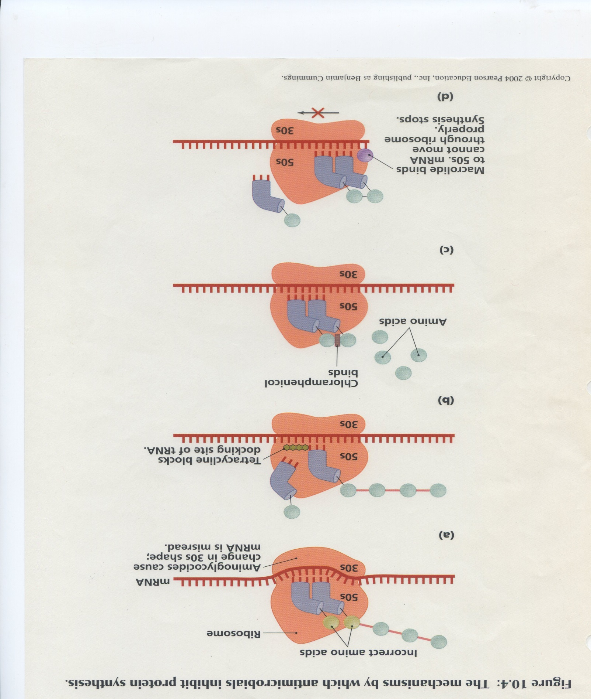
3- examples of inhibition of protein synthesis

Slide 11
3- Groups causes inhibition of protein synthesis
1- Aminoglycosides group :Are a specialized group of antibiotics with a broad spectrum of activity (BACTERIOCIDAL ), used for gram-negative bacteria and Interfere with protein production ex: gentamicin, neomycin, amikacin, tobramycin, and streptomycin.
The primary mechanism of action of aminoglycosides is:
The drug bound to the prokaryotic ribosome at the 16S ribosomal RNA (rRNA) site located in the small (30S) subunit of the ribosome
Then Binding of the aminoglycoside to the A site for aminoacyl–tRNA inhibits the translation process by causing misreading and/or hindering the translocation step.
attachment at the A site suggests that aminoglycosides block transition during the peptide bond–forming translocation
stop elongation of the nest protein chain

Slide 12
3- inhibition of protein synthesis
  2- Tetracyclines: bacteriostatic antibiotics with a broad spectrum of activity, including rickettsial agents ex: tetracycline, oxytetracycline, chlortetracycline, doxycycline, and minocycline
inhibit protein synthesis at this ribosomal level due to disruption of codon– anticodon interactions between tRNA and mRNA in which binding of aminoacyl–tRNA to the ribosomal acceptor site is prevented

Slide 13
3-inhibition of protein synthesis
By Acting on 50S Ribosome site
  1- Chloramphenicol : Is a broad-spectrum (bacteriostatic) antibiotic that penetrates tissues and fluids well (including the eyes and CNS :central nerves system ) Binds peptidyl transferase component of 50S ribosome, blocking peptide elongation
  2- Clindamycin : Narrow spectrum . Binds 50S ribosome, blocks peptide elongation; Inhibits peptidyl transferase by interfering with binding of amino acid-acyl-tRNA complex

Slide 14
3- inhibition of protein synthesis
3- Macrolides --->bacteriostatic .
Reversibly bind to 50s subunit ribosome, and block peptide elongation
Macrolides block the approach to the exit tunnel for elongating peptides and thus prevent polypeptide translation, causing premature release of peptidyl–tRNA intermediates
Macrolides also block assembly of 50S subunits by their interaction with the 23S rRNA
Macrolides such as erythromycin, clarithromycin, and azithromycin.

Slide 15
3- inhibition of protein synthesis
Other antibiotics inhibit protein synthesis by interfering with 50s subunit
Azolides, Lincosamides, Ketolides, and Streptogramins
their mechanism of action against the 50S subunit of the bacterial ribosomes.
Lincosamides, however, inhibit the initiation of peptide chain formation

Slide 16
3- inhibition of protein synthesis
Nitrofurantoin: inhibit protein synthesis. In addition, nitrofurantoin appears to have another important mechanism of action. Nitrofurantoin has been found to increase the levels of Gp4, an
enzyme implicated in the induction of the stringent response . At the same time, nitrofurans, including nitrofurantoin, have specific interactions with ribosome sites such of the 30S subunit, which disrupts codon–anticodon interactions and thereby prevents mRNA translation mRNAs for inducible enzymes
ex : Nitrofurans : Are broad-spectrum antimicrobial agents that include furazolidone, nitrofurazone, and nitrofurantoin
  Used to treat wounds (topically) and urinary tract infections

Slide 17
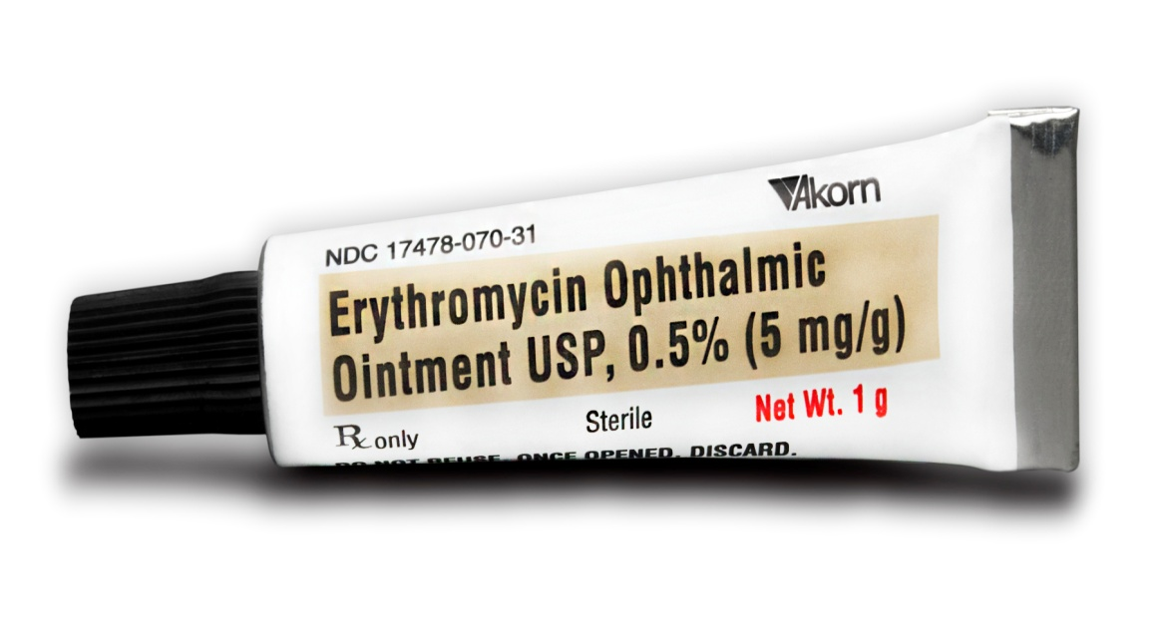
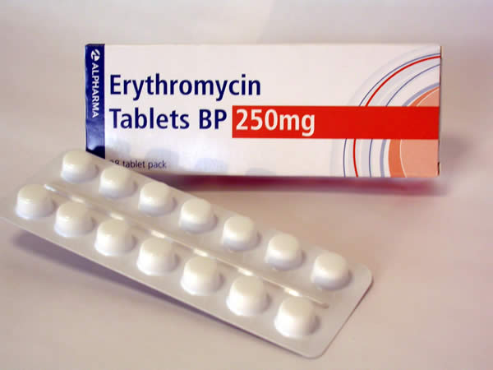
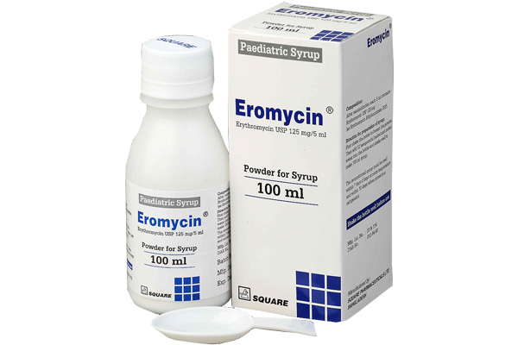

Slide 18
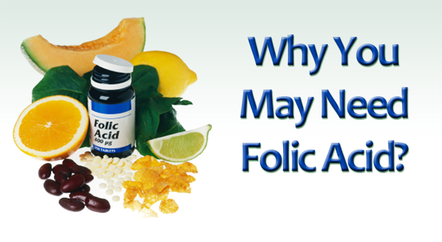
  4-Interference with metabolism process
Sulfonamides : Are broad-spectrum bateceriostatic antibiotics that inhibit the synthesis of folic acid (needed for the growth of many bacteria) Some are designed to stay in the GI tract (enteric forms); some are absorbed by the GI tract and penetrate tissues (systemic forms) Bactericidal when potentiated with trimethoprim
  Ex: include sulfadiazine/trimethoprim , sulfadimethoxine,

Slide 19
  5-Inhibithion the synthesis of nucleic acids (DNA & RNA)
Acting on DNA (Bactericidal )
1- Fluoroquinolones
  Are antimicrobial agents with fluorine bound to the quinolone base, which increases the drug’s potency, spectrum of activity, and absorption .they Are broad-spectrum antibiotics (gram + and gram -)
  . Ex: include enrofloxacin, ciprofloxacin, orbifloxacin, difloxacin, marbofloxacin, and sarafloxacin
Quinolones ---> Inhibit DNA gyrases required for supercoiling of DNA; bind to alpha subunit

Slide 20
  5-Inhibithion the synthesis of nucleic acids (DNA & RNA)
Rifampin : Disrupts RNA synthesis
  Is broad-spectrum; used in conjunction with other antibiotics (usually erythromycin)
Rifampin, like other rifamycins, acts by binding
to the β subunit of the RNA polymerase and blocks the extension of the nascent RNA chain after the first or second condensation step

Slide 21
Antiparastic agents
Nitroimiazoles Have antibacterial and antiprotozoal activity; work by disrupting DNA and nucleic acid synthesis
  An example is metronidazole, which is considered by some the drug of choice for canine diarrhea
  Used to treat Giardia and Trichomonas infections
  Also used for amoebiasis and anaerobic bacteria
  Oral or intravascular administration

Slide 22
Antifungal Agents
Antifungals: are chemicals used to treat diseases caused by fungi (mold or yeast) Some fungal diseases are superficial (ringworm);others are systemic (blastomycosis)
Types of antifungals
  1-Polyene antifungal agents : Work by binding to the fungal cell membrane Ex: Nystatin and Amphotericin B
  2-Imidazole antifungal : Work by causing leakage of the fungal cell membrane ex: Ketoconazole
  3-Antimetabolic antifungal agents :Work by interfering with the metabolism of RNA and proteins ex: is flucytosine
  4- Superficial antifungal agents : Work by disrupting fungal cell division ex: griseofulvin

Slide 23
Antiviral Agents
Viruses are intracellular invaders that alter the host cell’s metabolic pathways :Antiviral drugs act by preventing viral penetration of the host cell or by inhibiting the virus’s production of RNA or DNA ex:
  Acyclovir : interferes with the virus’s synthesis of DNA used to treat herpes virus infections (Tablets, suspension, injectable
  Interferons protect host cells from a number of different viruse

