Slide 1
Muscle Tissue
Muscle is the primary tissue in the
Heart (cardiac MT)
Walls of hollow organs (Smooth MT)
Skeletal muscle
Makes up nearly half the body’s mass
Muscular (contractile) tissue is composed of cells called
muscle fibers.
Muscle fibers contain actin and myosin, which are protein filaments .
The three types of vertebrate muscles are skeletal, smooth, and cardiac.

Slide 2
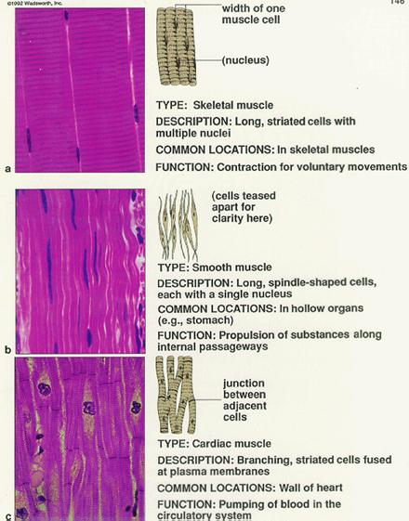
Essentially all muscles cells are mesodermal origin.

Slide 3
Skeletal Muscle Tissue
voluntary, striated
fibers are longest
stripes (striations)
location
attached to and covers bony skeleton
40% of body weight
contracts rapidly
tires easily
must rest after short periods of activity
function
responsible for overall body mobility

Slide 4
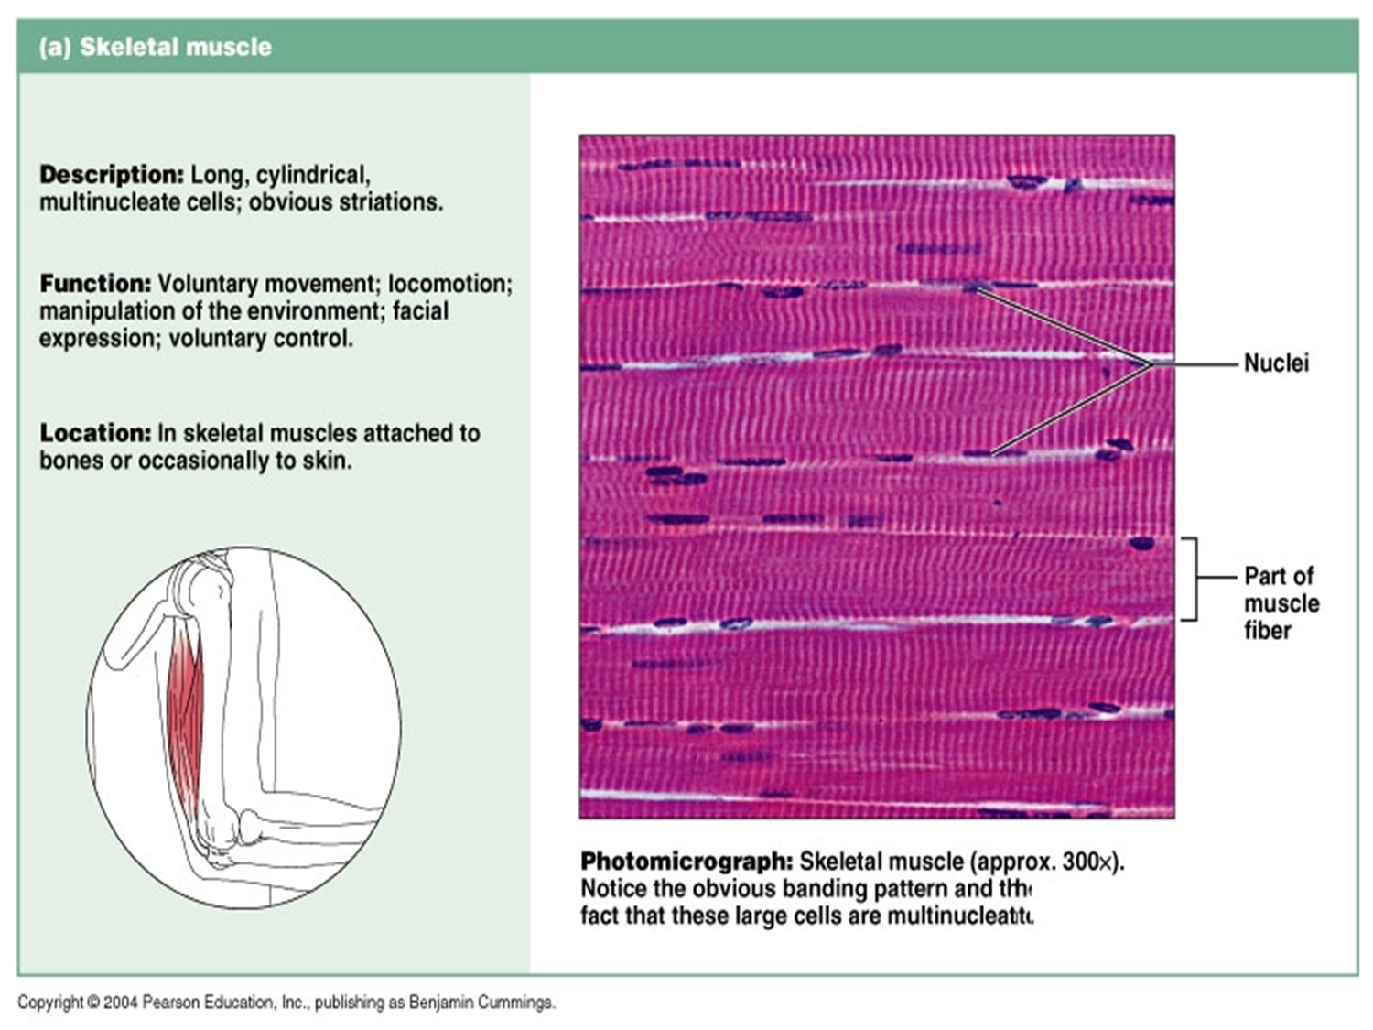

Slide 5
Cardiac Muscle Tissue
striated, involuntary
location
found only in heart
constitutes the bulk of the heart wall
controlled involuntarily

Slide 6
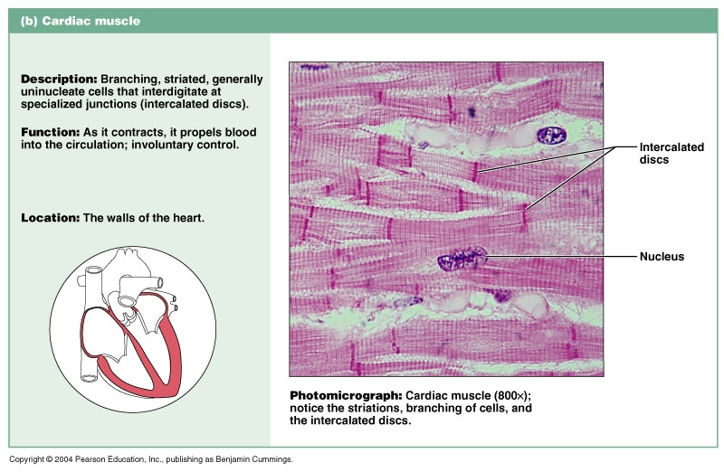

Slide 7
Smooth Muscle Tissue
nonstriated, involuntary
location
walls of hollow visceral organs
stomach, urinary bladder, respiratory passages
function
force fluids & other substances through internal body channels
controlled involuntarily
contractions are slow & sustained

