Slide 1
Viral Infection Basics
Lecture 7
Dept. of Biology
2nd year, 2020
Mustansiriyah University

Slide 2
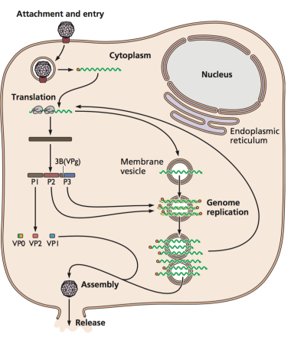
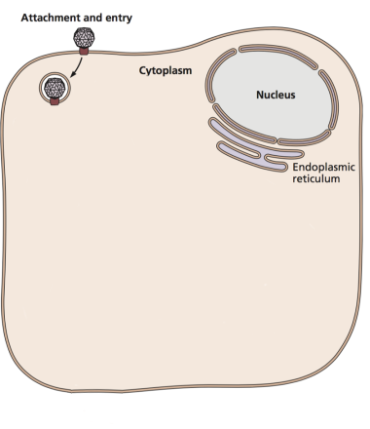
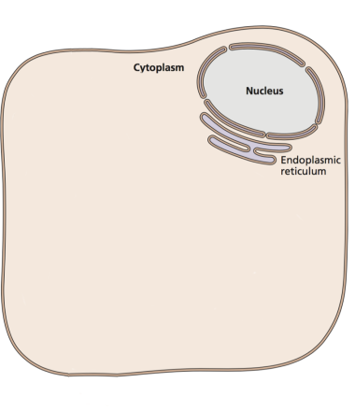
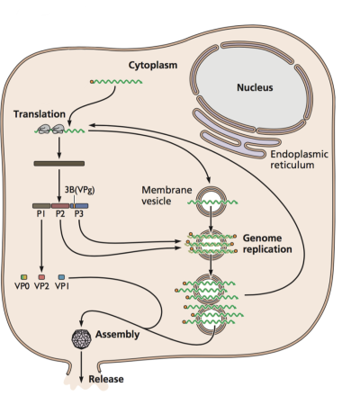

Some important definitions
A Susceptible cell has a functional receptor for a given virus – the cell may or may not be able to support viral replication
A resistant cell has no receptor – it may or may not be competent to support viral replication
A permissive cell has the capacity to replicate virus – it may or may not be susceptible
A susceptible AND permissive is the only cell that can take up a virus particle and replicate it

Slide 3

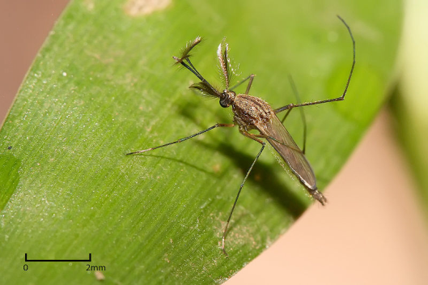
We live and prosper in a cloud of viruses
Most viruses we encounter have no consequence i.e. they pass through us, e.g. plant viruses
Many infections are inapparent or asymptomatic
ــ Sings: Evidence of disease that can be observed by others
e.g. rash, measuring virus in blood samples, fever
ــ Symptoms: apparent only to the patient (what only you feel)
e.g. stomach ache, headache
ــ May overlap, e.g. rashes

Slide 4
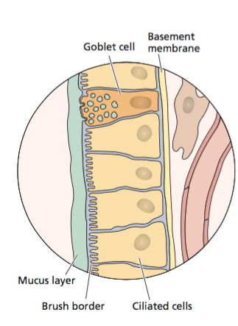
Viral spread
After replication at the site of virus entry, viruses may remain localized: virus spreads within the epithelium and is contained by tissue structure and immune system
Some viruses spread beyond the primary site: disseminated; if many organs are infected, systemic
Physical (skin, basement membrane lining epithelium) and immune barriers must be breached
The basement membrane prevents virus from getting through to sub-epithelial tissues
Once virus spreads from epithelial to sub-epithelial tissue, it can move through the entire host
Respiratory tract epithelium

Slide 5
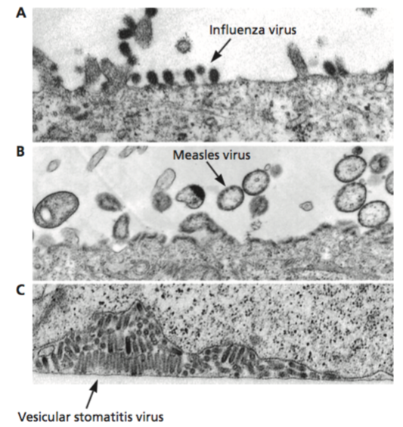
Viral spread is polarized
Apical
Influenza virus budding from apical site of cell. It does not have access to the sub-epithelial tissues. The virus will be released to the lumen of the respiratory tract
That is why respiratory viruses spread by aerosol.
Basolateral release provides access to underlying tissues, may facilitate systemic spread
Vascular stomatitis virus (VSV) spreads basolaterally. It does not spread by aerosol
Basolateral

Slide 6
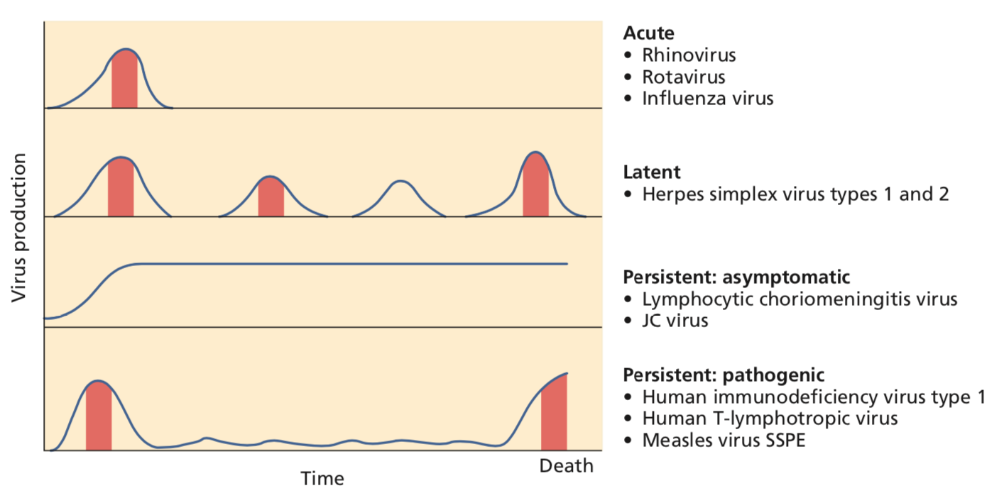
General patterns of infection
Blue line: virus production; red blocks: period of disease
Acute infection: defined period virus production and disease and then virus resolution
Many viruses that cause different types of persistent infection
Persistent infection: can last the lifetime of the host with or without periods of disease

Slide 7
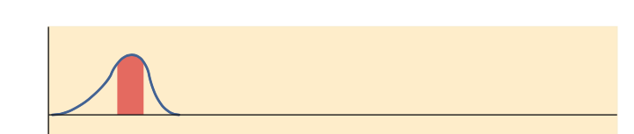
Acute infections
Rapid onset of viral reproduction
Short but possible severe course of disease, but not always
Production of large number of virus particles
Immune response eventually clears the infection

Slide 8

Inapparent acute infections (asymptomatic)
Successful infection, no symptoms or disease
Sufficient virus particles produced to spread in the population
How do we know? Serological surveys
Viruses that cause asymptomatic infections are well-adapted pathogens because they spread efficiently from to person to person
ــ <90% of poliovirus infections inapparent

Slide 9
Acute vs persistent infections
Acute infection – rapid and self-limiting, accompanied by disease but not always, resolved by fixed amount of time
Persistent infection ــ long term, lifetime of the host
Most persistent infections probably begin as an acute infection that is never cleared

Slide 10
General patterns of infection
Self-limiting virus infection (acute)
Periods of virus production followed by latency, where the genome is silent. Periodically through the lifetime of host the virus reactivates and sheds with the presence or absence of disease (latent)
Entirely asymptomatic, the virus production reaches a level which continues for the life of the host in the absence of any pathology (persistent asymptomatic)
Initial acute infection, but the virus is not cleared and remains with the host for long period of time. After long time, the virus levels rise accompanied by death (persistent pathogenic)

Slide 11
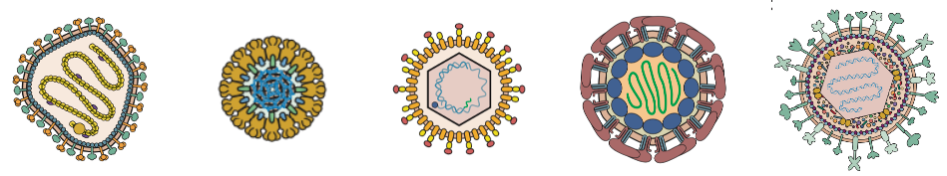
Persistent infections
Occur when primary infection is not cleared by immune response
ــ viruses encode number of immune evasion proteins
Virions, proteins, genomes often continue to be produced
Viral genomes may remain after proteins are not detected

Slide 12
Persistent infections
No single mechanism for persistent infections
ــ mechanisms are different among viruses of different families
When cytopathic effects (changes appeared on cell infected with virus) are absent and host defenses are reduced, persistent infection is likely
ــ the absence of cytopathic effect reduces the inflammation and the adaptive response, so infections are not efficiently cleared
Viral immune modulation
ــ host immune response can be evaded by virus-produced proteins which is the main cause of persistent infections

Slide 13
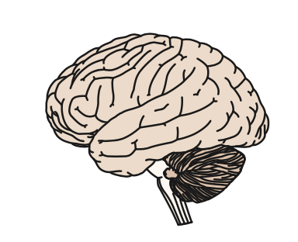
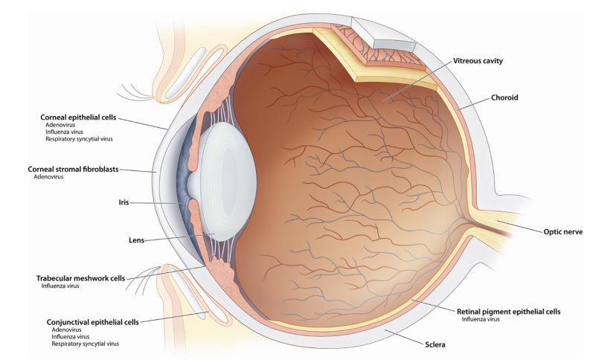
Common features of persistent infections
They last the lifetime of the host
Viral immune modulation is involved
ــ herpes simples virus, hepatitis virus C
Immune cells may be infected, e.g. HIV
ــ HIV infection of CD4 T cells, measles virus infection of antigen presenting cells (APCs)
They may occur in areas of reduced immune surveillance, CNS and vitreous humoral fluid of eye
ــ Ebola virus persistence in ocular fluid

Slide 14
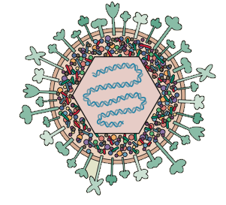
Latent infections ــ general properties
Viral proteins that promote productive replication are not made or found in low concentrations
Cells harboring the latent viral genome are poorly recognized by the immune system
Viral genome persists intact so that productive infection (making new virus particles) can be initiated to spread infection to new hosts
Reactivation of the latent viral genomes is needed to produce virus particles, otherwise the infection will eventually end
Latent infection means either viral genome is not expressed or at low levels

Slide 15
State of the genome
Non-replicating DNA in a non-dividing cell
ــ Herpes simplex virus (HSV), varicella zoster virus (VSV) in neurons
Autonomous self-replicating DNA in dividing cell
ــ Human papilloma virus (HPV), Hepatitis B virus (HBV)
Integrated into host chromosome, replicates with host
ــ Human herpes virus 6 (HHV6)

Slide 16
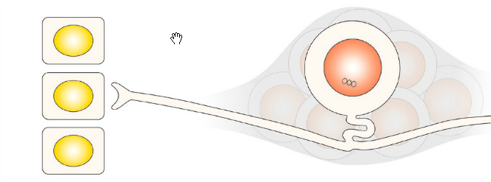
HSV post-infection events in neurons
Neuron cell
Mucosal epithelial cells
Silent viral genome
Epithelial cells are infected with HSV, the virus enters the nerve terminus travelling to the central nervous system neuron
At the neuron, viral genome silenced, coated with nucleosome
Multiple copies of viral DNA remain silent in nucleus separate from chromosomal DNA (episomal)
Neurons do not divide
Herpes is forever – drugs and vaccines cannot cure a latent infection

Slide 17
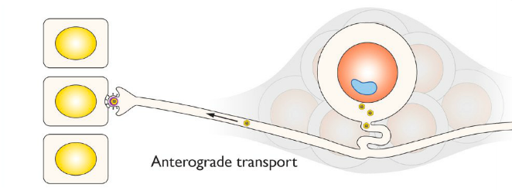
Reactivation
Blisters formation
Virus spread
Sunburn (UV), physical or emotional stress, nerve damage, hormonal imbalance, steroids can reactivate infection
Physical or emotional stress
Nerve damage
Hormonal imbalance, steroids
Immunosuppression
- Stress stimulates viral proteins needed to activate viral transcription program
- Activated viruses travel from the center of the neuron to the periphery (anterograde transport)
- Virus particles replicate in mucosal tissues innervated by latently infected ganglia (blisters ensue)

Slide 18
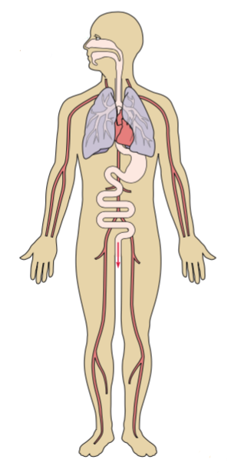
Viral pathogenesis
Pathogenesis: the process of producing a disease
Two components of viral disease
- Effects of viral replication on the host
- Effects of host response on virus and host
Signs and symptoms are caused by immune response

Slide 19
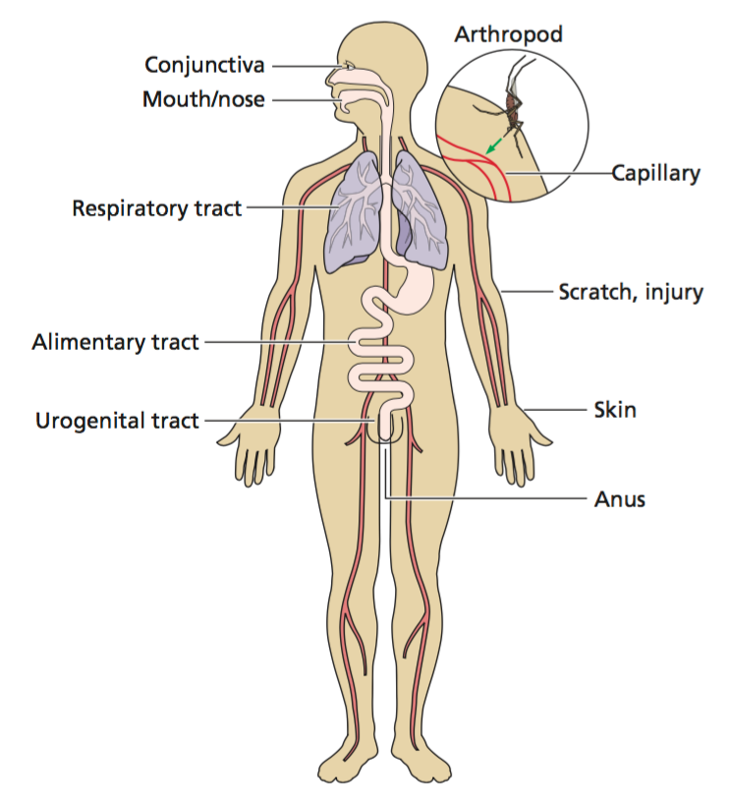
Three requirements for a successful infection
Enough virus (dose of infection)
- depends on virus and host (health condition, age)
Cells accessible, susceptible, permissive
- Virus should find the right host cell to replicate
Local antiviral defense absent or overcome

Slide 20
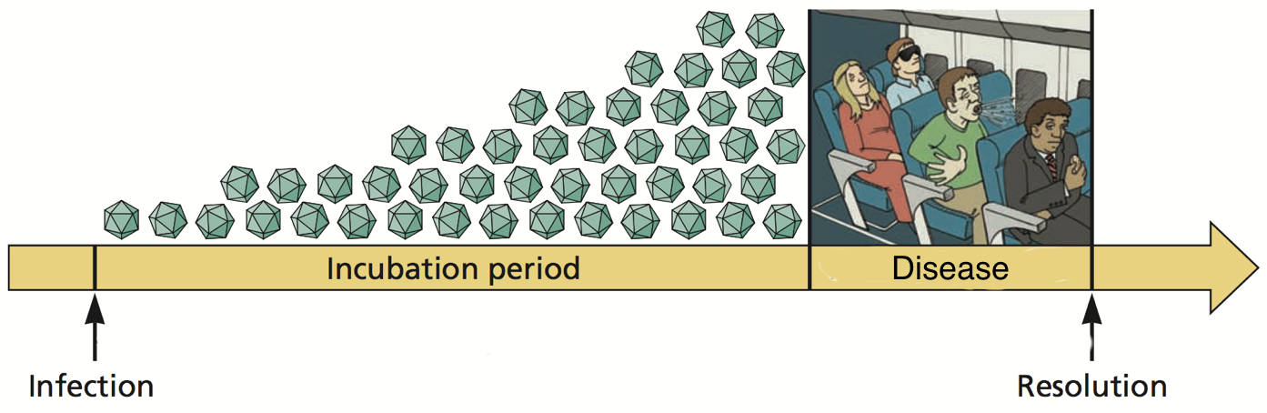
Incubation period
Initial period before symptoms of disease are obvious
Viral genomes are replicating
Host is responding
Virus may or may not be transmitted during incubation period

Slide 21
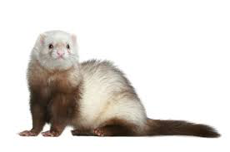

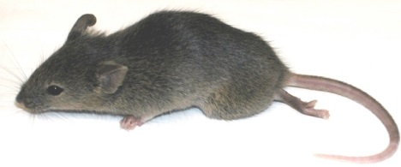
Viral virulence
Capacity of a virus to cause disease in a host
Avirulent or attenuated virus do not cause any disease (attenuated vaccines)
Virulence can be measured in laboratory
- Virus titer (amount of virus particles or viral components in the host)
- Mean time to death
- Mean time to appearance of signs
- Measurement of fever, weight loss
- Measurement of pathological lesions (poliovirus), reduction in blood CD4+ lymphocytes (HIV)
Viral virulence is influenced by dose, route of infection, species, age, gender, and susceptibility of host

