Slide 1
Virus structure Lecture Two 2nd stage

Slide 3
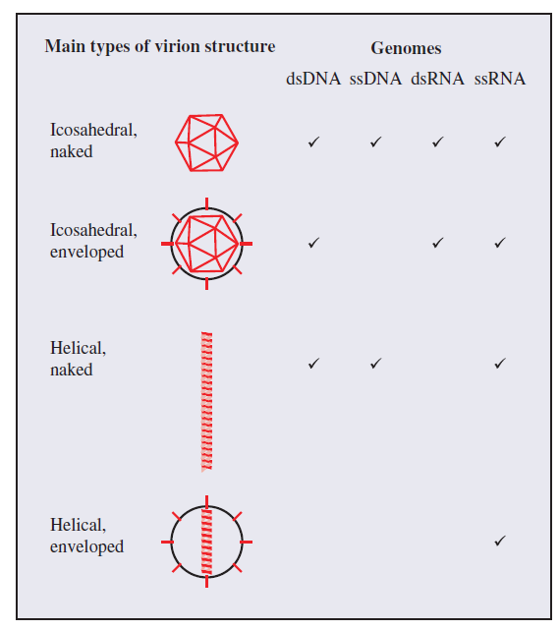
Viruses have genome either DNA or RNA which is double-stranded (ds) or single-stranded (ss).
Virions can be categorized into four groups according to their structure: icosahedral (enveloped, naked) and helical (enveloped, naked).
Naked icosahedral capsid is common in all viruses containing genomes.
Most viruses have icosahedral enveloped capsid except for ssDNA viruses.
There are no dsRNA viruses with naked helical symmetry.
Helical enveloped is the only symmetry that exists in ssRNA viruses.

Slide 4
In order to retain their infectivity, virus particles (virions) should struggle the harsh environment that could inactivate the nucleic acid genome from physical, chemical, or enzymatic damage.
All virions consist of the virus genome which is packaged in a protein structure known as capsid.
Many viruses also have a lipid component, present at the surface of the virion forming an envelope which also contains proteins that play a role in entry of virus into host cells.
Virus component and structure
Virus genomes: virus has genome which is composed of either DNA or RNA. According to the number of nucleic acid strands, viruses can be classified into dsDNA, ssDNA, dsRNA, and ssRNA.

Slide 5
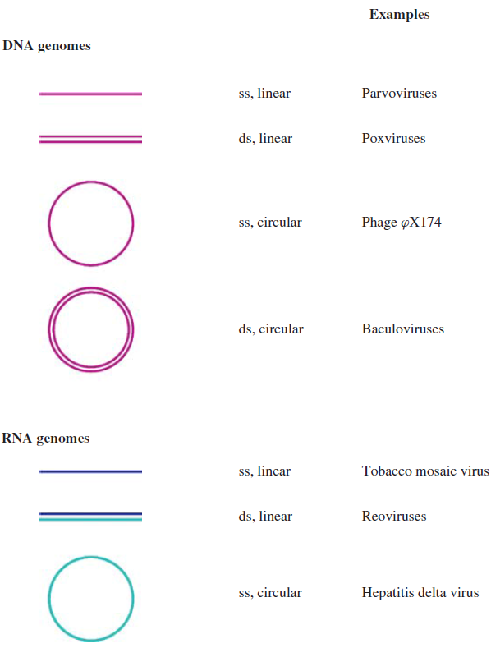
Virus nucleic acid is either linear with free 5’ and 3’ ends or circular as a result of the strand(s) being covalently closed as showed in the figure.
There are no viruses known with circular dsRNA genomes.
ᵠ = phi

Slide 6
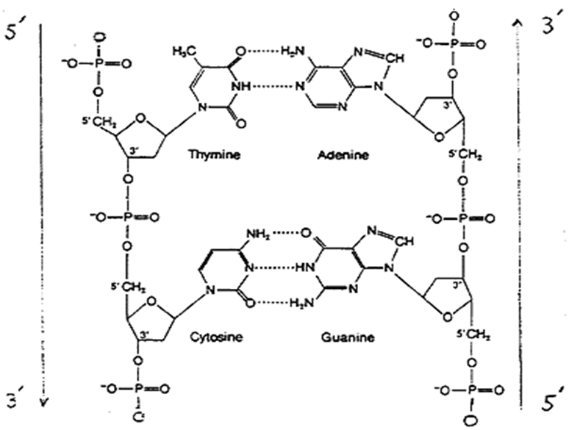

Slide 7
Segmented genomes:
Most virus genomes consist of a single molecule of nucleic acid, but the genes of some viruses are distributed on two or more nucleic acid molecules. The segmented genomes are more common in RNA viruses than DNA viruses. Influenza virus is a ssRNA virus with segmented genome packaged in one virion. However, infection of cells with the viruses of segmented genomes requires all genome segments to enter the cell.

Slide 8
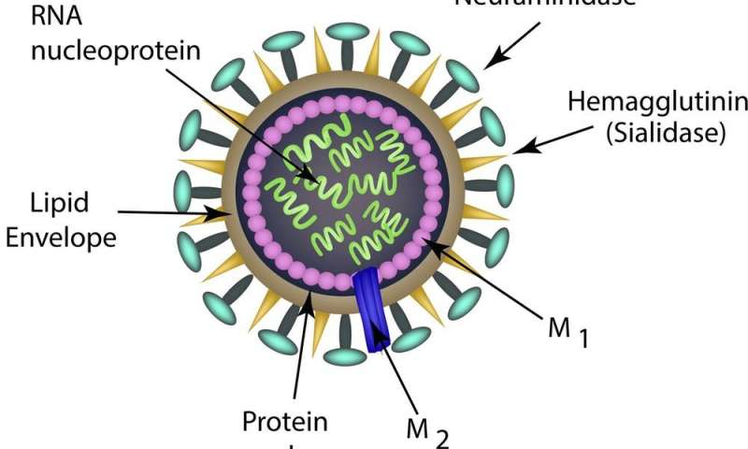

Slide 9
Virus proteins
Viruses encode their own proteins which have various functions and they are classified into structural and non-structural proteins. Virion-forming proteins are known as structural proteins. Their functions are including:
Protection of the virus genome.
Attachment of the virion to a host cell.
Fusion of the virion envelope to a cell membrane (for enveloped viruses).
Non-structural proteins are synthesized by the virus in an infected cell but they are not virion components. They function as:
Enzymes, e.g. protease, reverse transcriptase
Transcription factors
Primers for nucleic acid replication
Interference with the immune response of the host.

Slide 10
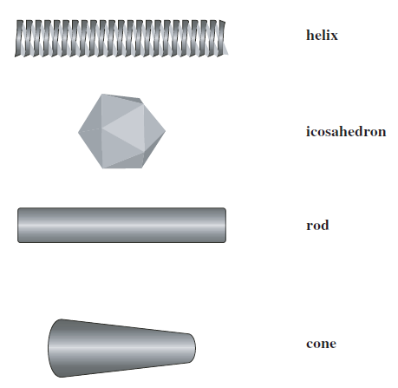
Capsids
Capsids are constructed from many molecules of one or a few species (type, subunit) of protein. The capsid protein subunits are asymmetrical, but they are organized to form symmetrical structures.
Various types of symmetrical structures can be seen among virus capsids. The vast majority of virus capsids have either helical or icosahedral symmetry.
Types of symmetrical structures

Slide 11
Capsids with helical symmetry
Helical symmetry is very common in ssRNA viruses. The RNA is coiled in the form of a helix and many copies of the same protein species are arranged around the coil. This arrangement forms an elongated structure which may be either a rigid rod if the protein molecules are bound in strong bonds in turns of the helix, or a flexible rod if these bonds are weak. The capsid varies in length according to the length of the nucleic acid.
Influenza virus and measles virus are ssRNA viruses and have helical nucleic acids which are coated with protein to form nucleocapsid, which is inside an envelope. The nucleocapsid may be coiled or folded to form compact (complex) structure.
M13 bacteriophage is an example to the filamentous DNA viruses that have helical symmetry.

Slide 12
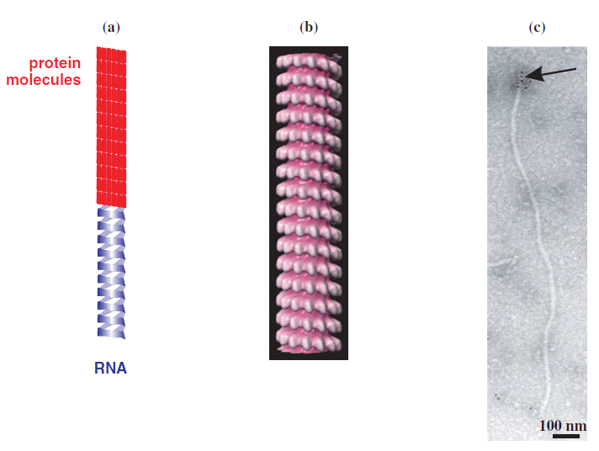
(a) Capsid with helical symmetry. (b) part of measles virus nucleocapsid. (c) long flexible rod virion.

Slide 13
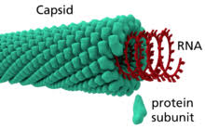

Slide 14
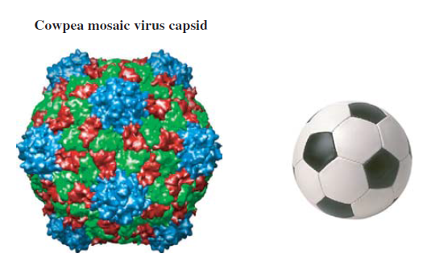
Capsids with icosahedral symmetry
Icosahedron is an object with 20 faces (triangles), 12 vertices, and 30 edges.
Icosahedral capsids are built from identical protein molecules arranged in an icosahedron. The minimum number of identical protein molecules required for icosahedron construction is three molecules per one triangle, totally 60 molecules for icosahedron (3*20=60). There are many icosahedral capsids may composed of more than 60 molecules.
Also the capsids of many icosahedral viruses are constructed from more than one protein species. For instance, cowpea mosaic virus is composed of two proteins.
Capsid constructed from two
protein species.

Slide 15
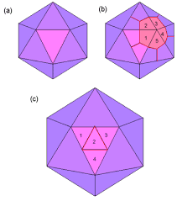

Slide 16
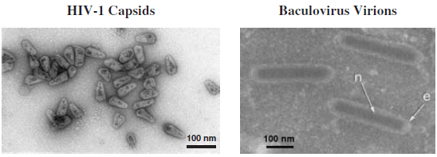
Capsid shapes (capsid surface)
Capsid surfaces vary in their topography, in which there may be canyons, hollows, ridges, and/or spikes present.
There are also projections, knobs, and fibers at each of 12 vertices of the capsid. These structures are involved in attachment of the virion to its host cell and in delivery of the virus genome into the cell.
The football is constructed in a form of icosahedral symmetry, but the structure is spherical.
Many small viruses with icosahedral capsids appear to be spherical which is known as isometric such as adenoviruses and foot and mouth disease virus.
Some capsids with icosahedral symmetry are elongated like geminiviruses (Plant viruses) which are formed from two incomplete icosahedra.
HIV-1 and baculoviruses have capsids that are conical and rod-shaped, respectively.
Conical and rod-shaped capsids

Slide 17
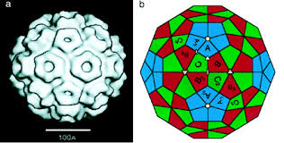

Slide 18
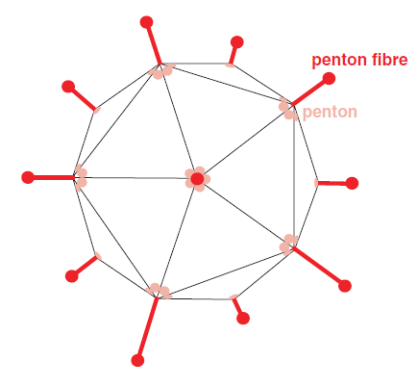
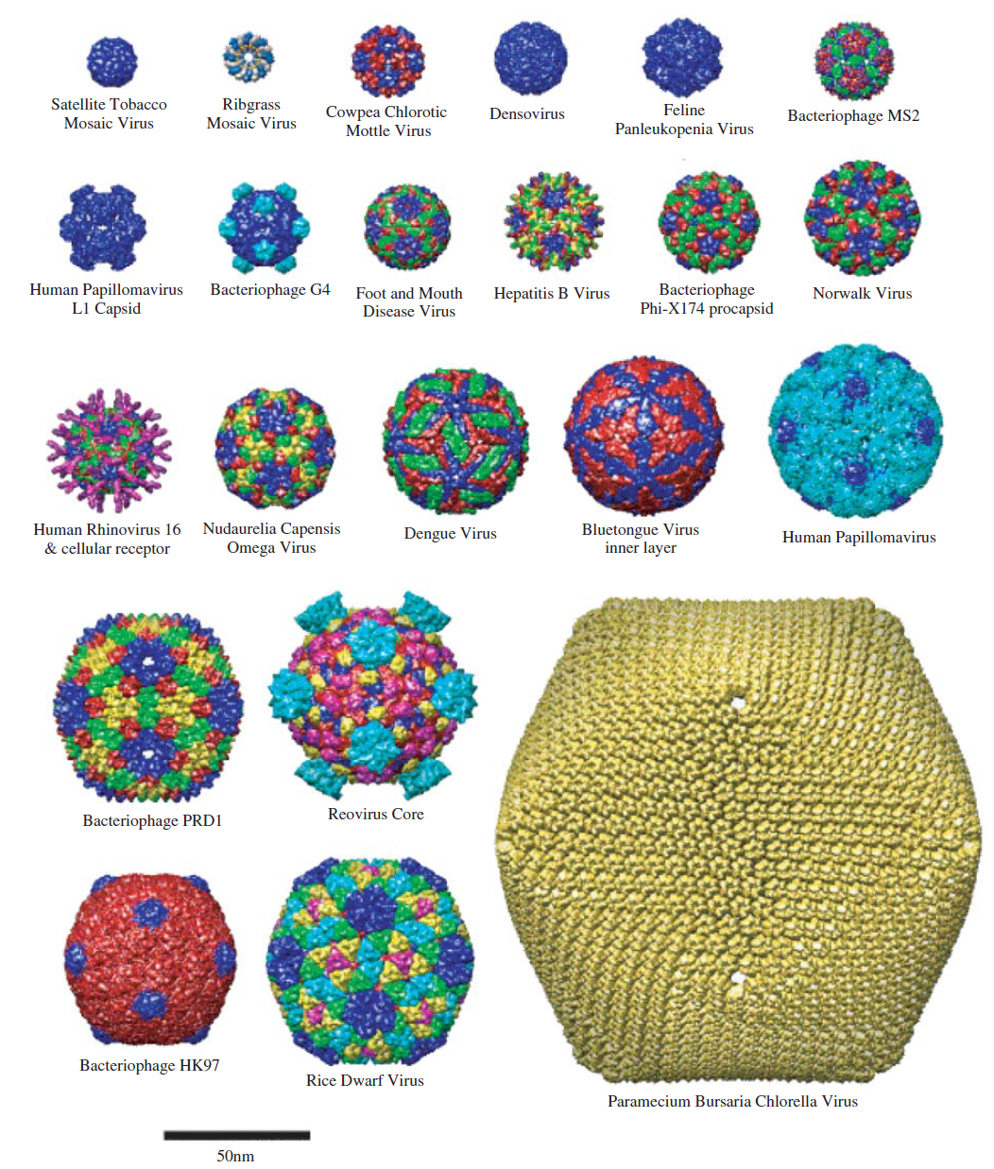
Adenovirus virion. fibers with the knobs at the end
Capsids with icosahedral symmetry.

Slide 19
Enveloped virions
Envelope is a lipid-protein structure at the virion surface and associated with one or more of virus protein and it encloses the nucleocapsid (nucleic acid plus capsid).
Many animal viruses are enveloped including all those with helical symmetry e.g. influenza virus and those with icosahedral symmetry such as herpesviruses. Enveloped virions are much less common in plant viruses.
One or more species of protein associates with membranes of enveloped virus. Most of proteins are glycosylated (glycoprotein). For instance, the envelope of influenza A virus has two glycoprotein species: haemagglutinin and neuraminidase, besides the third protein species (M2) which is not glycosylated. The glycoprotein of envelope mediate the fusion of the virion to a cell membrane during the infection process.
Membrane lipids
Most virion membranes are derived from host cell membranes , for example, HIV-1 envelope is derived from the plasma membrane of the host cell. Virions gain their membranes when they are released from cells.

Slide 20
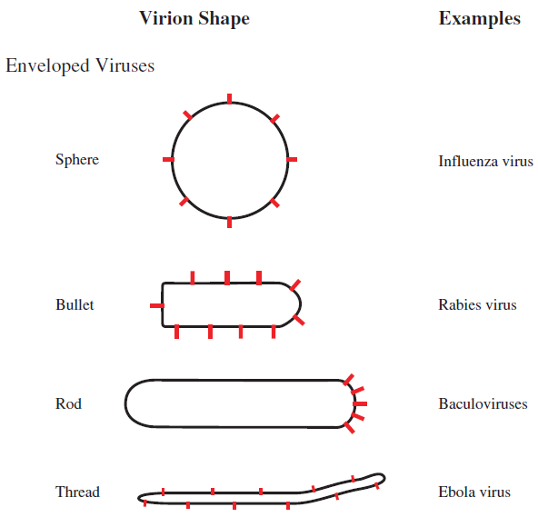
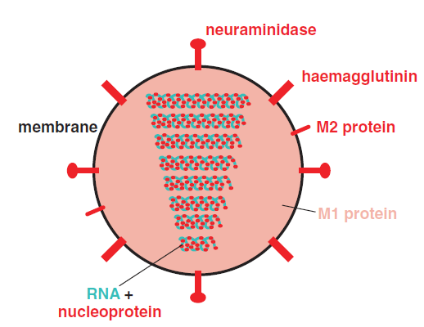
Influenza A virus
Virion shape

