Slide 1
What is a virus
Lecture One
Dept. of Biology, 2nd year, 2020
Mustansiriyah University
References:
Virology: principles and applications, John Carter and Venetia Saunders, 2013.
Principles of Molecular Virology, Alan, J. Cann, 2012.
Principles of virology 4th Ed. Jane Flint et al., 2015

Slide 2
Course goals
This course is designed to help you understand the basics of virology
We’ll show you how to think about virology as an integrative discipline
You will learn the fundamentals about these molecular entities that amaze the informed and frightened the uninformed

Slide 3
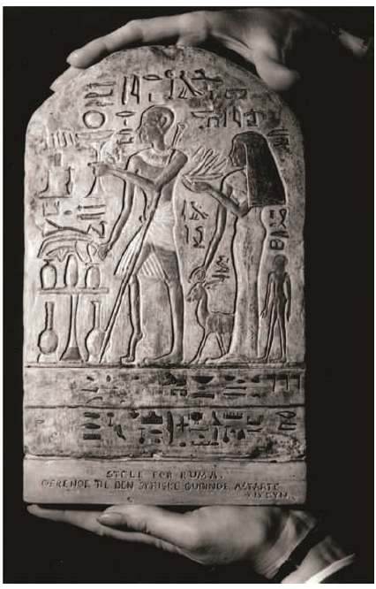
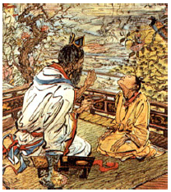
History of Virus
The 1st record, in 3700 BC, drawn in hieroglyph depicted a temple priest showing a typical clinical signs of paralytic poliomyelitis.
By 1000 BC, small pox was endemic in China. Smallpox-infected people inhaled the dried crusts from smallpox pustules or inoculated the pus from a lesion into a scratch on the arm. This practice is called Variolation which was practiced for centuries as effective method for disease prevention. It was risky because the outcome of the inoculation was never certain.

Slide 4
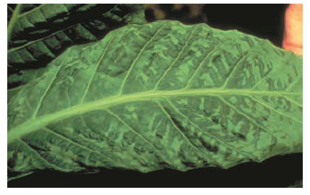
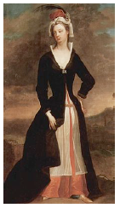
History of Virus
In 1796, Edward Jenner successfully found a safer alternative treatment, Vaccination. He used cowpox-infected material to vaccinate 8-year-old boy. Vaccination against smallpox was entirely adopted worldwide during 19th century.
Virus Discovery
In 1892, Dimitri Ivanovski, a Russian botanist, showed that extracts from diseased tobacco plants could transmit disease to other plants although passing the extracts through filters fine enough to retain the smallest bacteria.

Slide 5
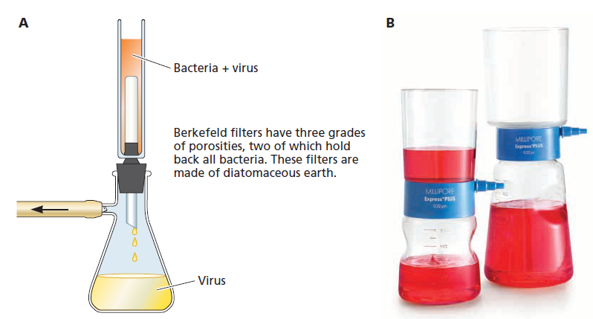
In 1898, Martinus Beijerinick independently made the same Ivanovski’s observation and showed that the diseased tobacco plants were infected with “filterable agent” now called Tobacco mosaic virus (TMV). Beijerinick was first to develop the modern idea of the virus, which he referred to as “contagium vivum fluidum” (soluble living germ).
Freidrich Loeffler and Paul Frosch (1898) showed that similar agent (filterable agent) was responsible for foot-and-mouth disease in cattle.
Frederick Twort (1915) and Felix d’Herelle (1917) were the first to identify the viruses that infect bacteria, which d’Herelle called bacteriophage (eaters of bacteria)
Virus=poison

Slide 6
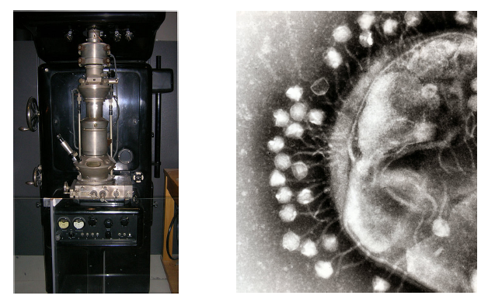
1939-Viruses are not liquids
In 1933, Helmut Ruska built first electron microscope.
First EM of bacteriophage, 1939

Slide 7
What is a virus?
An infectious, obligate intracellular parasite comprising genetic material (DNA or RNA), often surrounded by a protein coat, sometimes a membrane.

Slide 8
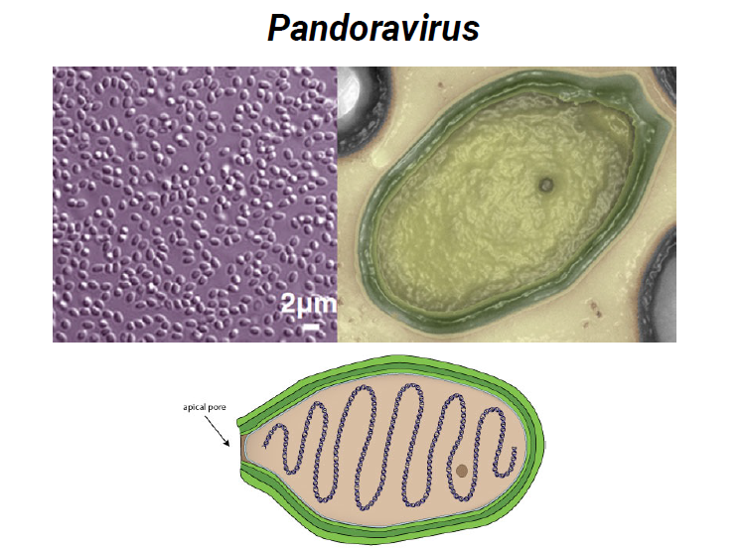
Some viruses are bigger than what we thought
Light microscope field
Genome size: 2.5 Mbp DNA
Particle size: 1.5 µm

Slide 9
Common features of viruses
Viruses have nucleic acid (DNA or RNA) which is single or double-stranded.
The viral genome is encased in a protective coat or coat of protein or lipoprotein (capsid).
The genetic material of viruses encode to various proteins with wide range of functions, including structural protein (coat protein), virus replication enzymes, virus movement from cell to cell (in plant viruses), virus transmission.
Replication of many viruses takes place in distinctive virus-induced structures in the cell.
Virion is morphologically complete (mature) infectious virus particle.

Slide 10
Why do we study viruses?
Viruses cause very important diseases to living organisms (human, animals, plants, insects and bacteria). Viral diseases are ranging from common simple (common cold) to the lethal (rabies) and viruses also play roles in the development of several types of cancer. In the past, smallpox highly affected the societies. AIDS (acquired immunodeficiency syndrome), hepatitis and Ebola (hemorrhagic fever), SARS CoV2 (COVID-19) have great impact today.
Studies have focused on the nature of viruses, how they replicate and how they cause disease. These studies contributed to develop effective means for prevention, diagnosis, and treatment.
Animal and plant viruses are also very important due to the economic impact of viruses that cause diseases in domestic animals, crop plants and vegetables. Foot and mouth disease and rice yellow mottle virus are two examples that cause economic damage.

Slide 11
Some viruses are useful!
Some viruses are studied because they have useful applications:
Phage typing of bacteria: Identification of some bacterial isolates (e.g. Salmonella species) can be done on the basis of the spectrum of phages to which these bacteria are susceptible.
Source of enzymes: Many enzymes that have various applications and used in molecular biology and gene cloning are derived from viruses. For instance, reverse transcriptase from retroviruses and T4 ligase from T4 bacteriophage used in genetic engineering techniques.
Pesticides: Some viruses like baculoviruses and myxoma virus are used to control insect pests.
Anti-bacterial agents: Some phages were used for treatment of bacterial infections, however this application declined with the discovery of antibiotics.
Anti-cancer agents: Viruses such as herpes simplex virus and vaccinia virus are being investigated for treatment of cancers. These strains were genetically modified in order to be able to infect and destroy the specific tumor cells, but not the normal cells.

Slide 12
Unusual Infectious Agents
What is the minimum genome size required to establish infection?
Could an infectious agent exist without ANY genome?
Viroids, satellites and prions provide answers

Slide 13
Viroids
Viroids:
Circular ssRNA s, 120 – 475 nt
No protein coding regions
No protective coat, yet migrate from host to host (no receptors required)
Replicate when introduced into plants
Families Pospiviroidae (replicate in nucleus) and Avsunviroidae (replicate in chloroplast)
RNA displays extensive internal base-pairing, appears as 50 nm rod in electron microscope (EM)

Slide 14
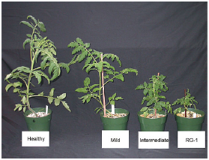
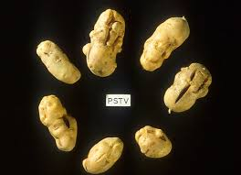
Potato spindle tuber viroid (PSTVd) discovered in 1967
- Prototype for smallest nucleic acid-based agent of infectious disease
- Some are benign, others cause economically important diseases of crop plants

Slide 15
Satellites
ssRNA, DNA, circular RNA (cRNA)
Depend on helper virus to replicate (helper-dependent)
Lack genes required for replication
Satellite viruses encode their own coat proteins (form distinct particles)
Satellite RNAs (virusoids) packaged by helper virus proteins, rely on helper for replication. May or may not encode protein. (HDV)
Characteristics of satellites:
Their genomes are about 500-2000 nt of single-stranded RNA (ssRNA).
Satellites show little or no nucleotide sequence similarity with the helper virus genome.
They cause distinct disease symptoms in plants that are not seen with the helper virus alone.
Replication of satellites usually interferes with the replication of the helper virus.
Tobacco ringspot virus satellite RNA (helper: nepovirus)
Hepatitis delta virus satellite RNA (HDV), (helper: hepatitis B virus (HBV).
Adeno-associated virus (ssDNA), (helper: adenovirus or herpesvirus

Slide 16
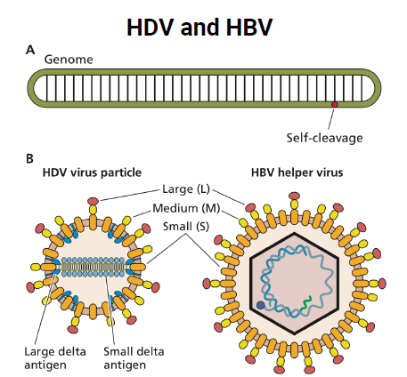

Slide 17
Characteristics of satellites and viroids
Viroids | Satellites | Characteristics
No | Yes | Helper virus required for replication
No | Yes | Protein(s) encoded
Host cell RNA polymerase II | Helper virus enzymes | Genome replicated by
Nucleus | Nucleus or cytoplasm | Site of replication

Slide 18
Prions: a proteinaceous infectious particles that do not have nucleic acid (DNA or RNA), believed to be responsible for transmissible spongiform encephalopathies (TSE) such as Creutzfeldt-Jakob disease (CJD) or bovine spongiform encephalopathy (BSE, mad cow disease).
In 1967, Tikvah Alper claimed that the agent of TSEs might replicate without nucleic acid.
Prions are proteins encoded by prnp gene
Pathogenic prion is a conformational isoform of a normal host protein, PrP^{c}.
The abnormal form, when introduced into the organism, causes conversion of normal PrP^{c} into the pathogenic form.
The term of prion was first coined by Stanley Prusiner in 1981.
How did we know that prions are not viruses?
The evidence that prions are not conventional viruses relied on the fact that nucleic acid is not necessary for infectivity.
Prions are resistant to heat inactivation. At 135 ^{ₒ}C for 18 min, infectivity of prion is reduced but not eliminated.
Resistant to radiation damage. Infectivity is not diminished by treating with UV and ionizing radiation which both inactivate infectious organisms by causing damage to the genome.
Resistant to DNAse and RNAse treatments which inactivate nucleic acids.
Sensitive to urea, SDS, phenol and other protein-denaturing chemicals.

