Slide 1
Scientometrics
Scientometrics is the study of measuring and analysing science , technology and innovation.
Major research issues include the measurement of impact, reference sets of articles to investigate the impact of journals and institutes, understanding of scientific citations, mapping scientific fields and the production of indicators for use in policy and management contexts

Slide 2
Impact factor (IF)
The impact factor (IF) or journal impact factor (JIF) of an academic journal is a measure reflecting the yearly average number of citations to recent articles published in that journal
It is frequently used as a proxy for the relative importance of a journal within its field; journals with higher impact factors are often deemed to be more important than those with lower ones

Slide 3
The impact factor was devised by Eugene Garfield, the founder of the Institute for Scientific Information. Impact factors are calculated yearly starting from 1975 for journals listed in the Journal Citation Reports.

Slide 4
Thomson Reuters Corporation is a Canadian multinational mass media and information firm. The firm was founded in Toronto, Ontario, Canada, where it is headquartered at 333 Bay Street in Downtown Toronto.
Thomson Reuters was created by the Thomson Corporation's purchase of the British company Reuters Group in April 2008, and is majority owned by The Woodbridge Company, a holding company for the Thomson family. Thomson Reuters was ranked as Canada's "leading corporate brand" in the 2010 Interbrand Best Canadian Brands ranking. Thomson Reuters operates in more than 100 countries, and has more than 45,000 employees.

Slide 5
How to calculate IF?
In any given year, the impact factor of a journal is the number of citations, received in that year, of articles published in that journal during the two preceding years, divided by the total number of articles published in that journal during the two preceding years:

Slide 6
For example, Nature had an impact factor of 41.456 in 2014:
This means that, on average, its papers published in 2012 and 2013 received roughly 41 citations each in 2014. Note that 2014 impact factors are reported in 2015; they cannot be calculated until all of the 2014 publications have been processed by the indexing agency.

Slide 7
Journal indexing agencies
Journal indexing means:
Indexing a database of higher scientific journals having a good track record of maintaining the ethics and quality in terms of publication. Indexing journals considered to be higher quality in comparison to any non index journals.
Indexing of a journal provides better visibility of the journal with a wider user. Being visible and accessible to larger people will cause better quality papers and results.

Slide 8
What benefits for Indexed journals?
- Indexed journal gets better visibility.
- Gets quality papers from the authors for publication.
- Journal impact factor get increased.
- Authority and importance of the journal get improved.

Slide 9
Journal indexing procedure
Many Journal indexing agencies have certain rules like
- Journal must have e-IISN and P-ISSN
- Journal must have at least 5 issues or at latest 1-3 years old.
- Journal must have at least 60 % foreign members in the editorial board

Slide 10
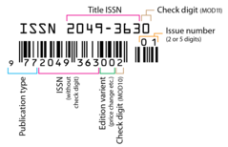
An International Standard Serial Number (ISSN) is an eight-digit serial number used to uniquely identify a serial publication, such as a magazine.
print ISSN (p-ISSN), electronic ISSN (e-ISSN)-

Slide 11
Highest impact factor of Journal in 2018
1. CA-A Cancer Journal for Clinicians: 244.585
2. The New England Journal of Medicine: 79.258
3. Lancet: 53.254
4. Chemical Reviews: 52.613

Slide 12
Journal indexing agencies list
Here are some of the popular journal indexing agencies where you can check the indexing and apply for it.
· Google scholar
· Scopus
· PubMed
· EBSCO
· EMBASE

Slide 13
Usage of IP
The impact factor is used to compare different journals within a certain field. The Web of Science indexes more than 11,000 science and social science journals.
Journal impact factors are often used to evaluate the merit of individual articles and individual researchers. This particular use of impact factors was summarised by Hoeffel:
Impact Factor is not a perfect tool to measure the quality of articles but there is nothing better and it has the advantage of already being in existence and is, therefore, a good technique for scientific evaluation. Experience has shown that in each specialty the best journals are those in which it is most difficult to have an article accepted, and these are the journals that have a high impact factor. Most of these journals existed long before the impact factor was devised. The use of impact factor as a measure of quality is widespread because it fits well with the opinion we have in each field of the best journals in our specialty.

Slide 14
In conclusion, prestigious journals publish papers of high level. Therefore, their impact factor is high, and not the contrary.
As impact factors is a journal-level metric, rather than an article or individual level metric, this use is controversial. Garfield agrees with Hoeffel, but warns about the "misuse in evaluating individuals" because there is "a wide variation [of citations] from article to article within a single journal".

Slide 15
Other measures of impact
Additional journal-level metrics are available from other organizations. For example, CiteScore: is a metric for serial titles in Scopus launched in December 2016 by Elsevier. While these metrics apply only to journals, there are also author-level metrics, such as the H-index, that apply to individual researchers. In addition, article-level metrics measure impact at an article level instead of journal level. Other more general alternative metrics, or "altmetrics", may include article views, downloads, or mentions in social media.

Slide 16
Elsevier

Slide 17
Elsevier is a Dutch information and analytics company and one of the world's major providers of scientific, technical, and medical information. It was established in 1880 as a publishing company. It is a part of the RELX Group, known until 2015 as Reed Elsevier. Its products include journals such as The Lancet and Cell, the ScienceDirect collection of electronic journals, the Trends and Current Opinion series of journals, the online citation database Scopus, and the ClinicalKey solution for clinicians ( search engine) . Elsevier's products and services include the entire academic research lifecycle, including software and data-management, instruction and assessment tools.
Elsevier publishes more than 430,000 articles annually in 2,500 journals. Its archives contain over 13 million documents and 30,000 e-books. Total yearly downloads amount to more than 900 million

Slide 18
Scopus is Elsevier’s abstract and citation database launched in 2004. Scopus covers nearly 36,377 titles (22,794 active titles and 13,583 inactive titles) from approximately 11,678 publishers, of which 34,346 are peer-reviewed journals in top-level subject fields: life sciences, social sciences, physical sciences and health sciences. It covers three types of sources: book series, journals, and trade journals. All journals covered in the Scopus database, regardless of who they are published under, are reviewed each year to ensure high quality standards are maintained.

Slide 19
peer review
Definition of peer review
: a process by which something proposed (as for research or publication) is evaluated by a group of experts in the appropriate field

Slide 20
Scopus gives four types of quality measure for each title; those are h-Index , CiteScore, SJR (SCImago Journal Rank) and SNIP (Source Normalized Impact per Paper).

Slide 21
The h-index is an author-level metric that attempts to measure both the productivity and citation impact of the publications of a scientist or scholar.
The index can also be applied to the productivity and impact of a scholarly journal as well as a group of scientists, such as a department or university or country. The index was suggested in 2005 by Jorge E. Hirsch, a physicist at UC San Diego, as a tool for determining theoretical physicist‘s relative quality and is sometimes called the Hirsch index or Hirsch number

Slide 22
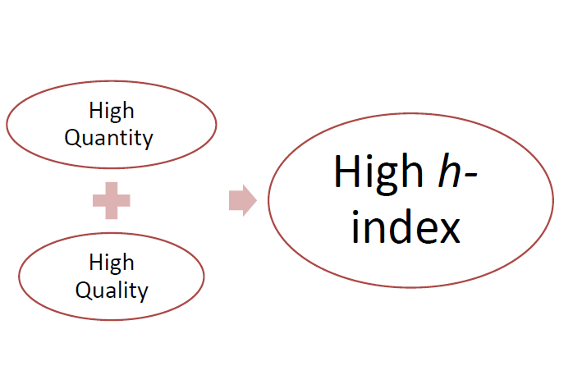

Slide 24
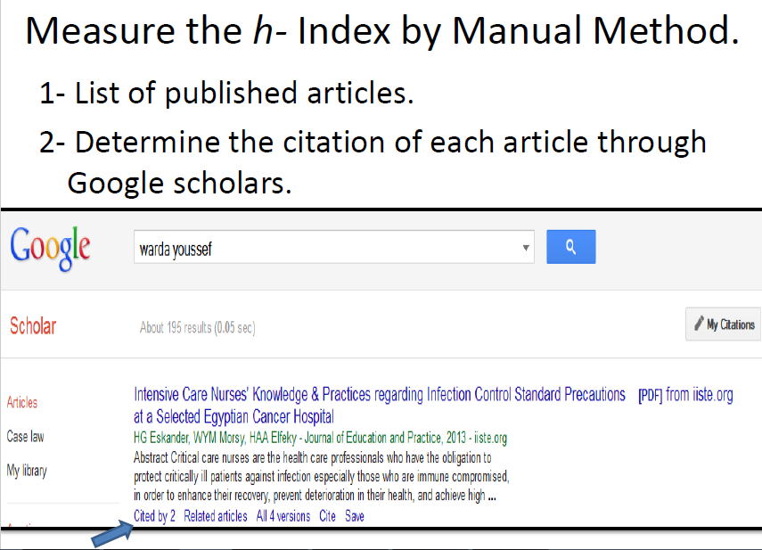

Slide 26
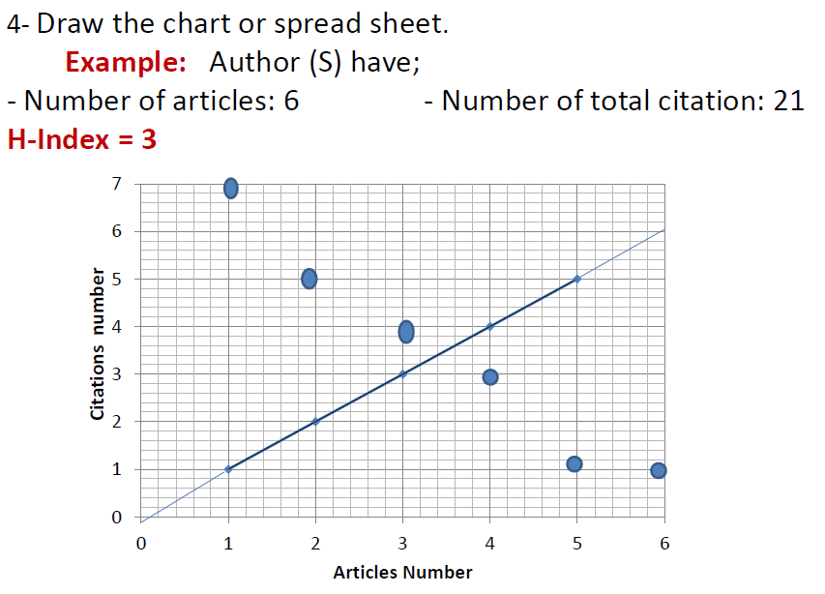

Slide 28
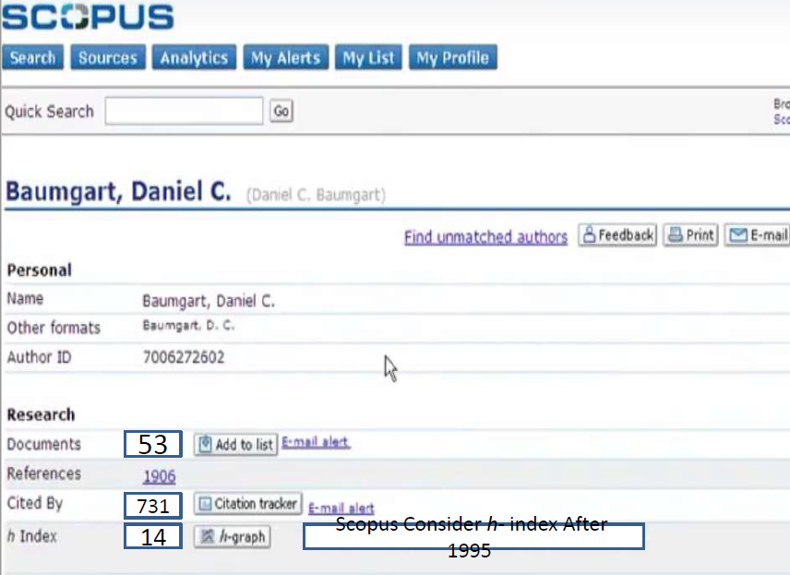

Slide 29
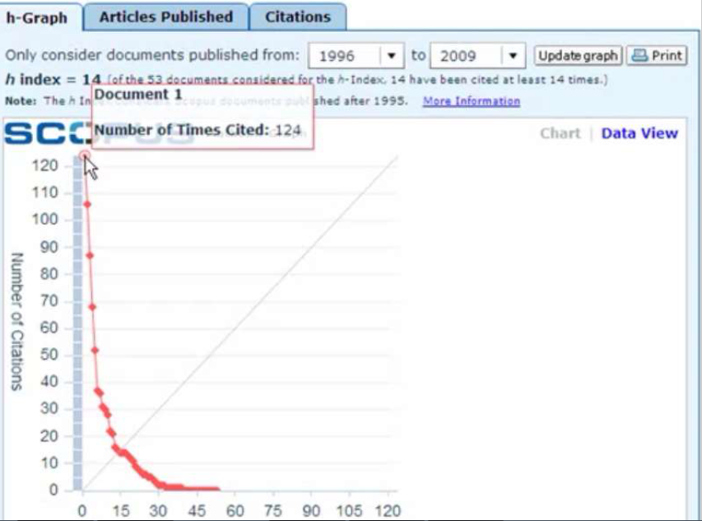

Slide 30
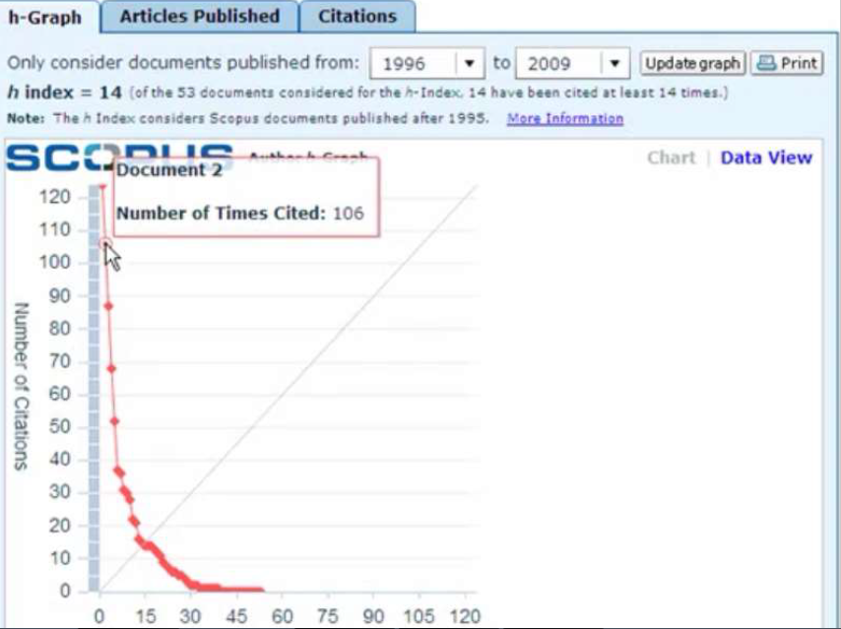

Slide 31
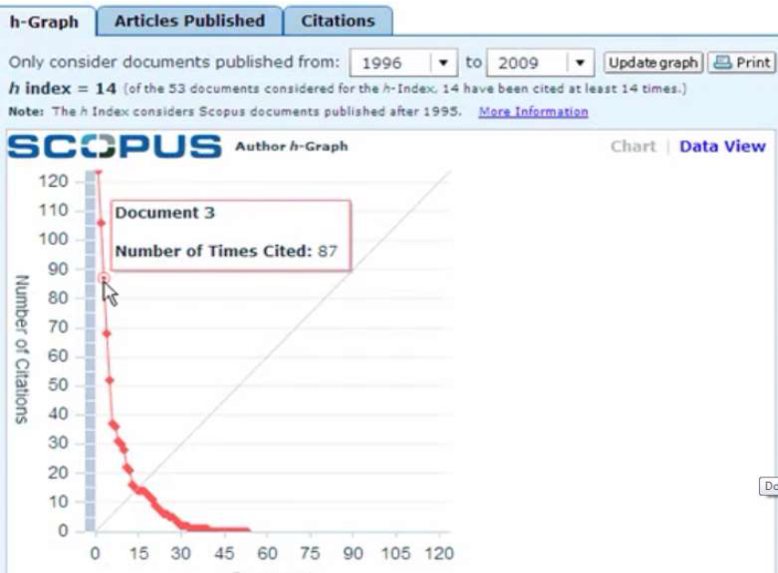

Slide 34
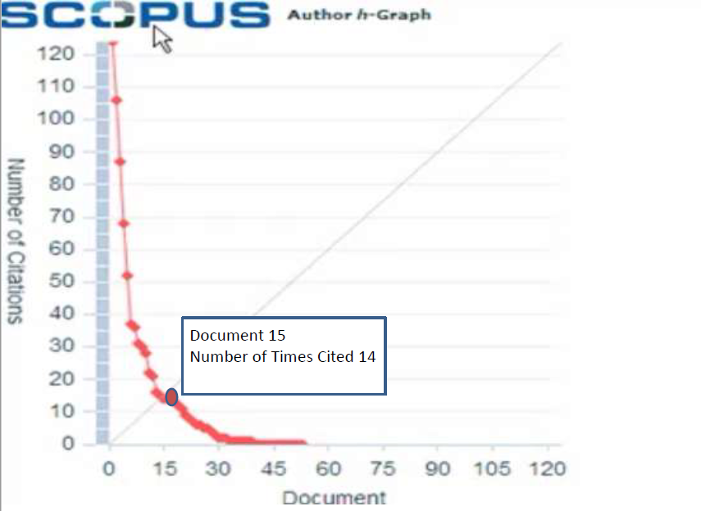

Slide 36
CiteScore metrics: a new standard that gives a more comprehensive, transparent and current view of a journal’s impact that will help you guide your journal more effectively in the future.

Slide 37
What is the CiteScore methodology
Calculating CiteScore is simple and is based on the average citations received per document. CiteScore is the number of citations received by a journal in one year to documents published in the three previous years, divided by the number of documents indexed in Scopus published in those same three years.

Slide 38
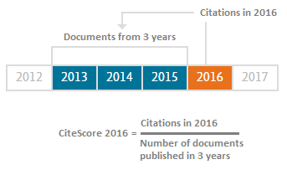
For example, the 2016 CiteScore counts the citations received in 2016 to documents published in 2013, 2014 or 2015, and divides this by the number of documents indexed in Scopus published in 2013, 2014 and 2015.

Slide 39
What's included in CiteScore calculations?
CiteScore’s numerator and denominator both include all document types. This not only includes articles and reviews but also letters, notes, editorials, conference papers and other types indexed by Scopus. Therefore, the numerator and the denominator used in the CiteScore calculation are consistent. This approach gives a more complete picture of citation impact and makes manipulation of the calculation more difficult.

Slide 40
CiteScore Tracker is calculated in the same way as CiteScore, but for the current year rather than previous, complete years.
The CiteScore Tracker calculation is updated every month, as a current indication of a title's performance.

Slide 41
What are the other CiteScore metrics?
A number of other new metrics will complement CiteScore. These are:
CiteScore Percentile indicates the relative standing of a journal in its subject field. A CiteScore Percentile of 98% means the journal is in the top 2% of its subject field. You can use this number to compare journals in different subject fields.
CiteScore Rank, and Rank Out Of indicates the absolute standing of a serial in its field; for example, 14th out of 63 journals in the category.
Documents is the denominator of the CiteScore calculation.
Citation Count is the numerator of the CiteScore calculation.
CiteScore Tracker forecasts a source’s performance for the upcoming year. CiteScore Tracker 2016, for instance, will continue to update on a monthly basis until it is fixed as an annual score in spring 2017, at which point Scopus will start to provide a monthly view on CiteScore Tracker 2017.

Slide 42
CiteScore itself represents a robust approach for two reasons:
1- The three-year citation window. Research has found that in slower-moving fields, two years’ worth of data is too short; yet five years is too long to consider in faster-moving fields. Three years is the best compromise for a broad-scope database, such as Scopus, as it incorporates a representative proportion of citations across all disciplines while also reflecting relatively recent data.
2- CiteScore’s numerator and denominator both include all document types. This means not only articles and reviews but also letters, notes, editorials, conference papers and other documents indexed by Scopus are included. As a result, the numerator and the denominator used in the CiteScore calculation are consistent. This approach gives a more complete picture of citation impact and makes manipulating the calculation more difficult.

Slide 43
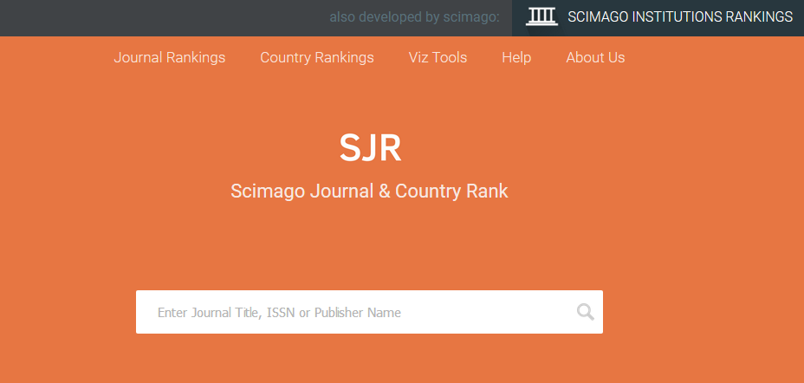
SJR
Scimago Jouranl & country Ranking

