Slide 1
The Course of Atmospheric Thermodynamics
MUSTANSIRIYAH UNIVERSITY
COLLEGE OF SCIENCES
ATMOSPHERIC SCIENCES DEPARTMENT
2020-2021
Dr. Sama Khalid Mohammed
SECOND STAGE
Lecture 7

Slide 2
THIS LECTURE INCLUDING THE FOLLOWING ITEMS
The Second Law of Thermodynamics
THE CARNOT CYCLE
Heat-engine efficiency is very relevant to atmospheric processes

Slide 3
THE SECOND LAW OF THERMODYNAMICS
The Second Law of Thermodynamics has several possible equivalent statements, two of them are:
The entropy of an isolated system can never decrease.
It is impossible for an engine operating in a cyclic process to convert energy into work with 100% efficiency.

Slide 4
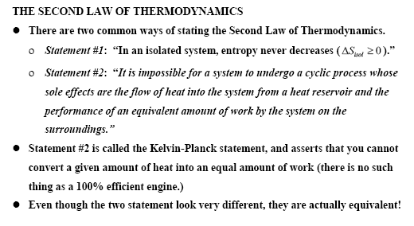
THE SECOND LAW OF THERMODYNAMICS

Slide 5
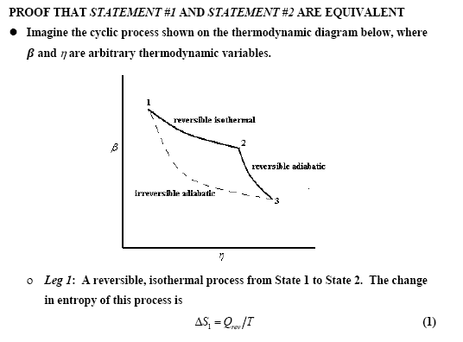

Slide 6
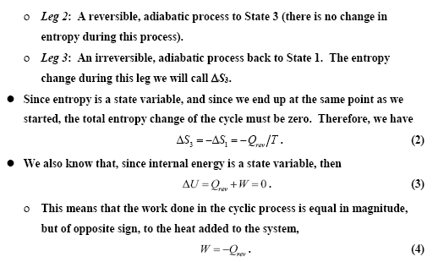

Slide 7
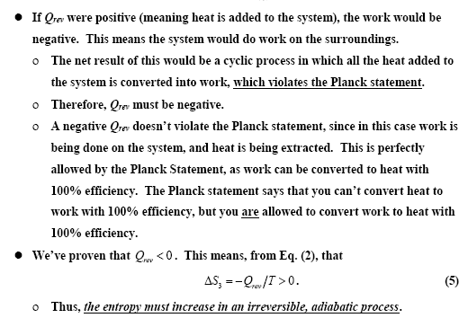

Slide 9
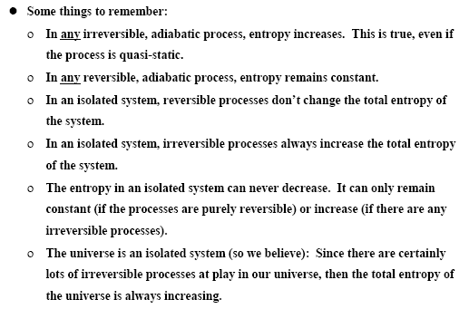
FURTHER COMMENTS ON THE SECOND LAW

Slide 10
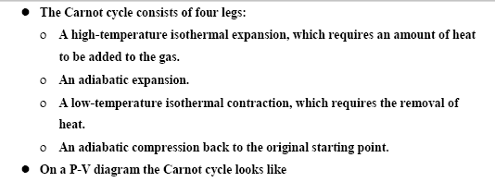
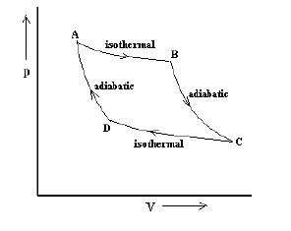
THE CARNOT CYCLE

Slide 11
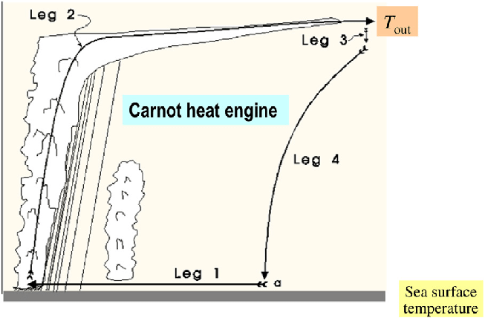
THE CARNOT CYCLE
Schematic of the hurricane viewed as a Carnot engine of the classical Carnot cycle in thermodynamics.
Leg 1 represents the isothermal expansion, namely gas is been heated and pressure is reduced, q e increases
Leg 2 represents an adiabatic expansion where there is no heat exchange and thus pressure is reduced but temperature is decreasing, keeping q e constant.
Leg 3 represents an isothermal compression where gas is cooled, with pressure increased and thus q e decreases.
Leg 4 represents an adiabatic compression where there is no heat exchange and pressure is increased while q e keeps constant.
https://www.researchgate.net/publication/308608010_Hurricane_Dynamics/figures?lo=1

Slide 12
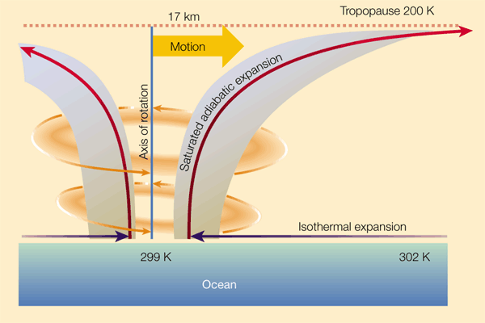
Heat-engine efficiency is very relevant to atmospheric processes
Tropical cyclones, the Hadley circulation, monsoons, etc. can all be thought of as heat engines that operate between a high temperature reservoir (the Tropical oceans) and a low temperature reservoir (the upper troposphere), and convert the heat into kinetic energy.
https://www.nature.com/articles/44287

Slide 13
Heat-engine efficiency is very relevant to atmospheric processes
A knowledge of the ‘efficiency’ of these heat engines can allow us to place upper limits on the amount of kinetic energy that can be produced.
However, atmospheric heat engines, like other real-life heat engines, are not reversible. To extend the concept of heat engines to real-life situations requires us to use the concept of non-equilibrium thermodynamics

