Slide 1
Filters and Histogram

Slide 2
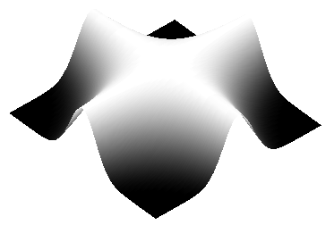
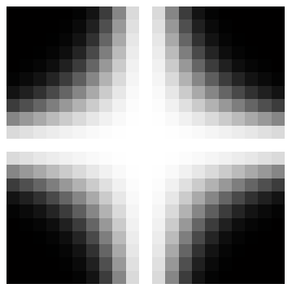
Images
column
Sample
Quantize
f(x, y)
row
y
x

Slide 3

Monochromatic Digital Image
y
x
Gray
Level
f(x,y)

Slide 4
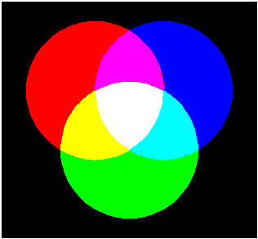
Color Images
R
M
B
W
Y
C
G
Mixtures of Light: Additive Primaries

Slide 5
B
B
G
G
R+G+B
R+G+B
R
R
B
B
G
G
R+G+B
R+G+B
R
R
B
B
G
G
R+G+B
R+G+B
R
R

Slide 6
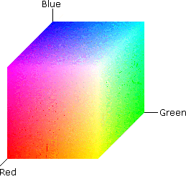
RGB Color Space

Slide 7
Fundamental Steps*
Preprocessing
(Enhancement & Restoration)
Representation &
Description
Segmentation
Problem
Domain
Image
Acquisition
Knowledge
Base
Recognition &
Interpretation
Result
*Rafael C. Gonzalez and Richard E. Woods, Digital Image Processing, Addison-Wesley, 1992

Slide 8
DIP: Details

Slide 9
Sampling & Quantization
Sampling
  demos/demo1sampling_and_quantization/demo_sampling.m
Quantization
  demos/demo1sampling_and_quantization/demo_quant.m
Digital Image Processing
Course Nos. 0909-452-01 (Senior Elective) and 0909-552-01 (Graduate)
Fall 2003
Previous Offering: http://engineering.rowan.edu/~shreek/fall01/dip/

Slide 10
DIP: Topics

Slide 11
Image Preprocessing
Enhancement
Restoration
Inverse filtering
Wiener filtering
Spatial
Domain
Spectral
Domain
Filtering
>>fft2/ifft2
>>fftshift
Point Processing
>>imadjust
>>histeq
Spatial filtering
>>filter2

Slide 12
Zooming (over sampling) images
Ch2, lesson2: Zooming and shrinking
Zooming requires 2 steps:
􀂁 The creation of new pixel locations.
􀂁 The assignment of gray levels to these new locations.
Two techniques for zooming:
1. Nearest neighbor interpolation
2. Bilinear interpolation: is a resampling method that uses the distanceweighted average of the four nearest pixel values to estimate a new pixel value.

Slide 13
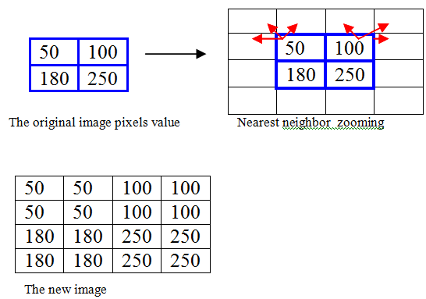

Nearest neighbor interpolation
Ch2, lesson2: Zooming and shrinking
Example:
Suppose A 2x2 pixels image will be enlarged 2 times by the nearest neighbor method:
Lay an imaginary 4*4 grid over the original image..
2. For any point in the overlay, look for the closest pixel in the original image, and assign its gray level to the new pixel in the grid. (copy)
3. When all the new pixels are assigned values, expand the overlay grid to the original specified size to obtain the zoomed image.
Pixel replication (re sampling) is a special case that is applicable when the size of the image needs to be increased an integer number of times (like 2 times not 1.5 for example).
+ ve : Nearest neighbor is fast
-ve: it produces a checkerboard effect like this!

Slide 14
shrinking
Ch2, lesson2: Zooming and shrinking
Similar to image zooming.
Shrinking an image an integer number of times
􀂁 Pixel replication is replaced by row&column deletion.

Slide 15
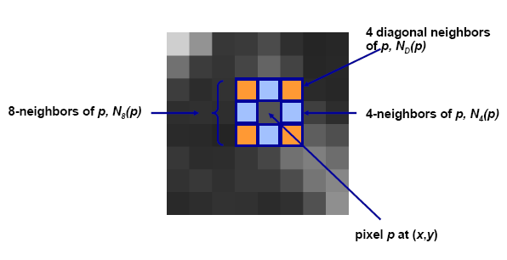
Neighbors of a pixel
Ch2, lesson3: Some basic Relationships between pixels

Slide 16
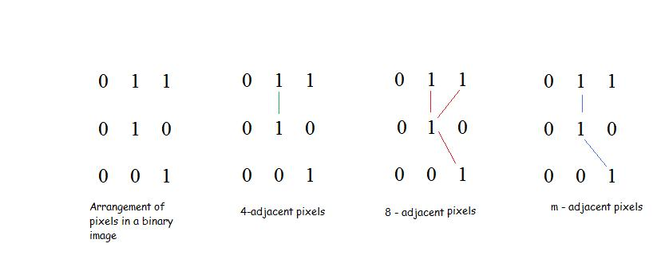
Adjacency
Ch2, lesson3: Some basic Relationships between pixels
V: set of gray level values (L), (V is a subset of L.)
3 types of adjacency
4- adjacency: 2 pixels p and q with values from V are 4- adjacent if q is in the set N₄(p)
8- adjacency: 2 pixels p and q with values from V are 8- adjacent if q is in the set N₈(p)
m- adjacency: 2 pixels p and q with values from V are madjacent if
1. q is in N₄(p), or
2. q is in N_{D}(p) and the set N₄(p) ∩ N₄(q) has no pixels whose values are from V

Slide 17
connectivity
Ch2, lesson3: Some basic Relationships between pixels
A digital path from pixel p with coordinates (x,y) to pixel q with coordinates (s,t) is a sequence of distinct pixels with coordinates (x0,y0), (x1,y1), …, (xn,yn), where (x0,y0)= (x,y) and (xn,yn)=(s,t), and pixels (xi,yi) and (xi-1,yi-1) are adjacent for 1 ≤ i ≤ n.
S: a subset of pixels in an image.
Two pixels p and q are said to be connected in S if there exists a path between them consisting entirely of pixels in S.
For any pixel p in S, the set of pixels that are connected to it in S is called a connected component of S.
If S has only one connected component, it is called a connected set.

Slide 18
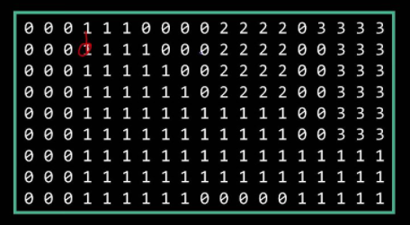

Slide 19
Regions and boundaries
Ch2, lesson3: Some basic Relationships between pixels
R: a subset of pixels in an image.
R is a region of the image if R is a connected set.
The boundary of a region R is the set of pixels in the region that have one or more neighbors that are not in R.

Slide 20
Foreground and background
Suppose that the image contains K disjoint regions Rk none of which touches the image border .
Ru : the union of all regions .
(Ru)^{c :} is the complement .
so Ru is called foreground , and (Ru)^{c :} is the background .

Slide 21
Distance measures
Ch2, lesson3: Some basic Relationships between pixels
If we have 3 pixels: p,q,z:
p with (x,y)
q with (s,t)
z with (v,w)
Then:
D(p,q) = 0 iff p = q
D(p,q) = D(q,p)
D(p,z) ≤ D(p,q) + D(q,z)
Euclidean distance between p and q: De(p,q) = [(x-s)² + (y-t)²]1/2
D4 distance: D4(p,q) = |x-s| + |y-t|
D8 distance: D8(p,q) = max (|x-s| , |y-t|)
D4 and D8 distances between p and q are independent of any paths that might exist between the points.
For m-adjacency, Dm distance between two points is defined as the shortest m-path between the points.

Slide 22
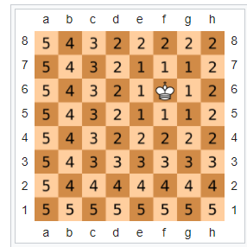
D8 It is also known as chessboard distance, since in the game of chess the minimum number of moves needed by a king to go from one square on a chessboard to another

Slide 23
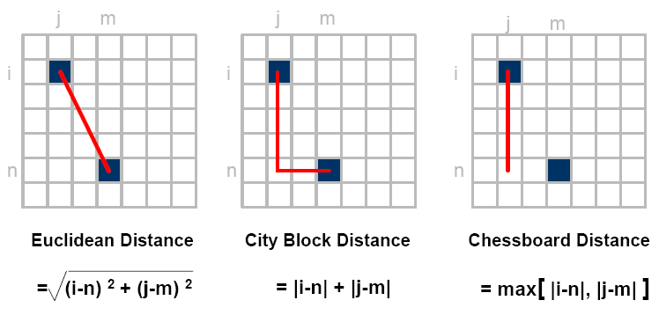
Distance measures

Slide 24
Example
Compute the distance between the two pixels using the three distances :
q:(1,1)
P: (2,2)
Euclidian distance : ((1-2)²+(1-2)²)^{1/2} = sqrt(2).
D4(City Block distance): |1-2| +|1-2| =2
D8(chessboard distance ) : max(|1-2|,|1-2|)= 1
(because it is one of the 8-neighbors )
1 2 3
 |  | q
 | p
1
2 3

Slide 25
Distance measures
Example :
Use the city block distance to prove 4-neighbors ?
Pixel A : | 2-2| + |1-2| = 1
Pixel B: | 3-2|+|2-2|= 1
Pixel C: |2-2|+|2-3| =1
Pixel D: |1-2| + |2-2| = 1
Now as a homework try the chessboard distance to proof the 8- neighbors!!!!
1 2 3
1 2 3
 | d
c | p | a
 | b

Slide 26
Edge Detection
Detecting edges is a basic operation in image processing. The edges of items in an image hold much of the information in the image.
The edges tell you where:
Items are.
Their size.
shape
and something about their texture.
Edge detection methods are used as a first step in the line detection processes, and they are used to find object boundaries by marking potential edge points corresponding to place in an image where rapid changes in brightness occur. After these edge points have been marked, they can be merged to form lines and objects outlines

Slide 27
Edge Detection Cont.
1- Sobel Operator: The Sobel edge detection masks look for edges in both the horizontal and vertical directions and then combine this information into a single metric. The masks are as follows:
Column Mask Row Mask
-1 -2 -1 -1 0 1 0 0 0 -2 0 2
1 2 1 -1 0 1
These masks are each convolved with the image. At each pixel location we now have two numbers: S1, corresponding to the result form the row mask and S2, from the column mask. We use this numbers to compute two matrices, the edge magnitude and the edge direction, which are defined as follows:
Edge Magnitude=
Edge Direction = Tan -1
S1ˆ2 + S2 ˆ2
S1
S2

Slide 28
EXAMPLE Sobel Filter
Ex. decribe the effects of Laplace and Sobel filters on the image?
10 20 200
10 20 200
10 20 200
Solution : 1- Laplace 0 -1 0
-1 4 -1
0 -1 0
= 10(0) + 20(-1) +200(0) + 10(-1) + 20(4) + 200(-1) + + 10(0) + 20(-1) + 200(0) = -170
2- Sobel Mask(row) -1 -2 -1 Mask (column) -1 0 1
0 0 0 -2 0 2
1 2 1 1 2 1
S1 = 10(-1) + 20(-2) +200(-1) + 10(0) + 20(0) + 200(0) +10(1)+20(2) +200(1)
= 0
S2 = 10(-1) +20(0) +200(1)+10(-2)+20(0)+200(2) +10(-1)+20(0)+200(1)
= 760

Slide 29
Edge Detection Cont.
:
Edge Magnitude=
0 ˆ2 + 760 ˆ2 =
= 760
Edge Direction = Tan -1
= Tan -1
= tan-1(0)
S1ˆ2 + S2 ˆ2
S1
S2
0
7600

Slide 30
Laplacian Operators
The Laplacian operator described here are similar to the ones used for pre-processing (as described in enhancement filter). The three Laplacian masks that follow represent different approximation of the Laplacian masks are rationally symmetric, which means edges at all orientation contribute to the result. They are applied by selecting one mask and convolving it with the image.

Slide 31
Laplacian Operators Cont.
0 -1 0 1 -2 1 -1 -1 -1
-1 4 -1 -2 4 -2 -1 8 -1
0 -1 0 1 -2 1 -1 -1 -1
These masks differ from the Laplacian type previously described in that the centre coefficients have been decreased by one. So, if we are only interested in edge information, the sum of the coefficients should be zero. If we want to retain most of the information the coefficient should sum to a number greater than zero. Consider an extreme example in which the center coefficient value will depend most heavily up on the current value, with only minimal contribution from surrounding pixel values.

Slide 32
Spatial filters
Ch3, lesson 6: spatial filters
Remember that types of neighborhood:
intensity transformation: neighborhood of size 1x1
spatial filter (or mask ,kernel, template or window): neighborhood of larger size , like 3*3 mask
The spatial filter mask is moved from point to point in an image. At each point (x,y), the response of the filter is calculated

Slide 33
Spatial filters
Ch3, lesson 5: spatial filters

Slide 34
Spatial filters : Smoothing ( low pass)
Ch3, lesson 6: Smoothing filters
Use: for blurring and noise reduction.
How it works? The value of every pixel is replaced by the average of the gray levels in the neighborhood.
Type of smoothing filters:
    Standard average
    weighted average.
    3. Median filter
linear
Order statistics

Slide 35
Spatial filters : Smoothing linear smoothing : averaging kernels
Ch3, lesson 6: Smoothing filters
    Standard average weighted average.
Used to reduce blurring more.

Slide 36
Spatial filters : Smoothing
Standard and weighted Average- example
Ch3, lesson 6: Smoothing filters
130 | 90 | 120 | 110
200 | 98 | 94 | 91
100 | 99 | 91 | 90
90 | 85 | 96 | 82
The mask is moved from point to point in an image. At each point (x,y), the response of the filter is calculated
Standard averaging filter:
(110 +120+90+91+94+98+90+91+99)/9 =883/9 = 98.1
Weighted averaging filter:
(110 +2 x 120+90+2 x 91+4 x 94+2 x 98+90+2 x 91+99)/16 =

Slide 37
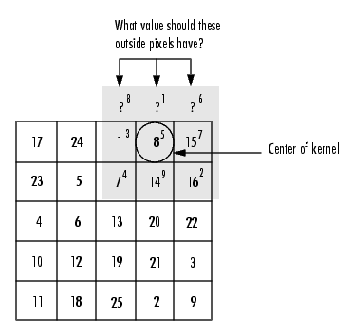
What happens when the Values of the Kernel Fall Outside the Image??!
Ch3, lesson 6: Smoothing filters

Slide 38
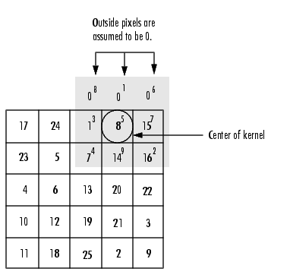
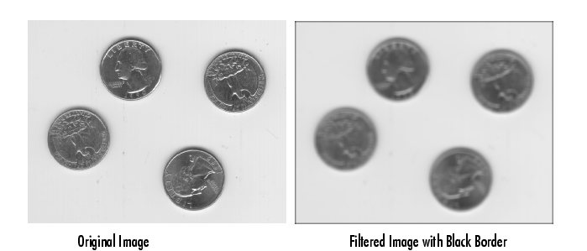
First solution :Zero padding,
Ch3, lesson 6: Smoothing filters
-ve: black border

Slide 39
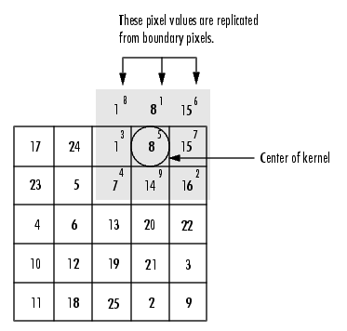
border padding
Ch3, lesson 6: Smoothing filters

Slide 40
Spatial filters : Smoothing
Averaging effects: blurring + reducing noise
Ch3, lesson 6: Smoothing filters
Original image
3 x 3 averaging
5 x 5 averaging
9 x 9 averaging
15 x 15 averaging
35 x 35 averaging

Slide 41
Spatial filters : Smoothing order statistics: Median filter
Ch3, lesson 6: Smoothing filters
130 | 90 | 120 | 110
200 | 98 | 94 | 91
100 | 99 | 95 | 90
90 | 85 | 96 | 82
becomes
95
Steps:
1. Sort the pixels in ascending order:
90,90, 91, 94, 95, 98, 99, 110, 120
2. replace the original pixel value by the median :
95

Slide 42
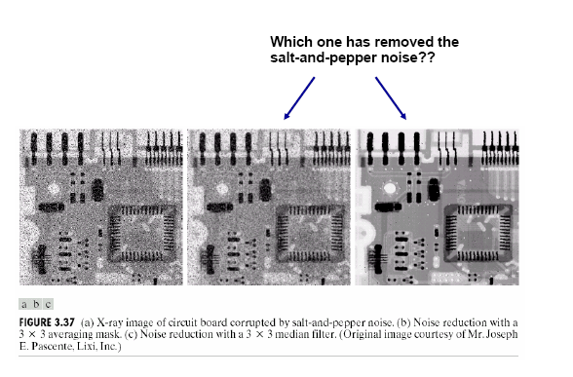
Spatial filters : Smoothing order statistics: Median filter use : blurring + reduce salt and pepper noise
Ch3, lesson 6: Smoothing filters
The original image with salt and pepper noise
The smoothed image using averaging
The smoothed image using median

Slide 43
Spatial filters : Sharpening ( high pass)
Ch3, lesson 7: sharpening filters
LAPLACE
SOBEL

Slide 44
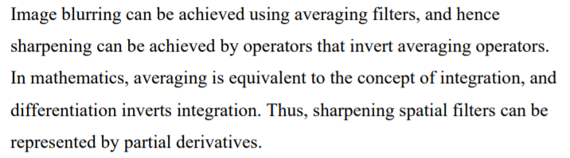
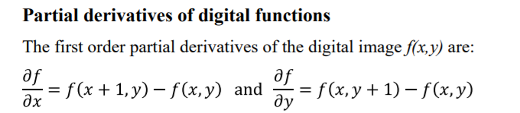
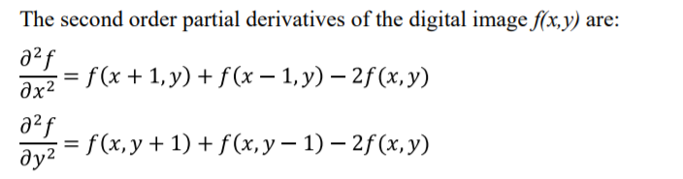

Slide 45
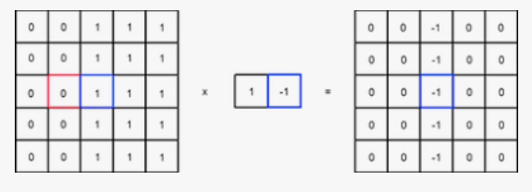

Slide 46
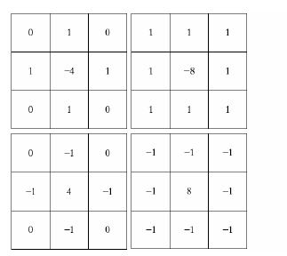
Spatial filters : Sharpening
1) LAPLACE
Ch3, lesson 7: sharpening filters
Laplace kernels

Slide 47
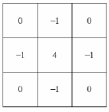
Ch3, lesson 7: sharpening filters
Spatial filters : Sharpening
LAPLACE – 1st derivative
Use: for highlighting fine detail or enhancing detail that has been blurred.
Example: apply the following laplace on the highlighted pixel
155 | 153 | 156 | 157 | 153
159 | 156 | 158 | 156 | 159
160 | 156 | 154 | 158 | 155
160 | 160 | 158 | 157 | 154
155 | 156 | 157 | 157 | 157
154*4 – 158- 156-158-158 = -14
So the value after filter = -14
We call the resultant image: sharpened image.
Filtered image=original +sharpened image
The value in the filtered image=154-14 =130

Slide 48
Ch3, lesson 7: sharpening filters
Spatial filters : Sharpening
LAPLACE – 1st derivative
In the sharpened image , we may get negative value,
We deal with this case in 3 ways:
Covert negative value to zero (matlab does this)
Apply 2nd derivative of laplace ( 2 ways)
  Convert the negative value to the minimum value of its neighbors (after applying 1st derivative of course)
  Apply laplace again to the resultant sharpened image

Slide 49
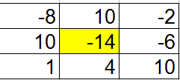
Ch3, lesson 7: sharpening filters
Spatial filters : Sharpening
LAPLACE – 2nd derivative
Example: apply the following laplace 2nd derivative on the highlighted pixel
155 | 153 | 156 | 157 | 153
159 | 156 | 158 | 156 | 159
160 | 156 | 154 | 158 | 155
160 | 160 | 158 | 157 | 154
155 | 156 | 157 | 157 | 157
154*4 – 158- 156-158-158 = -14
Solution1: convert -14 into 1.
Solution2: apply laplace to all pixels
Then apply it again to our pixel:-14*4 – 10 -10 – (-6) -4 =-74
So the value after 2nd derivative filter =-74
the value of pixel in the filtered image=154-74 = 80

Slide 50
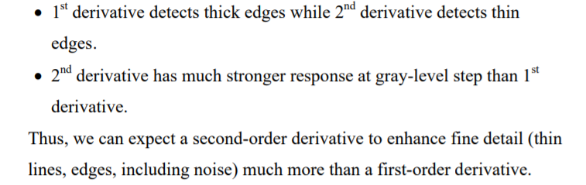
Ch3, lesson 7: sharpening filters
Spatial filters : Sharpening
1st VS 2nd derivative sharpening

Slide 51
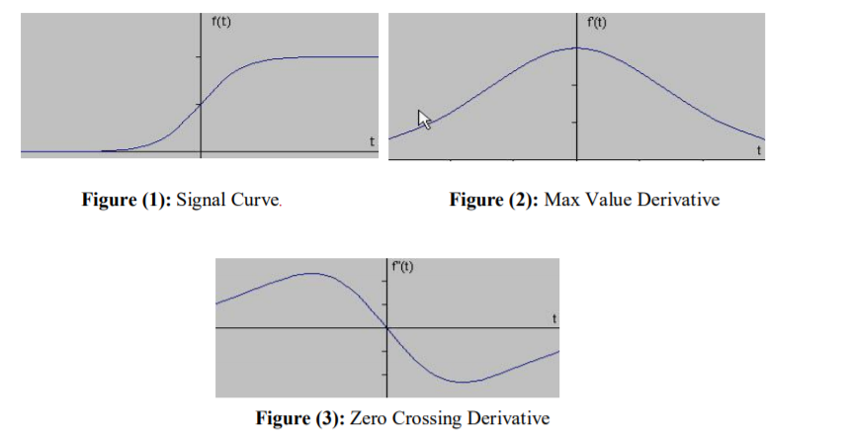
1st and 2nd derivative

Slide 52
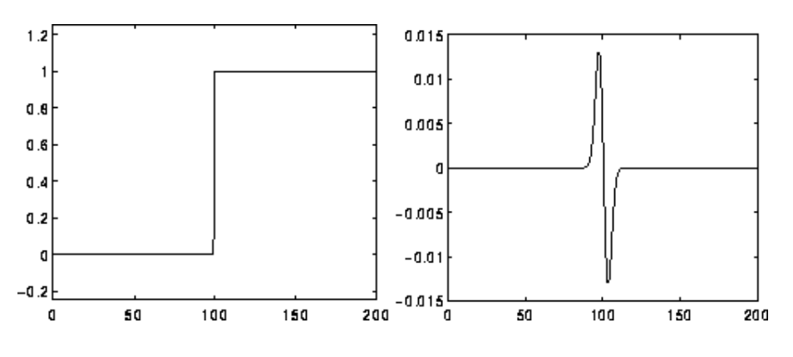
Zero crossing of 2nd derivative

Slide 53
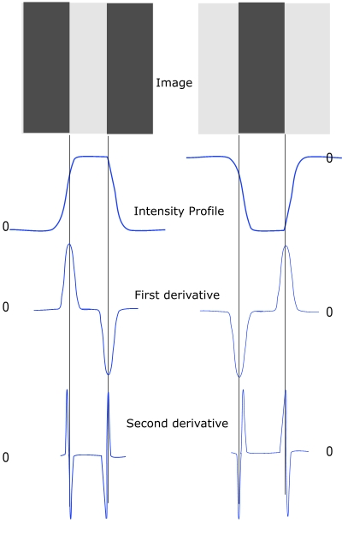

Slide 54
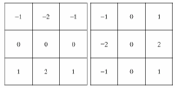
Ch3, lesson 7: sharpening filters
Spatial filters : Sharpening
2) Sobel
Detects horizontal edges
Detects vertical edges

Slide 55
Ch3, lesson 7: sharpening filters
Spatial filters : Sharpening
2) Sobel
we can apply the sobel horizontal kernel or the sobel vertical kernel or both and adding them together.

Slide 56
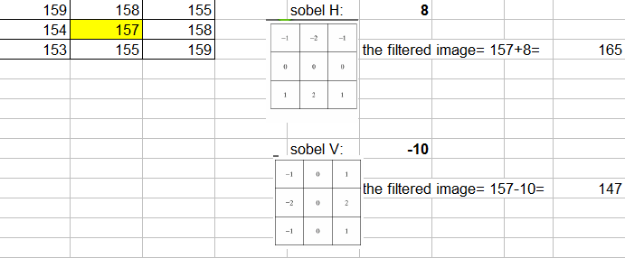
Ch3, lesson 7: sharpening filters
Spatial filters : Sharpening
2) Sobel
Example:

Slide 57
MATLAB
Fspecial : for choosing the filter:
X=fspecial(‘average’,[3 3])
p=fspecial(‘laplace’, 0)
v=fspecial(‘sobel’) → horizontal sobel
Y=v’ → vertical sobel
Imfilter : for applying filter.
m= imread(‘cameraman.tif‘);
f= imfilter(m,x) → this command will apply average filter on image
Fp=imfilter(m,p) → this command will apply laplace filter on image
Imshow(fp) → this command will show the laplace sharpened image
imshow(m+fp) → this command will show the filtered image after applying la place

Slide 58
MATLAB – cont.
Ex.
X=imtread(‘cameraman.tif‘)
p=fspecial(‘laplace’, 0)
Xp=imfilter(x,p, ‘replicate‘)
This command will apply border padding instead of zero padding

Slide 59
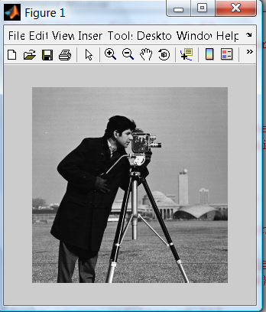
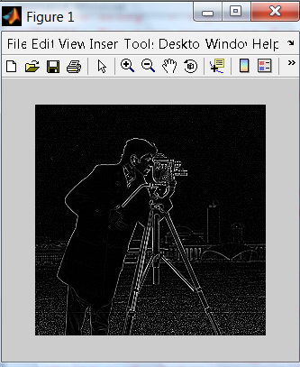
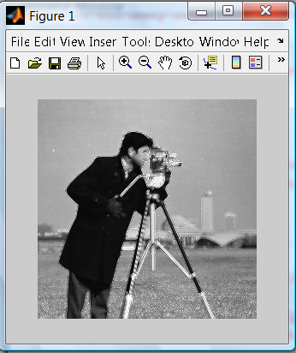
La place Sharpened image
La place filtered image

Slide 60
Histogram
The histogram of an image is a plot of the gray _levels values versus the number of pixels at that value.
A histogram appears as a graph with "brightness" on the horizontal axis from 0 to 255 (for an 8-bit) intensity scale) and "number of pixels "on the vertical axis. For each colored image three histogram are computed, one for each component (RGB, HSL).The histogram gives us a convenient -easy -to -read representation of the concentration of pixels versus brightness of an image, using this graph we able to see immediately:
1- Whether an image is basically dark or light and high or low contrast.
2- Give us our first clues a bout what contrast enhancement would be appropriately applied to make the image more subjectively pleasing to an observer, or easier to interpret by succeeding image analysis operations.
So the shape of histogram provide us with information about nature of the image or sub image if we considering an object within the image. For example:
1- Very narrow histogram implies a low-contrast image
2-Histogram skewed toward the high end implies a bright image
3- Histogram with two major peaks , called bimodal, implies an object that is in contrast with the background ……Next slide some examples

Slide 61
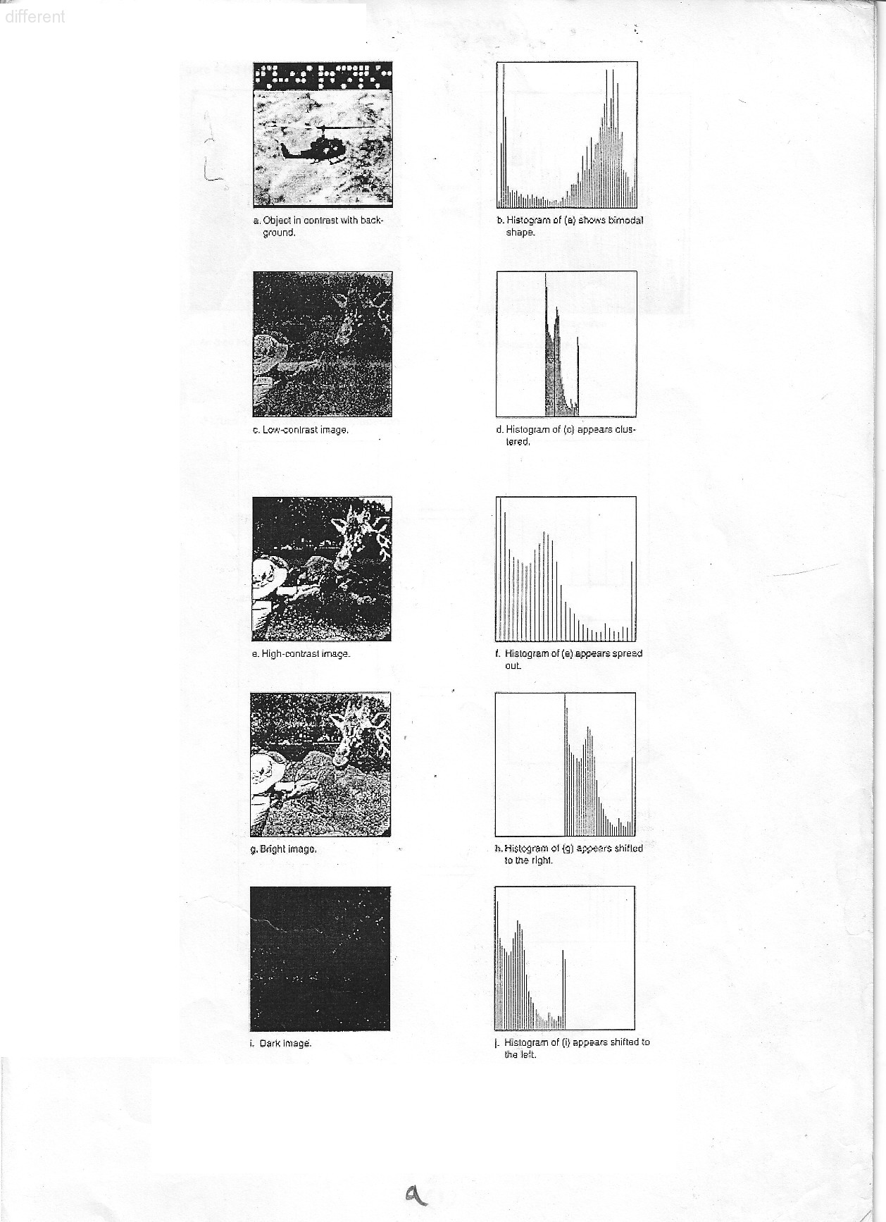

Slide 62
Histogram Modifications
The gray level histogram of an image is the distribution of the gray level in an image.
The histogram can be modified by mapping functions, which will stretch, shrink (compress), or slide the histogram. Next Figure illustrates a graphical representation of histogram stretch, shrink and slide.
.

Slide 63
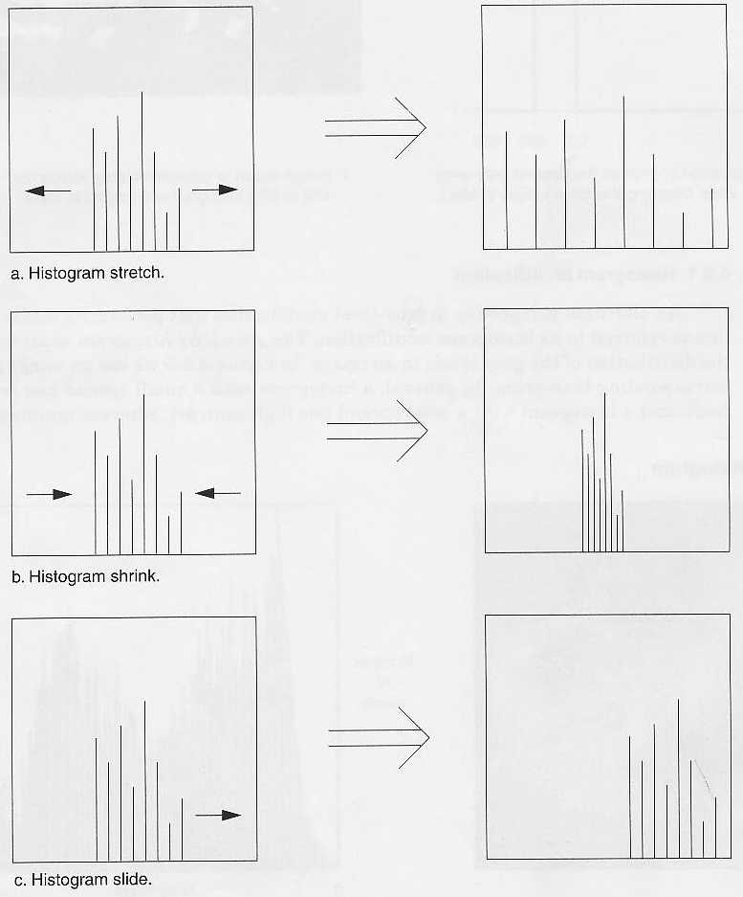

Slide 64
mapping function
The mapping function for histogram stretch can be found by the
following equation:
Stretch (I (r, c)) = [MAX-MIN] + MIN
Where, I(r,c) max is the largest gray- level in the image I(r,c).
I(r,c) min is the smallest gray- level in the image I(r,c).
MAX and MIN correspond to the maximum and minimum gray –
level values possible (for an 8-bit image these are 255 and 0).
This equation will take an image and stretch the histogram a cross the entire gray-level range which has the effect of increasing the contrast of a low contrast image of histogram stretching).
.

Slide 65
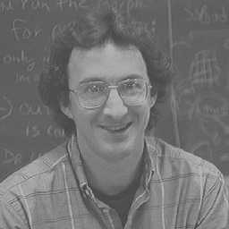
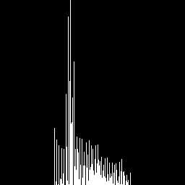
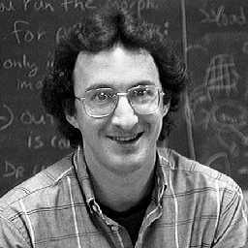
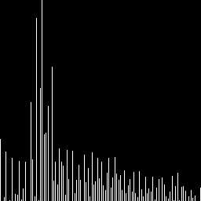
Low-contrast image
Histogram of low-contrast image
Image after histogram stretching
Histogram of image after stretching

Slide 66
Mapping Function Cont.
In most of the pixel values in an image fall within small range, but a few outlires force the histogram to span the entire range, a pure histogram stretch will not improve the image. In this case it is useful to allow a small percentage of the pixel values to be clipped at the low and high end of the range (for an 8-bit image this means truncating at 0 and 255). See figure (2.20) of stretched and clipped histogram).

Slide 67
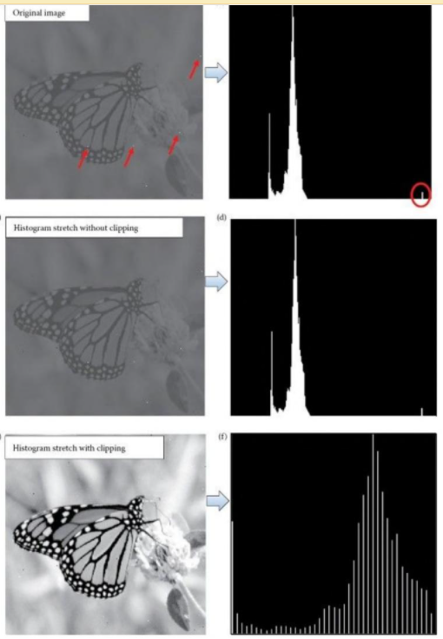

Slide 70
Histogram Shrink
The opposite of a histogram stretch is a histogram shrink, which will decrease image contrast by compressing the gray levels. The mapping function for a histogram shrinking can be found by the following equation:
[ I(r,c)-I(r,c)_{min}]+ Shrink _{min} Shrink ((r,c))=
Shrink _{max} and shrink _{min} correspond to the maximum and minimum desired in the compressed histogram. In general, this process produces an image of reduced contrast and may not seem to be useful an image enhancement (see figure (2-21) of shrink histogram).
.

Slide 72
Histogram Slide Techniques
The histogram slide techniques can be used to make an image either darker or lighter but retain the relationship between gray-level values. This can be a accomplished by simply adding or subtracting a fixed number for all the gray-level values, as follows:
Slide (I(r,c)) = I (r,c)+ OFFSET.
Where OFFSET values is the amount to slide the In this equation, a positive OFFSET value will increase the overall brightness; where as a negative OFFSET will create a darker image, figure (2-22) shows histogram sliding.

Slide 74
Histogram Equalization
Is a popular technique for improving the appearance of a poor image. It's a function is similar to that of a histogram stretch but often provides more visually pleasing results a cross a wide rang of images.
Histogram equalization is a technique where the histogram of the resultant image is as flat as possible (with histogram stretching the overall shape of the histogram remains the same).
The results in a histogram with a mountain grouped closely together to "spreading or flatting histogram makes the dark pixels appear darker and the light pixels appear lighter (the key word is "appear" the dark pixels in a photograph can not by any darker. If, however, the pixels that are only slightly lighter become much lighter, then the dark pixels will appear darker).
.

Slide 75
Histogram Equalization Cont.
The histogram equalization process for digital images consists of four steps:
1- Find the running sum of the histogram values
2- Normalize the values from step1 by dividing by total number of pixels.
3- Multiply the values from step2 by the maximum gray level value and round.
4- Map the gray-level values to the results from step 3, using a one-to-one correspondence. The following example will help to clarify this process.

Slide 76
Example
We have an image with 3 bit /pixel, so the possible range of values is 0 to 7. We have an image with the following histogram.
Step 1: Great a running sum of histogram values. This means that the
values is 10, the second is 10+8=18, next is 10+8+9=27, and
so on. Here we get 10,18,27,29,43,44,49,51.
Step 2: Normalize by dividing by total number of pixels. The total
number of pixels is 10+8+9+2+14+1+5+0=51.
Step 3: Multiply these values by the maximum gray – level values in this case 7 , and then round the result to the closet integer. After this
is done we obtain 1,2,4,4,6,6,7,7.
Step 4 : Map the original values to the results from step3 by a one –to-
one correspondence.
Gray-level value | 0 | 1 | 2 | 3 | 4 | 5 | 6 | 7
No of Pixel Histogram value | 10 | 8 | 9 | 2 | 14 | 1 | 5 | 2

Slide 77
Histogram Equalization Cont.
The first three steps:
.
The fourth step:
All pixel in the original image with gray level 0 are set to 1, values of 1 are set to 2, 2 set to 4, 3 set to 4, and so on (see figure (2-21)) histogram equalization, you can see the original histogram and the resulting histogram equalized histogram. Although the result is not flat, it is closer to being flat than the original
Gray-level | 0 | 1 | 2 | 3 | 4 | 5 | 6 | 7
No. of Pixel | 10 | 8 | 9 | 2 | 14 | 1 | 5 | 2
Run Sum | 10 | 18 | 27 | 29 | 43 | 44 | 49 | 51
Normalized | 10/51 | 18/51 | 27/51 | 29/51 | 43/51 | 44/51 | 49/51 | 51/51
Multiply by 7 | 1 | 2 | 4 | 4 | 6 | 6 | 7 | 7
Old | 0 | 1 | 2 | 3 | 4 | 5 | 6 | 7
New | 1 | 2 | 4 | 4 | 6 | 6 | 7 | 7

Slide 79
Histogram features
The histogram features that we are considered are statically based features where the histogram is used as a model of the probability distribution of the gray levels. These statistical features provide us with information a bout the characteristic of the gray – level distribution for the image or sub image. We define the first – order histogram probability P(a) as :
M is the number of pixels in the image or sub image (if the entire image is under consideration, then M= N ˆ2 for N×N), and N (g) is the number of pixels at gray level g. as with any probability distribution, all values for P (g) are less than or equal to 1, histogram probability features are mean, standard deviation, skew, energy and entropy.
.

Slide 80
Histogram features Cont.
Mean: the mean is the average value, so it tells us something about the general brightness of the image. A bright image will have a high mean, and a dark image will have a low mean. We will use L as the total number of gray levels available, so the gray levels range from 0 to L_1. For example, for typical 8-bit image data, L is 256 and ranges from 0 to 255. We can define the mean as follows:
If we use the second form of the equation, we sum over the rows and columns corresponding to the pixels in the image or sub image under consideration.
.

Slide 81
Histogram features Cont.
Standard deviation: Which is also known as the square root of the variance, tell us something about the contrast. It describe the spread in the data, so a high contrast image will have a high variance, and a low – contrast image will have a low variance. It is defined as follows:

Slide 82
Histogram features Cont.
Energy :The energy measure tell us something a bout how the gray level are distributed
Energy =
The energy measure has a maximum value of 1 for an image with a constant value and gets increasingly smaller as the pixel values are distributed a cross more gray level values(remember that al the P(g) values are less than or equal to 1).the lager this value is, the easier it is to compress the image data. If the energy is high, it tells us that the number of gray levels in the image is few, that is, the distribution is concentrated in only a small number of different gray levels

Slide 83
Histogram features Cont.
Entropy: the entropy is a measure that tells us how many bits we need to code the image data and given by :
As the pixel values in the image are distributed among more gray levels, the entropy increases. This measure tends to vary inversely with the energy

Slide 84
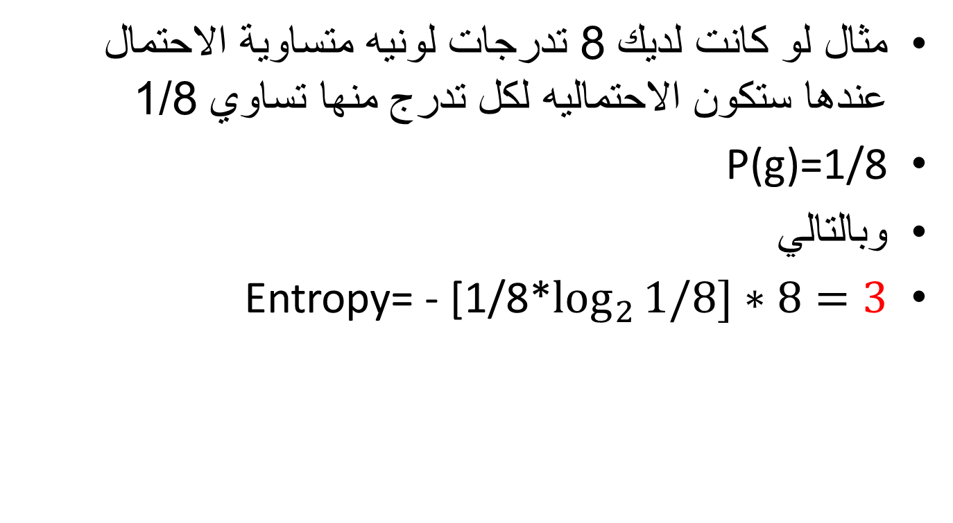
مثال لو كانت لديك 8 تدرجات لونيه متساوية الاحتمال عندها ستكون الاحتماليه لكل تدرج منها تساوي 1/8
P(g)=1/8
وبالتالي
Entropy= - [1/8*$\log_{2}{1/8]∗8=3}$

Slide 85
Image Processing
Ch4:
Filtering in frequency domain
AOU

Slide 86
Ch4, introduction
Introduction
We can enhance the image in two ways:
1) spatial domain
2) frequency domain
In spatial we access the pixels themselves.تغيير مباشر على البكسلات في الصورة
In frequency we convert the image into fourior transform make changes on this domain.
تحويل الصورة الى تمثيل موجي ثم التغيير على قيمه ثم ارجاع الصورة بعد التعديل

Slide 87
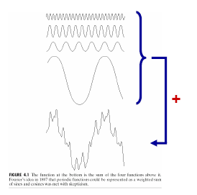
Fourier transform .. review
Ch4, lesson 1
Fourier Series: Any periodic function can be expressed as the sum of complex exponentials (sines and/or cosines) of different frequencies, each multiplied by a different coefficient.
Frequency domain:
View frequency as an independent variable

Slide 88
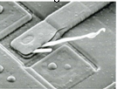
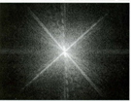
Fourier → spatial spatial → Fourier
Ch4, lesson 1
Fourier transform
Spatial
signals
Frequency
signals
Inv. Fourier transform
The FT is a transformation from time (temporal) or spatial domain to the frequency domain (FD).
Complex exponentials have sine and cosine components.
Therefore sines and cosines are basic building blocks of (well behaved) signals.
Hence the FT is a recipe for construction of signals using sines and cosines as basis.
The FT gives information about the spectral content of signals.

Slide 89
Fourier → spatial spatial → Fourier
Ch4, lesson 1
Fourier transform
Spatial
signals
Frequency
signals
Inv. Fourier transform
There are four cases to study:
1) 1-D continuous case (FFT/IFFT2)
2) 1-d discrete case (DFT/IDFT)
3) 2-d continuous case (FFT2 / IFFT2)
4) 2-d discrete case (DFT2 / IDFT2)
سندرس هذه الحالات كلها ولكن في برمجة الماتلاب سنستخدم الثالثة فقط

Slide 90
Fourier → spatial spatial → Fourier
Ch4, lesson 1
هناك اربع انواع من اشارات ال spatial ممكن تحويلها الى اشارات frequency
There are four cases to study:
1) 1-D continuous signal case
تحويل اشارة مستمرة ذات بعد واحد من spatial الى frequency .. مثال: اشارات الصوت
2) 1-D discrete case
تحويل اشارة متقطعة ذات بعد واحد من spatial الى frequency .. مثال: اشارات الصوت المخزنة حاسوبيا (الرقمية ): digital sound
3) 2-D continuous case
تحويل اشارة مستمرة ثنائية الابعاد من spatial الى frequency .. مثال: الصورة التي لم تخزن بعد في الحاسوب
4) 2-D discrete case
تحويل اشارة متقطعة ثنائية الابعاد من spatial الى frequency .. مثال: اشارات الصورة المخزنة حاسوبيا (الرقمية ): digital image

Slide 91
1) 1-D continuous signal case
Ch4, lesson 2: 1-D
The Fourier Transform (FT) is given by:
The Inverse Fourier Transform is given by:

Slide 92


2) 1-D discrete signal case
Ch4, lesson 2: 1-D
The Fourier Transform (FT) is given by:
The Inverse Fourier Transform is given by:
Note:
In the discrete case …
the integrals are replaced by sums.

Slide 93
2) 1-D discrete signal case – example
Ch4, lesson 2: 1-D
Q: Suppose you have the following discrete signal array, convert f(0) to Fourier transform?
f(x)
10 | 30 | 10 | 50
We use the previous formula to convert:
M=4
F(0)= ¼ (f(0) * e ^{–j*2*∏*0*0/4} + f(1) * e ^{–j*2*∏*0*1/4} + f(2) * e ^{–j*2*∏*0*2/4} + f(3) * e ^{–j*2*∏*0*3/4} )
=¼ (50 * e ⁰ + 10 * e ⁰ ⁺ 30 * e ⁰ + 10 * e ⁰ )
= ¼(50*1 + 10 *1 + 30*1 + 10*1)
= 25
NOTE that F(0) = average of f(x)
F(u)
 |  |  | 25

Slide 94
2) 1-D discrete signal case – example – continued.
Ch4, lesson 2: 1-D
f(x)
10 | 30 | 10 | 50
والان نعيد المعادلة لكل F(u) لنحصل على كل القيم, حاول ان تحول f(1) الى fourior حسب المعادلة
F(1)= ¼ (f(0) * e ^{–j*2*∏*1*0/4} + f(1) * e ^{–j*2*∏*1*1/4} + f(2) * e ^{–j*2*∏*1*2/4} + f(3) * e ^{–j*2*∏*1*3/4} )
= ¼ ( 50 *1 + 10 * e ^{–j∏/2} + 30 * e ^{–j} * ∏ + 10 * e ^{–j* 3∏/2} )
Note that in the result we will have an imaginary part since there is j which means
i.e. F(u) consists of two parts: real R(u) and imaginary I(u).

Slide 95
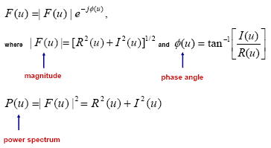
Phase , magnitude, power spectrum in 1-D.
Ch4, lesson 2: 1-D

Slide 96


3) 2-D continuous signal case
Ch4, lesson 3: 2-D
The Fourier Transform (FT) is given by:
The Inverse Fourier Transform is given by:
Note:
2-D case is an extension of the 1-D concepts.
Mostly applied for 2-D Image Processing.

Slide 97



4) 2-D discrete signal case
Ch4, lesson 3: 2-D
The Fourier Transform (FT) is given by:
The Inverse Fourier Transform is given by:

Slide 98
2-D discrete signal case – example
Ch4, lesson 3: 2-D
f(x,y)
Q: Suppose you have the following discrete image, convert f(0,0) to Fourier transform?
20 | 10 | 5
5 | 15 | 5
الحل We use the previous formula to convert:
M=3, N=2
F(0,0)=
1/6 (f(0,0) * e ^{–j*2*∏*(0*0/3+ 0*0/2)} + f(0,1) * e ^{–j*2*∏*(0*0/3+ 0*1/2)} + f(0,2) * e ^{–j*2*∏*(0*0/3+ 0*2/2)} +
f(1,0) * e ^{–j*2*∏*(0*1/3+ 0*0/2)} + f(1,1) * e ^{–j*2*∏*(0*1/3+ 0*1/2)} + f(1,2) * e ^{–j*2*∏*(0*1/3+ 0*2/2)} )
=1/6 (5 * e ⁰ + 10 * e ⁰ ⁺ 20 * e ⁰ + 5 * e ⁰ + 15 * e ⁰ + 5* e ⁰ )
= 1/6(60) = 10
NOTE that F(0,0) = average of f(x,y)
F(u,v)
 |  | 10
نعيد المعادلة لكل بكسلات الصورة لنحول من spatial الى flourier وسنرى ان هناك كما تعلمنا سابقا رقم صحيح ورقم تخيلي لكل بكسل تقريبا.

Slide 99

Phase , magnitude, power spectrum in 2-D.
Ch4, lesson 3: 2-D
magnitude
phase

Slide 100
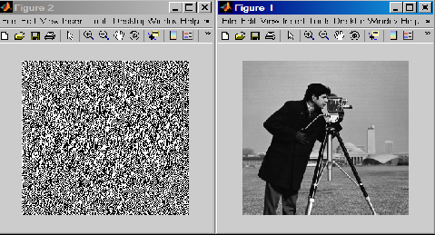
How to convert from spatial to frequency in Matlab. (fft2 /ifft2)
Ch4, lesson 4: Matlab codes
X= imread(cameraman.tif);
Y= fft2(double(x));
Imshow(x);
Figure, imshow(y);
Read image in spatial
Convet image to Fourier
Display both the spatial & the Fourier versions from cameraman
z= uint8(ifft2(y));
Figure, imshow(z);
Convert image to spatial

Slide 101
How to get the magnitude and phase from the fouriour (abs /angle)
Ch4, lesson 4: Matlab codes
X= imread(cameraman.tif);
Y= fft2(double(x));
Mag= abs(y);
Phase = unwrap(angle(y));
You can reconstruct the image from mag alone or from phase alone,
To do this use ifft2 not with y , but with mag , or with phase.
but in both cases ,you will not get the original image.
Get the magnitude
Get the phase

Slide 102
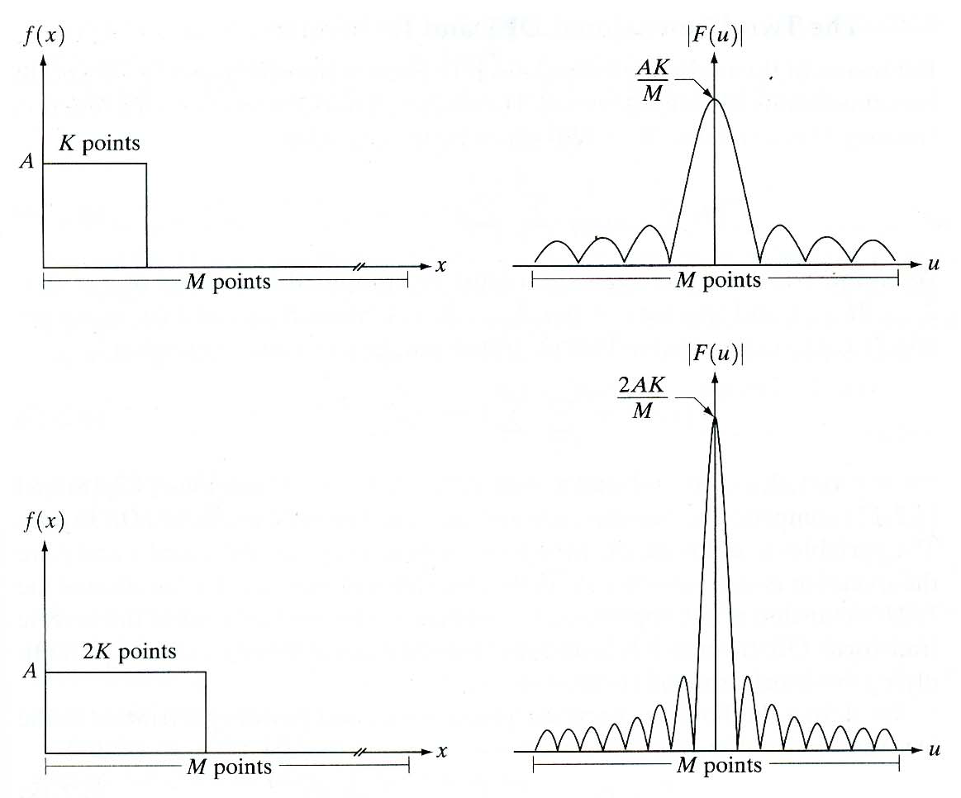
Example
F(0) = average of f(x) , revise slide 9
M=1024, A=1, K=8
F(0) must appear at the beginning of the curve but it was shifted to the center
( revise slide 14)
M=1024, A=1, K=16
Higher frequency
lower frequency

Slide 103
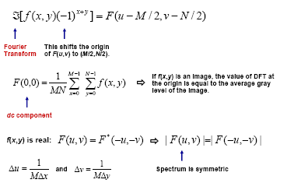
Shifting the origin
Ch4, lesson 5: shifting the origin

Slide 104
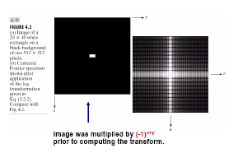
Shifting the origin
Ch4, lesson 5: shifting the origin

Slide 105
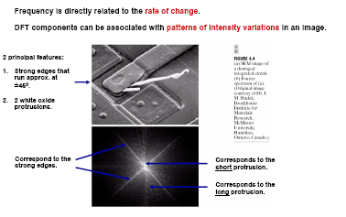
Fourier VS spatial characteristics
Example: The 2-D DFT shows diagonal components corresponding to the diagonal edges in the image.
Try fftshift to do this in Matlab

Slide 106
Some properties of the 2-D DFT:
Rotation
Ch4, lesson 6: properties
Rotation by an angle in the SD causes rotation by same angle in the FD.

Slide 107

Some properties of the 2-D DFT: translation
Ch4, lesson 6: properties
Multiplication by complex exponentials in the spatial domain (SD) has the effect of translation in the FD.
Frequency modulation concept.

Slide 108

Some properties of the 2-D DFT: periodicity + symmetry
Ch4, lesson 6: properties
Periodicity: The 2-D FT is periodic in the u and v directions.
Conjugate Symmetry: (for FT of a real function f(x,y) ):

Slide 109
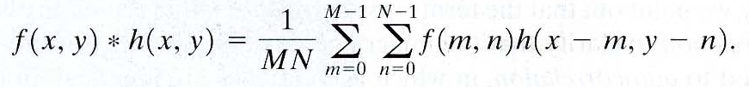
Some properties of the 2-D DFT: convolution
Ch4, lesson 6: properties
Convolution (becomes multiplication in FD): This highlights the important operations of filtering in the FD..

Slide 110
Ch4, lesson 6: properties
Intuitively:
Periodicity: The 2-D FT is periodic in the u and v directions.
Conjugate Symmetry (for FT of a real function f(x,y) ): The magnitude (hence spectrum) of the FT is symmetric.
Convolution (becomes multiplication in FD): This highlights the important operations of filtering in the FD.

Slide 111
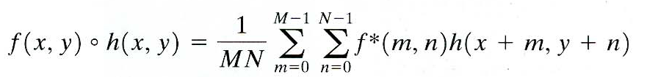

Ch4, lesson 6: properties
Correlation:

Slide 112
Ch4, lesson 7: summary of properties
Summary of DFT properties:
2021-06-13
112

Slide 113

Ch4, lesson 7: summary of properties
2021-06-13
113

Slide 114

Ch4, lesson 7: summary of properties
2021-06-13
114

Slide 115
Ch4, lesson 7: summary of properties
2021-06-13
115

Slide 116
Ch4, lesson 7: summary of properties
Usefulness of FT Concepts:
FT concepts are essential for understanding filtering (image enhancement) in the FD.
FT concepts are essential for understanding the spectral (FD) properties of signals and systems and have very wide applications such as filtering, image compression, image feature representation etc.

Slide 117
Image Processing
Filtering in frequency domain

Slide 118
Part 2
Filtering in frequency domain

Slide 119
Frequency Domain Filtering & Spatial Domain Filtering
Similar jobs can be done in the spatial and frequency domains
Filtering in the spatial domain can be easier to understand
Filtering in the frequency domain can be much faster – especially for large images
Notes:
119

Slide 120
introduction
Ch4, lesson 8: The basics of filtering in the Frequency Domain (FD)
It consists of modifying the FT of an input image and then finding the IFT to get the output image.
Mathematically its given by:
G(u,v)= H(u,v)F(u,v)

Slide 121

Steps of frequency domain filter
Ch4, lesson 8: The basics of filtering in the Frequency Domain (FD)
Multiply the input image by (-1)x+y
2. Compute F(u,v)
3. Multiply F(u,v) by a filter function H(u,v)
4. Compute the inverse DFT
5. Obtain the real part
6. Multiply the real part by (-1)x+y

Slide 122
Steps of frequency domain filter
Ch4, lesson 8: The basics of filtering in the Frequency Domain (FD)
Given an input image f(x,y) of size MxN, select the padding parameters P=2M and Q=2N.
Form a padded image of size PxQ by appending the necessary zeros to f(x,y).
Multiply padded image by (-1)^{(x+y)} to center its transform.
Compute the DFT F(u,v) of the image from step 3.
Generate a real, symmetric filter function H(u,v) of size PxQ. Form the product G(u,v)=H(u,v)F(u,v).
Find the processed image by computing the real part of the IDFT of G(u,v)
Multiply above by by (-1)^{(x+y)}
get g(x,y) from above step by extracting an MxN region from top left quadrant.

Slide 123
Correspondence between FD and SD filtering:
Ch4, lesson 9: correspondence between FD & SD filters
SD: filtering is given by discrete convolution
Correlation is…
FD: Discrete convolution in FD is equivalent to multiplication
Filtering can be done in either domain.

Slide 124

SD VS FD filters
Low pass
High pass
laplace filters
Average filters

Slide 125

Low pass & High pass filters in FD
Ch4, lesson 10: low pass & high pass filters in FD
Low-pass filter: A filter that attenuates high frequencies while passing low frequencies.- used for blurring (smoothing)
High-pass filter: A filter that attenuates low frequencies while passing high frequencies. used for sharpening

Slide 126
Low pass & High pass filters in FD
Ch4, lesson 10: low pass & high pass filters in FD
1) Low pass - Smoothing filters
  1.1) Ideal lowpass filters (very sharp)
  1.2) Butterworth lowpass filters
  1.3) Gaussian lowpass filters (very smooth)
    Butterworth filter parameter: filter order
    High values: filter has the form of the ideal filter.
    Low values: filter has the form of the Gaussian filter.
2) High pass- Sharpening filters
  2.1) Ideal highpass filters
  2.2) Butterworth highpass filters
  2.3) Gaussian highpass filters

Slide 127
1) Low pass – image smoothing
Ch4, lesson 10: low pass & high pass filters in FD
Image smoothing using FD filters
Noise is usually high frequency.
Hence noise removal is usually termed smoothing or blurring.
Smoothing is achieved by lowpass filters (LPFs).
3 types of LPFs will be studied i.e. Ideal LPF, Butterworth LPF and Gaussian LPF.
Note/Caution: Image details and edges have high frequency characteristics.

Slide 128
Ch4, lesson 10: low pass filters
1) Low pass - image Smoothing
Smoothing filters:
1.1) Ideal low pass filters (ILPF)
1.2) Butterworth low pass filters (BLPF)
1.3) Gaussian low pass filters (GLPF)

Slide 129
1.1) 2-D Ideal low pass filter ILPF
Ch4, lesson 11: ILPF
The simplest lowpass filter is ILPF, it (cuts off) all high frequency components that are at distance greater than a specified distance: D₀ from the center
Where
D(u,v) is the distance from (u,v) to the center of the frequency rectangle
Image size: MxN
Center of the frequency rectangle: (u,v) = (M/2, N/2)
Distance to the center: D(u,v) = [(u – M/2)² + (v – N/2)²]^{1/2}

Slide 130

How does ILPF function works?
Ch4, lesson 11: ILPF
نضرب قيم هذا الماسك H(u,v) بالقيم المكافئة لها بالصورة F(u,v). فنحصل فقط على ال frequencies داخل الدائرة
دائما منتصف الصورة تحمل اهم المعلومات عنها ( اي معظم معلومات الصورة), بينما تتوزع التفاصيل
كل ما كبر نصف قطر الدائرة (اي D₀), كل ما حصلنا على صورة اقرب للاصل.( انظر الشريحة التالية)

Slide 131

Ch4, lesson 11: ILPF
كل ما كبر نصف قطر الدائرة (اي D0),
كل ما حصلنا على صورة اقرب للاصل
دائما منتصف الصورة تحمل اهم المعلومات عنها ( اي معظم معلومات الصورة), بينما تتوزع التفاصيل
Radius total image power %
5 92.0
15 94.6
30 96.4
80 98
230 pixels 99.5

Slide 132

Ideal Low Pass Filter results
Ch4, lesson 11: ILPF
Result of filtering with ideal low pass filter of radius 5
Original
image
Ringing is a characteristics of ideal Filter
Result of filtering with ideal low pass filter of radius 30
Result of filtering with ideal low pass filter of radius 15
Result of filtering with ideal low pass filter of radius 80
Result of filtering with ideal low pass filter of radius 230
Ideal lowpass filtering is not very practical but they can be implemented on a computer to study their behavior.
Notes:
132

Slide 133
Blurring and ringing feature of ILPFs:
Ch4, lesson 11: ILPF
The ILPF has sharp cutoffs or discontinuities which cause ringing.
The ILPF has a sink function behaviour in the SD.
The center of lobe is the cause for blurring but the outer smaller lobes cause ringing.
We want to achieve blurring with little ringing.

Slide 134
1.2) Butterworth low pass filter - BLPF:
Ch4, lesson 12: BLPF
ILPF transfer function has sharp discontinuities.
BLPF transfer function does not have sharp discontinuities in order to reduce ringing.
The transfer function of a Butterworth lowpass filter of order n with cutoff frequency at distance D₀ from the origin is defined as:

Slide 135

Butterworth low pass filter - BLPF:
Ch4, lesson 12: BLPF
Note:
H(U,V) =0.50 (50% from its maximum value of 1) when D(u,v) =D₀

Slide 136

Butterworth Lowpass Filter (cont…)
Ch4, lesson 12: BLPF
Result of filtering with Butterworth filter of order 2 and cutoff radius 5
Original
image
Ringing is not visible in
any of these images.
Result of filtering with Butterworth filter of order 2 and cutoff radius 15
Result of filtering with Butterworth filter of order 2 and cutoff radius 30
Result of filtering with Butterworth filter of order 2 and cutoff radius 80
Result of filtering with Butterworth filter of order 2 and cutoff radius 230

Slide 137

Ch4, lesson 12: BLPF
Ringing increases with filter order (n) as seen in SD

Slide 138

Ch4, lesson 13: GLPF
1.3) Gaussian Lowpass Filters -GLPF
The transfer function of a Gaussian lowpass filter is defined as
Note:
The IFT (INVERSE FOURIOUR) of Gaussian is also Gaussian. Hence there is no ringing effect.

Slide 139
Gaussian low pass filter - GLPF:
Ch4, lesson 12: BLPF
Note:
H(U,V) =0.667 when D(u,v) =D₀

Slide 140

Gaussian Lowpass Filters (cont…)
Ch4, lesson 13: GLPF
Result of filtering with Gaussian filter with cutoff radius 5
Original
image
No ringing
Result of filtering with Gaussian filter with cutoff radius 15
Result of filtering with Gaussian filter with cutoff radius 30
Result of filtering with Gaussian filter with cutoff radius 85
Result of filtering with Gaussian filter with cutoff radius 230

Slide 141
Lowpass Filters Compared
Result of filtering with ideal low pass filter of radius 15
Result of filtering with Butterworth filter of order 2 and cutoff radius 15
Result of filtering with Gaussian filter with cutoff radius 15

Slide 142

Lowpass Filtering Examples
Machine recognition systems have
difficulty in reading broken characters.
GLPF with D0 = 80
A low pass Gaussian filter is used to connect broken text
Notes:
142

Slide 143

Lowpass Filtering Examples (cont…)
Different lowpass Gaussian filters used to remove blemishes in a photograph
Notes:
143

Slide 144
2)High pass - image Sharpening
Ch4, lesson 14: high pass
Blurring (smoothing) is achieved by attenuating التخلص the HF(high frequency) components of DFT of an image. (low pass filters)
Sharpening is achieved by attenuating the LF (low frequency) components of DFT of an image. Where Edges and fine detail in images are associated with high frequency components (high pass filters)
High pass filters – only pass the high frequencies, drop the low ones. High pass frequencies are precisely the reverse of low pass filters, so:
H_{hp}(u, v) = 1 – H_{lp}(u, v)
Notes:
144

Slide 145
Ch4, lesson 14: high pass
2)High pass - image Sharpening
Sharpening filters:
2.1) Ideal high pass filters (IHPF)
2.2) Butterworth high pass filters (BHPF)
2.3) Gaussian high pass filters (GHPF)

Slide 146

2.1) Ideal High Pass Filters
Ch4, lesson 15: IHPF
The ideal high pass filter is given as:
where D₀ is the cut off distance as before
Notes:
146

Slide 147

Ideal High Pass Filters (cont…)
Ch4, lesson 15: IHPF
Results of ideal high pass filtering with D₀ = 15
Results of ideal high pass filtering with D₀ = 30
Results of ideal high pass filtering with D₀ = 80
Notes:
147

Slide 148
Butterworth High Pass Filters
Ch4, lesson 16: BHPF
The Butterworth high pass filter is given as:
where n is the order and D₀ is the cut off distance as before
Notes:
148

Slide 149

Butterworth High Pass Filters (cont…)
Ch4, lesson 16: BHPF
Results of Butterworth high pass filtering of order 2 with D₀ = 15
Results of Butterworth high pass filtering of order 2 with D₀ = 80
Results of Butterworth high pass filtering of order 2 with D₀ = 30
Notes:
149

Slide 150
Gaussian High Pass Filters
Ch4, lesson 17: GHPF
The Gaussian high pass filter is given as:
where D₀ is the cut off distance as before
Notes:
150

Slide 151

Gaussian High Pass Filters (cont…)
Ch4, lesson 17: GHPF
Results of Gaussian high pass filtering with D₀ = 15
Results of Gaussian high pass filtering with D₀ = 80
Results of Gaussian high pass filtering with D₀ = 30
Notes:
151

Slide 152

Highpass Filter Comparison
BF represents a transition
between the sharpness
of the IF and the
smoothness of the GF
يعني يعتبر BF مرحلة وسطية بين IF و GF
حيث يعتبر IF حاد للغاية بينما يمتاز GF بنعومته
Notes:
152

Slide 153
Highpass Filter Comparison
Results of ideal high pass filtering with D₀ = 15
Results of Butterworth high pass filtering of order 2 with D₀ = 15
Results of Gaussian high pass filtering with D₀ = 15
Notes:
153

Slide 154
The 3 HPF SD representation

